Slide 1
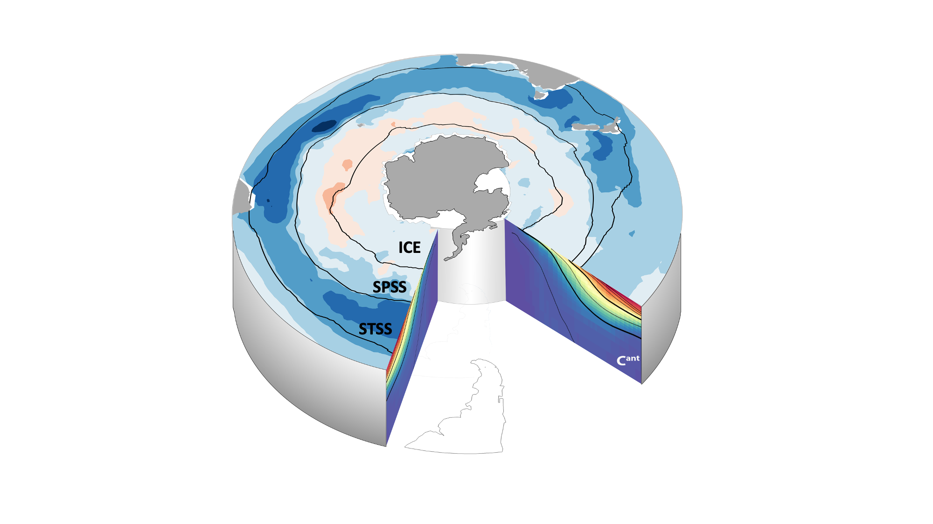
Means
Seasonal cycle
Increasing sink strength from South to North
Stronger thermal uptake
STSS
Stronger DIC control
Season of maximal uptake
SPSS + ICE
winter
Trends
summer
SPSS
Atlantic and Indian sectors of the STSS are the strongest sinks (Fig 3)
Large C_{ant} uptake, C_{ant} dampens C_{nat}
Largest C_{ant} storage in STSS and northward
Atlantic is only mean SPSS sink
Notes:
Remove Cant on left slice. Move so we don’t see the slice.

Slide 2
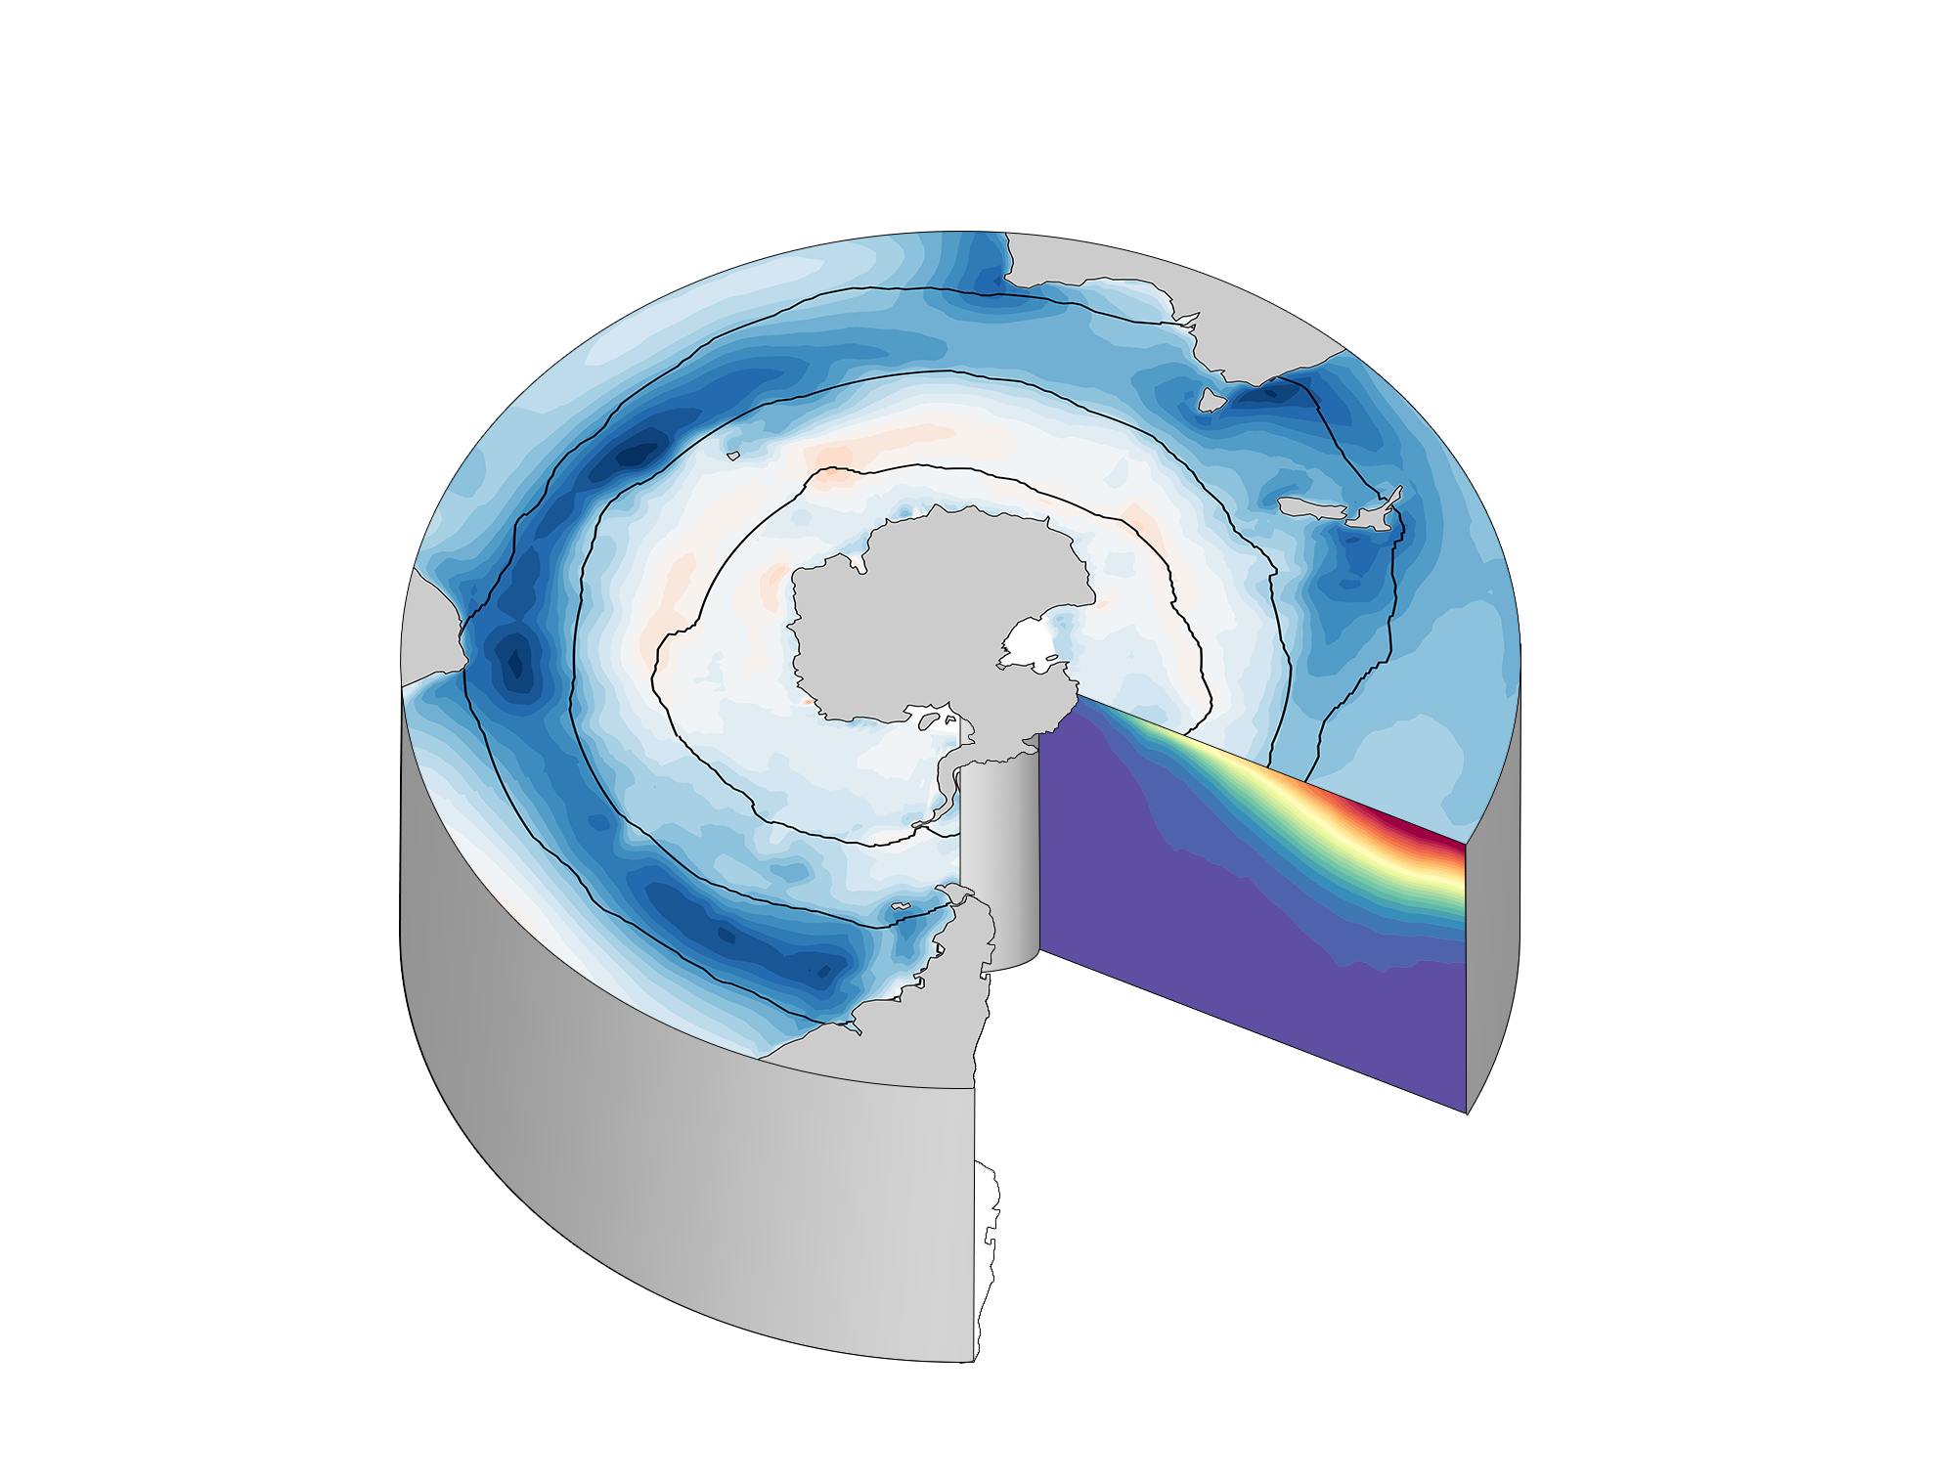
Season of maximum uptake
Drivers of pCO₂
Increasing sink strength from South to North
Winter
Summer
Thermal
DIC-driven
Atlantic-STSS
STSS trends
Least agreement between GOBMs & pCO₂ prods. trends
Atl. and Ind. STSS are strongest Southern Ocean sinks (Fig 3)
Strongest sinks
ICE
SPSS
STSS
Atlantic-SPSS
Largest C_{ant} storage in STSS and northward
Atlantic is only mean SPSS sink
Large C_{ant} uptake, C_{ant} dampens C_{nat}

Slide 3
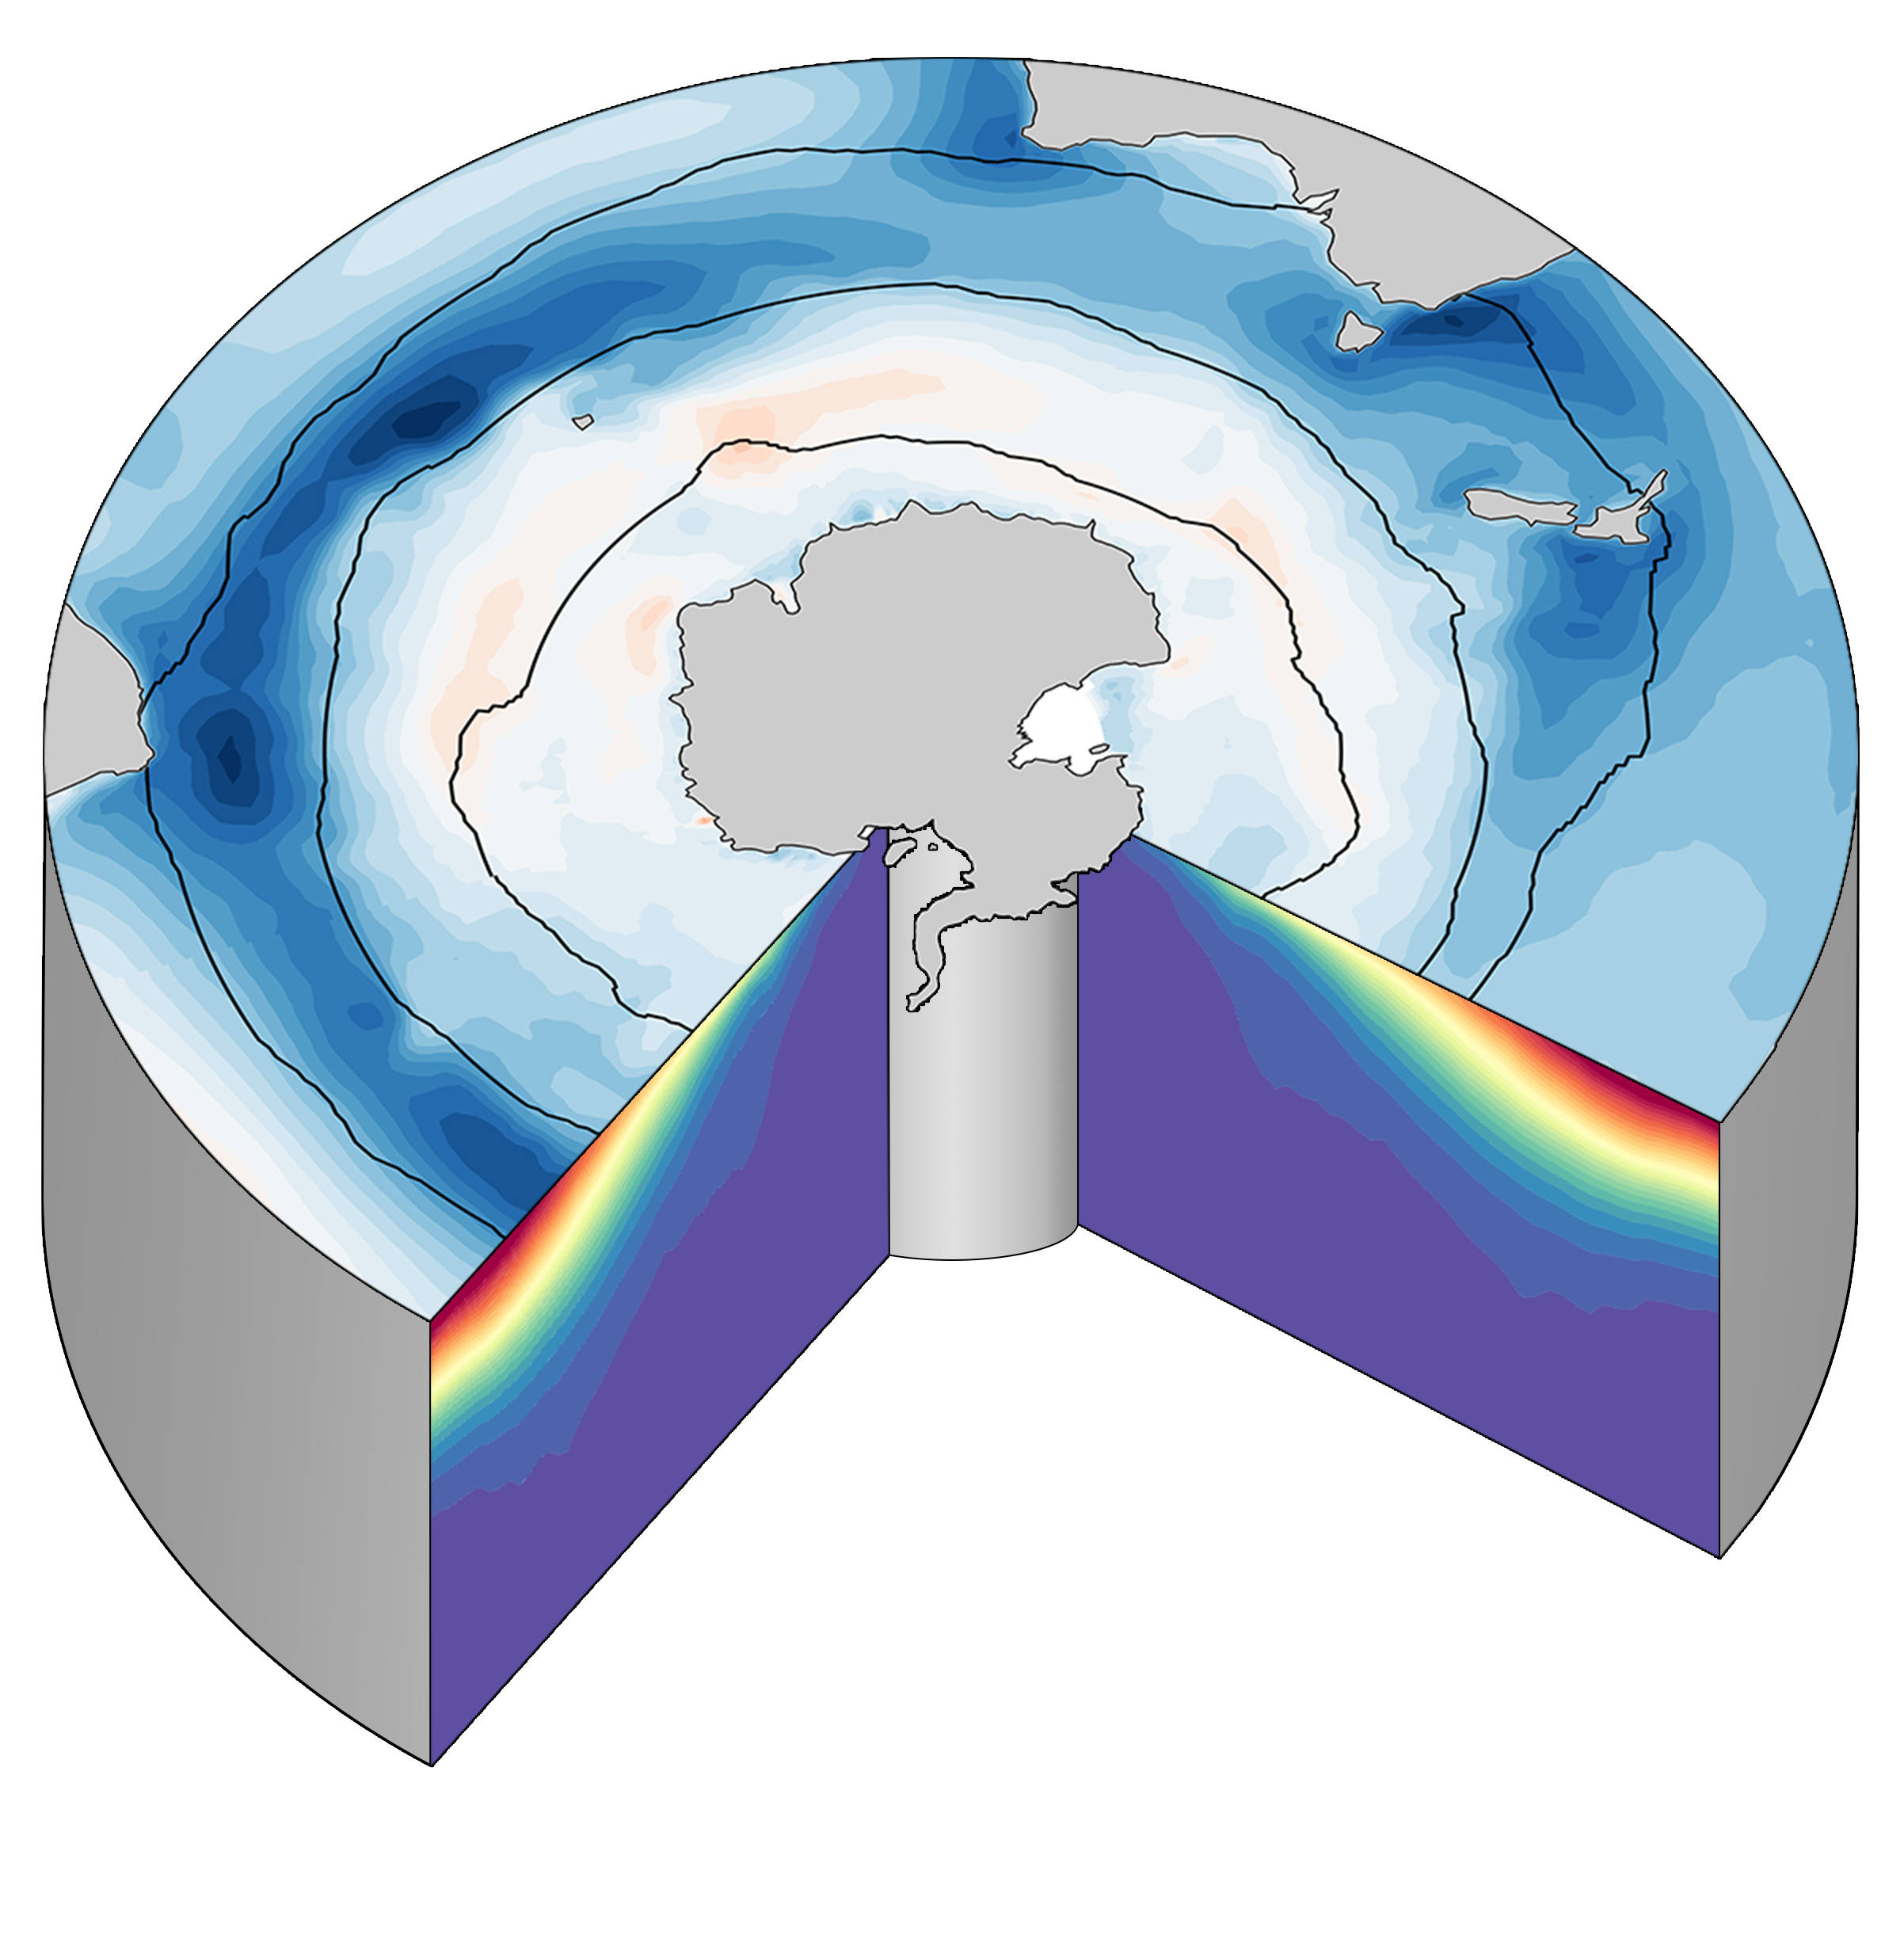
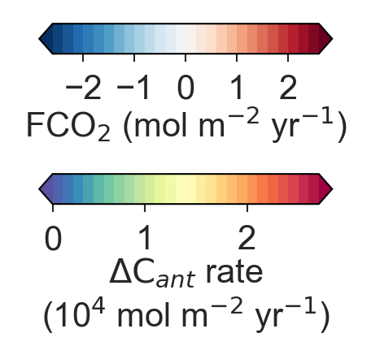
Season of maximum uptake (Fig. 5–7)
Seasonal drivers of pCO₂ (Fig. 8)
Increasing sink strength from South to North (Fig. 2)
Winter
Summer
Thermal
DIC-driven
Least disagreement between CO₂ flux trends derived from GOBMs or pCO₂-products (Fig. 3)
Atlantic and Indian STSS are strongest Southern Ocean sinks (Fig. 2, 3)
Strongest sinks
STSS trends
ICE
SPSS
STSS
Atlantic-SPSS
FCO₂
Atlantic is only mean SPSS sink (Fig. 2)
C_{net}
C_{ant}
placeholder
Large C_{ant} uptake (Fig. 9), C_{ant} uptake compensates C_{nat} which dampens C_{net} outgassing
Largest C_{ant} storage in STSS and northward
(Fig. 10, 11)

Slide 4
Means
Seasonal cycle
Trends
Interior

