Slide 1
A title
Hello world

Slide 2
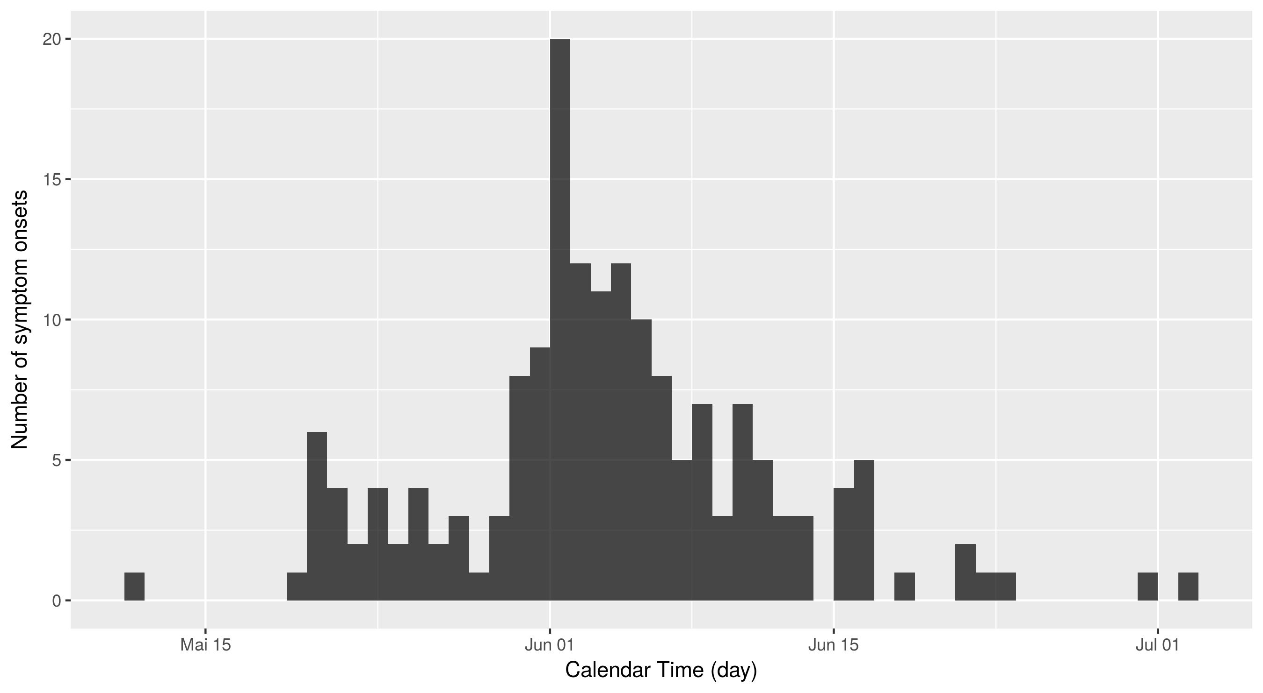
An epicurve

Slide 3
MS chart - modifiable

