Slide 1
A title
Hello world

Slide 2
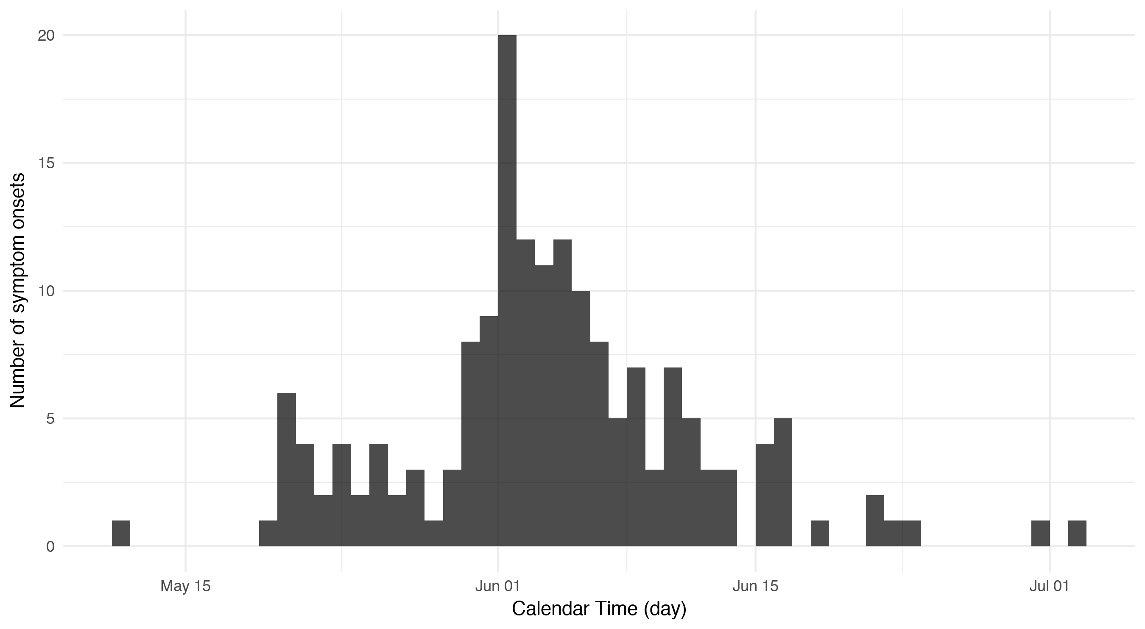
An epicurve

Slide 3
2
1
0
rnorm(100)
-1
-2
-3
0
20
40
60
80
100
Index

Slide 4
MS chart - modifiable

