Slide 1



Knowdive Research Products
Knowledge Graph Engineering project - academic year 2024/2025
Final Presentation
By Aloisi Deborah, Giaretta Leonardo

Slide 2
Phase 1 - Purpose Definition
From the informal purpose:
"A service which helps the users to query and know about all the products and the people that are working or were working in the Knowdive research group at the University of Trento"
2 Common Entities
Personal- Reference
Personal
Domains of Interest
35 Competency Questions
1 Contextual Entity
7 Personas
Reference- Personal
6 Scenarios
Reference
5 Core Entities

Slide 3
Phase 2 - Information Gathering
LiveDataUNITN
Knowdive Website
LiveSchema
Open Street Map
Research Product
Courses
Vivo Core
University
Staff
Research Topic
Academic Institution Internal Structure
Created by us
Courses
Research Product
Digital University
Project
Semantic Web for Research Communities
KRG-UNITN
DU-UNITN
Staff

Slide 4
Phase 3 - Language Definition
Person
Member
Alumni
Project
Research Product
Research Topic
University
Course
Location
Info
Concept from existing language
Concept created by us

Slide 5
Phase 4 - Knowledge Definition
related_to
Research Topic
Member
head_of
expertise_in
Project
status_member
responsible_for
Research Product
Location
Person
worksAtProject
has_produced
has_location
has_info
is_part_of
status_alumni
University
teaches
Alumni
has_subject
Info
Course
Matched with existing ontology
No Match Found

Slide 6
Phase 5 - Entity Definition
Entity
Matching
Entity
Identification
Data
Mapping
Karma
Linker
Alumni
Alumni
Person
Member
Member

Slide 7
Evaluation
Knowledge
Layer
Data
Layer
25
Coverage
Results
Connectivity
Query
Execution
36

Slide 8
Metadata Definition
Project
1
Title
URL
Keywords
Type
Description
Start Date
End Date
Funding Agency
Input
Output
Coordinator
Observations
Data resources
8
10
Title
Description
Type
Size
FileFormat
Keywords
Source Info
Language Resources
2
1
Title
Description
Type
Size
FileFormat
Keywords
Source Info
Knowledge resources
1
4
Title
Description
Type
Size
FileFormat
Keywords
Source Info
Pre-existing resource
Produced during project

Slide 9
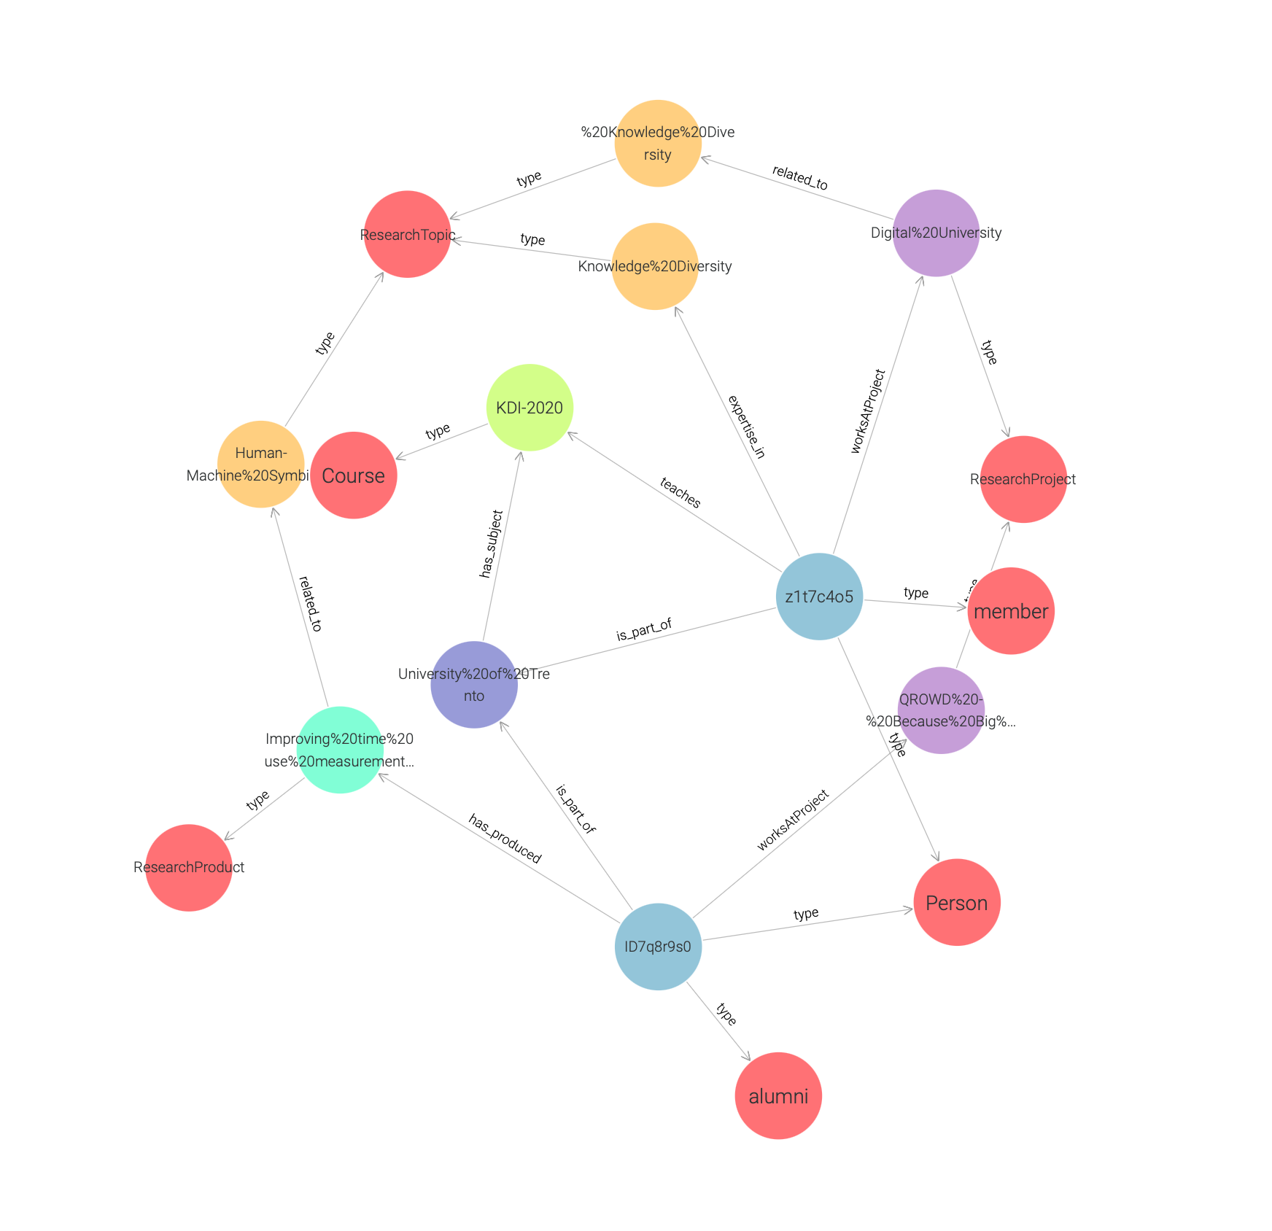
Result & Open Issues
Lack of Data
Late relevance of Metadata
EType

