Slide 1
Progressive Student Dashboard
End-to-End Verification & Walkthrough Report
Date: June 20, 2026 | Status: PASSED | Verified Roles: Student & Mentor

Slide 2
System Environment & Architecture
VERIFICATION SETUP DETAILS
✔ FastAPI Backend Server: Running on port 5001 with Uvicorn reload module.
✔ Vite + React Frontend: Running on port 5173 with TypeScript & Tailwind CSS.
✔ SQLite Local Database: Pre-populated using seed.py to ensure test repeatability.
✔ Automated Testing Sandbox: Evaluated using Chrome DevTools browser controls.
✔ Role Segmentation: Secure token routing for students and mentors.

Slide 3
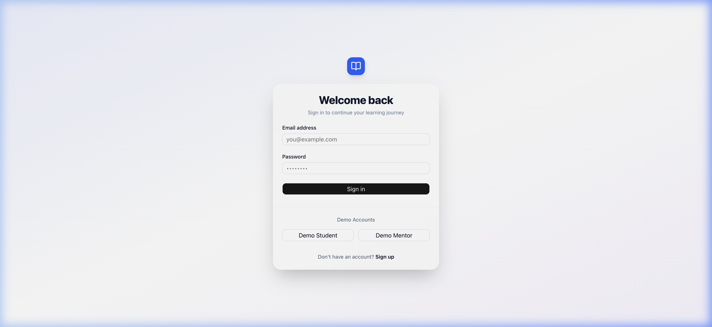
1. Unified Authentication Gateway
LOGIN SCREEN
• Role-based segregation: Direct routes to Student or Mentor dashboards.
• User Validation: Real-time checks for correct email format.
• Backend Security: Salted bcrypt passwords matched against database.
• Session Management: JSON Web Tokens (JWT) saved upon successful login.

Slide 4
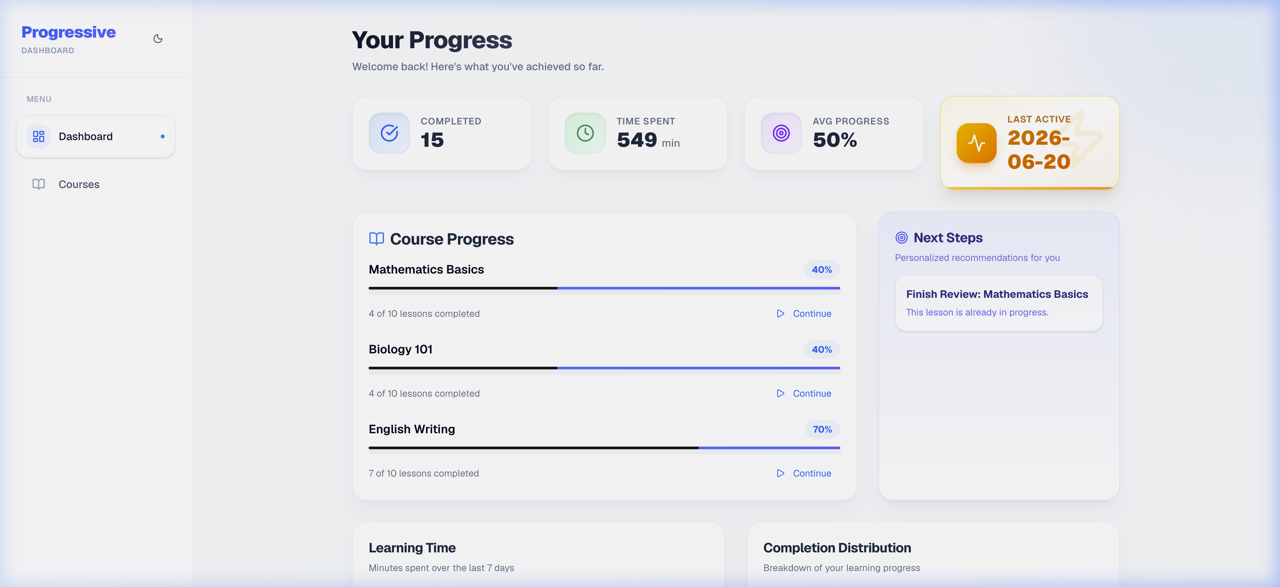
2. Student Dashboard Console
GENERAL PROGRESS & METRICS SUMMARY
• Summary Analytics: Live counters for completed lessons, time spent, and averages.
• Interactive Visualizations: Recharts charts displaying completion rates and trends.
• AI Recommendations: Custom next-steps generated based on performance metrics.
• Active Course Roster: Dynamic cards tracking ongoing course progress percentages.

Slide 5
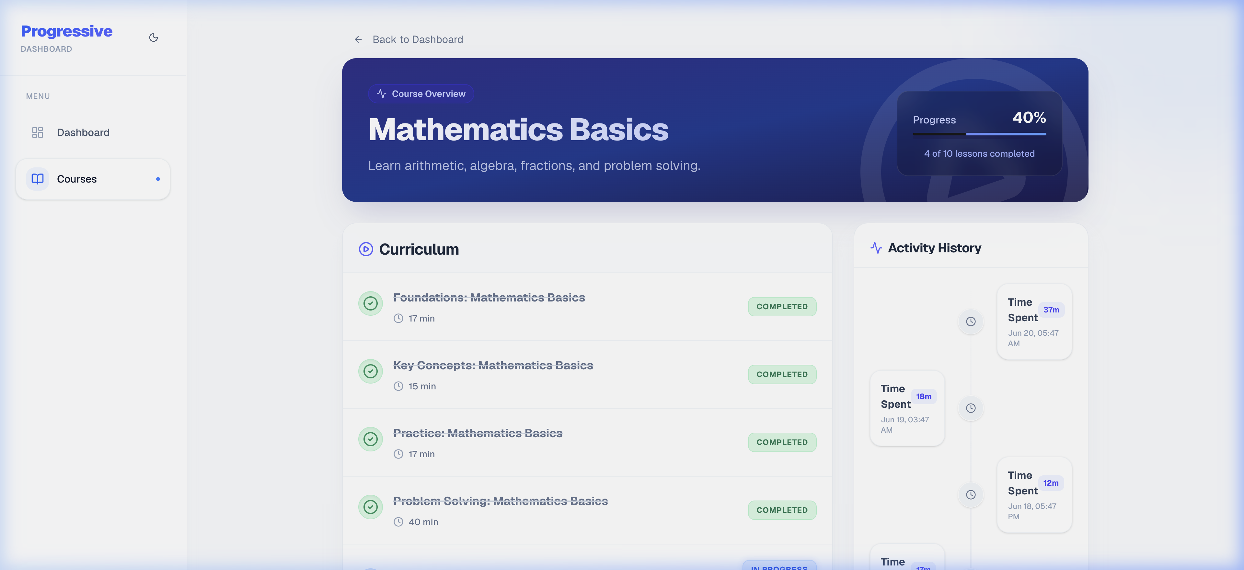
3. Granular Course tracking
INTERACTIVE PROGRESS TOGGLE
• Curriculum Breakdown: View detailed modules and estimated reading times.
• Dynamic Progress Update: Toggle checkboxes to mark lessons as completed.
• Live API sync: Interacting with lesson toggles updates database values in real-time.
• Progress Recalculation: Course completion percentages adjust instantly in UI.

Slide 6
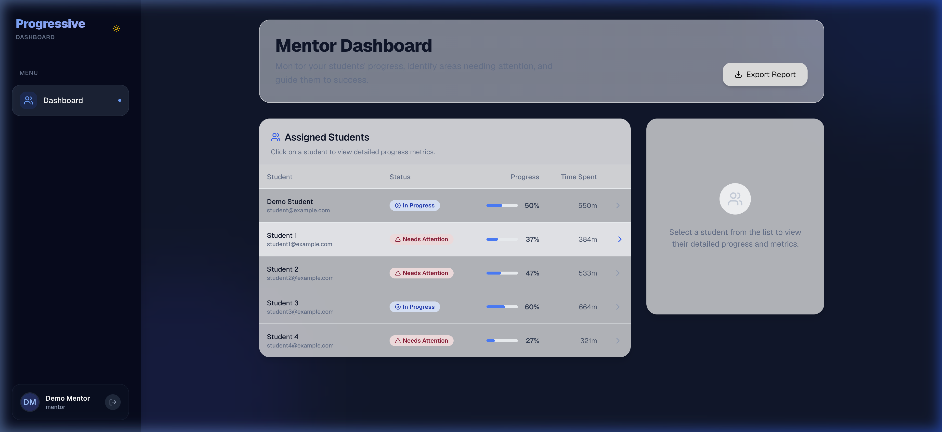
4. Mentor Cohort Management
COHORT DASHBOARD OVERVIEW
• Macro cohort view: Roster of all assigned student accounts and profiles.
• At-a-glance KPI analysis: Review overall averages and cumulative study times.
• Failing Progress Warnings: Automatic highlighting for courses requiring assistance.
• Actionable Drilldown: Instantly open detailed inspections of individual progress.

Slide 7
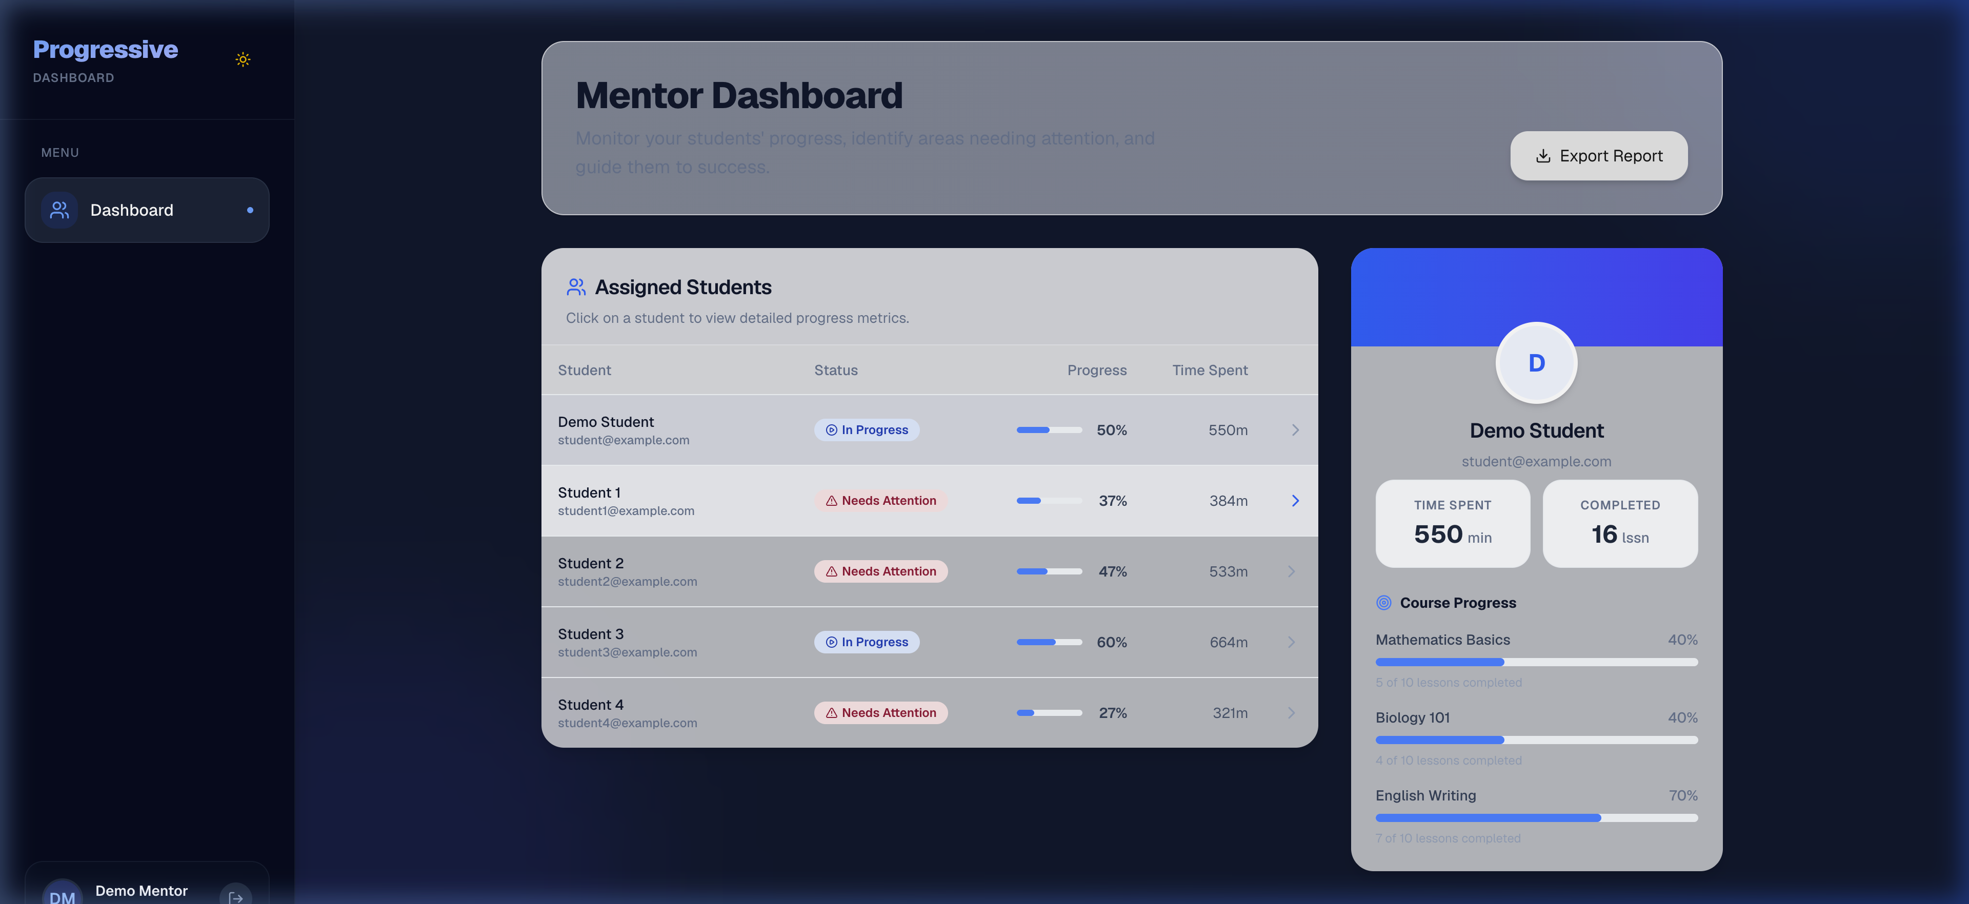
5. Nested Progress Inspection
STUDENT DETAIL VIEW (MENTOR MODE)
• Student Focus Mode: Access exact courses and active details for a selected student.
• Read-only Monitoring: Review lesson progress without altering student statistics.
• Responsive Layout: Panel overlay allows rapid swapping between cohort students.
• Navigation Integrity: Retains sidebar status options and workspace hierarchy.

Slide 8

6. Automated E2E Flow
RECORDED INTERACTION FLOW
• Automated Simulation: Tests end-to-end user navigation pathways in sequence.
• Flow Summary: Student Login -> Course Toggle -> Student Logout -> Mentor Login -> Inspector -> Mentor Logout.
• Playback asset: Saved in high fidelity as 'demo_assets/student_dashboard_flow.webp'.
• Execution Result: 100% test scenario completion with no console failures.

Slide 9
Verification Summary
VERIFICATION STATUS: PASSED
All E2E flow testing components for students and mentors are functional and integrated.
✔ Interactive toggles successfully synced with FastAPI backend and SQLAlchemy.
✔ Role segmentation checks verified on React Router client-side logic.
✔ Dynamic analytics (Recharts) matched pre-seeded database metrics exactly.
✔ A detailed HTML report with interactive elements is saved as demo.html.

