Slide 1

Getting Started With CrowdSec

Slide 2

Agenda
What is CrowdSec?
How does it work?
Before we get started

Slide 3

What is CrowdSec?
CrowdSec is a free, open-source, and collaborative IPS(Intrusion prevention system).
Analyze behaviors, respond to attacks & share signals across the community.
Belongs to the SOAR(Security Orchestration, Automation, and Response) platform.

Slide 4
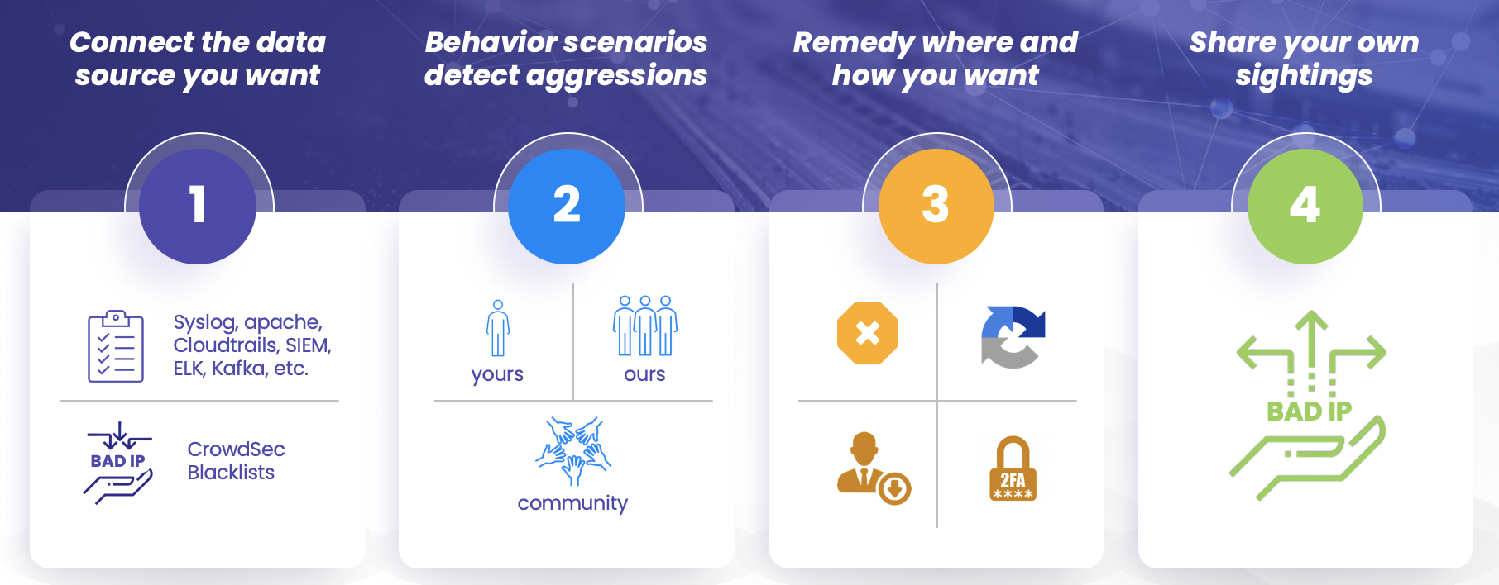
How does it work?

Slide 5

Before we get started
Prerequisites:
Ubuntu/Windows server
Apache2 or any service installed in server
If(server == ubuntu) Convert CLI to GUI
(Command: sudo apt install ubuntu-desktop) [OPTIONAL]

Slide 6
Play Time!

