Slide 1
Amazon Automation
Guide for Amazon
Project Group Number - KC148CSE445
Submitted by: Upendar, Naveen, Preetham, Mohith
Submitted to: Puneet – (Assistant Professor)

Slide 2
INTRODUCTION
What is Selenium?
Selenium refers to a suite of tools that are widely used in the testing community when it comes to cross-browser testing.
Selenium supports -
Google Chrome
Internet Explorer
Safari
Opera
Operating systems

Slide 3
Selenium Components
The Selenium test suite comprises four main components:-
Selenium IDE
Selenium RC
Selenium WebDriver
Selenium Grid

Slide 4
What is Selenium WebDriver?
Selenium WebDriver is a web framework that permits you to execute cross-browser tests.
Selenium WebDriver allows you to choose a programming language to create test scripts.
Drawback of Selenium WebDriver -
Selenium WebDriver is not capable of handling window components.
Tools - Sikuli, Auto IT, etc.

Slide 5
Project Description
This project acts like a guide by bringing all the information and tasks together at one place, all you need to do is select the option from the list and the task is performed for you
When we open Amazon website or app if you are an old user:
Sign in / Search Item / Access or update Account Details
When you are new to amazon:
Sign Up

Slide 6
Project Description
The entire project works on amazon website (www.amazon.in) with the help of python language.
Two main components to start the project:
pip install -U selenium
https://chromedriver.chromium.org/downloads

Slide 7
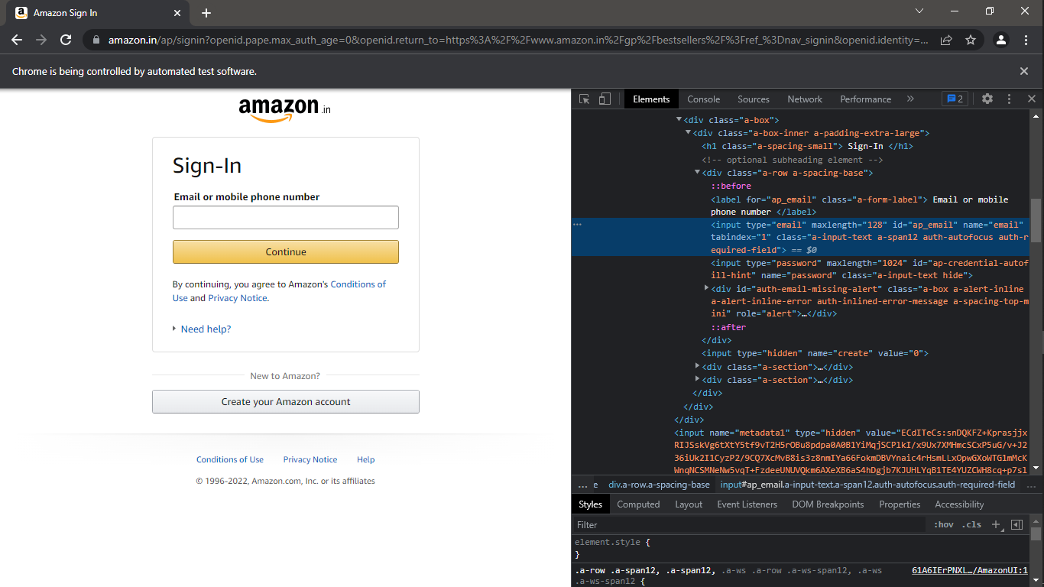
Sign In Page

Slide 8
Sign In Page
login_no = driver.find_element_by_id('ap_email')
continue_button = driver.find_element_by_id('continue')
login_pass = driver.find_element_by_id('ap_password')
sign_In_Submit = driver.find_element_by_id('signInSubmit')

Slide 9
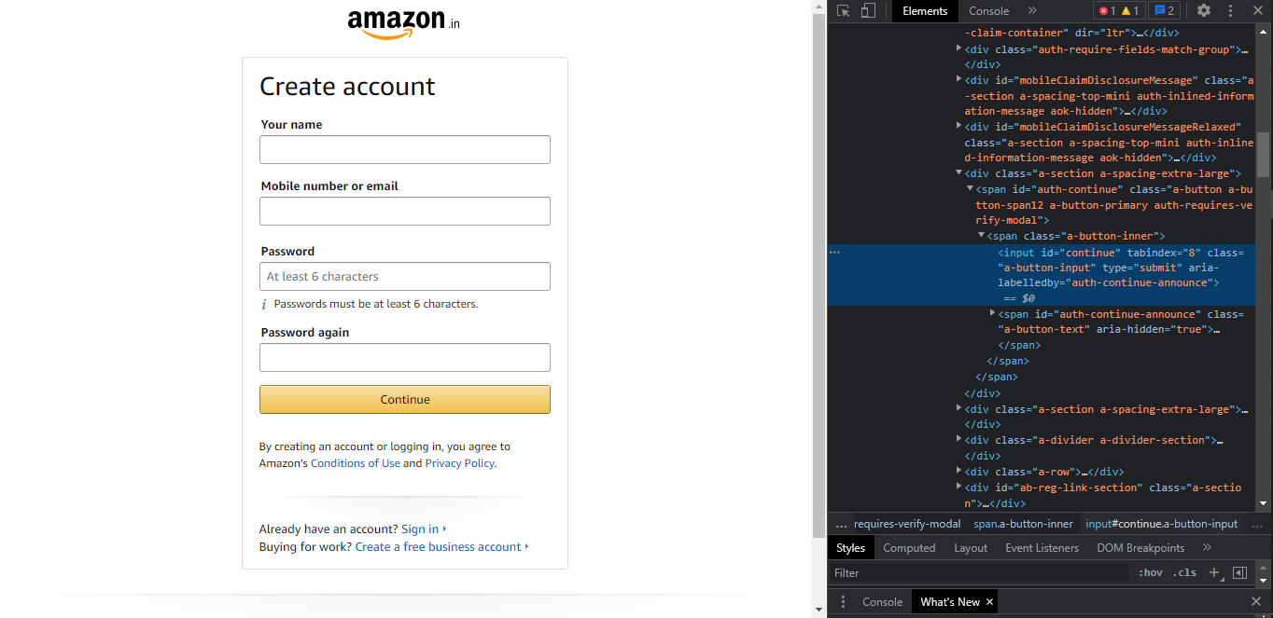
Sign-Up page

Slide 10
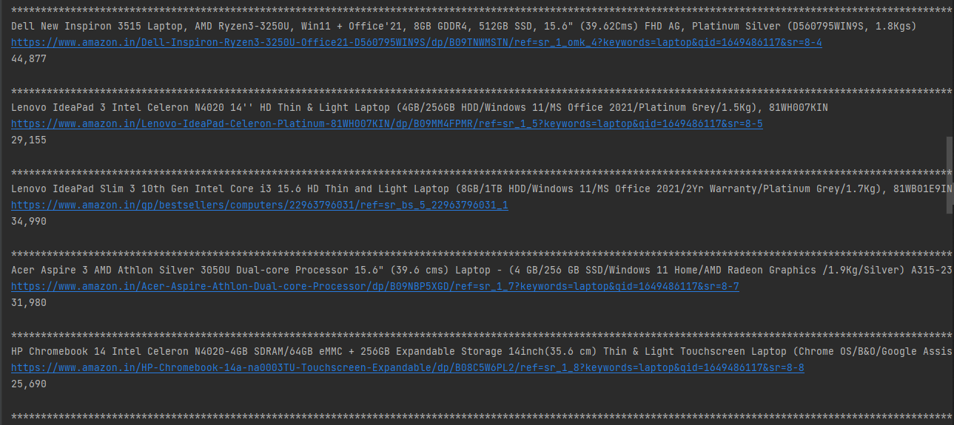
Search item and display
Item name, link, cost being displayed in console

Slide 11
Search item and display
Name:
for item in driver.find_elements_by_css_selector('.s-result-item.s-asin'):
item_name = item.find_element_by_css_selector('.a-color-base.a-text-normal')
print(item_name.text)
Cost:
for item in driver.find_elements_by_css_selector('.s-result-item.s-asin'):
try:
Catch:

Slide 12
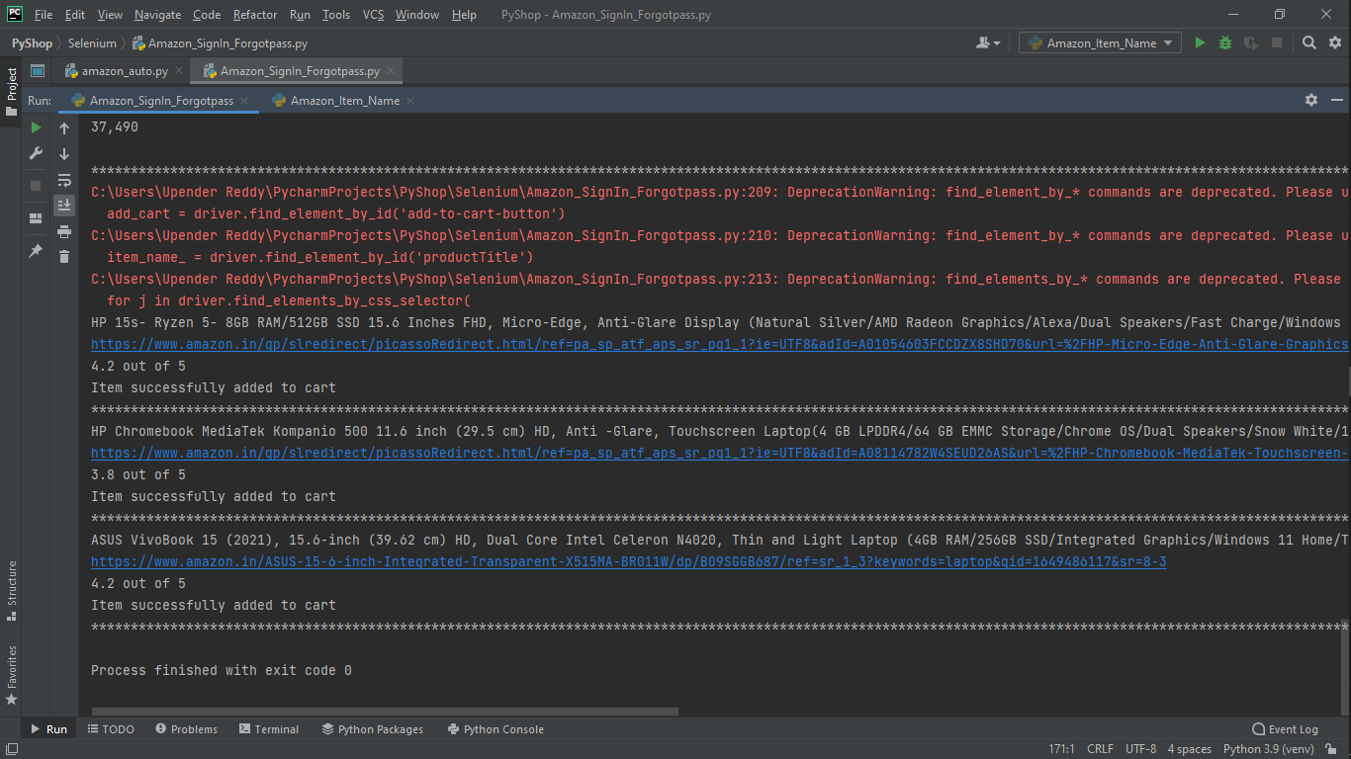
Add to Cart

Slide 13
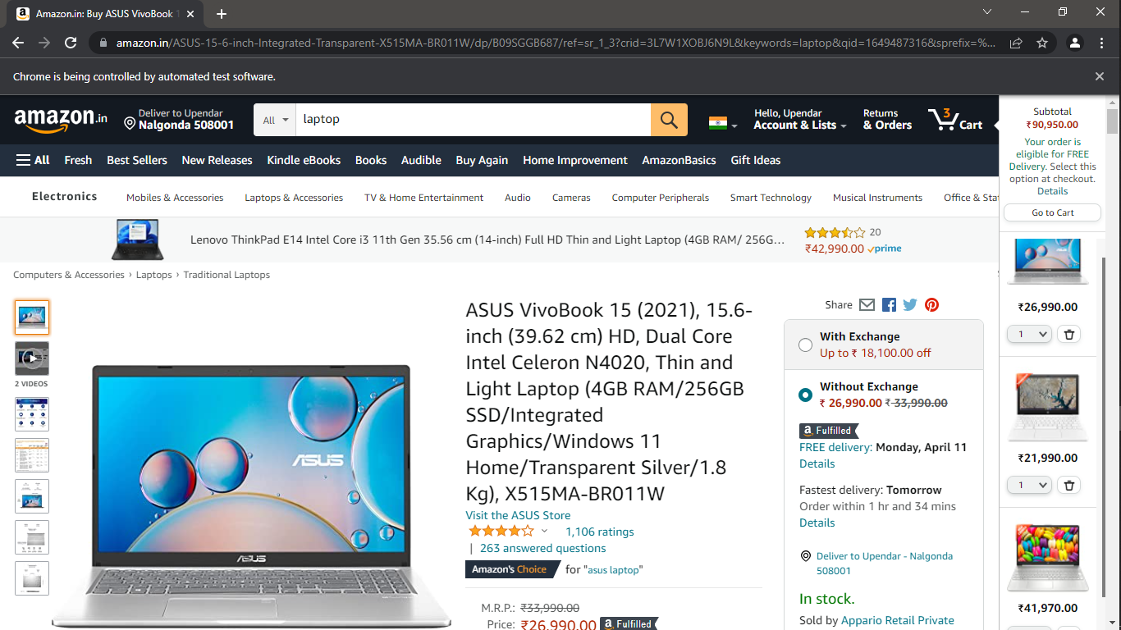
Add to Cart

Slide 14
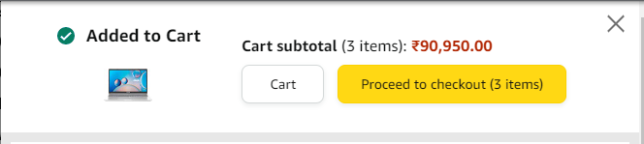
Add to Cart

Slide 15
Add to Cart
lst_ = list(map(str, lst.split())) for i in range(3): driver.get(f'{lst_[i]}') add_cart = driver.find_element_by_id('add-to-cart-button') for j in driver.find_elements_by_css_selector( '.a-section.a-spacing-none.a-spacing-top-mini.cr-widget-ACR'): try: rating = j.find_element_by_css_selector('.a-size-medium.a-color-base') print(rating.text) except: print("Rating is not given for this item") add_cart.click()

Slide 16
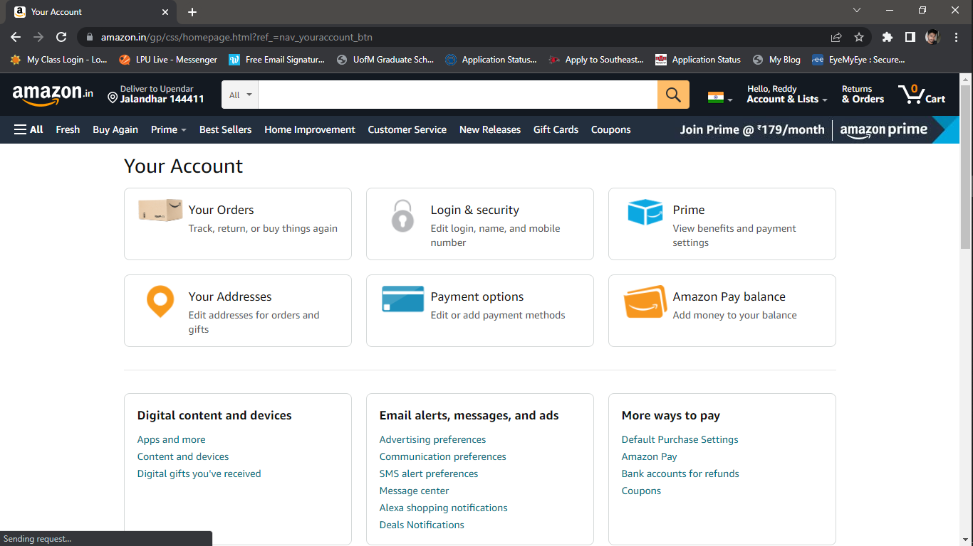
Your Account

Slide 17
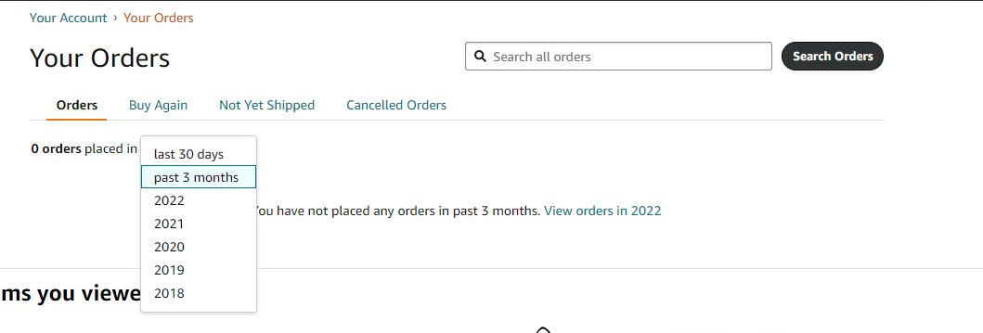
Your Orders

Slide 18
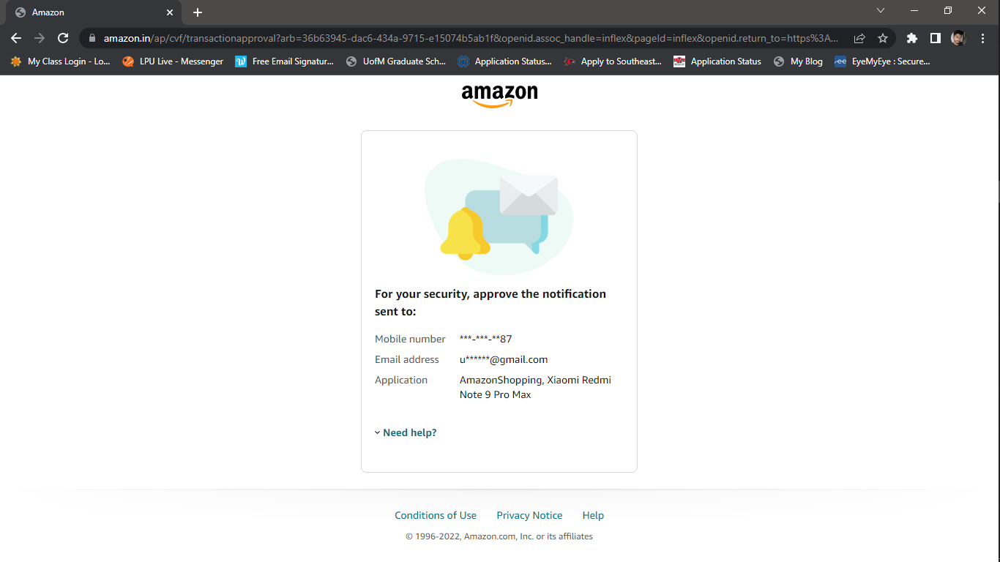
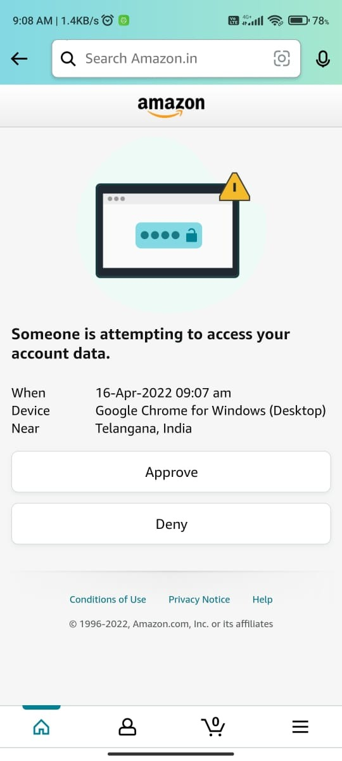
Login and Security - Secure Features of Amazon

Slide 19
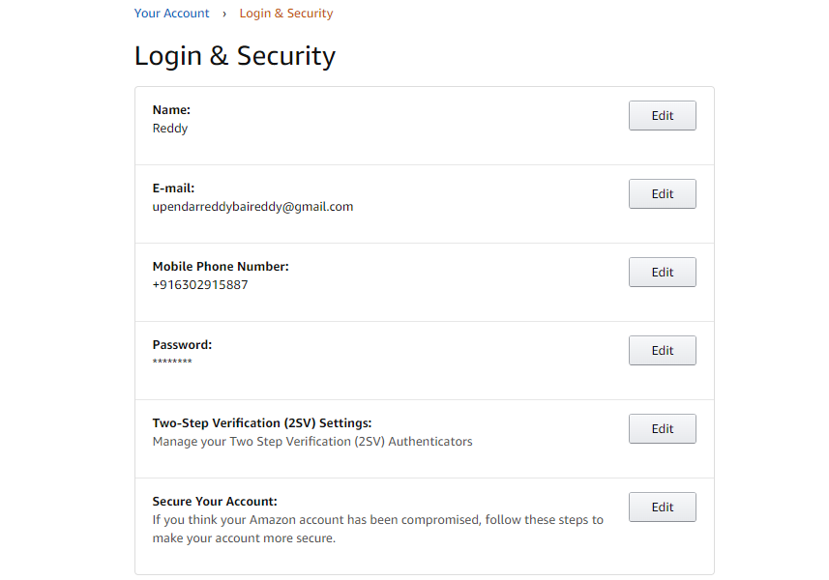
Login and Security

Slide 20
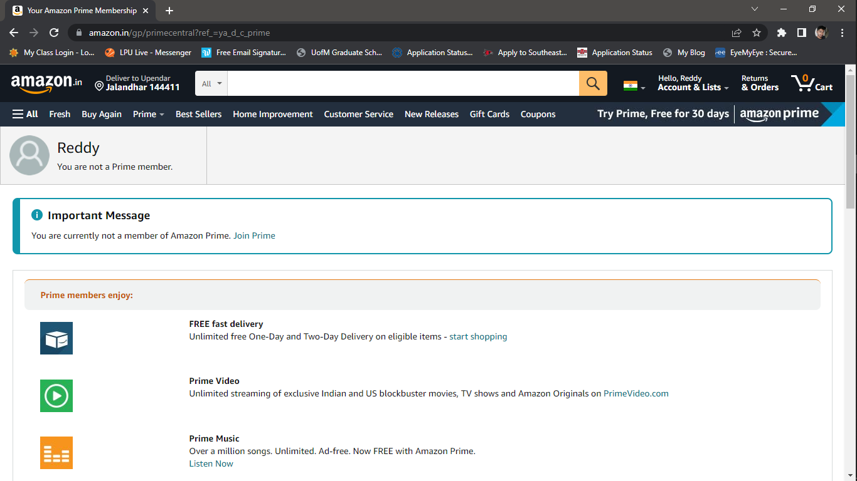
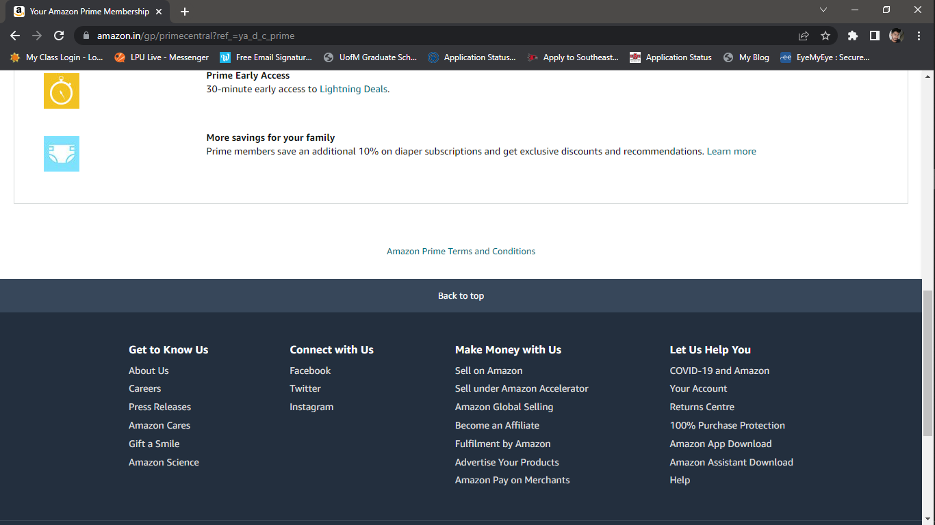
Prime

Slide 21
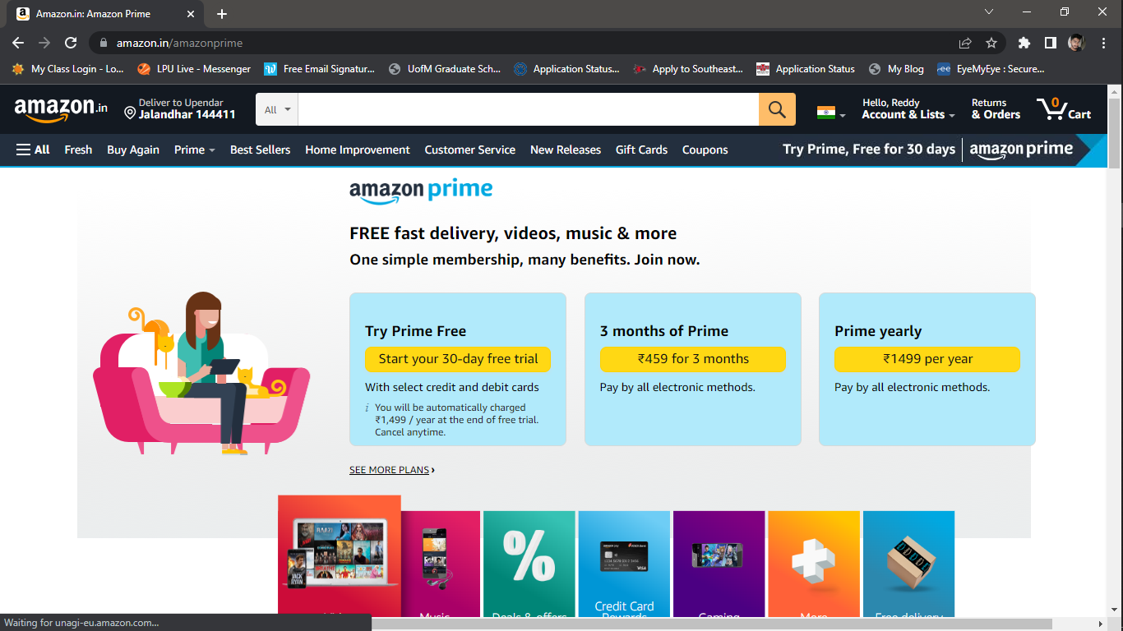
Join Prime

Slide 22
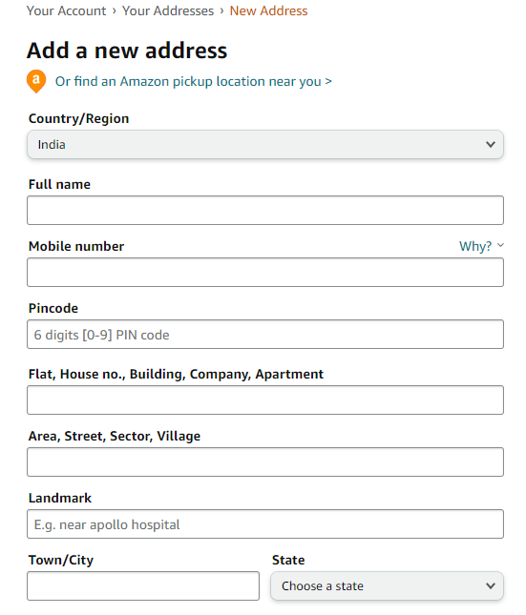
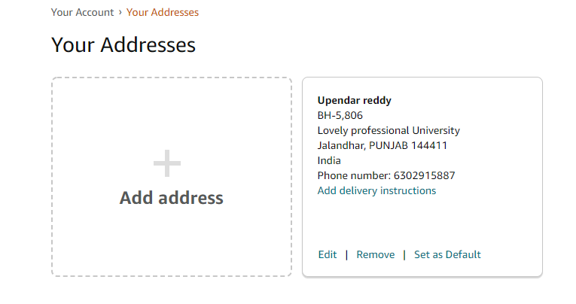
Address

Slide 23
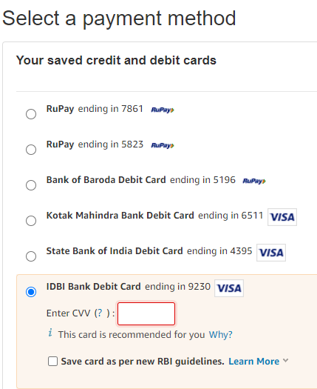
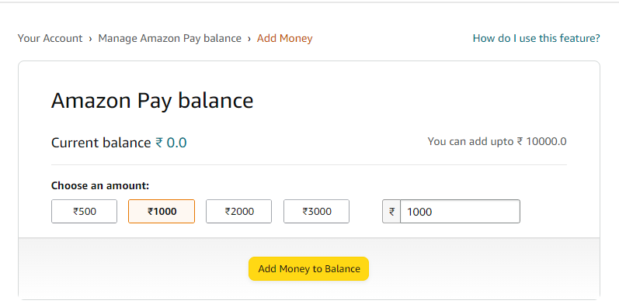
Amazon Pay Balance

Slide 24
Challenges and concern
Challenges -
Sign Up page:
Issues while opening the Sign Up form.
Cost and Rating:
Empty Fields.
Concern -
Sign Up page:
After submitting the sign up form there is a puzzle popping up to restrict the bot from running.

Slide 25
Conclusion
When a person is new to a any website he/she doesn’t know where to start with. We usually need assistance from someone.
Using automation we can make the interaction with the website much easier to the users without any external assistance.
The sole purpose of “Automation” is to reduce the human effort.

