Slide 1

VT Net Apps
Nathan Love

Slide 2
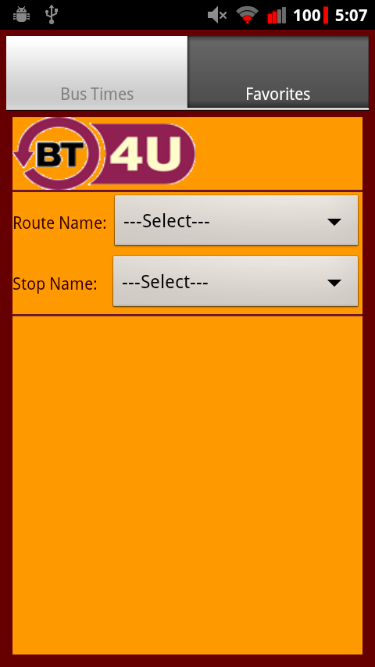
What Is It?
This app is designed to tell you when the bus is coming

Slide 3
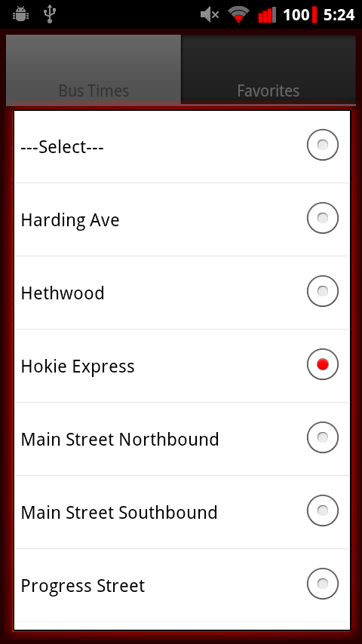
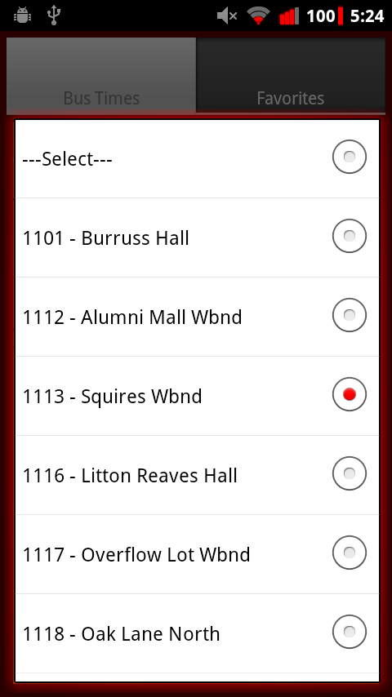
How Does It Work?
There are 2 steps to finding times
Step 1 Step 2

Slide 4
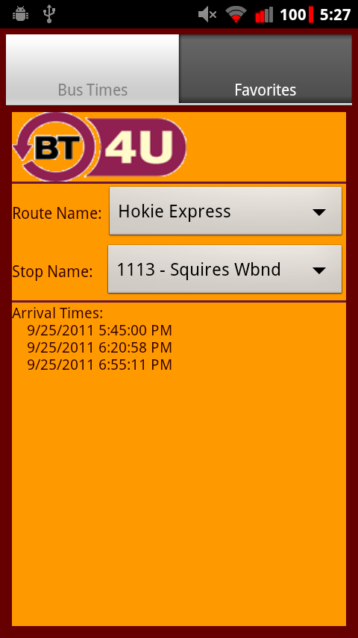
Result
After choosing both a route and a stop:

Slide 5
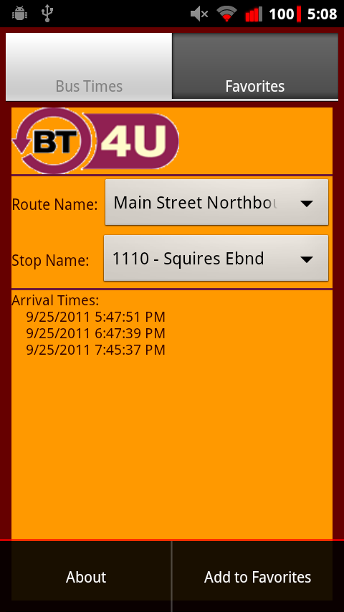
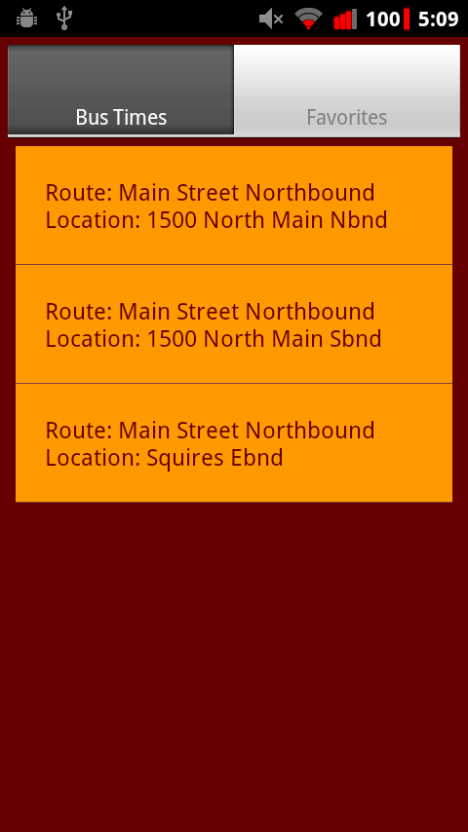
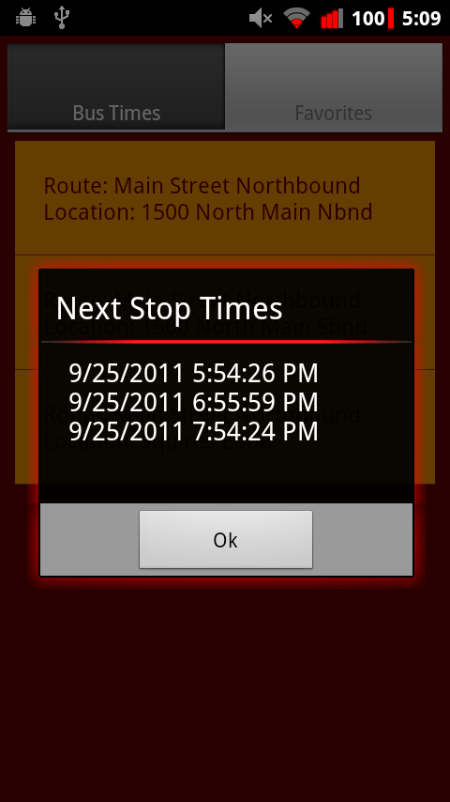
Favorites
What if I have a bus I ride a lot?

Slide 6
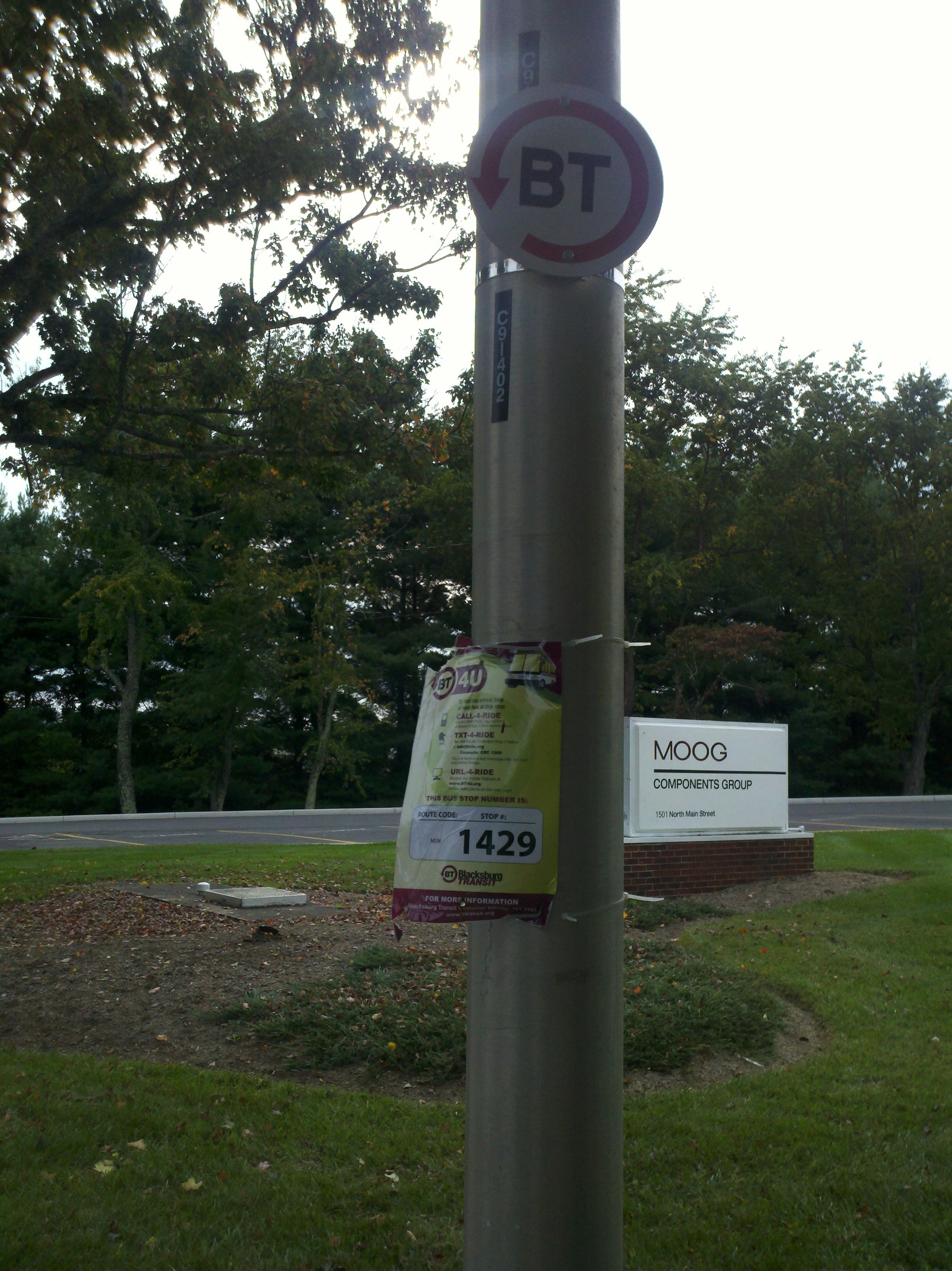
What is a stop code?
So you may have notice a sign at your bus stop with a stop code on it like this:
The Blacksburg Transit recently created a new system of getting bus times using these stop codes

Slide 7
Stop Codes
If you don’t the name of the stop location you’re at but see this stop code you can use that instead

Slide 8
Design
This app has a very simple design
It is designed that way so you can get your info quickly and in a layout that is easy to understand

