Slide 1
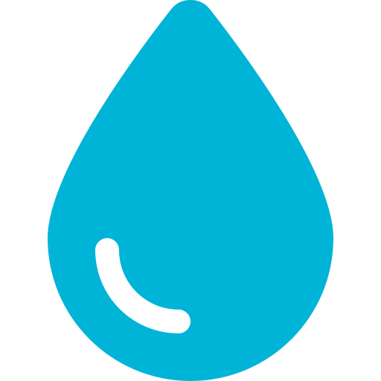
HydrateAI
"Show me."
Other apps ask if you drank water.
HydrateAI asks for proof.
AI Accountability Coach
for ADHD & Fitness Users
MVP Product Overview · Android First
Notes:
Opening slide. Lead with the killer differentiator quote: Show me. Pause for effect.

Slide 2



THE PROBLEM
ADHD & Distraction
Apps You Can Lie To
Reminder Fatigue
40M+ adults with ADHD forget basic habits not because they don't care — but because their brains work differently.
Every hydration app lets you tap 'Yes, I drank.' Zero verification. Zero accountability. Zero results.
Static 3-hour reminders get snoozed. Generic push notifications get ignored. Users quit in week 1.
Notes:
Frame the problem in three dimensions: neurological (ADHD), behavioral (lying to apps), and UX (reminder fatigue). This sets up why a verification-first app is necessary.

Slide 3

THE SOLUTION
HydrateAI Core Loop
🔑 Killer Feature
1
AI Check-in — App messages you every few hours — feels like a coach, not a tracker.
AI Photo Verification
Looks like a 32oz bottle. ~75% consumed. Logging 24 oz. ✓
2
You Respond — Send photo, text, or voice note showing your drink.
3
AI Verifies — Gemini Vision estimates container, volume, % consumed.
Gemini Vision API identifies container type, estimates volume, tracks your personal bottles over time.
4
Streak Updated — Progress syncs instantly. Gamified score improves.
5
Adaptive Learning — AI notes patterns and shifts reminder timing to match your life.
Notes:
Emphasize the Show Me mechanic. No other hydration app does photo verification. This is the core moat.

Slide 4
PRODUCT ARCHITECTURE
Flutter Android App
UI • Push notifications • Camera • Messaging chat interface
Firebase Backend
Auth • Firestore DB • Cloud Functions • FCM push
Gemini AI APIs
Vision (photo verification) • LangGraph agent • Adaptive reminders
RevenueCat
Subscription management • Free ↔ Premium upgrade flow
One codebase → Android (iOS later) · Claude Code orchestrates all engineering
Notes:
Stack: Flutter + Firebase + Gemini + RevenueCat. LangGraph manages the multi-step AI agent conversation. Claude Code is used as the dev engine.

Slide 5

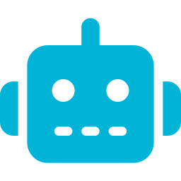

ADHD-FIRST DIFFERENTIATORS
Adaptive Reminders
Streak Psychology
AI tracks when you ignore reminders and auto-shifts timing. 3 ignored mornings = asks if you want 10 AM check-ins instead.
14-day streak break is psychologically powerful. Not just a number — a consequence. Loss aversion drives re-engagement.
AI Coach Personality
ADHD Reliability Score
Messages feel like a coach not a tracker. AI remembers your history, references yesterday's miss, celebrates wins.
Measures response rate, completion %, streak consistency. Gives users a number to improve — gamification without childish badges.
Notes:
These features are the moat. ADHD users are chronically underserved by generic reminder apps. Adaptive timing + accountability scoring are patentable differentiators.

Slide 6



BUSINESS MODEL
FREE
PREMIUM
$0 / month
$4.99 / month
Manual water logging
AI photo verification
Basic daily reminders
AI coach check-ins
Daily goal tracking
Smart adaptive reminders
Basic streak counter
Advanced analytics
Habit insights
Message-based coaching
Notes:
Free tier captures users, Premium captures revenue. Target 5-10% free-to-paid conversion. $4.99/month is impulse-buy pricing for a habit that users KNOW matters.

Slide 7


ROADMAP & SCALABILITY
Phase 1 · MVP
Phase 2 · Scale
Phase 3 · Platform
Day 1–30
Month 2–3
Month 4+
HydrateAI Android app
SMS / WhatsApp check-ins
Rebrand → HabitPilot
Photo verification (Gemini)
Voice input support
Add: sleep, meds, exercise
Basic streak + AI coach
iOS launch
Multi-habit AI agent
Firebase + RevenueCat
Deeper ADHD analytics
B2B / corporate wellness
Notes:
Hydration is Habit #1. The real business is HabitPilot — a platform for all ADHD-friendly habit accountability. This is the strategic expansion path.

Slide 8
THE VISION
Not a water reminder app.
An AI that helps people
consistently do the things
they know they should.
That is a subscription business.
HydrateAI → HabitPilot → AccountabilityAI Platform
Notes:
Closing vision slide. The pitch: Water is the beachhead. The real product is an AI accountability coach for the 40M+ adults with ADHD who need this. That is the subscription business.

