Slide 1
UNDERGRADUATE THESIS · WEEKLY PROGRESS REPORT 2
Design of a Medical Multimodal-Specific Tokenizer and a Unified Data Protocol
Week 2: image tokenization on MedMNIST (continuous vs VQ)
REDOANUZZAMAN
Sichuan University · October 15, 2026

Slide 2
Recap: Week 1 and supervisor feedback
Week 2 · Oct 15, 2026
Week 1
Foundation and protocol ✓ done
Done in Week 1
Week 2
Image tokenization (MedMNIST) ◀ now
• Unified token protocol v0.2: one vocabulary, one sequence format
• Open datasets chosen; data pipeline and splits ready
• Reference code + synthetic tests for the format
Week 3
Time series (PhysioNet 2012)
Week 4
Adaptation and integration: text, Cataract-101, point clouds
Week 5
Downstream tasks and ablations
Supervisor feedback (Oct 8)
Week 6
Reproducibility and delivery
• Scope = a scoped, reproducible prototype
• Images + time series fully implemented; at least two downstream tasks
• Text: synthetic notes; video: Cataract-101 phase events; point clouds: interface + tests
This week: the first fully implemented modality (2D images), and the end-of-Week-2 checkpoint.
2

Slide 3
Work done: two image tokenizers
Week 2 · Oct 15, 2026
Same autoencoder for both: 28×28 image → 7×7 latent grid → 28×28 image
A. Continuous projection (baseline)
B. Vector quantisation (VQ)
• 49 positions per image, each one carries an fp16 vector
• No discretisation: the encoder output goes straight to the model
• These vectors are NOT vocabulary tokens; they are reported as 'continuous vectors'
• Each latent vector → id of the nearest entry in a 1,024-entry codebook
• 56 vocabulary tokens per image (7×7 codes + 7 <ROW> markers)
• Codebook kept alive with EMA updates, cosine lookup and dead-code restarts
• Control run: vanilla VQ-VAE without these three remedies
Fair comparison
• One tokenizer for all three subsets (Blood, Pneumonia, Derma), trained on the training splits only
• Measured on the official test sets: reconstruction (PSNR, SSIM, MAE), compression, codebook use, tokens per image
3

Slide 4
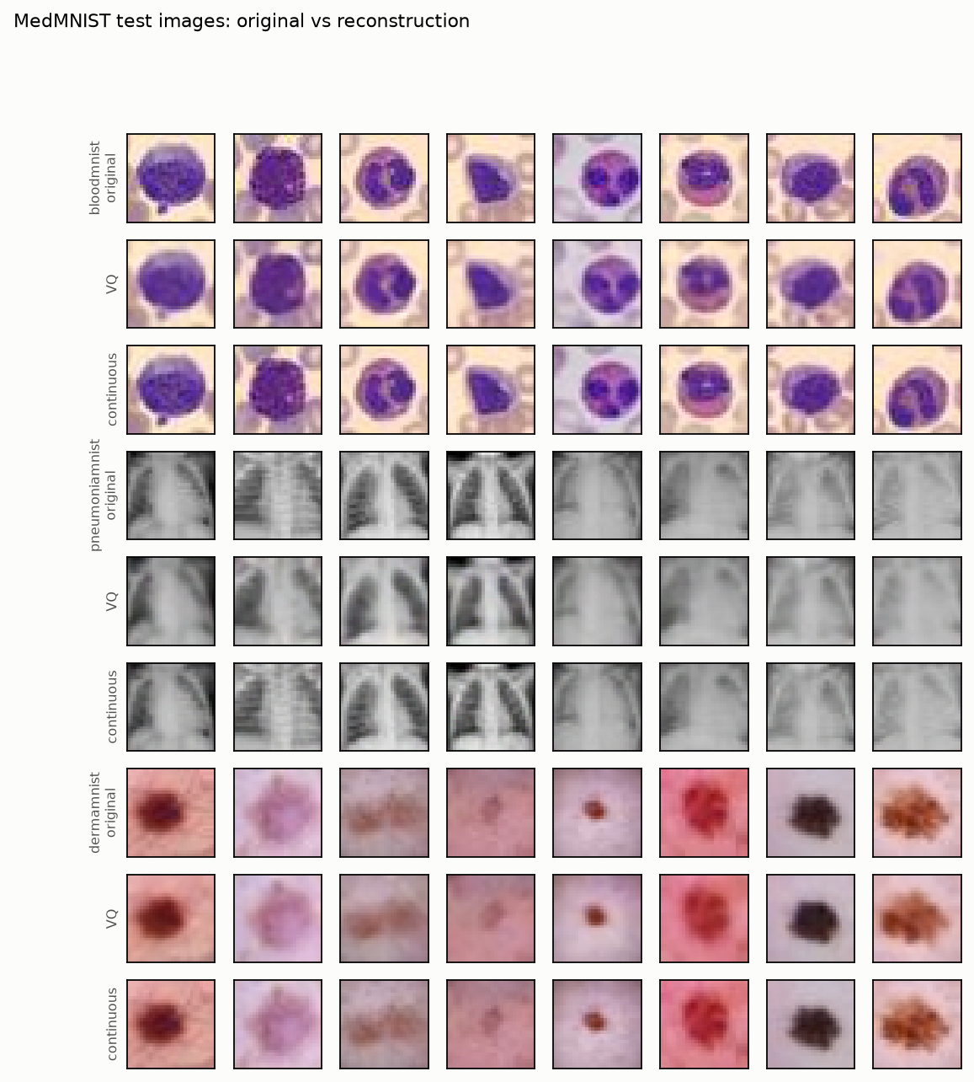
Results: reconstruction on the test sets
Week 2 · Oct 15, 2026
Subset | Method | PSNR dB | SSIM | MAE
BloodMNIST | continuous | 35.717 | 0.983 | 3.053
 | VQ | 28.149 | 0.916 | 7.457
PneumoniaMNIST | continuous | 38.948 | 0.993 | 2.132
 | VQ | 29.823 | 0.944 | 6.435
DermaMNIST | continuous | 43.996 | 0.993 | 1.193
 | VQ | 32.720 | 0.928 | 4.673
• Continuous keeps more detail: higher PSNR / SSIM on every subset
• VQ images are a little smoother, but cell shape, lung shape and lesion colour stay visible
• MAE is in 0–255 pixel units
Source: reports/tables/table_00.csv, reports/figures/recon_images.png
4

Slide 5
Results: token counts and compression
Week 2 · Oct 15, 2026
Subset | Method | positions | vocab tokens | cont. vectors | ratio (fixed) | ratio (+overhead)
BloodMNIST | continuous | 49 | 0 | 49 | 0.750 | 0.745
 | VQ | 56 | 56 | 0 | 33.595 | 26.350
PneumoniaMNIST | continuous | 49 | 0 | 49 | 0.250 | 0.248
 | VQ | 56 | 56 | 0 | 11.198 | 8.783
DermaMNIST | continuous | 49 | 0 | 49 | 0.750 | 0.745
 | VQ | 56 | 56 | 0 | 33.595 | 26.350
Continuous positions carry fp16 vectors: they are NOT vocabulary tokens (vocab tokens = 0 for the continuous baseline).
How to read the ratios (raw bits ÷ token bits)
• ratio (fixed): every VQ index costs log2(1,024) bits; every continuous value costs 16 bits (fp16)
• ratio (+overhead): also counts the span delimiters <START> <REP> <END> and the decoding metadata
Source: reports/tables/table_00.csv
5

Slide 6
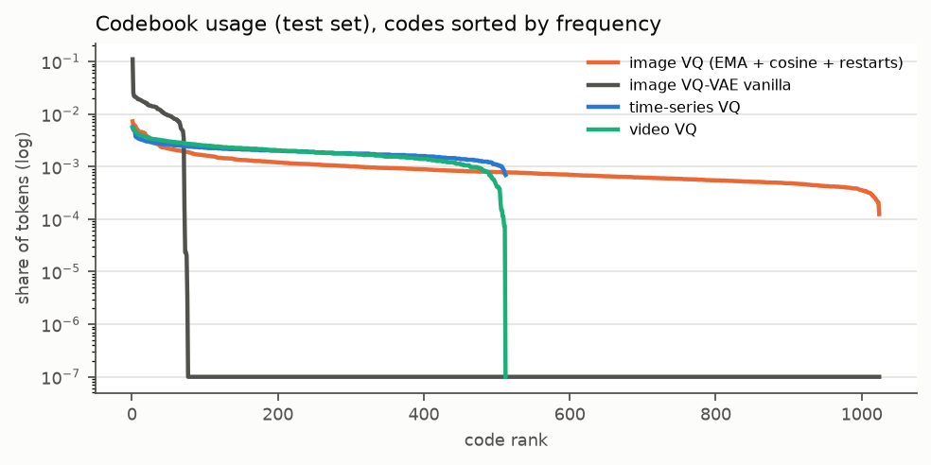
Results: codebook utilisation
Week 2 · Oct 15, 2026
Subset | Codebook | active codes | util | perplexity
BloodMNIST | with remedies | 1011 | 0.987 | 568.245
 | vanilla VQ-VAE | 74 | 0.072 | 45.158
PneumoniaMNIST | with remedies | 563 | 0.550 | 252.692
 | vanilla VQ-VAE | 74 | 0.072 | 35.442
DermaMNIST | with remedies | 962 | 0.939 | 376.231
 | vanilla VQ-VAE | 73 | 0.071 | 41.686
• util = active codes ÷ 1,024
• perplexity = 'effective number' of codes (higher = more even use)
• PneumoniaMNIST is grey-scale and very uniform, so it needs fewer codes
What it shows
• Vanilla VQ-VAE collapses: only 74 of 1,024 codes used on BloodMNIST
• With the three remedies: 1011 codes used (util 0.987)
• Utilisation is measured on the test set, after training
Source: reports/tables/table_00.csv, reports/figures/codebook_usage.png
6

Slide 7
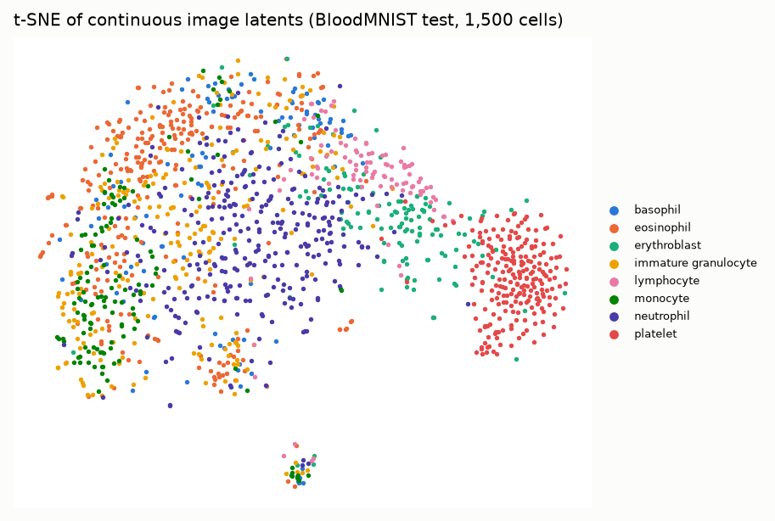
Results: do the latents keep meaning?
Week 2 · Oct 15, 2026
Reading the plot
• Each dot is one BloodMNIST test cell, coloured by its true cell type
• The encoder never saw the labels, but platelets and erythroblasts form their own groups
• So the latent space (which VQ then quantises) already holds class information
• Other white-cell types overlap: they look similar at 28×28
• A qualitative check only; the real test is the classification task in Week 5
Source: reports/figures/tsne_image_latents.png
7

Slide 8
End-of-Week-2 checkpoint
Week 2 · Oct 15, 2026
✓
Data readable
MedMNIST (3 subsets) and PhysioNet 2012 load, clean and split with fixed seeds; Cataract-101 frame cache built
✓
Compute enough
GPU re-run on Modal: about 10 min instead of about 17 h on the CPU; all downstream runs repeated on the same hardware
✓
Both downstream tasks run
MedMNIST classification and PhysioNet 2012 mortality train end to end on the token shards (11 runs finished, 3 seeds each)
Decision: on schedule, no reduction needed
• Keep full sample sizes and fixed splits; images, time series and both tasks stay in scope
• Fallback if we fall behind: smaller samples on the same fixed splits; advanced video encoding and point-cloud training move to 'extensions'
Source: run list: reports/tables/table_03.csv; timing: Modal GPU re-run vs the earlier CPU run
8

Slide 9
Issues and decisions
Week 2 · Oct 15, 2026
Codebook collapse
Low use on PneumoniaMNIST
Vanilla VQ-VAE used few codes. Decision: keep EMA + cosine lookup + dead-code restarts; keep vanilla as a control row.
Only 563 active codes (util 0.550). Grey X-rays are simple; one shared codebook is still used for all subsets.
VQ costs detail
Continuous ratio below 1
VQ has lower PSNR than continuous. This is the price of discrete tokens; whether it hurts the task is tested in Week 5.
Continuous ratio (fixed) is 0.750 on BloodMNIST: fp16 vectors take more bits than 8-bit pixels. It is a baseline, not a compressor.
9

Slide 10
Next week and questions
Week 2 · Oct 15, 2026
Plan for Week 3: time series
Questions for supervisor
• PhysioNet 2012, 48 h ICU stays, in-hospital mortality
• Handle missing values and irregular time (hourly grid + mask)
• Encode time with <DT> tokens + exact time side channel
• Compare continuous, VQ and event representations
• Report reconstruction error, sequence length, compression
• Is PSNR / SSIM / MAE + codebook use enough for the image part, or do you want another metric?
• Is the end-of-Week-2 checkpoint accepted (no scope reduction)?
• Is it OK to keep one shared codebook for all three MedMNIST subsets?
10

