Slide 1
UNDERGRADUATE THESIS · WEEKLY PROGRESS REPORT 3
Design of a Medical Multimodal-Specific Tokenizer and a Unified Data Protocol
Week 3: physiological time series on PhysioNet 2012
REDOANUZZAMAN
Sichuan University · October 22, 2026

Slide 2
Recap: Week 2 (images)
Week 3 · Oct 22, 2026
Week 1
Foundation and protocol ✓ done
Image results (BloodMNIST test)
Week 2
Image tokenization (MedMNIST) ✓ done
• PSNR: continuous 35.717 dB, VQ 28.149 dB
• VQ ratio (+overhead): 26.350×, 56 tokens per image
• Active codes: 1011 with remedies vs 74 for vanilla VQ-VAE
Week 3
Time series (PhysioNet 2012) ◀ now
Week 4
Adaptation and integration: text, Cataract-101, point clouds
Week 5
Downstream tasks and ablations
Week 6
Reproducibility and delivery
Week-2 checkpoint passed
This week: the second fully implemented modality, ICU time series.
• Data readable, compute enough (GPU re-run), both downstream tasks run
• No scope reduction needed
Source: reports/tables/table_00.csv
2

Slide 3
Work done: data, missing values, time
Week 3 · Oct 22, 2026
Data
Missing values
Time encoding
• PhysioNet 2012 set-a, open access (ODC-By 1.0)
• First 48 h of each ICU stay; 37 variables + 4 static values (age, gender, height, ICU type)
• Patient-level split, fixed seed; normalisation and bins fitted on training stays only
• Task: in-hospital mortality
• Most variables are measured only a few times a day
• Hourly grid + an 'observed' mask; empty cells are filled with 0 for the encoder
• Errors are scored on observed cells only, never on filled cells
• Training hides a random part of the observed cells (denoising), so codes cannot just copy cells
• <DT:k> tokens give a coarse time gap between events
• The exact time (minutes) is kept in a side channel on every token
• Moving raw data onto the hourly grid already costs MAE 0.073 (z); this is shared by all methods
Source: docs/datasets.md; gridding MAE from reports/tables/table_08.csv
3

Slide 4
Work done: three representations
Week 3 · Oct 22, 2026
A. Continuous
B. Vector quantisation
C. Event tokens
Window autoencoder over the hourly grid; each window gives fp16 latent vectors. Baseline only: not vocabulary tokens.
Same autoencoder; each latent → nearest of 512 codebook entries. Per window: <PATCH> + 4 codes.
Each measurement → <VAR:name> <VBIN:k> (16 quantile bins per variable). Variant 'changes only' writes a value only when its bin changes.
Same for all three
• The same discrete static block (age, gender, height, ICU type) starts every sequence
• Same splits, same scoring (MAE / RMSE in per-variable z-units on observed cells)
• Event tokens learn nothing except the bins, so they are the simplest and most readable option
4

Slide 5
Results: error, length, compression
Week 3 · Oct 22, 2026
Representation | positions mean | max | cont. vectors | MAE (z) | RMSE (z) | ratio (fixed) | ratio (+overhead)
A. continuous | 56.083 | 57 | 48 | 0.147 | 0.237 | 1.999 | 1.960
B. VQ | 68.083 | 69 | 0 | 0.333 | 0.471 | 40.214 | 28.833
C. event (every obs.) | 773.852 | 1352 | 0 | 0.079 | 0.249 | 3.841 | 3.751
C. event (changes only) | 539.369 | 876 | 0 | 0.079 | 0.249 | 5.511 | 5.300
Continuous rows: 48 positions carry fp16 vectors, NOT vocabulary tokens. ratio (+overhead) also counts span delimiters and decoding metadata.
Best reconstruction
Shortest and most compact
• Event tokens: MAE 0.079 (z), close to the grid error 0.073
• Both event variants decode to the same values on observed cells
• VQ: 68.083 positions, ratio (+overhead) 28.833×
• but the highest error: MAE 0.333 (z)
Source: reports/tables/table_01.csv
5

Slide 6
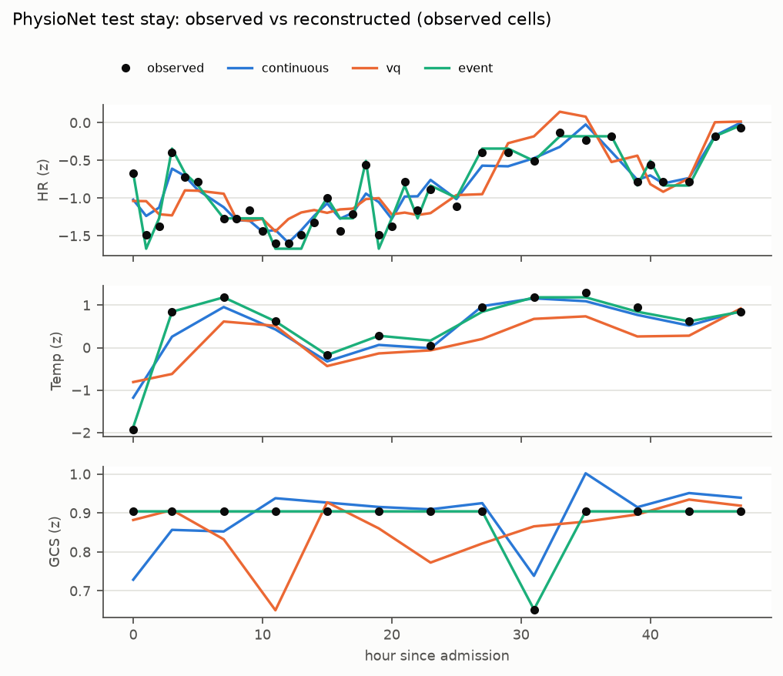
Results: one test stay, decoded three ways
Week 3 · Oct 22, 2026
Reading the plot
• Black dots = real measurements; lines = decoded values
• Event (green) passes through the dots: it stores each measurement as a bin
• Continuous (blue) follows the trend closely
• VQ (orange) is smoother and misses some peaks: 4 codes must describe a whole window
• GCS is almost constant here, so small wiggles look big on this scale
Source: reports/figures/recon_timeseries.png
6

Slide 7
Results: how to fill missing cells
Week 3 · Oct 22, 2026
VQ setting | MAE (z) | RMSE (z) | active codes | util | perplexity | dead %
zero fill + mask (main) | 0.333 | 0.471 | 512 | 1.000 | 492.799 | 0.000
last value carried forward (LOCF) | 0.612 | 0.825 | 510 | 0.996 | 262.370 | 0.391
vanilla VQ-VAE (no remedies) | 0.345 | 0.500 | 476 | 0.930 | 351.172 | 7.031
Decision: keep zero fill + mask
• LOCF almost doubles the error (MAE 0.612 vs 0.333), although the mask is given in both cases
• LOCF also uses the codebook less evenly (perplexity 262.370 vs 492.799): copied values seem to waste codes
• The codebook remedies also matter here: vanilla VQ-VAE leaves codes dead
• Other time settings (window length, sampling interval) are ablations in Week 5
Source: reports/tables/table_11.csv
7

Slide 8
Issues and decisions
Week 3 · Oct 22, 2026
Event sequences are long
VQ loses detail
Mean 773.852 positions, max 1352. Decision: add the 'changes only' variant (mean 539.369).
VQ has the highest MAE (0.333). It is the most compact; Week 5 checks whether the task still works.
Fair compression
Grid error is shared
Same raw-bit scale for all methods; fp16 for continuous values; delimiters and metadata counted in ratio (+overhead).
The hourly grid itself costs MAE 0.073 (z). It is reported separately so no method is blamed for it.
8

Slide 9
Next week and questions
Week 3 · Oct 22, 2026
Plan for Week 4: integration
Questions for supervisor
• Synthetic templated text (v2): round-trip and field-preservation tests
• Cataract-101 surgical video: VQ, continuous and phase-event tokens
• Point-cloud interface on synthetic surfaces
• Integration tests: all modalities in one sequence and one model
• Is zero fill + mask acceptable for missing values, or should I also try an interpolation baseline?
• Is the 48 h window with an hourly grid fine for the mortality task?
• For the thesis, should the main time-series method be event tokens (best error) or VQ (shortest)?
9

