Slide 1
UNDERGRADUATE THESIS · WEEKLY PROGRESS REPORT 4
Design of a Medical Multimodal-Specific Tokenizer and a Unified Data Protocol
Week 4: adaptation and integration (text, surgical video, point clouds)
REDOANUZZAMAN
Sichuan University · October 29, 2026

Slide 2
Recap: Week 3 (time series)
Week 4 · Oct 29, 2026
Week 1
Foundation and protocol ✓ done
Time-series results (test set)
Week 2
Image tokenization (MedMNIST) ✓ done
• Event tokens: lowest error, MAE 0.079 (z), but 773.852 positions
• 'Changes only' events: 539.369 positions, same error
• VQ: 68.083 positions, ratio (+overhead) 28.833×, MAE 0.333
• Missing values: zero fill + mask kept (LOCF was worse)
Week 3
Time series (PhysioNet 2012) ✓ done
Week 4
Adaptation and integration: text, Cataract-101, point clouds ◀ now
Week 5
Downstream tasks and ablations
Week 6
Reproducibility and delivery
Images and time series are now the two fully implemented modalities. This week adds the three 'adapted' modalities to the same protocol.
Source: reports/tables/table_01.csv
2

Slide 3
Scope of this week (as agreed)
Week 4 · Oct 29, 2026
Modality | Data | What is promised | What is NOT claimed
Clinical text | Synthetic templated notes (v2) | Lossless round-trip, field preservation, protocol compatibility | Clinical language understanding
Surgical video | Cataract-101 (10 phases) | VQ / continuous / segment tokens; phase events | Comparison with Cholec80 results
3D point cloud | Synthetic surfaces | Interface + tests: normalise → voxel groups → codes | A trained point-cloud model
Cataract-101: Schoeffmann et al., MMSys 2018. Licence CC BY-NC 4.0 (research use only).
• All three use the same vocabulary ranges, the same wire format and the same validator as images and time series
• Advanced video encoders and point-cloud training stay 'extensions', as agreed at the Week-2 checkpoint
3

Slide 4
Text: synthetic templated notes (v2)
Week 4 · Oct 29, 2026
Setting | exact round-trip | field preservation | tokens mean | ratio | ratio (+overhead)
BPE vocab 972, templates v2 | 1.000 | 1.000 | 51.467 | 3.418 | 3.158
SYNTHETIC text: accepted on round-trip, field preservation and protocol compatibility only. It never replaces the downstream tasks.
How the notes are made
What the numbers mean
• Rendered from structured fields: several wordings, units, missing values, negation, times
• Each note carries the tag synthetic-template:<kind>@v2
• No label leakage: ICU notes read only the first hour and never the outcome
• Byte-level BPE trained on the training split only
• exact round-trip = share of notes that decode to exactly the same text
• field preservation = share of values, units, times and negations that survive
• ratio (+overhead) also counts the span delimiters and metadata
Source: reports/tables/table_13.csv
4

Slide 5
Surgical video: Cataract-101
Week 4 · Oct 29, 2026
Representation | positions/min | PSNR dB | SSIM | ratio (fixed) | ratio (+overhead) | util
A. continuous (fp16 vectors) | 240.000 | 22.380 | 0.610 | 48.000 | 47.982 | –
B. VQ | 247.500 | 22.024 | 0.600 | 2647.091 | 2593.636 | 0.998
C. segment events (k-means states) | 9.873 | 18.557 | 0.467 | 73121.812 | 53482.877 | 1.000
Annotated phase events (ground truth) | 3.189 | – | – | 9.336 | 3.473 | –
Not comparable with Cholec80 results (other surgery, other 10-phase label set).
Ground-truth phase events = annotation encoding only (label → token → label), NOT phase recognition from video.
• Continuous positions carry fp16 vectors and are not vocabulary tokens
• Segment events are very short (a new token only when the scene changes), but reconstruct the frames worst
• Phase recognition from video tokens is a downstream task in Week 5
Cataract-101: Schoeffmann et al., MMSys 2018. Licence CC BY-NC 4.0 (research use only).
Source: reports/tables/table_02.csv
5

Slide 6
Point clouds: interface and tests
Week 4 · Oct 29, 2026
Voxel resolution | Chamfer (rel. to object size) | tokens mean | ratio | ratio (+overhead)
res4 | 0.032 | 32.200 | 763.230 | 155.446
res8 | 0.021 | 123.700 | 198.674 | 98.462
res16 | 0.016 | 425.850 | 57.710 | 44.461
Synthetic surfaces and non-learned features: this shows the interface works, not a trained point-cloud tokenizer.
Pipeline
Trade-off
• Normalise → group points into voxels → features → codebook ids
• depth_to_points ready for SCARED depth maps if access is granted
• Finer voxels: lower Chamfer error, but more tokens and less compression
• Same pattern as image patch size: detail costs sequence length
Source: reports/tables/table_13.csv
6

Slide 7
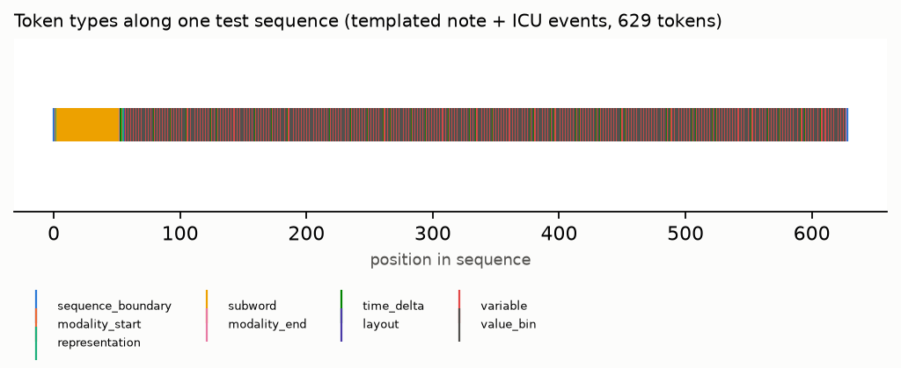
Integration: all modalities in one format
Week 4 · Oct 29, 2026
✓
Image pipeline
train → evaluate → encode shards → decode → downstream
✓
Time-series pipeline
all three representations; event codec exact on bins
✓
Video pipeline
VQ / continuous / segments; phase events round-trip exactly
One real test sequence: a synthetic note (sub-word tokens) followed by ICU event tokens.
✓
One model, three modalities
multi-task Transformer reads image, ICU and video tokens
How the tests work
• They run on small SYNTHETIC files laid out exactly like the real datasets, so they need no download
• Every sequence passes the validator; malformed input is rejected; JSONL / NPZ round-trips are lossless
Source: tests/test_pipeline_integration.py, reports/figures/token_sequence.png
7

Slide 8
Issues and decisions
Week 4 · Oct 29, 2026
No open clinical text
Cholec80 not accessible
MIMIC notes need credentialed access. Decision: synthetic, versioned templates; claims limited to round-trip and field preservation.
Archive needs a CAMMA request. Decision: Cataract-101, clearly marked as not comparable; cited; non-commercial licence respected.
Labels vs recognition
Point clouds stay small
Phase events from ground truth only show the protocol can store annotations. Recognition is measured from video tokens only.
Synthetic surfaces only; no training. Kept as an extension, as agreed at the checkpoint.
8

Slide 9
Next week and questions
Week 4 · Oct 29, 2026
Plan for Week 5: tasks and ablations
Questions for supervisor
• Image classification (AUROC, macro-F1) on the three MedMNIST subsets
• ICU mortality (AUROC, AUPRC) for every time-series representation
• One Transformer, fixed splits, same budget, 3 seeds
• Ablations: codebook size and time granularity
• Are the text acceptance criteria (round-trip, field preservation, compatibility) enough?
• Is it OK to present Cataract-101 phase recognition as an extra task, not a main result?
• Should the point-cloud interface stay in the thesis body or move to an appendix?
9

