Slide 1
UNDERGRADUATE THESIS · WEEKLY PROGRESS REPORT 6
Design of a Medical Multimodal-Specific Tokenizer and a Unified Data Protocol
Week 6: results summary, reproducibility and delivery
REDOANUZZAMAN
Sichuan University · November 12, 2026

Slide 2
Recap: Week 5 (tasks and ablations)
Week 6 · Nov 12, 2026
Week 1
Foundation and protocol ✓ done
Downstream results (test set)
Week 2
Image tokenization (MedMNIST) ✓ done
• BloodMNIST AUROC: continuous 0.983 ± 0.002, VQ 0.966 ± 0.001
• Mortality AUROC: continuous 0.783 ± 0.003, event 0.778 ± 0.006, VQ 0.727 ± 0.017
• Ablations: bigger codebooks reconstruct better; time granularity trades error for length
Week 3
Time series (PhysioNet 2012) ✓ done
Week 4
Adaptation and integration: text, Cataract-101, point clouds ✓ done
Week 5
Downstream tasks and ablations ✓ done
Week 6
Reproducibility and delivery ◀ now
This week: put everything together, make it reproducible, and deliver code, specification, report and demo.
Source: reports/tables/table_03.csv
2

Slide 3
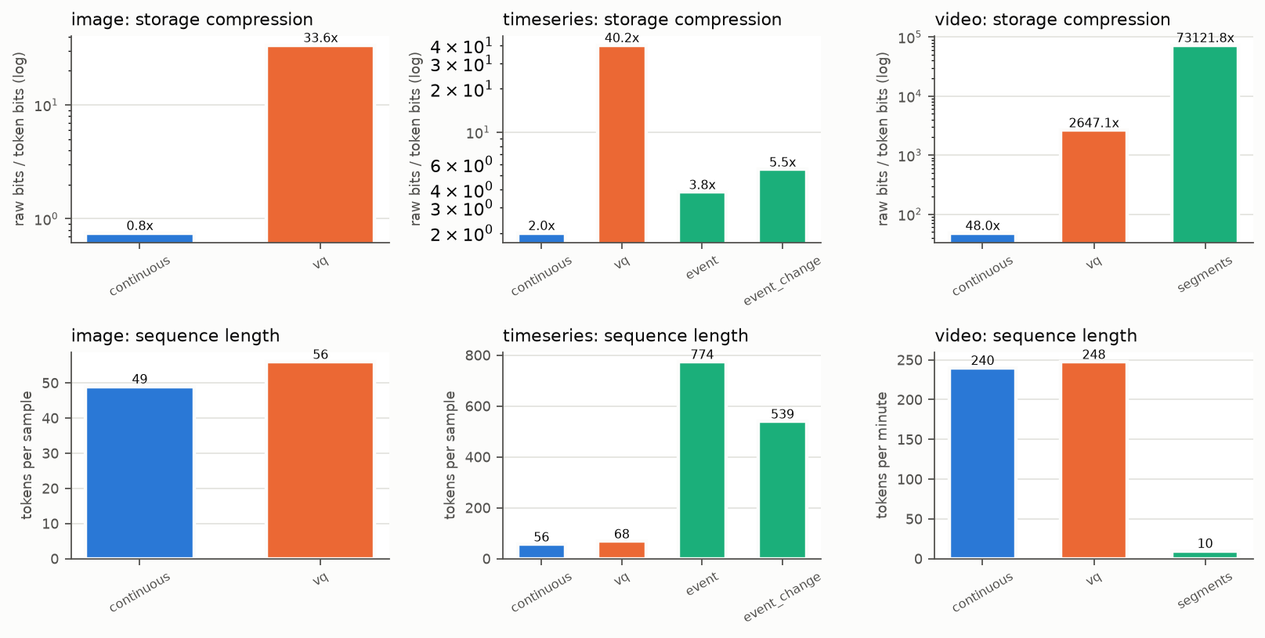
Summary: compression and length
Week 6 · Nov 12, 2026
Take-aways
• VQ gives the biggest storage saving for images and time series
• Event tokens are readable and exact on bins, but long
• Video segments are the shortest sequences
• Continuous saves little for images and ICU data: it is the baseline
Continuous positions carry fp16 vectors, NOT vocabulary tokens. Tables also report ratio (+overhead), which counts span delimiters and decoding metadata.
Source: reports/figures/compression_sequence_length.png (ratio (fixed)); reports/tables/table_00-02
3

Slide 4
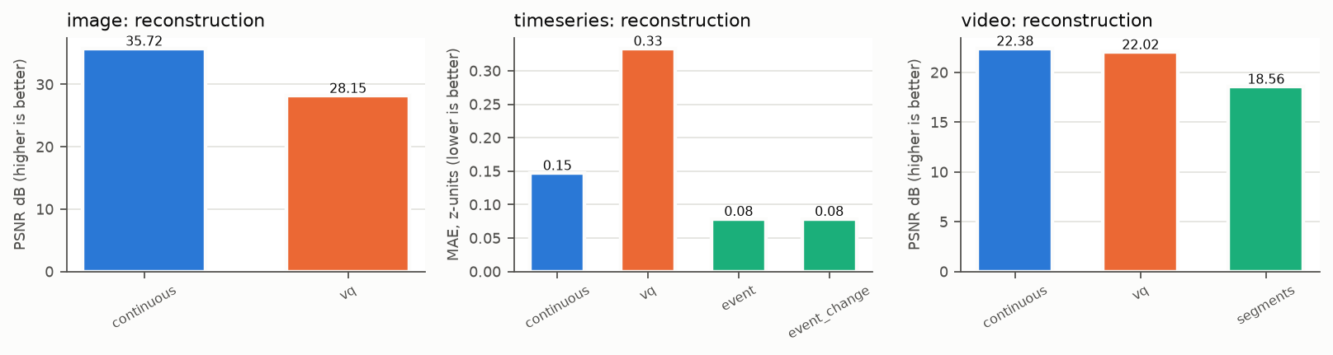
Summary: reconstruction, code use
Week 6 · Nov 12, 2026
VQ codebook | active codes | util
Image (BloodMNIST) | 1011 | 0.987
Time series | 512 | 1.000
Video (Cataract-101) | 511 | 0.998
Take-aways
• Continuous reconstructs best for images and video
• Event tokens reconstruct ICU data best
• With the three remedies almost every code is used: no collapse
Source: reports/figures/reconstruction_error.png; reports/tables/table_00.csv, table_01.csv, table_02.csv
4

Slide 5
Summary: the two main modalities
Week 6 · Nov 12, 2026
Modality | Method | positions | reconstruction | ratio (+overhead) | task metric 1 | task metric 2
Image (BloodMNIST) | continuous | 49 | PSNR 35.717 dB | 0.745 | AUROC 0.983 ± 0.002 | macro-F1 0.838 ± 0.015
 | VQ | 56 | PSNR 28.149 dB | 26.350 | AUROC 0.966 ± 0.001 | macro-F1 0.759 ± 0.007
ICU (PhysioNet 2012) | continuous | 56.083 | MAE 0.147 (z) | 1.960 | AUROC 0.783 ± 0.003 | AUPRC 0.428 ± 0.003
 | VQ | 68.083 | MAE 0.333 (z) | 28.833 | AUROC 0.727 ± 0.017 | AUPRC 0.324 ± 0.022
 | event | 773.852 | MAE 0.079 (z) | 3.751 | AUROC 0.778 ± 0.006 | AUPRC 0.425 ± 0.021
 | event (changes) | 539.369 | MAE 0.079 (z) | 5.300 | AUROC 0.763 ± 0.018 | AUPRC 0.366 ± 0.035
Continuous 'positions' are fp16 vectors, not vocabulary tokens. Images: positions per image; ICU: mean positions per stay.
Task metrics: test set, mean ± std over 3 seeds, same model and budget per task. Surgical video and text are reported separately (adapted modalities).
Source: reports/tables/table_00.csv, table_01.csv, table_03.csv
5

Slide 6
Reproducibility
Week 6 · Nov 12, 2026
One command: scripts/run_all.sh
1 prepare
2 tokenizers
3 interfaces
4 downstream
5 ablations
6 report
download open data, clean, fixed splits
train + evaluate every tokenizer
text and point-cloud checks
all tasks, 3 seeds
codebook, window, grid, remedies
RESULTS.md, tables, figures
What makes it repeatable
Numbers are never typed
• Fixed seeds and fixed splits; learned preprocessing fitted on training data only
• Each run stores its config, library versions, git commit, logs and metrics
• --skip-existing: safe to re-run after a crash
• Unit + integration tests on synthetic data, no download needed
• python -m medical_tokenizer.report writes every table and figure
• These slides read the same CSV files
• GPU re-run on Modal repeated all downstream runs on the same hardware
• Small differences can remain from multi-threaded CPU kernels
6

Slide 7
Deliverables
Week 6 · Nov 12, 2026
✓
Code
Python package medical_tokenizer: protocol, codecs, tokenizers, downstream model, CLI
✓
Specification
docs/token_protocol.md: id ranges, special tokens, wire format, positions, bit accounting
✓
Report
reports/RESULTS.md + tables + figures, generated from the experiment outputs
✓
Demo
browser demo: data → tokens → data for each modality, plus a mixed sequence as JSONL
✓
Notebook
notebooks/explore_tokens.ipynb: explore real token sequences
✓
Documentation
architecture, datasets (licences, splits), experiment protocol and limits
7

Slide 8
Limitations to state in the thesis
Week 6 · Nov 12, 2026
Continuous is a baseline
Cataract-101 ≠ Cholec80
Its fp16 vectors are never counted as vocabulary tokens; ratios include fp16 precision, index bits, delimiters and metadata.
Different surgery and labels: results are not comparable. Ground-truth phase events = annotation encoding only.
Synthetic text
Small inputs, small model
Templated notes: accepted on round-trip, field preservation and protocol compatibility only; they never replace the downstream tasks.
28×28 images, 64×64 frames, a 2-layer Transformer: chosen to compare many settings fairly, not to beat the state of the art.
Cataract-101: Schoeffmann et al., MMSys 2018. Licence CC BY-NC 4.0 (research use only). Point clouds: synthetic surfaces only.
8

Slide 9
Issues and decisions
Week 6 · Nov 12, 2026
No single winner
Scope kept
VQ: most compact (images, ICU). Continuous: best task scores. Events: best ICU reconstruction. Decision: the thesis presents trade-offs, not one winner.
Images + time series fully done with two tasks; video, text and point clouds adapted, as agreed at the Week-2 checkpoint.
Extensions
Licences
Better video encoders, point-cloud training, real paired clinical text (needs authorised data), Cholec80 if access is granted.
Only open data in the repo; Cataract-101 non-commercial; no patient-level data committed.
9

Slide 10
Next steps and questions
Week 6 · Nov 12, 2026
After Week 6: thesis writing
Questions for supervisor
• Write the thesis chapters from RESULTS.md and the specification
• Use these weekly decks as the outline for the defence
• Freeze the code at a tagged commit for the examiners
• Fix anything the supervisor asks for in this review
• Is the 'trade-offs, no single winner' conclusion the right framing?
• Is the set of deliverables complete for submission?
• Which results should be in the main text, and which in the appendix?
• When can I send you the first full thesis draft?
10

