Slide 1
UNDERGRADUATE THESIS · WEEKLY PROGRESS REPORT 5
Design of a Medical Multimodal-Specific Tokenizer and a Unified Data Protocol
Week 5: downstream tasks and ablations
REDOANUZZAMAN
Sichuan University · November 5, 2026

Slide 2
Recap: Week 4 (integration)
Week 5 · Nov 5, 2026
Week 1
Foundation and protocol ✓ done
Done in Week 4
Week 2
Image tokenization (MedMNIST) ✓ done
• Synthetic text v2: exact round-trip 1.000, field preservation 1.000
• Cataract-101 video VQ: PSNR 22.024 dB, util 0.998
• Point-cloud interface tested on synthetic surfaces
• Integration tests: one model reads image, ICU and video tokens
Week 3
Time series (PhysioNet 2012) ✓ done
Week 4
Adaptation and integration: text, Cataract-101, point clouds ✓ done
Week 5
Downstream tasks and ablations ◀ now
Week 6
Reproducibility and delivery
Text is synthetic; Cataract-101 is not comparable with Cholec80.
Source: reports/tables/table_02.csv, table_13.csv
2

Slide 3
Work done: one model, fixed budget
Week 5 · Nov 5, 2026
Same model for every run
Task | Data | Headline metrics
Image classification | Blood / Pneumonia / Derma MNIST | AUROC, macro-F1
ICU mortality | PhysioNet 2012 | AUROC, AUPRC
Surgical phase (extra) | Cataract-101 | macro-F1
Multi-task (extra) | all three, one model | per task
• UnifiedTokenTransformer, trained from scratch on the token shards
• It sees only protocol fields, never raw data
• Same size and training budget for every representation of a task
• Early stopping on validation; best checkpoint tested once
• 3 seeds; numbers are mean ± std
Why these metrics
• AUROC: ranking quality, does not depend on a threshold
• macro-F1 (images) and AUPRC (mortality) show how the rare classes do; mortality is an imbalanced task
3

Slide 4
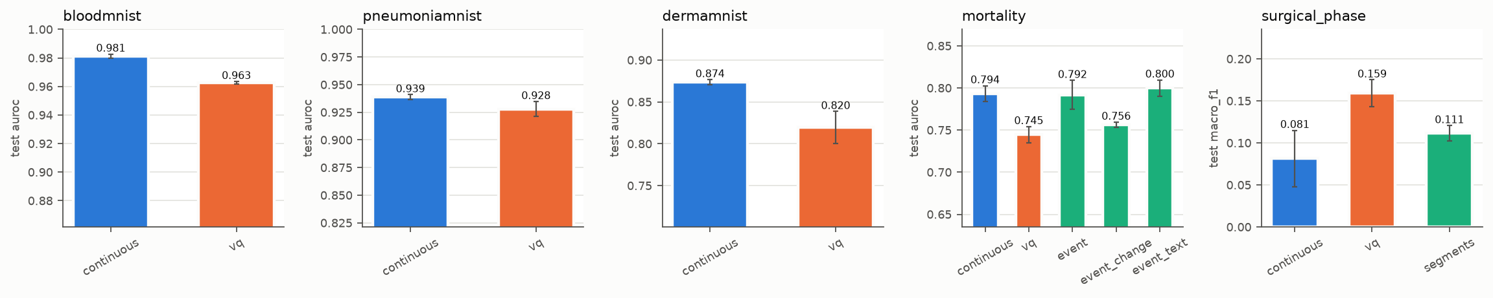
Results: all downstream tasks
Week 5 · Nov 5, 2026
Test AUROC (surgical phase: macro-F1), mean ± std over 3 seeds. Colours: blue continuous, orange VQ, green event / segments.
Images
ICU mortality
• Continuous is best on all three subsets
• VQ is a little lower, but still clearly learns the task
• Event tokens reach about the same AUROC as continuous, with real discrete tokens
• VQ is the weakest on mortality
Source: reports/figures/downstream.png, reports/tables/table_03.csv
4

Slide 5
Results: image classification
Week 5 · Nov 5, 2026
Subset | Method | seq len | AUROC | macro-F1 | accuracy
BloodMNIST | continuous | 54 | 0.981 ± 0.001 | 0.820 ± 0.008 | 0.840 ± 0.008
 | VQ | 61 | 0.963 ± 0.001 | 0.749 ± 0.001 | 0.779 ± 0.001
PneumoniaMNIST | continuous | 54 | 0.939 ± 0.002 | 0.868 ± 0.003 | 0.881 ± 0.000
 | VQ | 61 | 0.928 ± 0.007 | 0.807 ± 0.017 | 0.832 ± 0.011
DermaMNIST | continuous | 54 | 0.874 ± 0.003 | 0.372 ± 0.003 | 0.546 ± 0.005
 | VQ | 61 | 0.820 ± 0.019 | 0.295 ± 0.019 | 0.529 ± 0.028
Reading
• The gap between VQ and continuous is small in AUROC and larger in macro-F1
• DermaMNIST macro-F1 is low for both: some lesion classes are very rare
Source: reports/tables/table_03.csv
5

Slide 6
Results: ICU mortality and extra tasks
Week 5 · Nov 5, 2026
Representation | seq len | AUROC | AUPRC
A. continuous | 61.026 | 0.794 ± 0.009 | 0.437 ± 0.008
B. VQ | 73.026 | 0.745 ± 0.010 | 0.329 ± 0.036
C. event (every obs.) | 775.012 | 0.792 ± 0.017 | 0.455 ± 0.021
C. event (changes only) | 542.872 | 0.756 ± 0.003 | 0.346 ± 0.016
C. event + synthetic note | 830.342 | 0.800 ± 0.010 | 0.440 ± 0.014
Extra task | Method | macro-F1
Surgical phase | continuous | 0.081 ± 0.034
 | VQ | 0.159 ± 0.016
 | segments | 0.111 ± 0.009
Multi-task (one VQ model) | metric
bloodmnist | auroc 0.958 ± 0.005
mortality | auroc 0.752 ± 0.019
surgical_phase | macro_f1 0.118 ± 0.026
The note is SYNTHETIC (admission fields only, no outcome): a layout test, not a clinical text result.
• Event tokens (every observation) come close to continuous AUROC but need much longer sequences
• One multi-task model reaches close to the single-task VQ scores
Surgical phase: Cataract-101, not comparable with Cholec80. Scores are low; it stays an extra task.
Source: reports/tables/table_03.csv
6

Slide 7
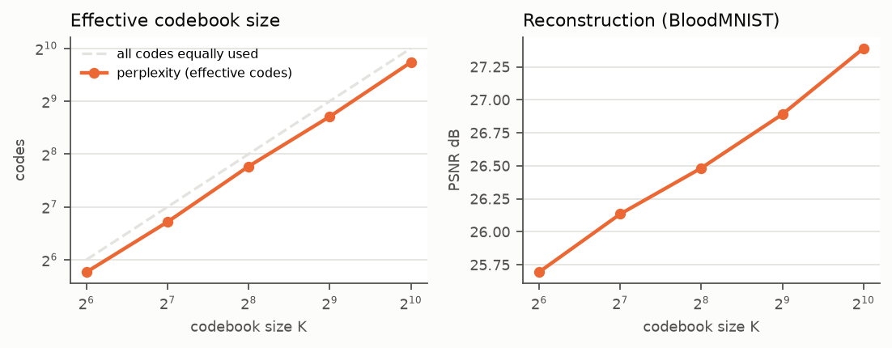
Ablation: codebook size
Week 5 · Nov 5, 2026
Image K | PSNR (blood) | perplexity | ratio (fixed)
64 | 25.694 | 54.444 | 55.792
128 | 26.134 | 105.125 | 47.923
256 | 26.483 | 217.927 | 41.970
512 | 26.890 | 418.472 | 37.322
1024 | 27.390 | 852.622 | 33.595
Time-series run | MAE (z) | active codes | util
abl_ts_k64 | 0.374 | 64 | 1.000
abl_ts_k128 | 0.355 | 128 | 1.000
timeseries_vq | 0.333 | 512 | 1.000
abl_ts_k1024 | 0.321 | 1024 | 1.000
Reading
• Bigger codebook: better reconstruction, every code still used
• But fewer bits saved per token (lower ratio)
• Time series: error also falls as K grows
• Image runs here use a short 5-epoch budget
Source: reports/tables/table_04.csv, table_08.csv, reports/figures/ablation_codebook_size.png
7

Slide 8
Ablation: time granularity
Week 5 · Nov 5, 2026
Window | tokens mean | MAE (z) | RMSE (z)
2 h windows | 128.083 | 0.275 | 0.389
4 h windows (main) | 68.083 | 0.333 | 0.471
8 h windows | 38.083 | 0.387 | 0.555
8 h windows, stride 4 h | 63.083 | 0.343 | 0.496
Sampling interval | MAE (z) | gridding MAE (z)
30 min grid | 0.348 | 0.041
60 min grid (main) | 0.333 | 0.073
120 min grid | 0.299 | 0.179
Window length
Sampling interval
• Shorter windows: lower error, but more tokens
• Overlapping 8 h windows recover part of the loss
• 4 h kept as the balance point
• A coarse grid looks easier for the tokenizer (lower MAE) ...
• ... but the grid itself loses more (higher gridding MAE)
• So both errors must be reported together; 60 min kept
Source: reports/tables/table_09.csv, table_10.csv
8

Slide 9
Issues and decisions
Week 5 · Nov 5, 2026
VQ below continuous
Event tokens are long
On every image task and on mortality. Discrete tokens cost some accuracy; reported honestly as the price of a shared vocabulary.
About the same AUROC as continuous on mortality, but much longer sequences, so attention cost is higher. Both are reported.
Surgical phase is weak
Fair budgets
Low macro-F1 on Cataract-101 with 64 px frames. Kept as an extra task, not a main result.
Same model, fixed splits, same epochs and early stopping, 3 seeds for every run.
9

Slide 10
Next week and questions
Week 5 · Nov 5, 2026
Plan for Week 6: delivery
Questions for supervisor
• Summarise compression, reconstruction, utilisation and task metrics
• Check that one script reproduces every table and figure
• Finish code, protocol specification, report, demo and notebook
• Start the thesis draft from these results
• Is the accuracy gap of VQ vs continuous acceptable as a finding, or should I try to close it?
• Is the ablation set (codebook size, time granularity) enough for the thesis?
• Should event tokens be the recommended representation for ICU data?
10

