Slide 1








CREDIT CARD TRANSACTION ANALYSIS
Presented by: Amrita Samuel

Slide 2


INTRODUCTION
THIS CREDIT CARD TRANSACTIONS ANALYSIS PROJECT AIMS TO EXPLORE AND ANALYZE TRANSACTION PATTERNS USING SQL. THE DATASET CONTAINS DETAILED RECORDS OF CREDIT CARD TRANSACTIONS, INCLUDING ATTRIBUTES SUCH AS TRANSACTION AMOUNT, CITY, EXPENSE TYPE, GENDER, AND CARD TYPE. THE PROJECT COVERS KEY SQL CONCEPTS, FROM BASIC AGGREGATIONS TO ADVANCED WINDOW FUNCTIONS, TO EXTRACT MEANINGFUL INSIGHTS—SUCH AS IDENTIFYING SPENDING TRENDS, RANKING TRANSACTIONS, DETECTING DUPLICATES, AND CALCULATING CUMULATIVE SUMS. BY LEVERAGING SQL QUERIES, THIS PROJECT PROVIDES A STRUCTURED APPROACH TO UNDERSTANDING CONSUMER SPENDING BEHAVIOR, AIDING FINANCIAL ANALYSIS AND DECISION-MAKING.

Slide 3


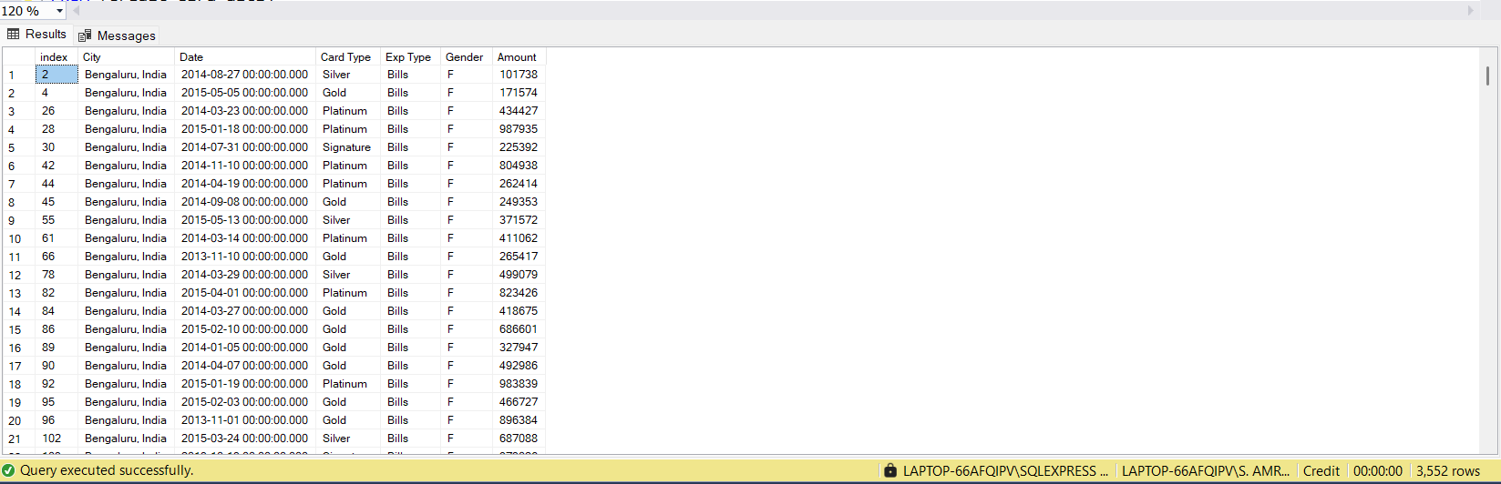
EASY LEVEL (BASIC QUERIES & AGGREGATIONS)
Retrieve all transactions that occurred in Bengaluru

Slide 4
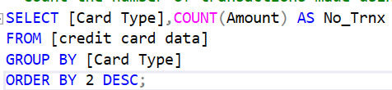
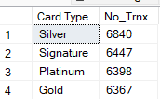
2.Count the number of transactions made using each Card Type.

Slide 5
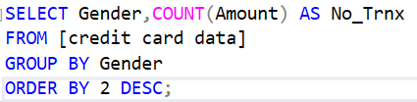

3.FIND THE TOTAL TRANSACTION AMOUNT FOR EACH GENDER.

Slide 6

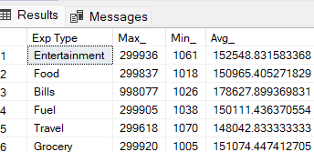
4.GET THE MAXIMUM, MINIMUM, AND AVERAGE AMOUNT SPENT FOR EACH EXP TYPE.

Slide 7

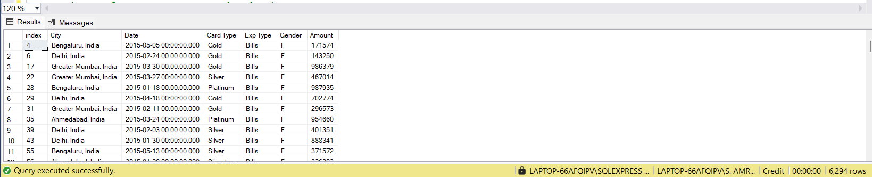
5.RETRIEVE TRANSACTIONS THAT OCCURRED AFTER JANUARY 1, 2015.

Slide 8
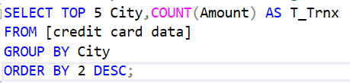
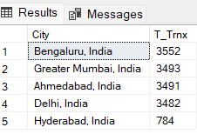
Medium Level (Joins, Grouping, and Subqueries)
Find the top 5 cities with the highest total transaction amounts.

Slide 9

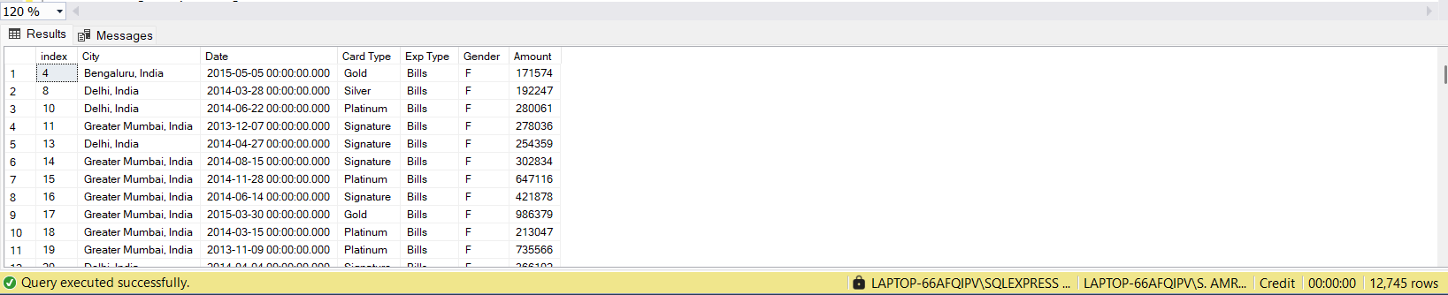
2.RETRIEVE THE DETAILS OF TRANSACTIONS WHERE THE AMOUNT IS ABOVE THE AVERAGE TRANSACTION AMOUNT.

Slide 10
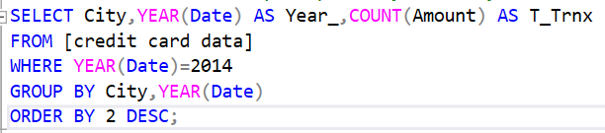
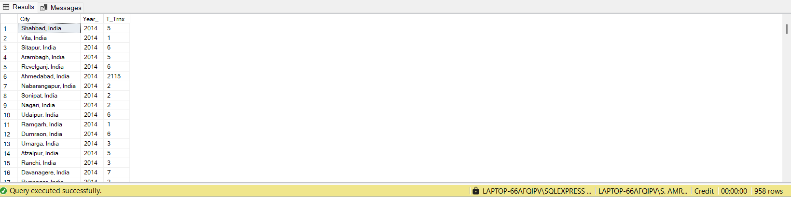
4.GET THE TOTAL AMOUNT SPENT PER CITY IN THE YEAR 2014.

Slide 11
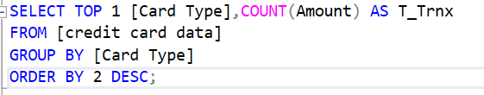

5.FIND THE CARD TYPE WITH THE HIGHEST NUMBER OF TRANSACTIONS.

Slide 12
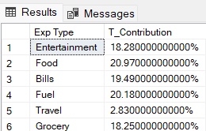
6.GET THE PERCENTAGE CONTRIBUTION OF EACH EXP TYPE IN THE TOTAL TRANSACTIONS.

Slide 13
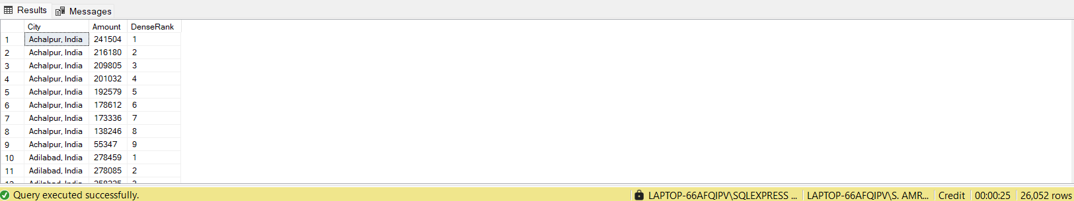
HARD LEVEL (ADVANCED QUERIES, WINDOW FUNCTIONS, CTE’S)
1.Rank transactions based on Amount within each City using a window function.

Slide 14
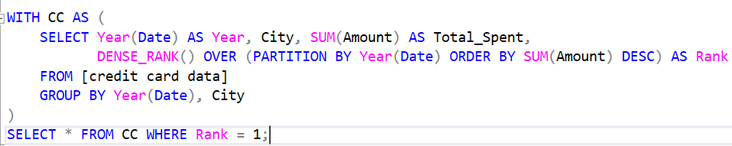

2.FIND THE CITY WHERE THE MAXIMUM AMOUNT WAS SPENT IN EACH YEAR.

Slide 15
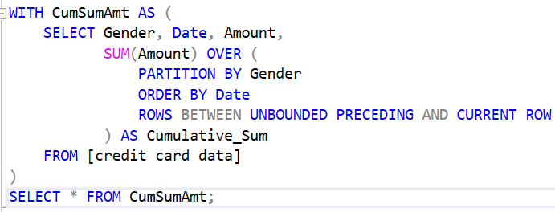
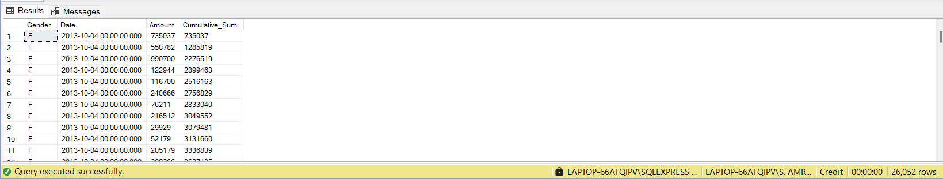
3.RETRIEVE THE CUMULATIVE SUM OF AMOUNT SPENT BY EACH GENDER OVER TIME.

Slide 16
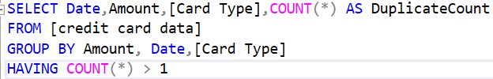
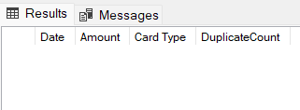
4.IDENTIFY DUPLICATE TRANSACTIONS BASED ON DATE, CARD TYPE, AND AMOUNT.

Slide 17
4.IDENTIFY DUPLICATE TRANSACTIONS BASED ON DATE, CARD TYPE, AND AMOUNT.

Slide 18
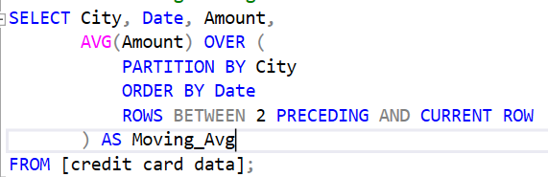
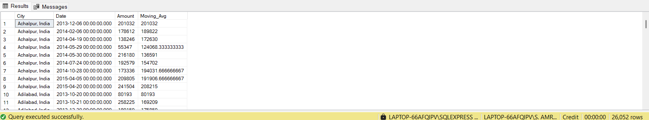
5.FIND THE MOVING AVERAGE OF TRANSACTION AMOUNTS FOR EACH CITY OVER A 3-MONTH PERIOD.

Slide 19
THANK YOU

