Slide 1

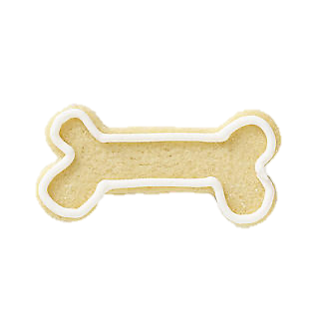



6
1
6
TAP
Notes:
https://www.google.com/search?q=puppy+superhero+flying&hl=en&sxsrf=ALeKk00A2TO9OLWxq4Ng7fRFdzAU2sgysw:1606672644325&source=lnms&tbm=isch&sa=X&ved=2ahUKEwjkxfCBqqjtAhWDoVwKHZDfDxYQ_AUoAXoECAQQAw&biw=1377&bih=605&dpr=2#imgrc=sa-7uYiciRsKkM

Slide 2
6
3
1
Notes:
https://www.google.com/search?q=puppy+superhero+flying&hl=en&sxsrf=ALeKk00A2TO9OLWxq4Ng7fRFdzAU2sgysw:1606672644325&source=lnms&tbm=isch&sa=X&ved=2ahUKEwjkxfCBqqjtAhWDoVwKHZDfDxYQ_AUoAXoECAQQAw&biw=1377&bih=605&dpr=2#imgrc=sa-7uYiciRsKkM

Slide 3



