Slide 1
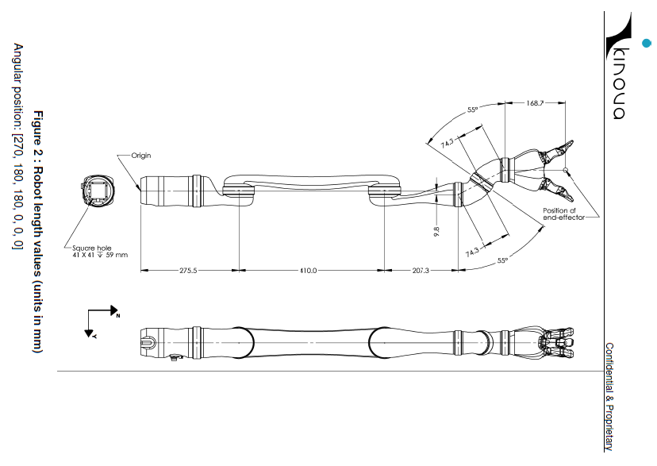
Jaco Arm: Draft
taken from DH Parameters - Kinova - 1.1.6.pdf

Slide 2
Jaco Arm: Mechanical Parameters
taken from DH Parameters - Kinova - 1.1.6.pdf

Slide 3
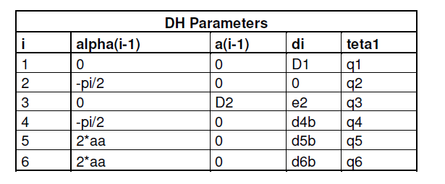
Jaco Arm: Modified DH Parameters
taken from DH Parameters - Kinova - 1.1.6.pdf

Slide 4
Jaco Arm: Frame by Modified DH Method
aa = 55[deg]
2aa = 110[deg]
y3
x3
z3
y2
x2
z2
z1
x1
x4
y4
y6
x6
y1
x5
z4
y5
z6
z5
z0
x0
y0
In hand frame of 6, z6 is a wrist axis
x6 is an axis from grasping point to thumb (first finger)
Camera position
can be (-0.05, 0.00, -0.10) in frame-6

Slide 5
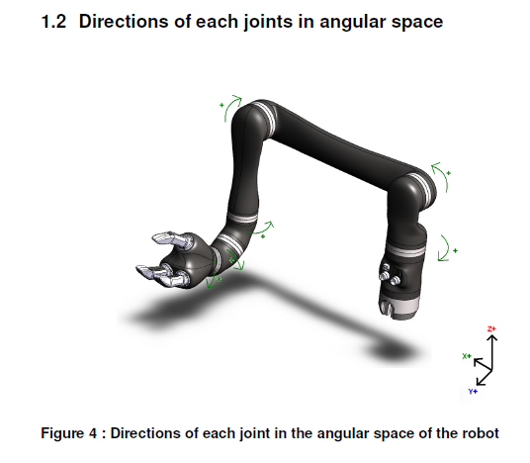
Jaco Arm: Angle orientation
taken from DH Parameters - Kinova - 1.1.6.pdf

