Slide 1
Frame Transformation（座標変換）
Translation transformation
（並進変換）
Rotational transformation
（回転変換）

Slide 2
Homogeneous Transformation Matrix （同次変換行列）
Translation and rotational transformation in a single step
（並進と回転変換を１ステップで）

Slide 3
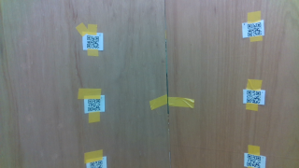
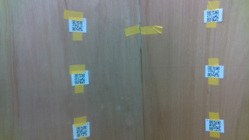
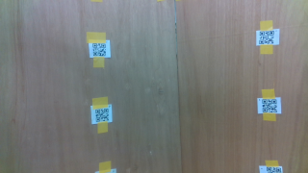
Data Set C: Middle position
Camera is place to cover two QR markers on each of the walls
Camera positions
Height: 0.70, 0.95, 1.30 [m]
Take several RGB-D shots at each of camera positions
E
E
D
D
C
C
B
B
A
A
(E, D, C) img1583215775.png
(D, C, B) img1583215821.png
(C, B, A) img1583215857.png
d_m = 1.15[m]
d_l = 1.00[m]
d_r = 1.00[m]

Slide 4
Data Set C: Middle position
Height: 0.70, 0.95, 1.30 [m]
(E, D, C) img1583215775.png
(D, C, B) img1583215821.png
(C, B, A) img1583215857.png

Slide 6
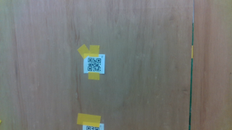
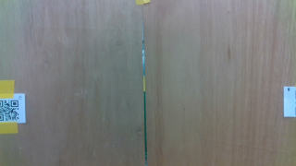
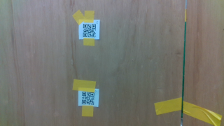
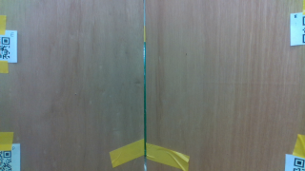
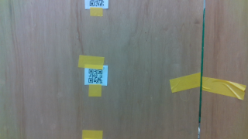
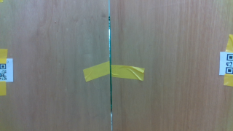
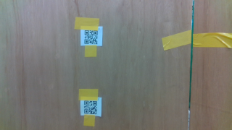
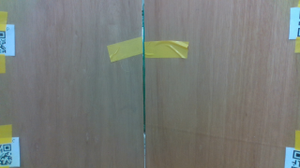
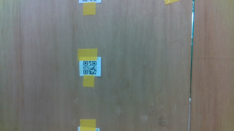
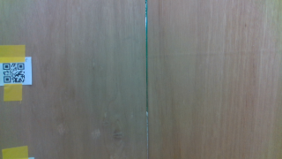
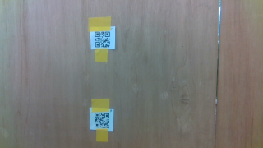
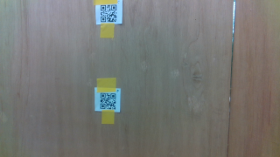
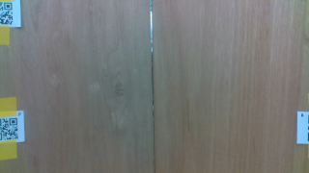
Left
(E) img1583215155.png
(E, D) img1583215200.png
(D) img1583215245.png
(D, C) img1583215338.png
(C) img1583215369.png
(C, B) img1583215403.png
(C, B) img1583215424.png
Middle
(B, C) img1583215494.png
(B, C) img1583215519.png
(D, C, D, C) img1583215556.png
(D, D) img1583215590.png
(E, D, E, D) img1583215627.png
(E, E) img1583215658.png
Right
(E, D, C) img1583215775.png
(D, C, B) img1583215821.png
(C, B, A) img1583215857.png

