Slide 1
BrowserStack
UNDER GUIDANCE OF MRS.VAISHALI SONANIS MAM
By Ravada Eswari Lakshmi Priyanka

Slide 2
INTRODUCTION
BrowserStack: A cloud-based testing platform for web applications, offering cross-browser, cross-device, and automated testing capabilities
Ensures compatibility, responsiveness, and seamless user experience through automated and manual testing.

Slide 3
RESPONSIBILITIES
ANALYZE EACH MODULE AND SUB-MODULE
CREATE TEST PLAN ON EACH MODULE
WRITING AND EVALUATING TEST CASES
PERFORMI BOTH MANUAL AND AUTOMATION TESTING
CREATE DEFECT REPORT

Slide 4
OVERVIEW
WHAT IS BrowserStack?
BrowserStack is a cloud-based testing platform that provides a comprehensive infrastructure for testing web applications across various browsers, operating systems, and devices.
It enables developers and testers to perform : Cross-browser testing, Cross-platform testing etc.
Key Features : Cloud-based infrastructure
2. Automated testing
3. Manual testing

Slide 5
MODULES
MODULE 1: LOGIN
Checked all the functionalities of username and password in the sign in page for login
MODULE 2: ADD AND DEL FROM CART
Checked all the functionality of add to cart and delete from cart button, by adding and deleting an item to the cart
MODULE 3:SEARCH
Checked all the functionalities of search button by searching multiple items
MODULE 4: BRAND
Checked all the functionalities of vendors button by selecting different company phones
MODULE 5: FAVORITES
Checked the functionality of favorites button by adding items to favorite

Slide 6
MODULE 6: CHECKOUT AND ADDRESS
Checked all the functionalities of checkout by buying an item from the cart.
MODULE 7: OFFERS
Checked all the functionality of offers button.
MODULE 8: SUBSCRIPTION
Checked all the functionalities including mail id fields and save button to get notify..
MODULE 9: ORDERS
Checked all the functionalities of orders like previous order history.
MODULE 10: PRIVACY POLICY
Checked all the functionalities of privacy policy button .
MODULE 11: LOGOUT
Checked the functionality of logout button

Slide 7
DEFECTS
DEFECT 1 : Search functionality is not working
DEFECT 2 : Product images are not clickable
DEFECT 3:Privacy Policy Read More is not navigating to policy page
DEFECT 4:Subscribe mail is accepting invalid email.

Slide 8
DEFECT IDENTIFIER:- B_001
Defect identifier :- B_001
Defect summary :- Expected result : in "Search", Product list shows as per the input but it is navigating to home page .i.e. search functionality fails
Test Id :- TC_001,TC_002,TC_003,TC_004,TC_005,TC_006
Test case name :- TC_ Search_Valid, Search_Invalid, Bstack_Search_PartialMatch, TC_valid_multiple_input_search
Ø Module name :- Search
Ø Reproducible :- when we input a particular product in search field ,Product list shows related products
Ø Severity :- High
Ø Priority :- High
Ø Raised by :- Eswari R.L.P
Ø Assigned to :- developer Team lead
Ø Date of assignment :-
Ø Status :- pending
Ø Fixed by :- developer
Ø Date of fixing :-

Slide 9
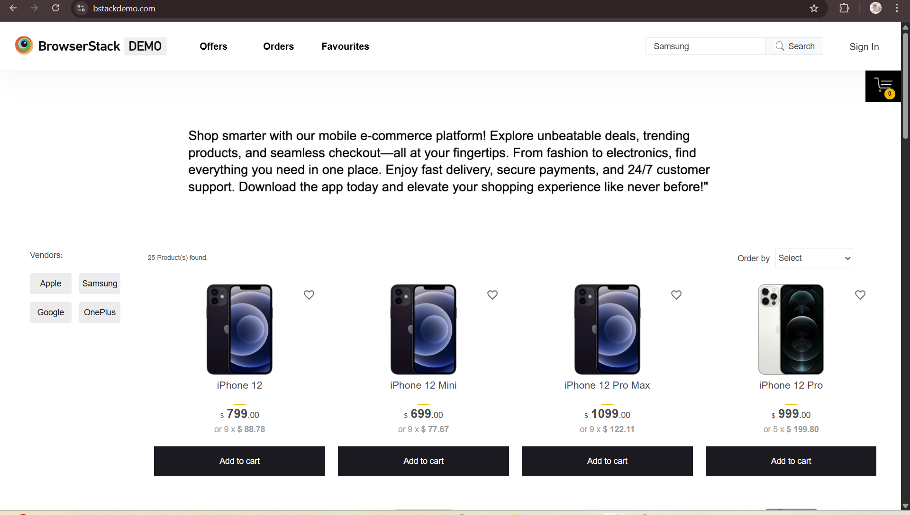
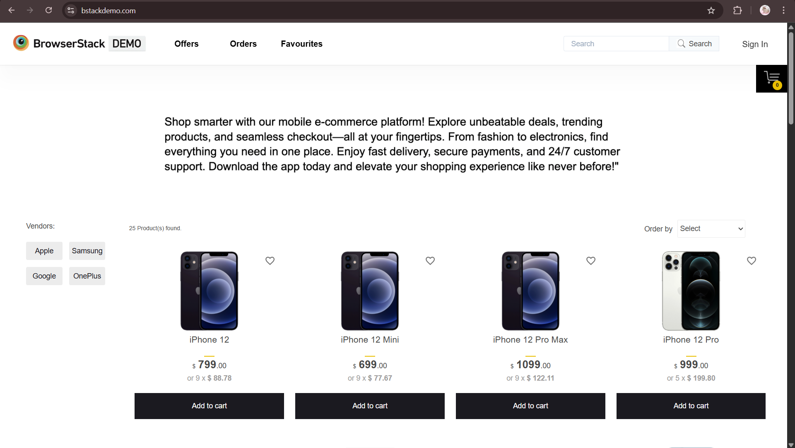

Slide 10
DEFECT IDENTIFIER:- B_002
Defect identifier :- B_002
Defect summary :- Expected result: "Privacy Policy Read More" it should navigate to the privacy policy page but it is navigating to Homepage
Ø Test Id :- TC_001,TC_002
Test case name :- TC_ReadMoreVisible,TC_ReadMoreRedirect
Module name :- Privacy Policy Read More
Ø Reproducible :-
Ø Severity :- high
Ø Priority :- high
Ø Raised by :- Eswari R.L.P
Ø Assigned to :- developer Team lead
Date of assignment :-
Ø Status :- pending
Ø Fixed by :- developer
Ø Date of fixing :-

Slide 11
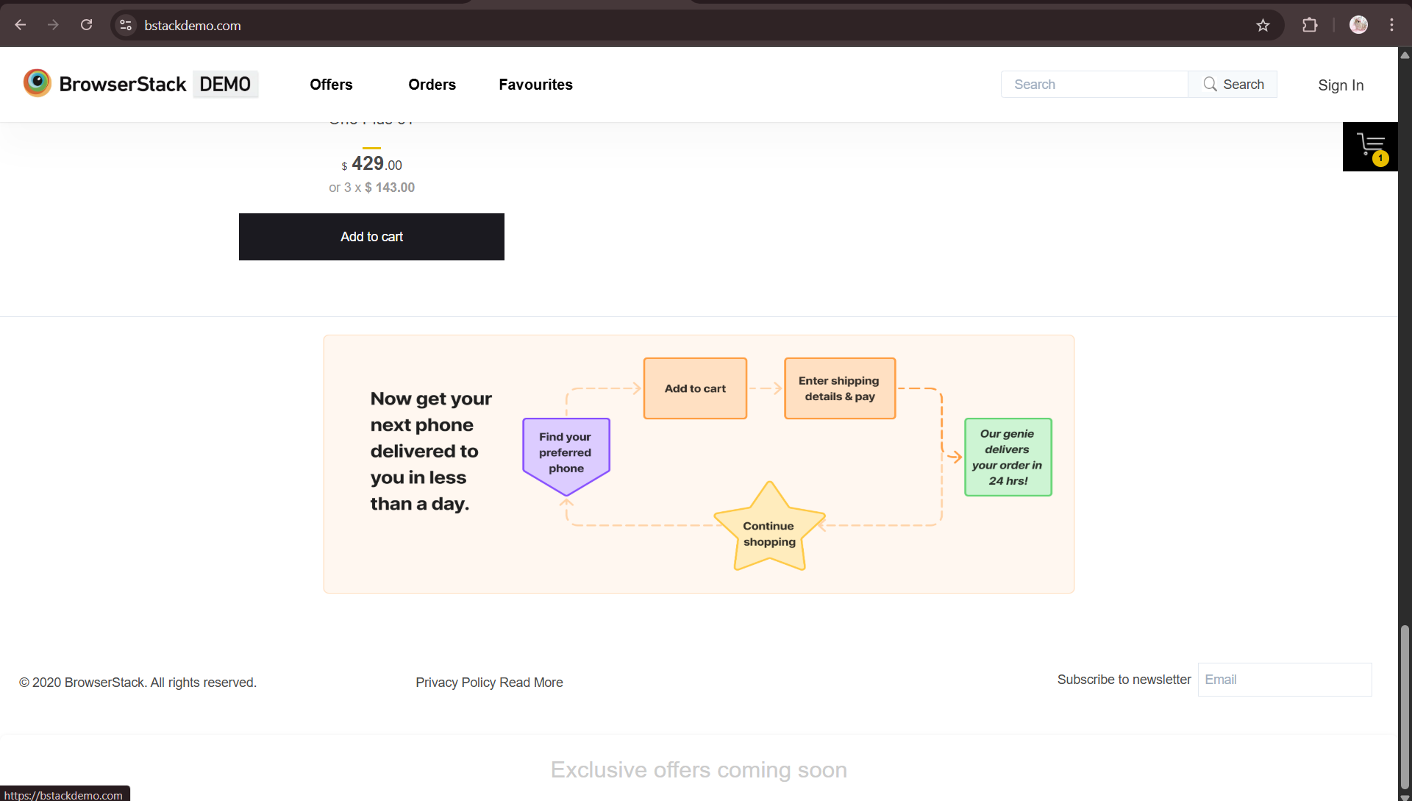
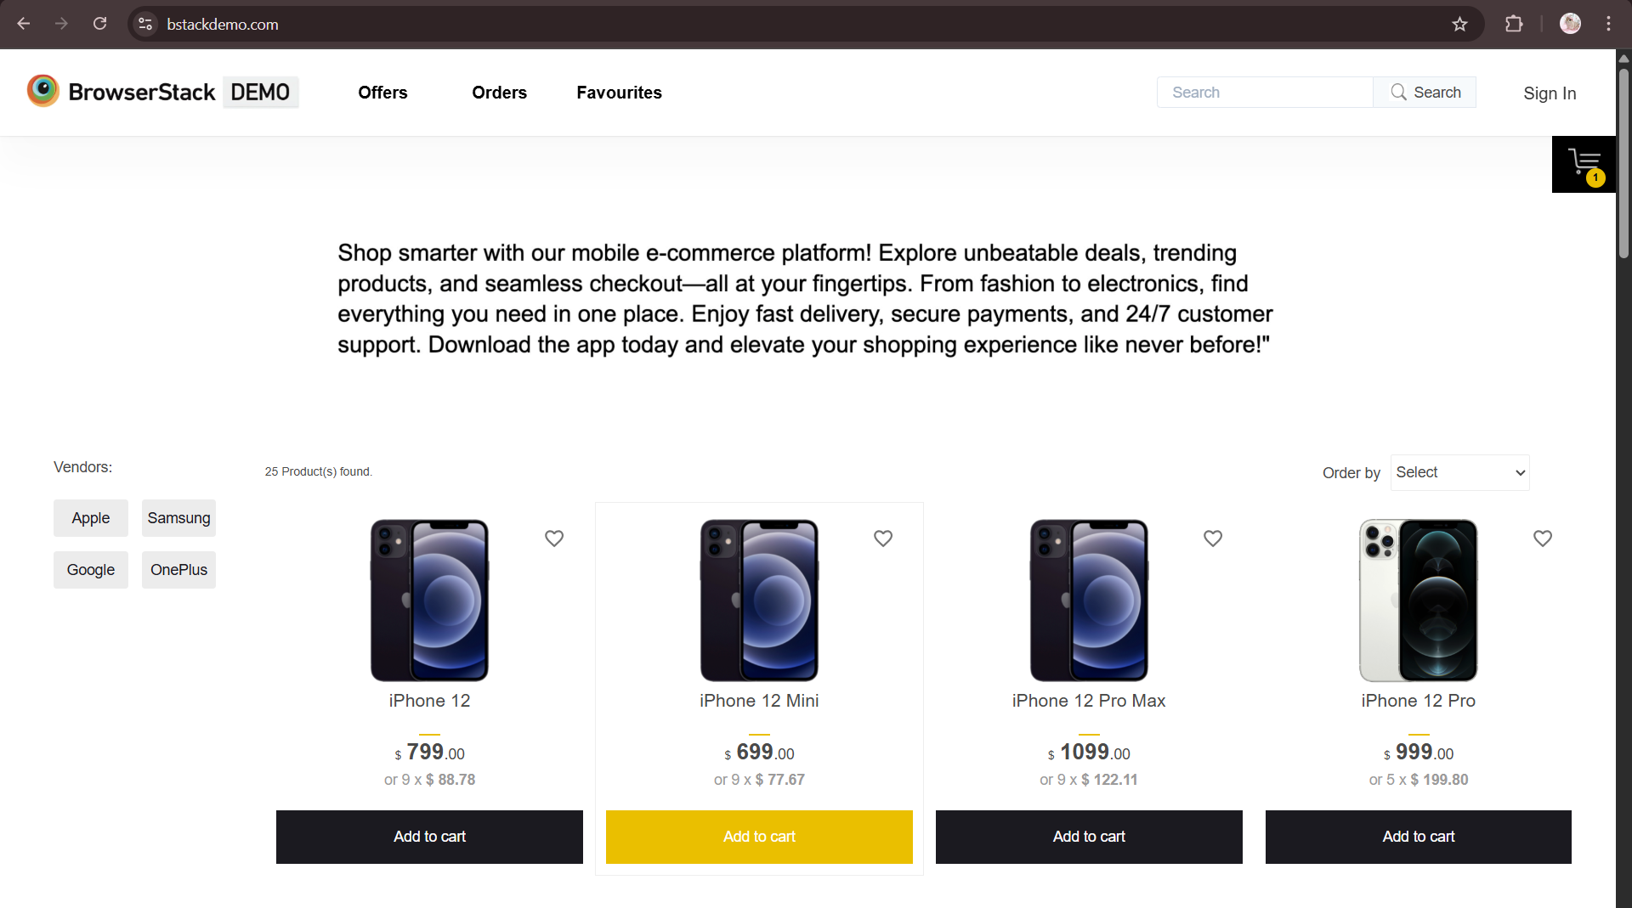

Slide 12
DEFECT IDENTIFIER:- B_003
Defect identifier :- B_003
Defect summary :- Expected result: when we click on product image, it should redirect to product details but it is not clickable
Ø Test Id :- TC_001
Test case name :- TC_ReadMoreVisible,TC_ReadMoreRedirect
Module name :- TC_addtocart
Ø Reproducible :- when we click on product image, it should redirect to product details but it is not clickable
Ø Severity :- medium
Ø Priority :- medium
Ø Raised by :- Eswari R.L.P
Ø Assigned to :- developer Team lead
Date of assignment :-
Ø Status :- pending
Ø Fixed by :- developer
Ø Date of fixing :-

Slide 14
DEFECT IDENTIFIER:- B_004
Defect identifier :- B_004
Defect summary :- Expected result: to subscribe news letter, the input field should only accept valid email but its accepting invalid mail
Ø Test Id :- TC_001,TC_002,TC_003
Test case name :- TC_Email_filed_clickable,TC_valid_email,TC_invalid_email
Module name :- Privacy Policy Read More
Ø Reproducible :-
Ø Severity :- medium
Ø Priority :- medium
Ø Raised by :- Eswari
Ø Assigned to :- developer Team lead
Date of assignment :-
Ø Status :- pending
Ø Fixed by :- developer
Ø Date of fixing :-

Slide 15
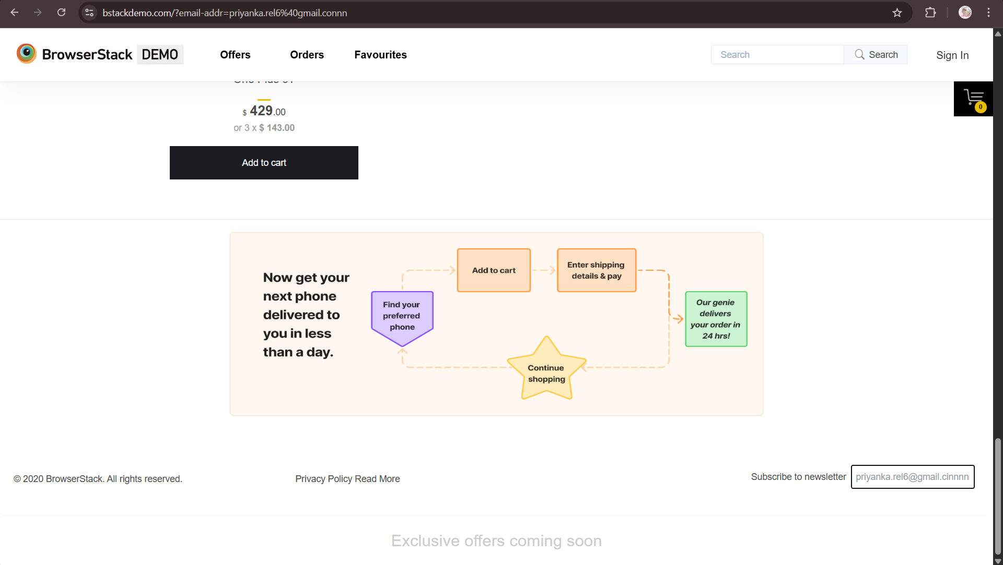

Slide 16
CHALLENGES
The login module was challenging due to difficulties in identifying and handling locators effectively.
Handling Dynamic Content: One of the biggest challenges was handling dynamic content on the website, such as favorites module.

Slide 17
EXPERIENCE
Testing this e-commerce site has been a valuable learning experience, allowing me to acquire hands-on skills in Selenium automation , Cucumber BDD and TestNG frameworks.
Started by exploring the website, navigating through different sections
And then I found many bugs
I created automated test scripts using Selenium WebDriver to test the website's functionality, product search, and checkout. .

Slide 18
THANK YOU!!!

