Slide 1
Cryptography
CONVENTIONAL ENCRYPTION ALGORITHMS
The art of secret writing: substitution & transposition ciphers
H
E
L
L
O
K
H
O
O
R
encrypt →

Slide 2






Key terms in cryptography
Cryptography
Plaintext
Ciphertext
The art of secret writing. “Crypto” means secret, “graphy” means writing.
The original message that is to be transformed.
The transformed, unreadable message.
MEET ME AT NOON
PHHW PH DW QRRQ
Encryption
Decryption
Cryptology
Plaintext → Ciphertext, using a key.
Ciphertext → Plaintext, using a key.
The study of encryption and decryption together.

Slide 3


Two types of cryptography
BASICS
Symmetric
Asymmetric
Private-key cryptography
Public-key cryptography
The same key encrypts and decrypts
Fast: ideal for large amounts of data
Challenge: sharing the key safely
Examples: AES, DES, Caesar, Vigenère
Two keys: public key and private key
Slower, but no secret to pre-share
Also used for digital signatures
Examples: RSA, ECC
Analogy: one house key, copied for both people
Analogy: a mailbox. Anyone can post a letter, only the owner can open it

Slide 4
Traditional encryption at a glance
OVERVIEW
Traditional Encryption
Substitution: letters are replaced
Transposition: letters are rearranged
Caesar
Keyword
Counting key
Columnar
Keyed columnar
Rail fence
Vigenère
Vernam / OTP
Each cipher that follows comes with a worked example and practice questions.

Slide 5
Caesar cipher: shift every letter
SUBSTITUTION · CAESAR
ENCRYPT
DECRYPT
Ci = (Pi + 3) mod 26
Pi = (Ci − 3) mod 26
Used by Julius Caesar (around 58 BC): each letter is replaced by the letter a fixed number of places after it. Caesar used a shift of 3.
PLAINTEXT
A
B
C
D
E
F
G
H
I
J
K
L
M
N
O
P
Q
R
S
T
U
V
W
X
Y
Z
CIPHERTEXT (SHIFT 3)
D
E
F
G
H
I
J
K
L
M
N
O
P
Q
R
S
T
U
V
W
X
Y
Z
A
B
C
Wrap-around: X → A, Y → B, Z → C. Example: H is 7, 7 + 3 = 10, which is K. Y is 24, 24 + 3 = 27, 27 mod 26 = 1, which is B.

Slide 6
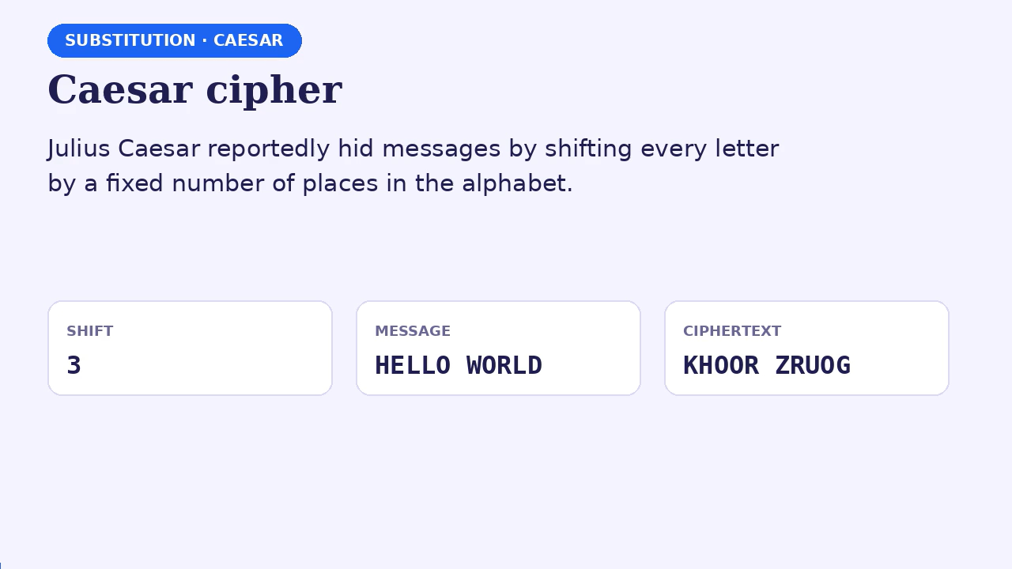

Slide 7
Caesar practice: encrypt and decrypt
SUBSTITUTION · CAESAR
ENCRYPT · SHIFT 3
DECRYPT · SHIFT 3
PLAINTEXT
CIPHERTEXT
MEET ME AFTER THE PARTY
UHWXUQ WR URPH
CIPHERTEXT
PLAINTEXT
PHHW PH DIWHU WKH SDUWB
RETURN TO ROME
Tip: to decrypt, shift backwards by the same amount. Write the shifted alphabet on a strip of paper and slide it.
SHIFT-3 ALPHABET FOR REFERENCE
A
B
C
D
E
F
G
H
I
J
K
L
M
N
O
P
Q
R
S
T
U
V
W
X
Y
Z
D
E
F
G
H
I
J
K
L
M
N
O
P
Q
R
S
T
U
V
W
X
Y
Z
A
B
C

Slide 8
More Caesar examples
SUBSTITUTION · CAESAR
SHIFT 3 · ENCRYPT
SHIFT 5 · ENCRYPT
PLAINTEXT
PLAINTEXT
ATTACK AT DAWN
HELLO WORLD
CIPHERTEXT
CIPHERTEXT
DWWDFN DW GDZQ
MJQQT BTWQI
ROT13 · APPLY TWICE = ORIGINAL
SHIFT 3 · DECRYPT
PLAINTEXT
CIPHERTEXT
SECRET MESSAGE
KHOOR ZRUOG
CIPHERTEXT
PLAINTEXT
FRPERG ZRFFNTR
HELLO WORLD

Slide 9
Keyword substitution alphabets
SUBSTITUTION · KEYWORD
Write the alphabet
Plain letters go on the top row.
Put the key underneath
Duplicate letters in the key are dropped.
Fill in the rest
Remaining letters follow in order.
1
2
3
KEY: WORD
A
B
C
D
E
F
G
H
I
J
K
L
M
N
O
P
Q
R
S
T
U
V
W
X
Y
Z
W
O
R
D
A
B
C
E
F
G
H
I
J
K
L
M
N
P
Q
S
T
U
V
X
Y
Z
KEY: TEST (SECOND T DROPPED, SO THE KEY IS TES)
A
B
C
D
E
F
G
H
I
J
K
L
M
N
O
P
Q
R
S
T
U
V
W
X
Y
Z
T
E
S
A
B
C
D
F
G
H
I
J
K
L
M
N
O
P
Q
R
U
V
W
X
Y
Z
key letters
remaining letters in alphabetical order

Slide 10
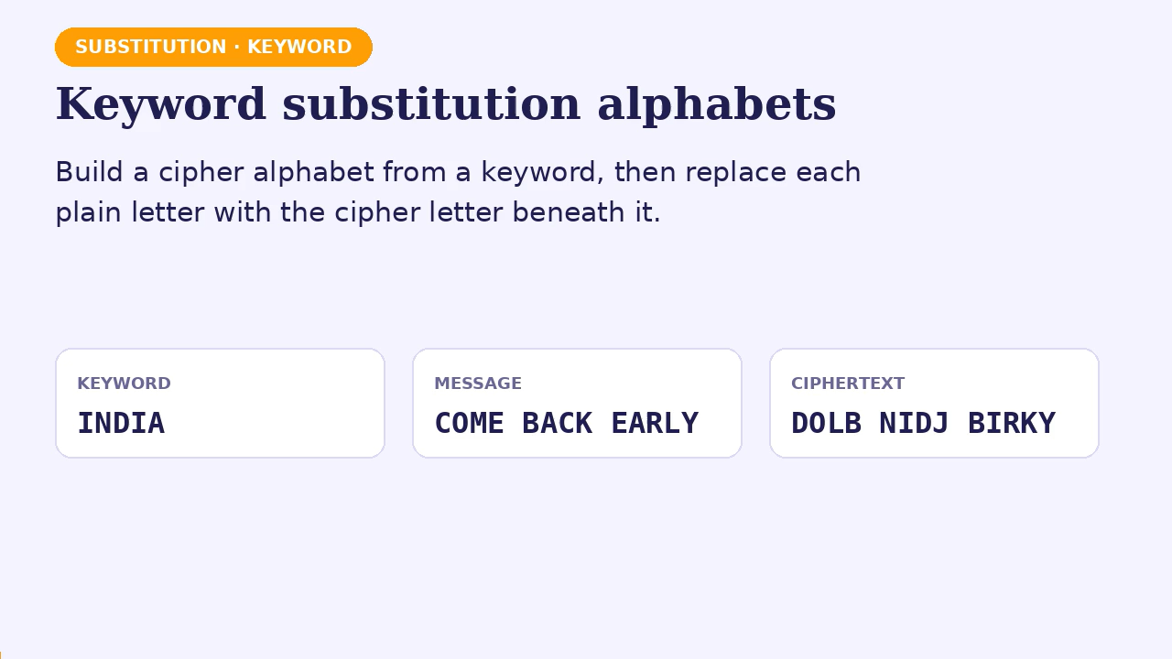

Slide 11
Keyword practice
SUBSTITUTION · KEYWORD
KEY: INDIA
KEY: CIPHER
KEY: SECURITY
CIPHER ALPHABET
CIPHER ALPHABET
CIPHER ALPHABET
INDABCEFGHJKLMOPQRSTUVWXYZ
CIPHERABDFGJKLMNOQSTUVWXYZ
SECURITYABDFGHJKLMNOPQVWXZ
PLAINTEXT
PLAINTEXT
PLAINTEXT
COME BACK EARLY
HELLO WORLD
ATTACK AT NOON
CIPHERTEXT
CIPHERTEXT
CIPHERTEXT
DOLB NIDJ BIRKY
BEJJM WMQJH
SOOSCD SO HJJH

Slide 12
Counting-key alphabets
SUBSTITUTION · COUNTING KEY
Write the alphabet
Start at A.
Count by the key
Key 3: A, D, G, J, M …
Wrap and continue
Past Z, carry on: … Y, B, E, H …
1
2
3
KEY 3: A → D → G → J …
A
B
C
D
E
F
G
H
I
J
K
L
M
N
O
P
Q
R
S
T
U
V
W
X
Y
Z
A
D
G
J
M
P
S
V
Y
B
E
H
K
N
Q
T
W
Z
C
F
I
L
O
R
U
X
KEY 5: A → F → K → P …
A
B
C
D
E
F
G
H
I
J
K
L
M
N
O
P
Q
R
S
T
U
V
W
X
Y
Z
A
F
K
P
U
Z
E
J
O
T
Y
D
I
N
S
X
C
H
M
R
W
B
G
L
Q
V
Rule: the key must share no factor with 26 (3, 5, 7, 9, 11, 15 …), otherwise letters repeat and the alphabet breaks.

Slide 13
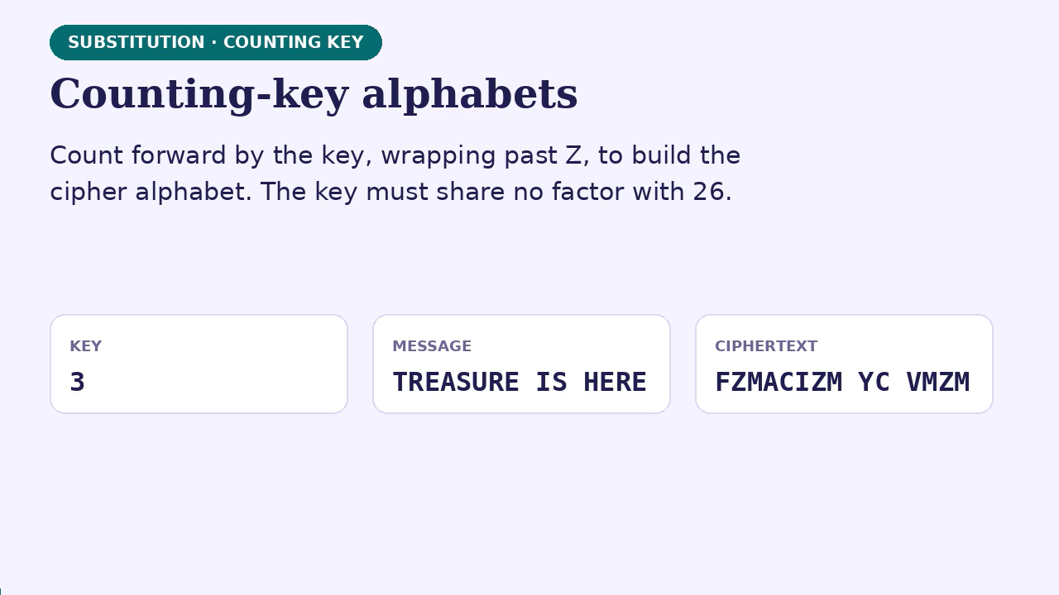

Slide 14
Counting-key practice
SUBSTITUTION · COUNTING KEY
KEY: 3
KEY: 5
KEY: 7
CIPHER ALPHABET
CIPHER ALPHABET
CIPHER ALPHABET
ADGJMPSVYBEHKNQTWZCFILORUX
AFKPUZEJOTYDINSXCHMRWBGLQV
AHOVCJQXELSZGNUBIPWDKRYFMT
PLAINTEXT
PLAINTEXT
PLAINTEXT
TREASURE IS HERE
MEET AT NOON
SEND HELP NOW
CIPHERTEXT
CIPHERTEXT
CIPHERTEXT
FZMACIZM YC VMZM
IUUR AR NSSN
WCNV XCZB NUY

Slide 15
Vigenère cipher: polyalphabetic
SUBSTITUTION · VIGENÈRE
Find the plaintext letter
Look along the top row of the Vigenère table.
MINI EXAMPLE
1
W
+
D
=
Z
Find the key letter
Look down the side column. The key repeats along the message.
2
Plain W (22) + key D (3) = 25, which is Z.
SAME LETTER, DIFFERENT OUTPUT
Read the intersection
The letter where row and column cross is the ciphertext letter.
E
E
E
plain
key
cipher
3
A
B
C
E
F
G
Nicknamed “le chiffre indéchiffrable” (the indecipherable cipher) until Kasiski published a method to break it in 1863.

Slide 16
The Vigenère table
SUBSTITUTION · VIGENÈRE
 | A | B | C | D | E | F | G | H | I | J | K | L | M | N | O | P | Q | R | S | T | U | V | W | X | Y | Z
A | A | B | C | D | E | F | G | H | I | J | K | L | M | N | O | P | Q | R | S | T | U | V | W | X | Y | Z
B | B | C | D | E | F | G | H | I | J | K | L | M | N | O | P | Q | R | S | T | U | V | W | X | Y | Z | A
C | C | D | E | F | G | H | I | J | K | L | M | N | O | P | Q | R | S | T | U | V | W | X | Y | Z | A | B
D | D | E | F | G | H | I | J | K | L | M | N | O | P | Q | R | S | T | U | V | W | X | Y | Z | A | B | C
E | E | F | G | H | I | J | K | L | M | N | O | P | Q | R | S | T | U | V | W | X | Y | Z | A | B | C | D
F | F | G | H | I | J | K | L | M | N | O | P | Q | R | S | T | U | V | W | X | Y | Z | A | B | C | D | E
G | G | H | I | J | K | L | M | N | O | P | Q | R | S | T | U | V | W | X | Y | Z | A | B | C | D | E | F
H | H | I | J | K | L | M | N | O | P | Q | R | S | T | U | V | W | X | Y | Z | A | B | C | D | E | F | G
I | I | J | K | L | M | N | O | P | Q | R | S | T | U | V | W | X | Y | Z | A | B | C | D | E | F | G | H
J | J | K | L | M | N | O | P | Q | R | S | T | U | V | W | X | Y | Z | A | B | C | D | E | F | G | H | I
K | K | L | M | N | O | P | Q | R | S | T | U | V | W | X | Y | Z | A | B | C | D | E | F | G | H | I | J
L | L | M | N | O | P | Q | R | S | T | U | V | W | X | Y | Z | A | B | C | D | E | F | G | H | I | J | K
M | M | N | O | P | Q | R | S | T | U | V | W | X | Y | Z | A | B | C | D | E | F | G | H | I | J | K | L
N | N | O | P | Q | R | S | T | U | V | W | X | Y | Z | A | B | C | D | E | F | G | H | I | J | K | L | M
O | O | P | Q | R | S | T | U | V | W | X | Y | Z | A | B | C | D | E | F | G | H | I | J | K | L | M | N
P | P | Q | R | S | T | U | V | W | X | Y | Z | A | B | C | D | E | F | G | H | I | J | K | L | M | N | O
Q | Q | R | S | T | U | V | W | X | Y | Z | A | B | C | D | E | F | G | H | I | J | K | L | M | N | O | P
R | R | S | T | U | V | W | X | Y | Z | A | B | C | D | E | F | G | H | I | J | K | L | M | N | O | P | Q
S | S | T | U | V | W | X | Y | Z | A | B | C | D | E | F | G | H | I | J | K | L | M | N | O | P | Q | R
T | T | U | V | W | X | Y | Z | A | B | C | D | E | F | G | H | I | J | K | L | M | N | O | P | Q | R | S
U | U | V | W | X | Y | Z | A | B | C | D | E | F | G | H | I | J | K | L | M | N | O | P | Q | R | S | T
V | V | W | X | Y | Z | A | B | C | D | E | F | G | H | I | J | K | L | M | N | O | P | Q | R | S | T | U
W | W | X | Y | Z | A | B | C | D | E | F | G | H | I | J | K | L | M | N | O | P | Q | R | S | T | U | V
X | X | Y | Z | A | B | C | D | E | F | G | H | I | J | K | L | M | N | O | P | Q | R | S | T | U | V | W
Y | Y | Z | A | B | C | D | E | F | G | H | I | J | K | L | M | N | O | P | Q | R | S | T | U | V | W | X
Z | Z | A | B | C | D | E | F | G | H | I | J | K | L | M | N | O | P | Q | R | S | T | U | V | W | X | Y
KEY
D
+
PLAIN
W
=
Z

Slide 17
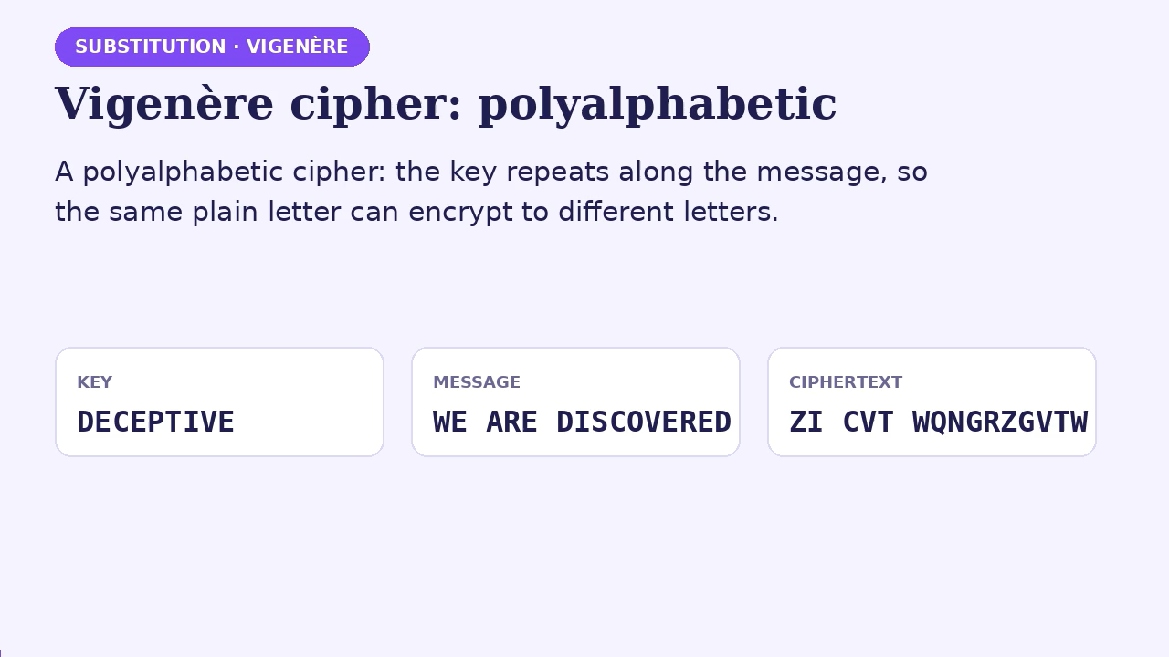

Slide 18
Vigenère worked example
SUBSTITUTION · VIGENÈRE
W
E
A
R
E
D
I
S
C
O
V
E
R
E
D
PLAINTEXT
D
E
C
E
P
T
I
V
E
D
E
C
E
P
T
KEY
Z
I
C
V
T
W
Q
N
G
R
Z
G
V
T
W
CIPHERTEXT
How the first letters work
W (22) + D (3) = 25, which is Z
E (4) + E (4) = 8, which is I
Good to know
The key DECEPTIVE repeats along the letters. Spaces are copied unchanged and the key does not advance on them.

Slide 19
Vigenère practice
SUBSTITUTION · VIGENÈRE
KEY: LUCKY
KEY: LEMON
KEY: KEY · DECRYPT
PLAINTEXT
PLAINTEXT
CIPHERTEXT
COMPUTING GIVES INSIGHT
ATTACK AT DAWN
RIJVS UYVJN
CIPHERTEXT
CIPHERTEXT
PLAINTEXT
NIOZSECPQ ETPGC GYMKQFE
LXFOPV EF RNHR
HELLO WORLD

Slide 20




Vernam cipher and the one-time pad
SUBSTITUTION · VERNAM
1
2
3
4
Letters to numbers
Random numbers
Add and wrap
Numbers to letters
A = 0, B = 1 … Z = 25
Generate one random number per letter
Sum of letter code + random, then mod 26
Convert each result back to a letter
One-time pad: key truly random, as long as the message, never reused. Shannon proved in 1949 that this gives perfect secrecy.

Slide 21
Vernam worked example
SUBSTITUTION · VERNAM
V
E
R
N
A
M
C
I
P
H
E
R
PLAINTEXT
21
4
17
13
0
12
2
8
15
7
4
17
NUMERIC
76
48
16
82
44
3
58
11
60
5
48
88
RANDOM
97
52
33
95
44
15
60
19
75
12
52
105
SUM
19
0
7
17
18
15
8
19
23
12
0
1
SUM MOD 26
T
A
H
R
S
P
I
T
X
M
A
B
CIPHERTEXT

Slide 22
Vernam practice
SUBSTITUTION · VERNAM
ENCRYPT
ENCRYPT
DECRYPT
PLAINTEXT
PLAINTEXT
CIPHERTEXT
I AM HERE
STOP NOW
T SP MABO
RANDOM NUMBERS
RANDOM NUMBERS
RANDOM NUMBERS
11 44 3 5 48 88 10
5 12 8 19 2 30 41
11 44 3 5 48 88 10
CIPHERTEXT
CIPHERTEXT
PLAINTEXT
T SP MABO
XFWI PSL
I AM HERE

Slide 23
Columnar transposition
TRANSPOSITION · COLUMNAR
Write in rows
Use a fixed number of characters per row.
MINI EXAMPLE · WIDTH 4
1
A
T
T
A
Fill short columns
Pad the last row with a special character.
2
C
K
A
T
Read down columns
Join the columns to form the ciphertext.
D
A
W
N
3
read down each column
Keep the width
The width is the key. Receiver needs it.
4
ACD
TKA
TAW
ATN
Ciphertext: ACD TKA TAW ATN

Slide 24
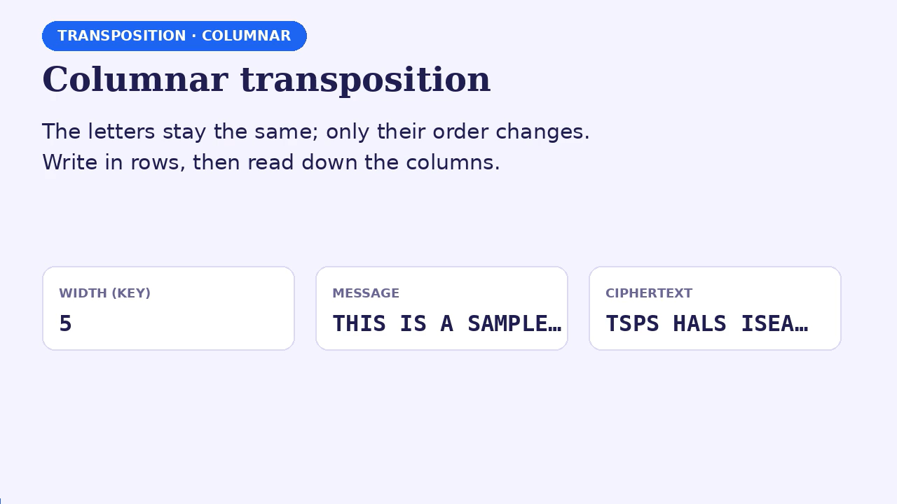

Slide 25
Columnar worked example
TRANSPOSITION · COLUMNAR
THIS IS A SAMPLE MESSAGE · WIDTH 5
READ COLUMN BY COLUMN
T
H
I
S
I
TSPS
column 1 ↓
HALS
column 2 ↓
S
A
S
A
M
ISEA
column 3 ↓
P
L
E
M
E
SAMG
column 4 ↓
S
S
A
G
E
IMEE
column 5 ↓
TSPS HALS ISEA SAMG IMEE

Slide 26
More columnar examples
TRANSPOSITION · COLUMNAR
WIDTH 5 · PADDED WITH X
WIDTH 7 · EXACT FIT
MEET ME AFTER THE PARTY
HELP IS ON THE WAY
M
E
E
T
M
H
E
L
P
I
S
O
E
A
F
T
E
N
T
H
E
W
A
Y
R
T
H
E
P
CIPHERTEXT
HN ET LH PE IW SA OY
A
R
T
Y
X
CIPHERTEXT
MERA EATR EFHT TTEY MEPX

Slide 27
Keyed columnar transposition
TRANSPOSITION · KEYED COLUMNAR
KEY ZEBRAS · MESSAGE WEAREDISCOVERED
KEY CODE · MESSAGE ATTACKATDAWN
Z
E
B
R
A
S
C
O
D
E
6
3
2
4
1
5
1
4
2
3
W
E
A
R
E
D
A
T
T
A
I
S
C
O
V
E
C
K
A
T
R
E
D
$
$
$
D
A
W
N
READ COLUMNS IN KEY ORDER 1 → 6
READ COLUMNS IN KEY ORDER 1 → 4
EV$ ACD ESE RO$ DE$ WIR
ACD TAW ATN TKA

Slide 28
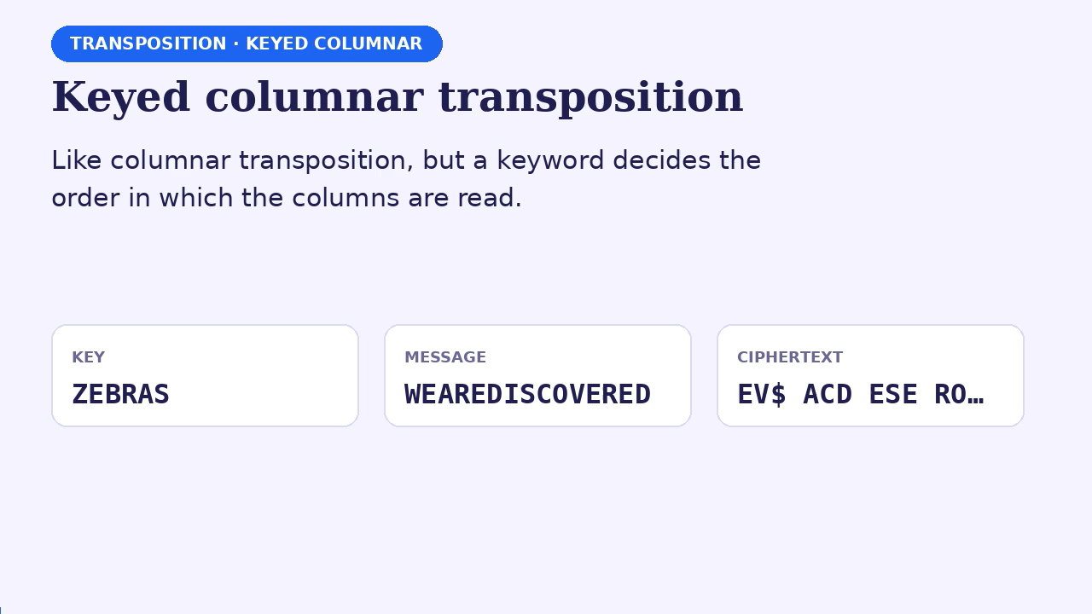

Slide 29
Rail fence cipher: a zigzag
TRANSPOSITION · RAIL FENCE
2 RAILS · MEET ME AFTER THE PARTY
M
E
M
A
T
R
H
P
R
Y
E
T
E
F
E
T
E
A
T
Ciphertext = rail 1, then rail 2:
MEMATRHPRYETEFETEAT
3 RAILS · WE ARE DISCOVERED
W
E
C
R
Ciphertext = rail 1, rail 2, rail 3:
E
R
D
S
O
E
E
WECRERDSOEEAIVD
A
I
V
D

Slide 30
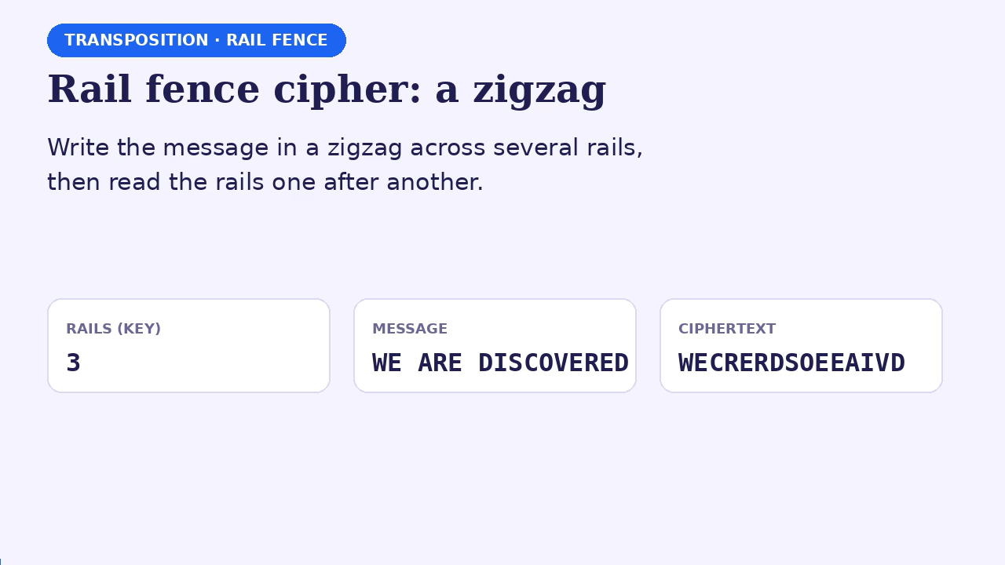

Slide 31
Comparing the ciphers
SUMMARY
Cipher | Family | Key | Main weakness
Caesar | Substitution · mono | Shift 1–25 | Only 25 keys: brute force
Keyword | Substitution · mono | Keyword → alphabet | Letter frequencies survive
Counting key | Substitution · mono | Step k, coprime to 26 | Only 12 valid keys
Vigenère | Substitution · poly | Repeating keyword | Repeats: Kasiski attack
Vernam / OTP | Substitution · poly | Random, message-length | Key sharing; never reuse
Columnar | Transposition | Column width or order | Frequencies unchanged
Rail fence | Transposition | Number of rails | Very few keys

Slide 32
Your turn: encrypt these
PRACTICE
CAESAR, SHIFT 7
KEYWORD - SECURITY
PLAINTEXT
PLAINTEXT
CRYPTO IS FUN
SEND HELP
CIPHERTEXT
CIPHERTEXT
? ? ?
? ? ?
VIGENÈRE, KEY CAT
COLUMNAR, WIDTH 4, PAD X
PLAINTEXT
PLAINTEXT
HIDE THE GOLD
COME TO THE PARTY
CIPHERTEXT
CIPHERTEXT
? ? ?
? ? ?

Slide 33
Answer key
PRACTICE
CAESAR, SHIFT 7
KEYWORD SECURITY
PLAINTEXT
PLAINTEXT
CRYPTO IS FUN
SEND HELP
CIPHERTEXT
CIPHERTEXT
JYFWAV PZ MBU
NRHU YRFK
VIGENÈRE, KEY CAT
COLUMNAR, WIDTH 4, PAD X
PLAINTEXT
PLAINTEXT
HIDE THE GOLD
COME TO THE PARTY
CIPHERTEXT
CIPHERTEXT
JIWG TAG GHND
CTET OOPY MTAX EHRX

