Slide 1
Electron Diffraction Patterns from Al (face center cubic structure)

Slide 2
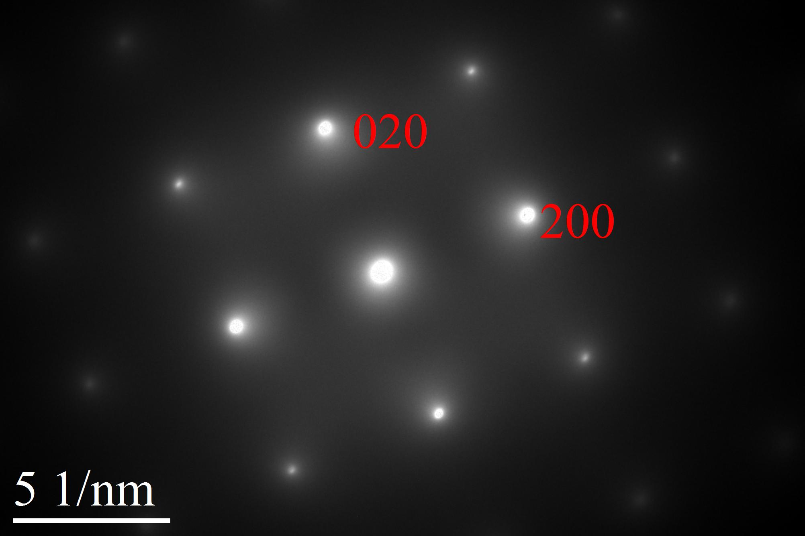
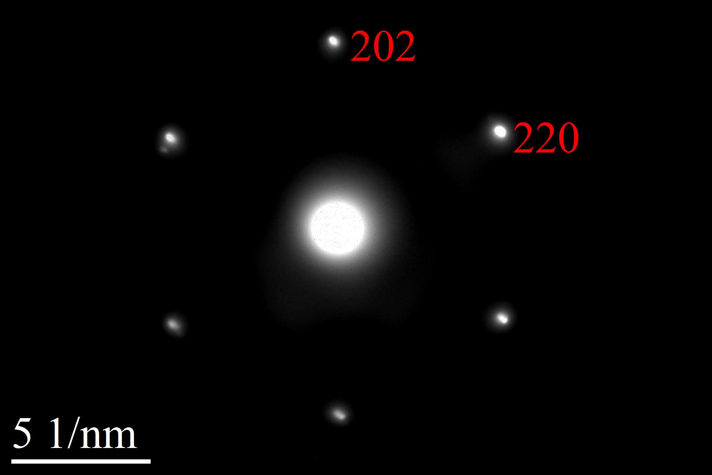
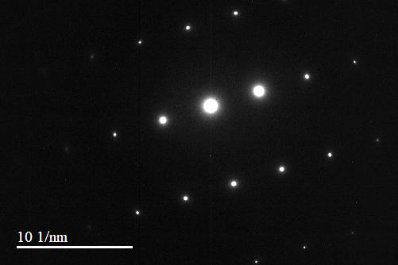
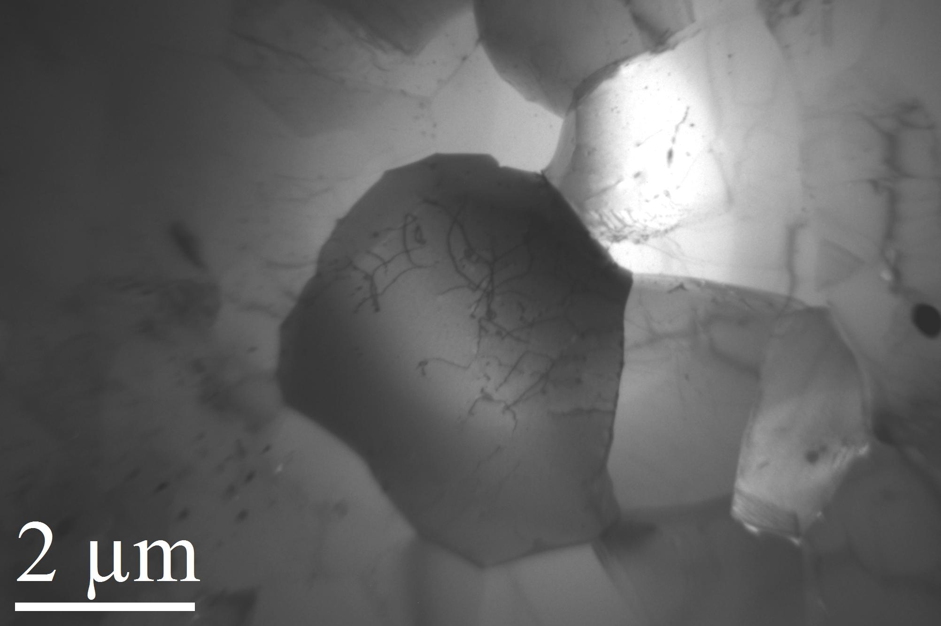
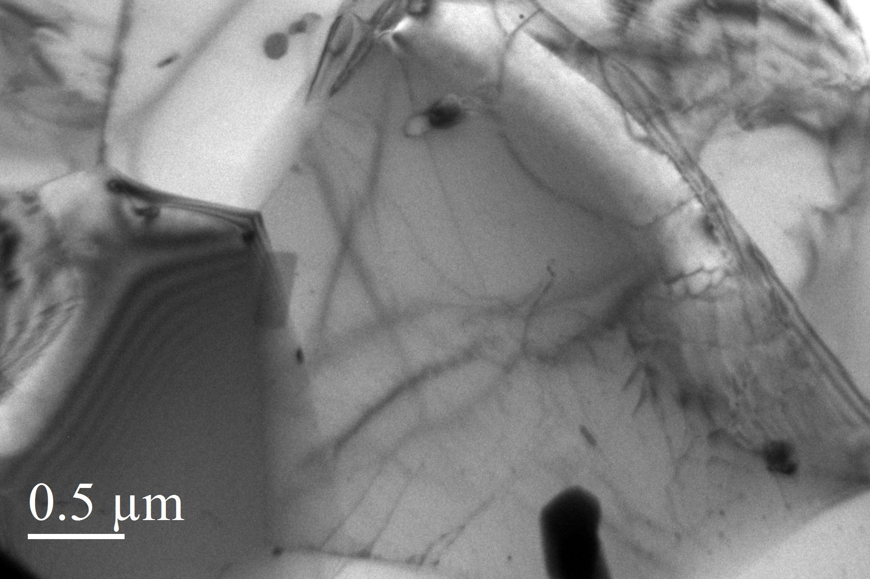
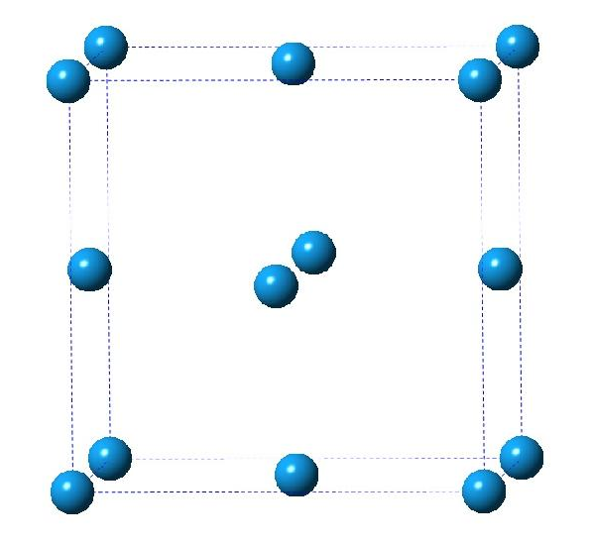
Diffraction patterns along different crystallographic directions of Al
Polycrystalline sample of Al contains grains with different orientations.

Slide 3
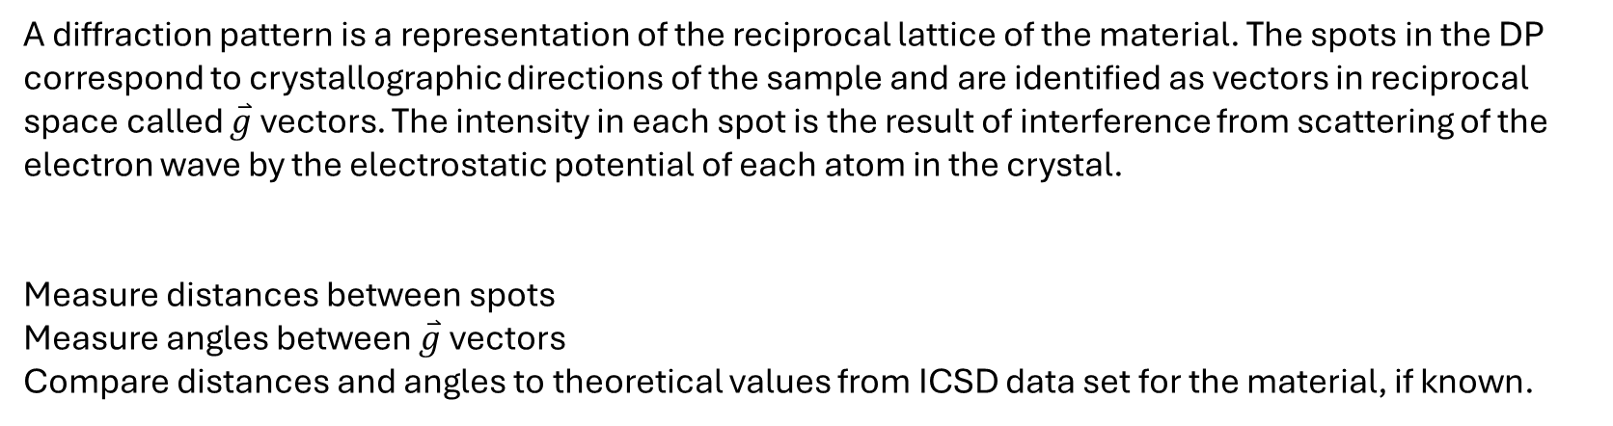
How to analyze diffraction patterns.

Slide 4
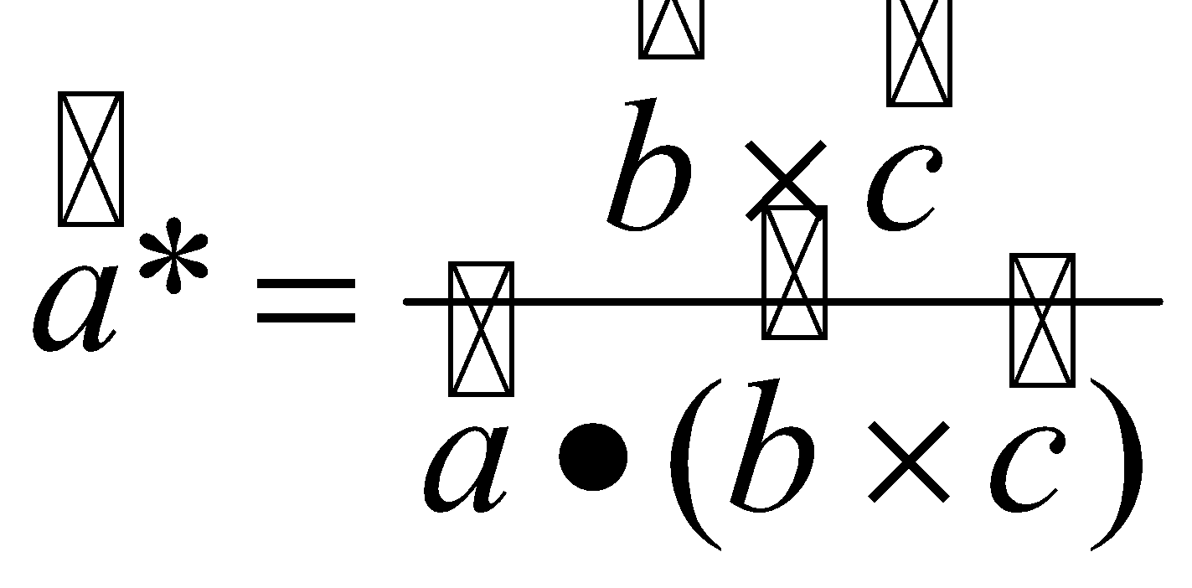
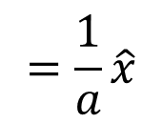
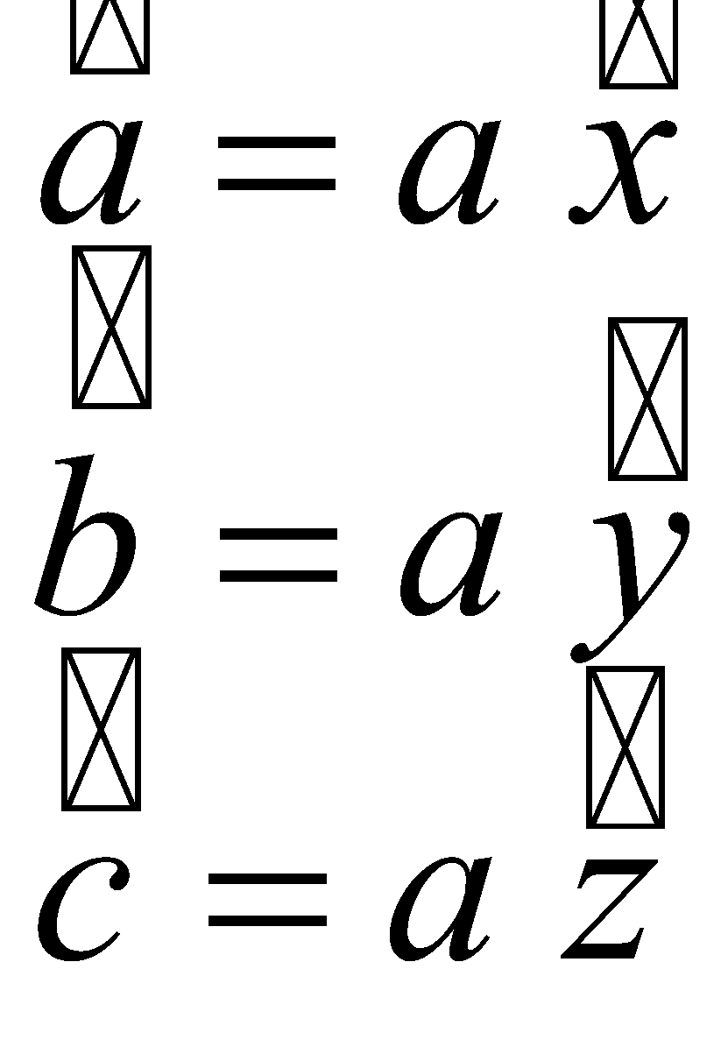


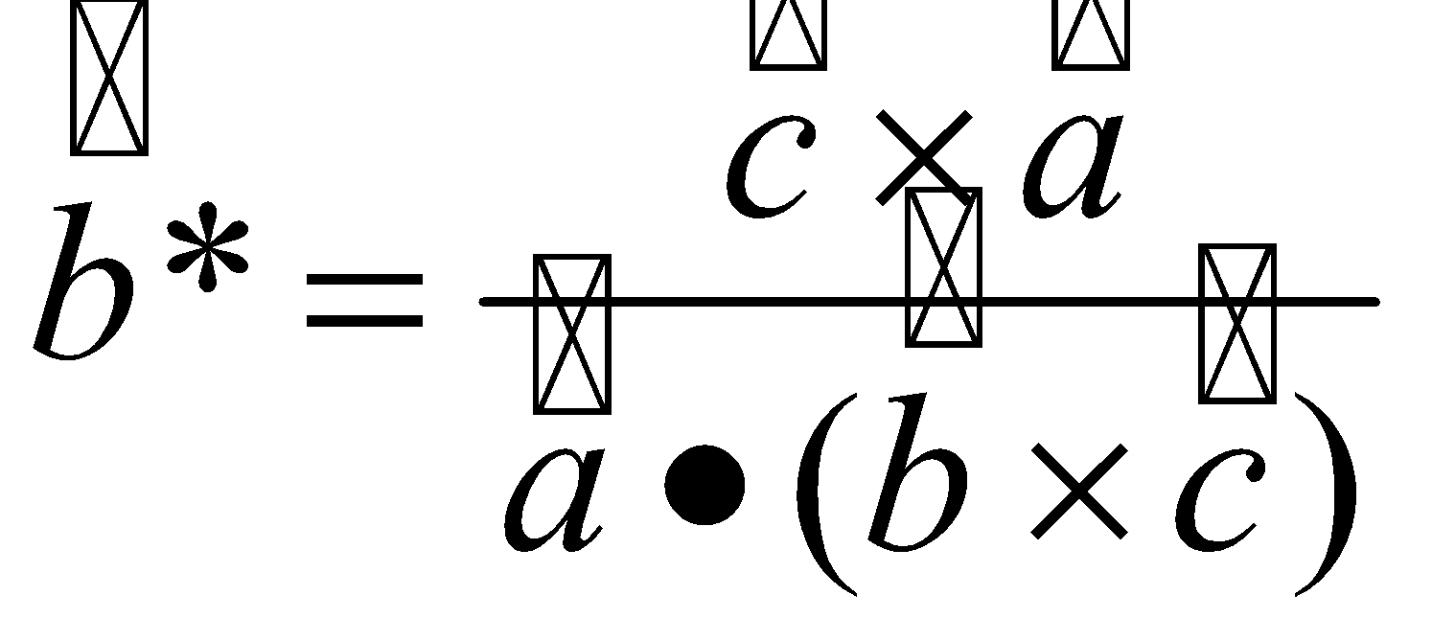
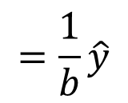




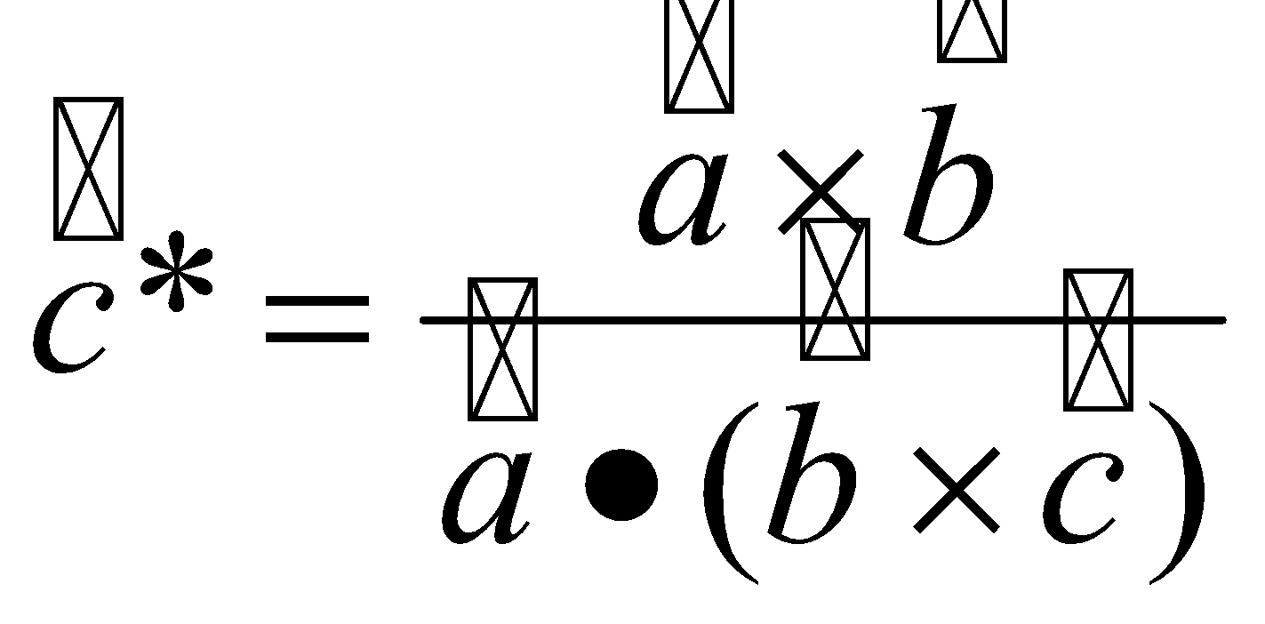
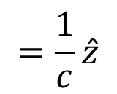
Real and Reciprocal Space
Real Space lattice
Reciprocal lattice
Basis:
Al at (000) (1/2,1/2,0) (1/2,0,1/2) (0,1/2,1/2)
Units are in nm
There is no basis in reciprocal space
Units are in nm⁻¹
Both real and reciprocal space lattices are periodic

Slide 5
Incident wave (plane wave)
Scattered wave (spherical wave)

Slide 6
Scattering of electrons by the potential of a crystal
Incident wave (plane wave)
Scattered wave (interference of spherical waves)

Slide 7
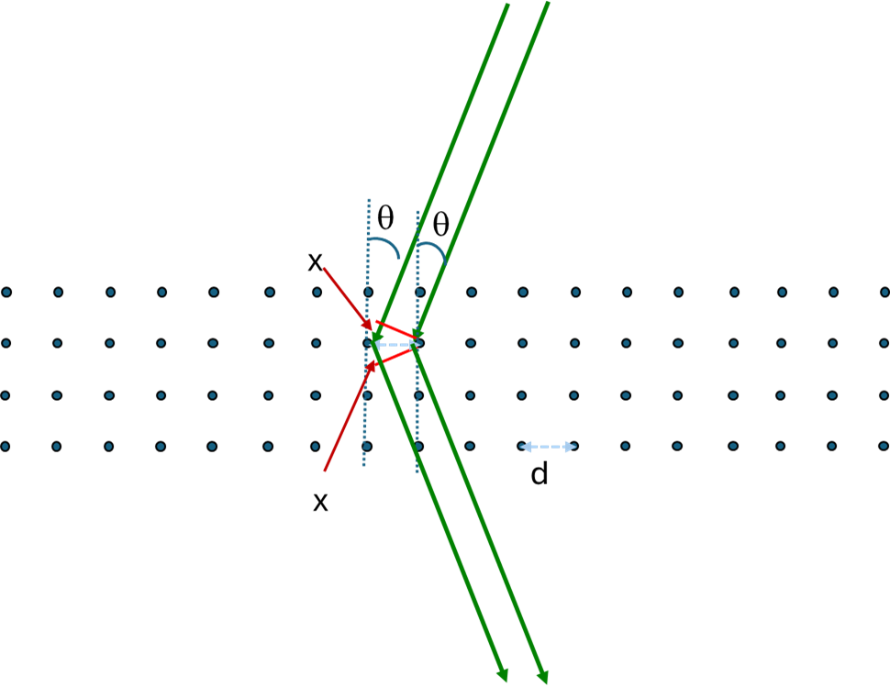
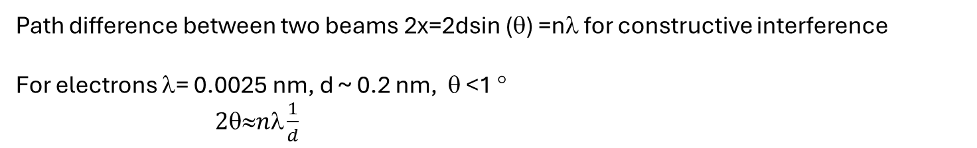
Bragg’s Law
d: interplanar distance between atomic planes

Slide 8
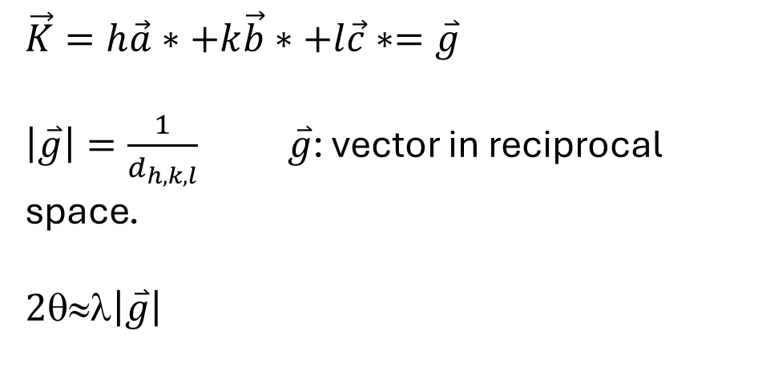
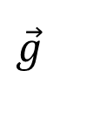
Bragg’s Law in reciprocal space
For constructive interference
For electrons λ~0.002 nm
Sphere of radius k=1/λ=500 nm⁻¹
Reciprocal lattice ~3 nm⁻¹

Slide 9
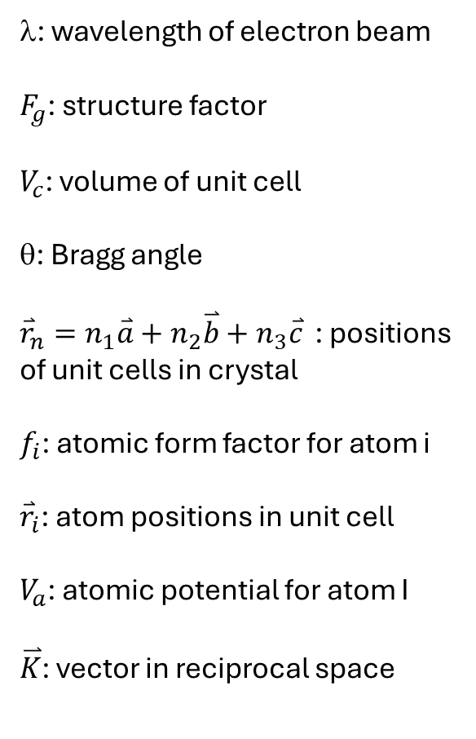
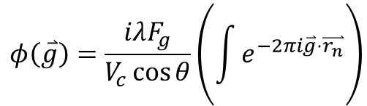
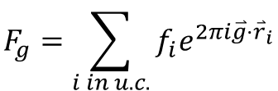
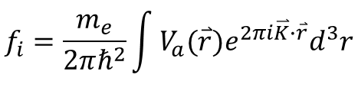
Diffraction from Quantum Mechanics

Slide 10
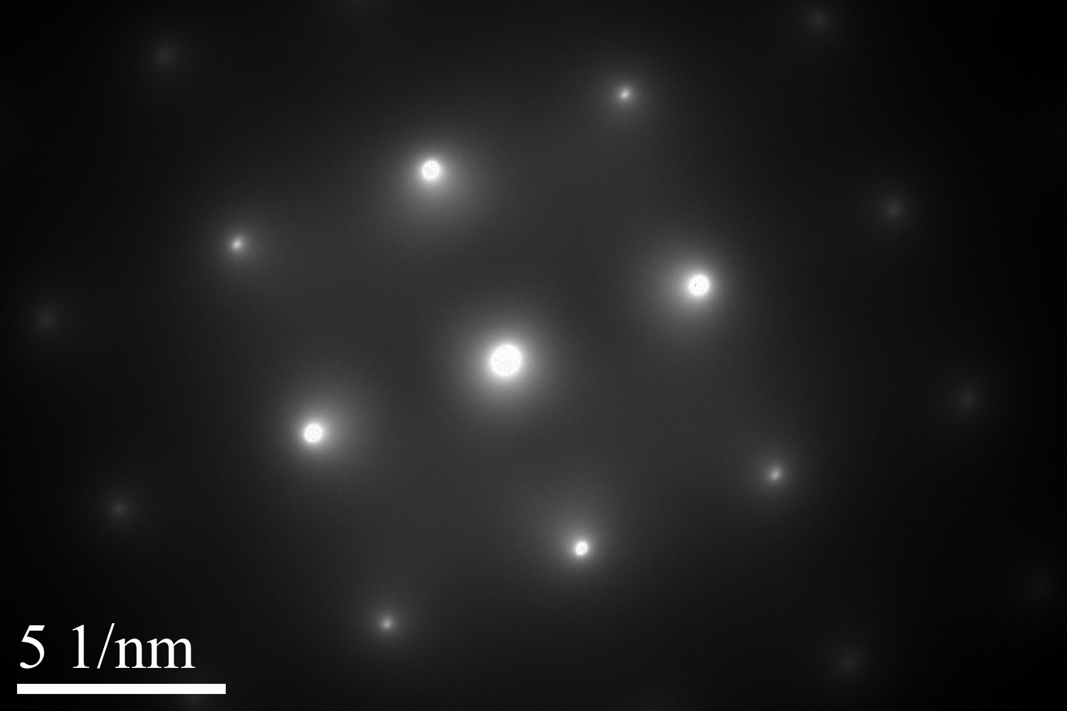
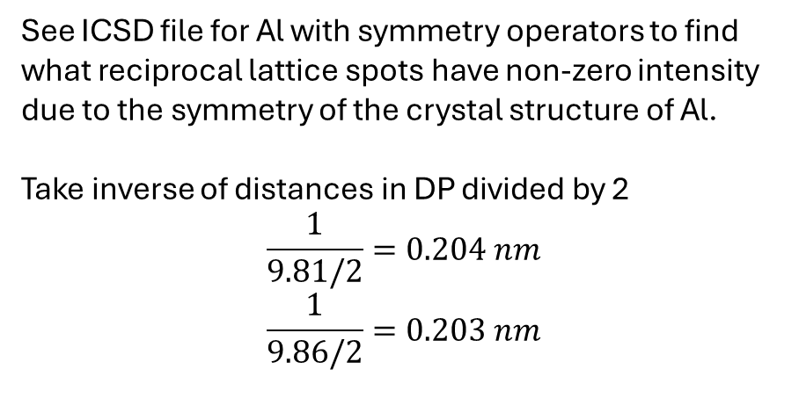
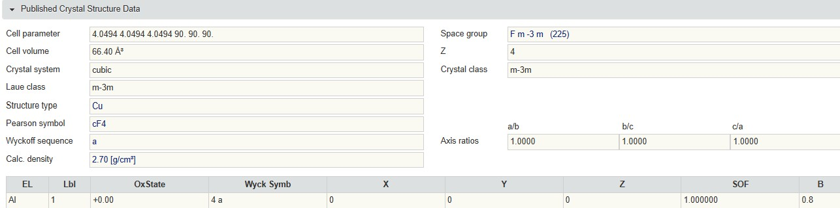
Examples
9.81 nm-1
90°
9.86 nm-1

Slide 11
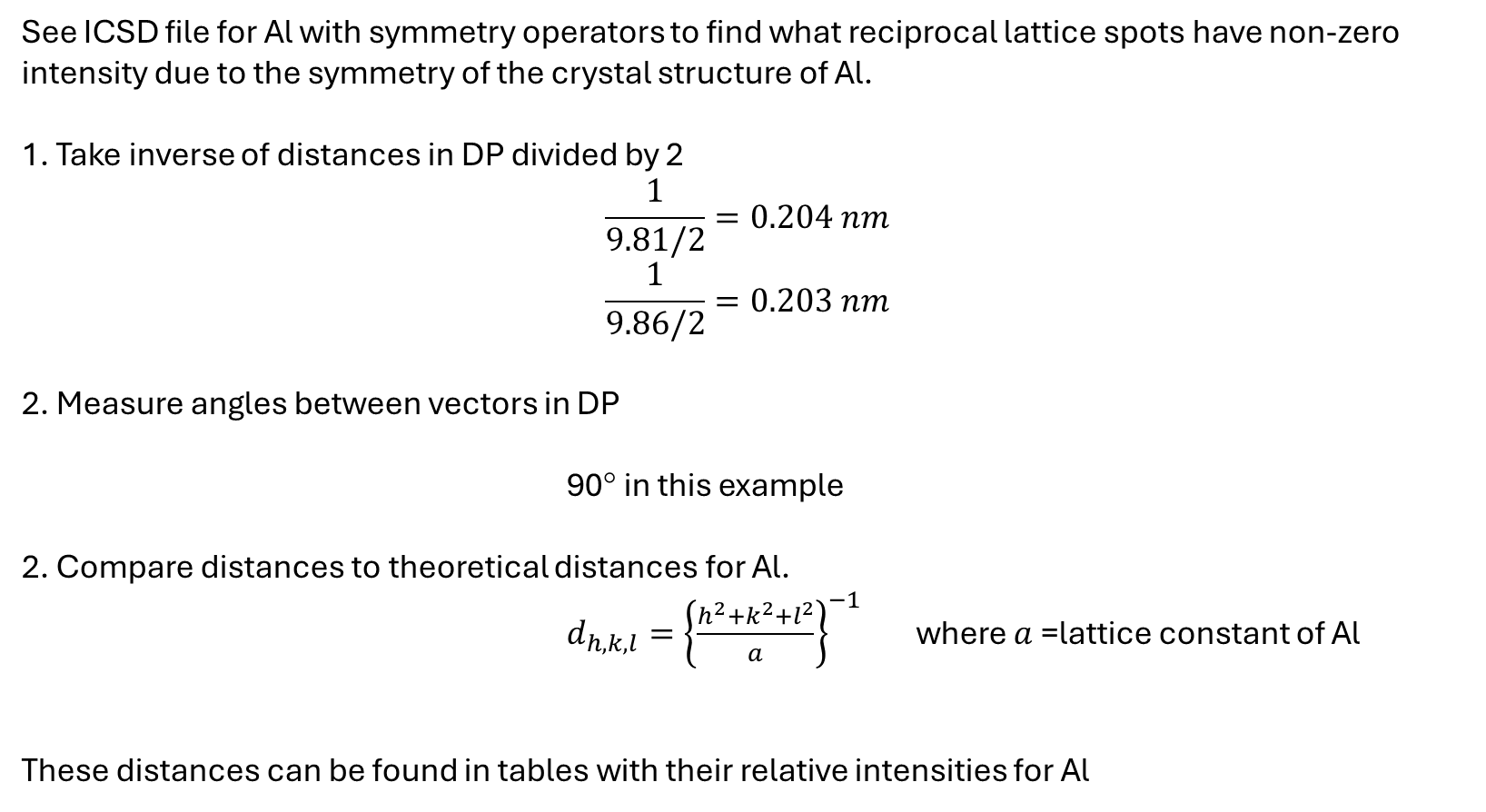
Indexing Diffraction Patterns

Slide 12
Analysis for Al DP
Dist in DP (nm⁻¹) | Exp.n Dist. Real space (nm) | Possible hkl | select
9.81 | 0.204 | 200, 020, 002 | 200
9.86 | 0.203 | 200, 020, 002 | 020
13.91 | 0.144 | 220, 022, etc | 220
9.81 nm-1
90°
9.86 nm-1
hkl | d_{hkl} (nm) | F _{hkl}
 | 0.4049 | 0
 | 0.2025 | =4f_{Al}
 | 0.286 | 0
 | 0.143 | =4f_{Al}
020
220
200
-200
0-20

Slide 13
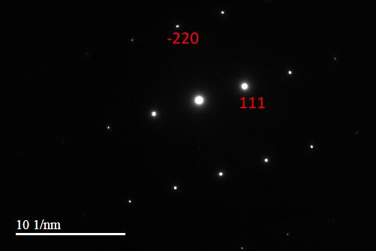
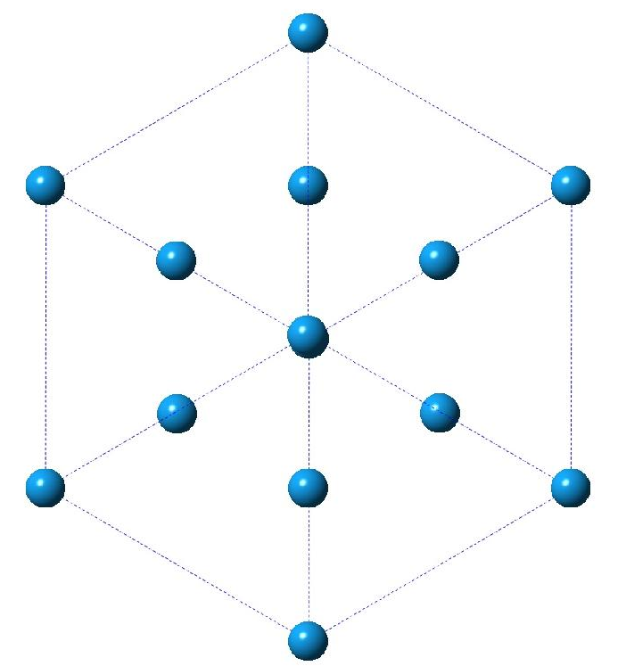
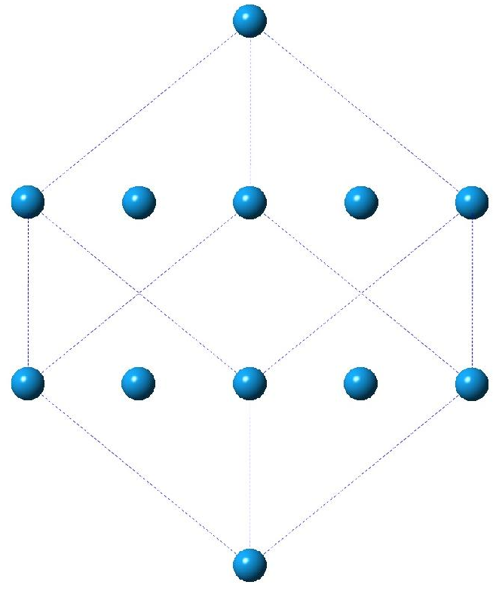
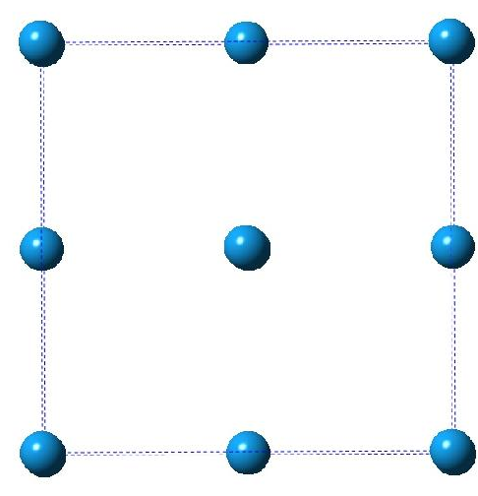
Each DP corresponds to a different orientation of the crystal with respect to the e-beam
[001] projection
[-111] projection
[11-2] projection

