Slide 1
CITEAM Workshop 2026 Lourdes Salamanca-Riba

Slide 2
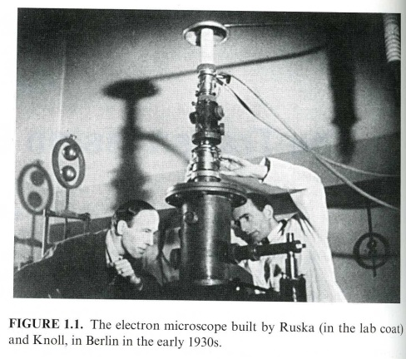
Section 0.1.1 Introduction to TEM/STEM
Transmission Electron Microscopy, A textbook for Materials Science, David B Williams and C Barry Carter, Springer, 2nd edition 2009

Slide 3
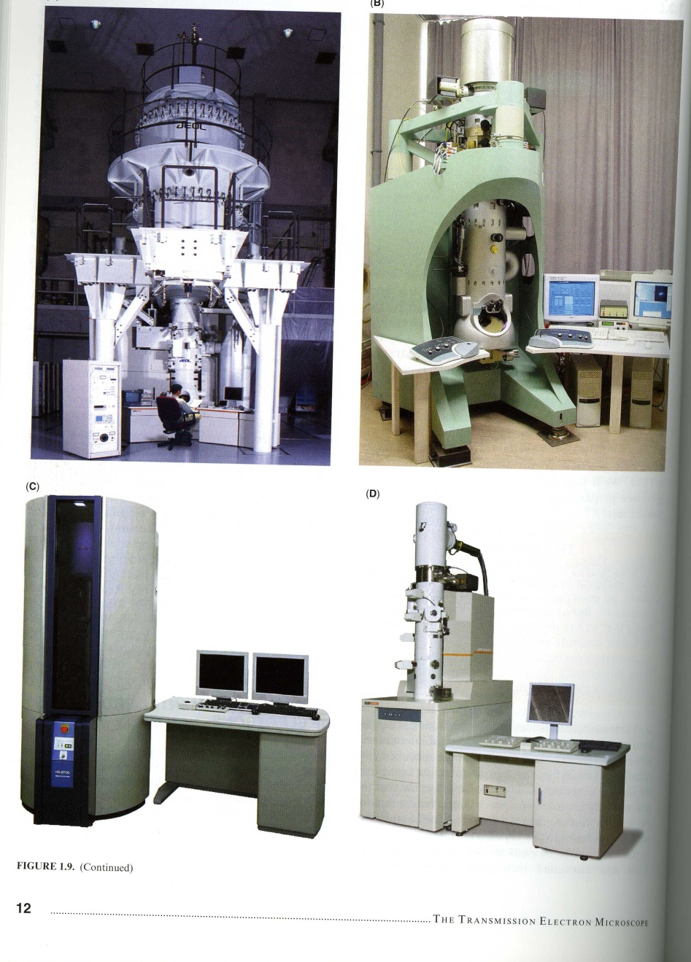
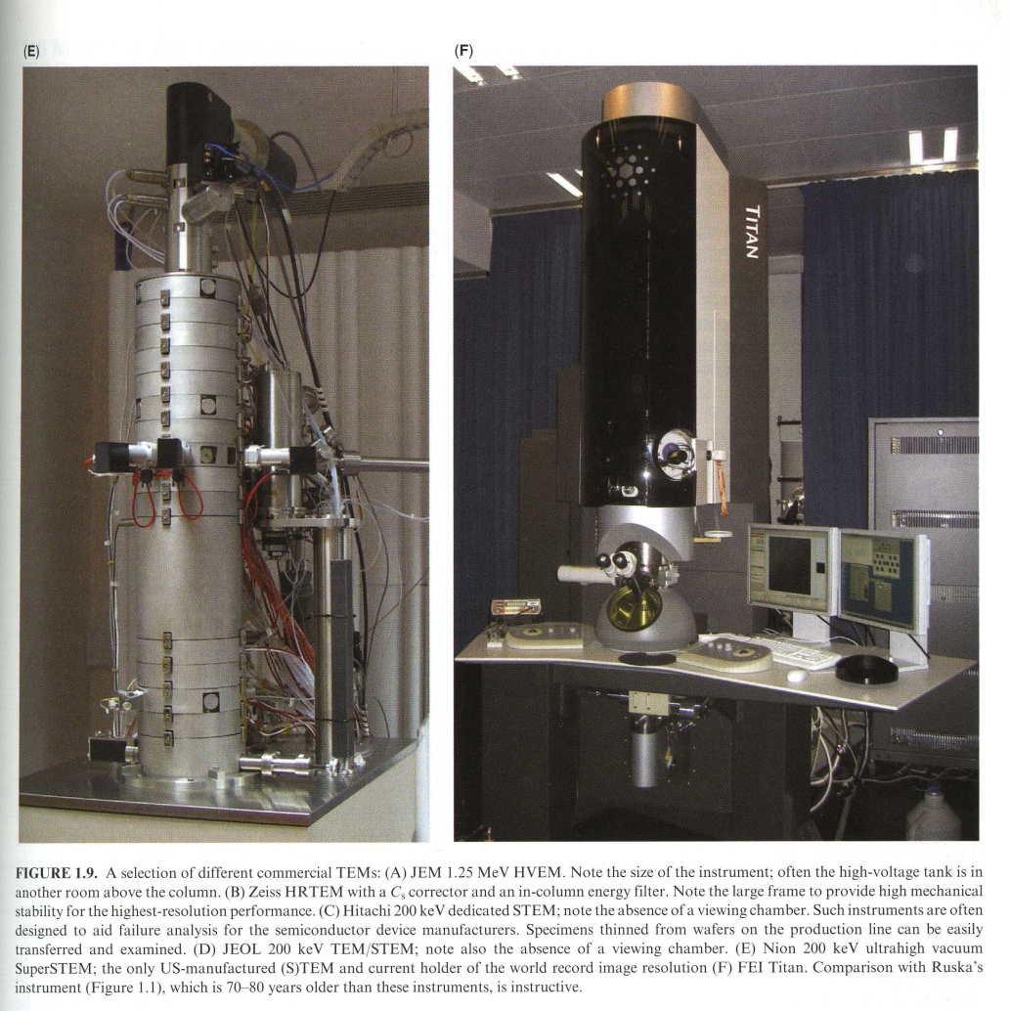
Evolution of TEMs
Transmission Electron Microscopy, A textbook for Materials Science, David B Williams and C Barry Carter, Springer, 2nd edition 2009

Slide 4
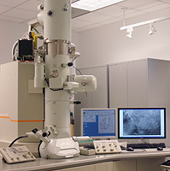
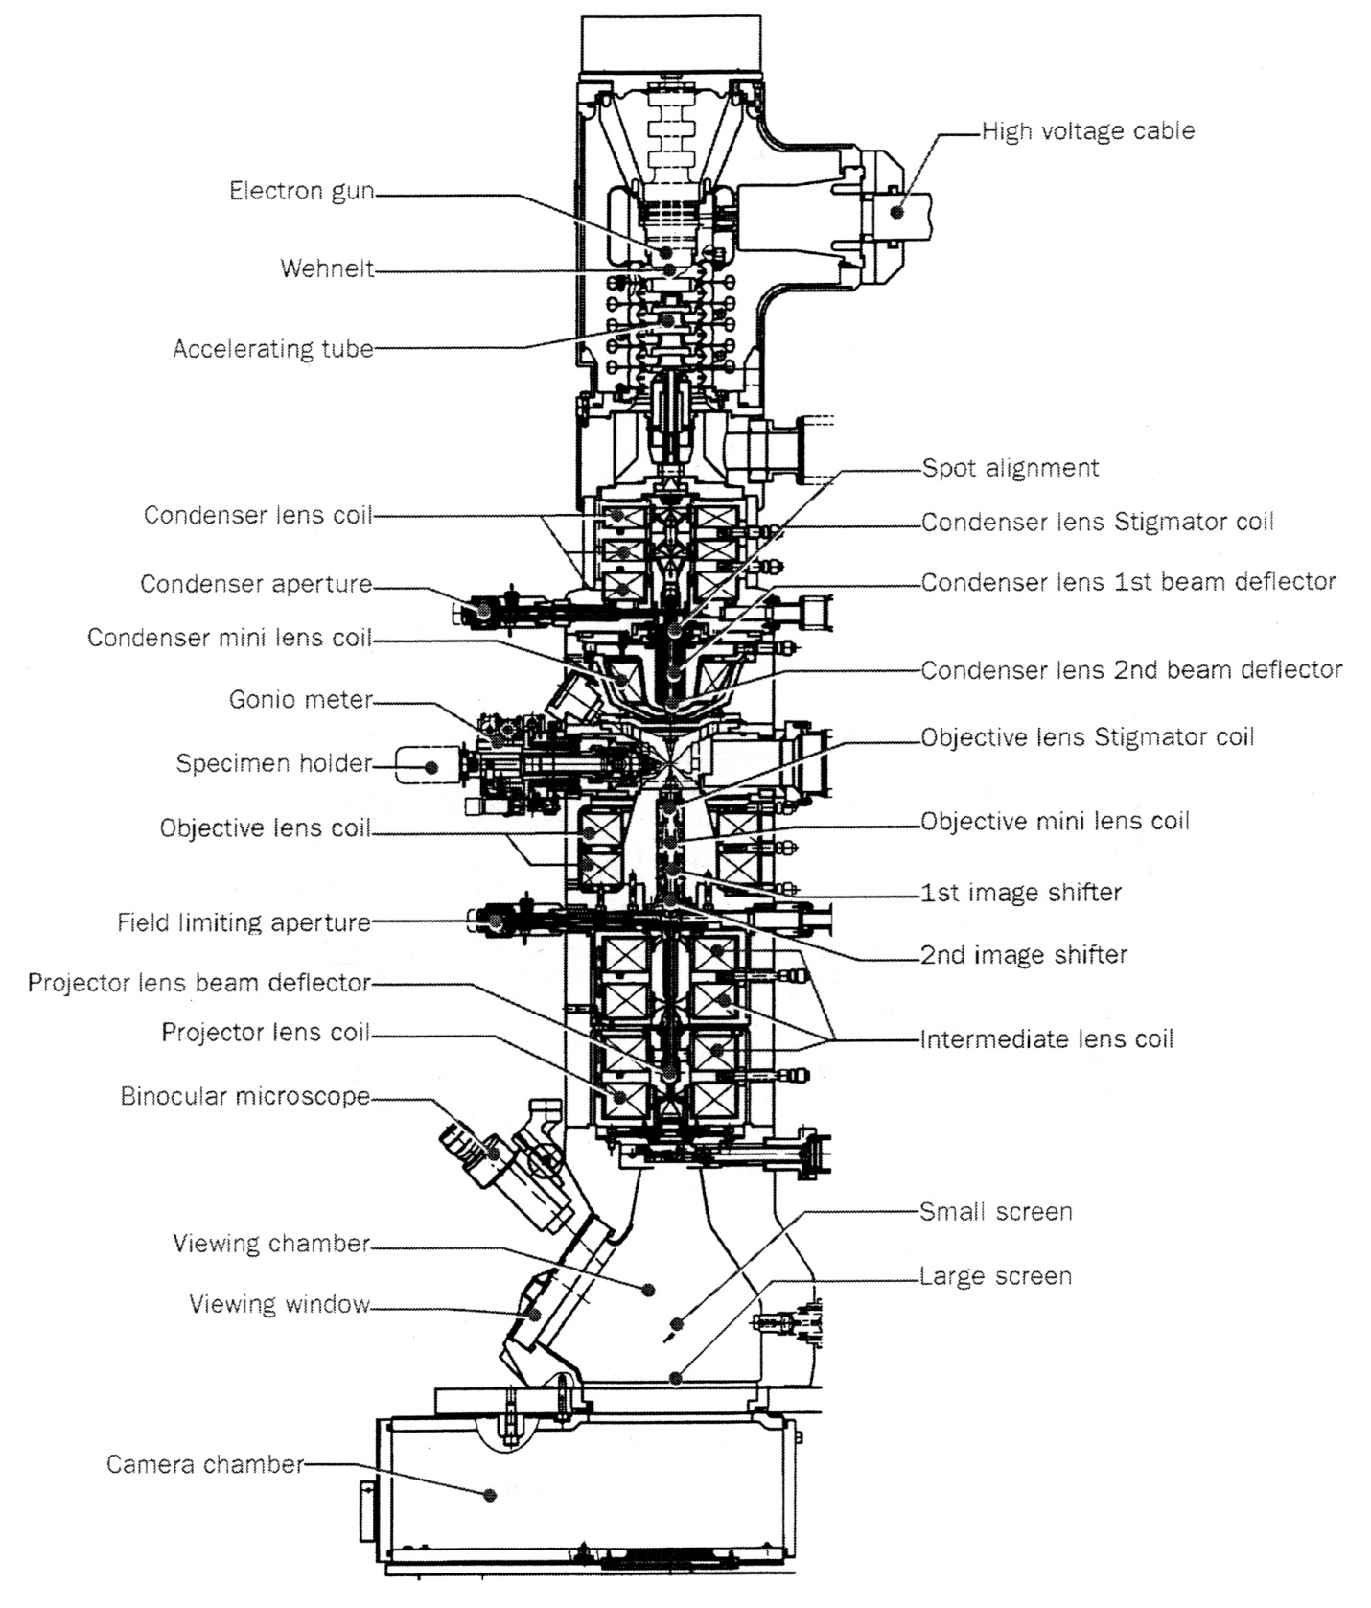
Cross section of the JEOL 2100F TEM
Electron gun 1st beam deflector
GUN 1
GUN 2
Spot
CL1~3
CLS
CLA1
CM
CLA2
OBS
OL1
OM
IS1
IS2
PLA
Intermediate lens stigmator
ILS
PL
IL1~3
https://www.nanocenter.umd.edu/aimlab/equipment/detail.php?id=sc144ef1db89bbfc

Slide 5
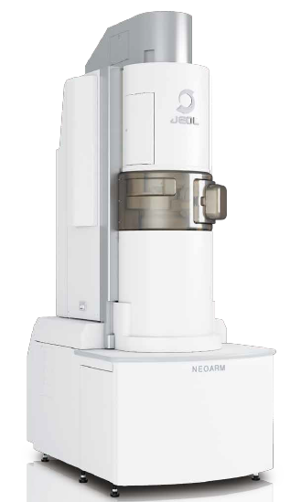
NEOARM Highlights
NEOARM 200 F Cs corrected TEM in the IDEA Factory
High Brightness Cold FEG
30-200kV
HR Pole Piece for maximum flexibility between analytical and resolution optimization
IDES Technology integration
Dual, large-area SDDs for efficient EDS collection
Highly stable probe current
COSMO Automated Corrector alignments

Slide 6
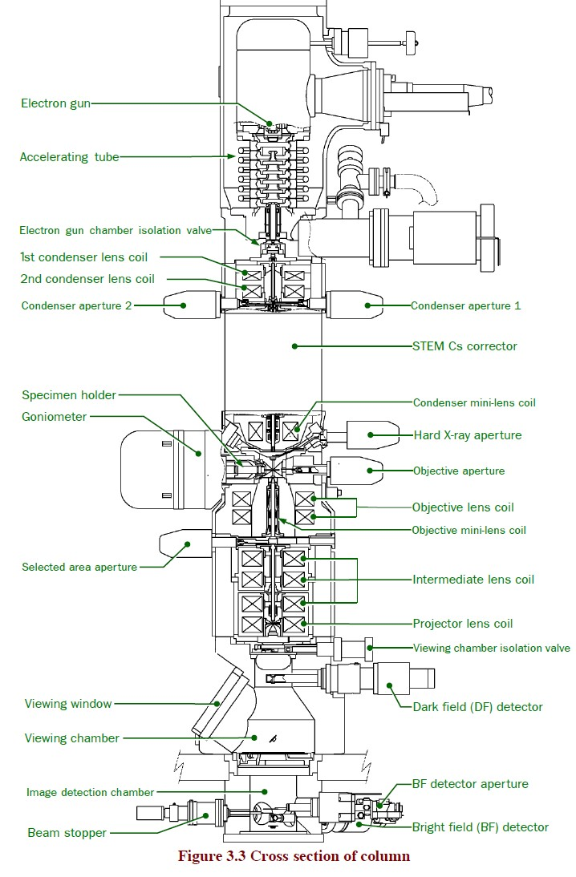
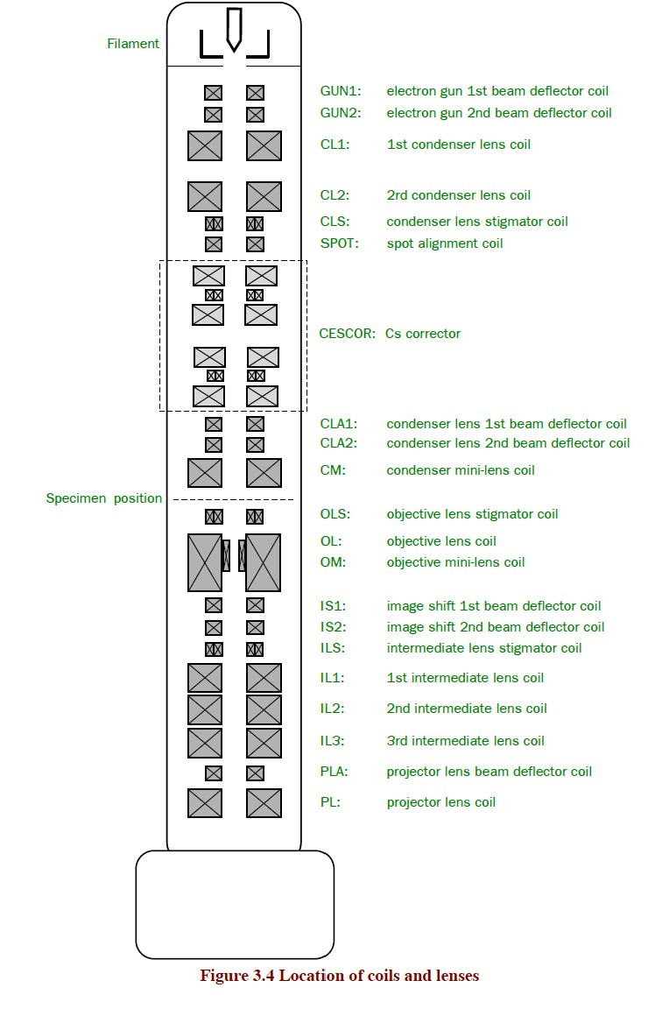
Cross section of NEOARM Column
ASCOR
From JEOL

Slide 7
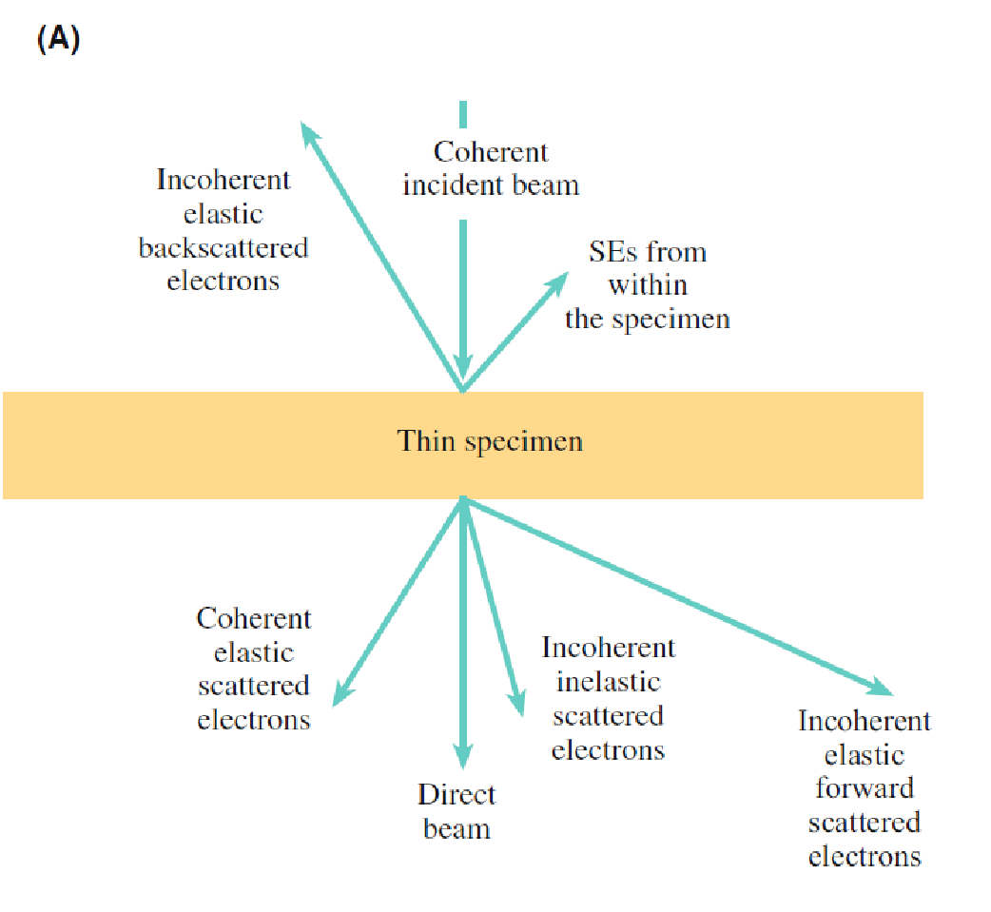
Electron beam sample interaction
Auger
electrons
Backscattered
electrons
composition
topography
Secondary
electrons
X-rays
~1 nm
Structure,
defects
Diffracted
electrons
Electronic states,
composition
(EELS)
Transmitted electrons
Transmission Electron Microscopy, A textbook for Materials Science, David B Williams and C Barry Carter, Springer, 2nd edition 2009

Slide 8
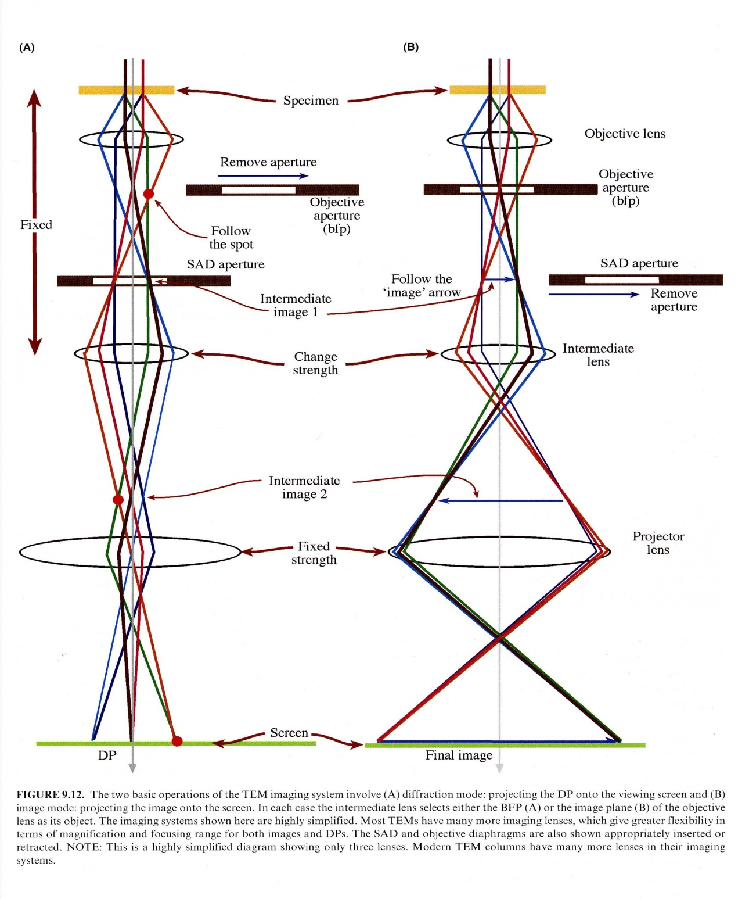
Imaging and Diffraction in TEM
Electron gun 1st beam deflector
GUN 1
GUN 2
Spot
CL1~3
CLS
CLA1
CM
CLA2
OBS
OL1
OM
IS1
IS2
PLA
Intermediate lens stigmator
ILS
PL
IL1~3
Transmission Electron Microscopy, A textbook for Materials Science, David B Williams and C Barry Carter, Springer, 2nd ed. 2009

Slide 9
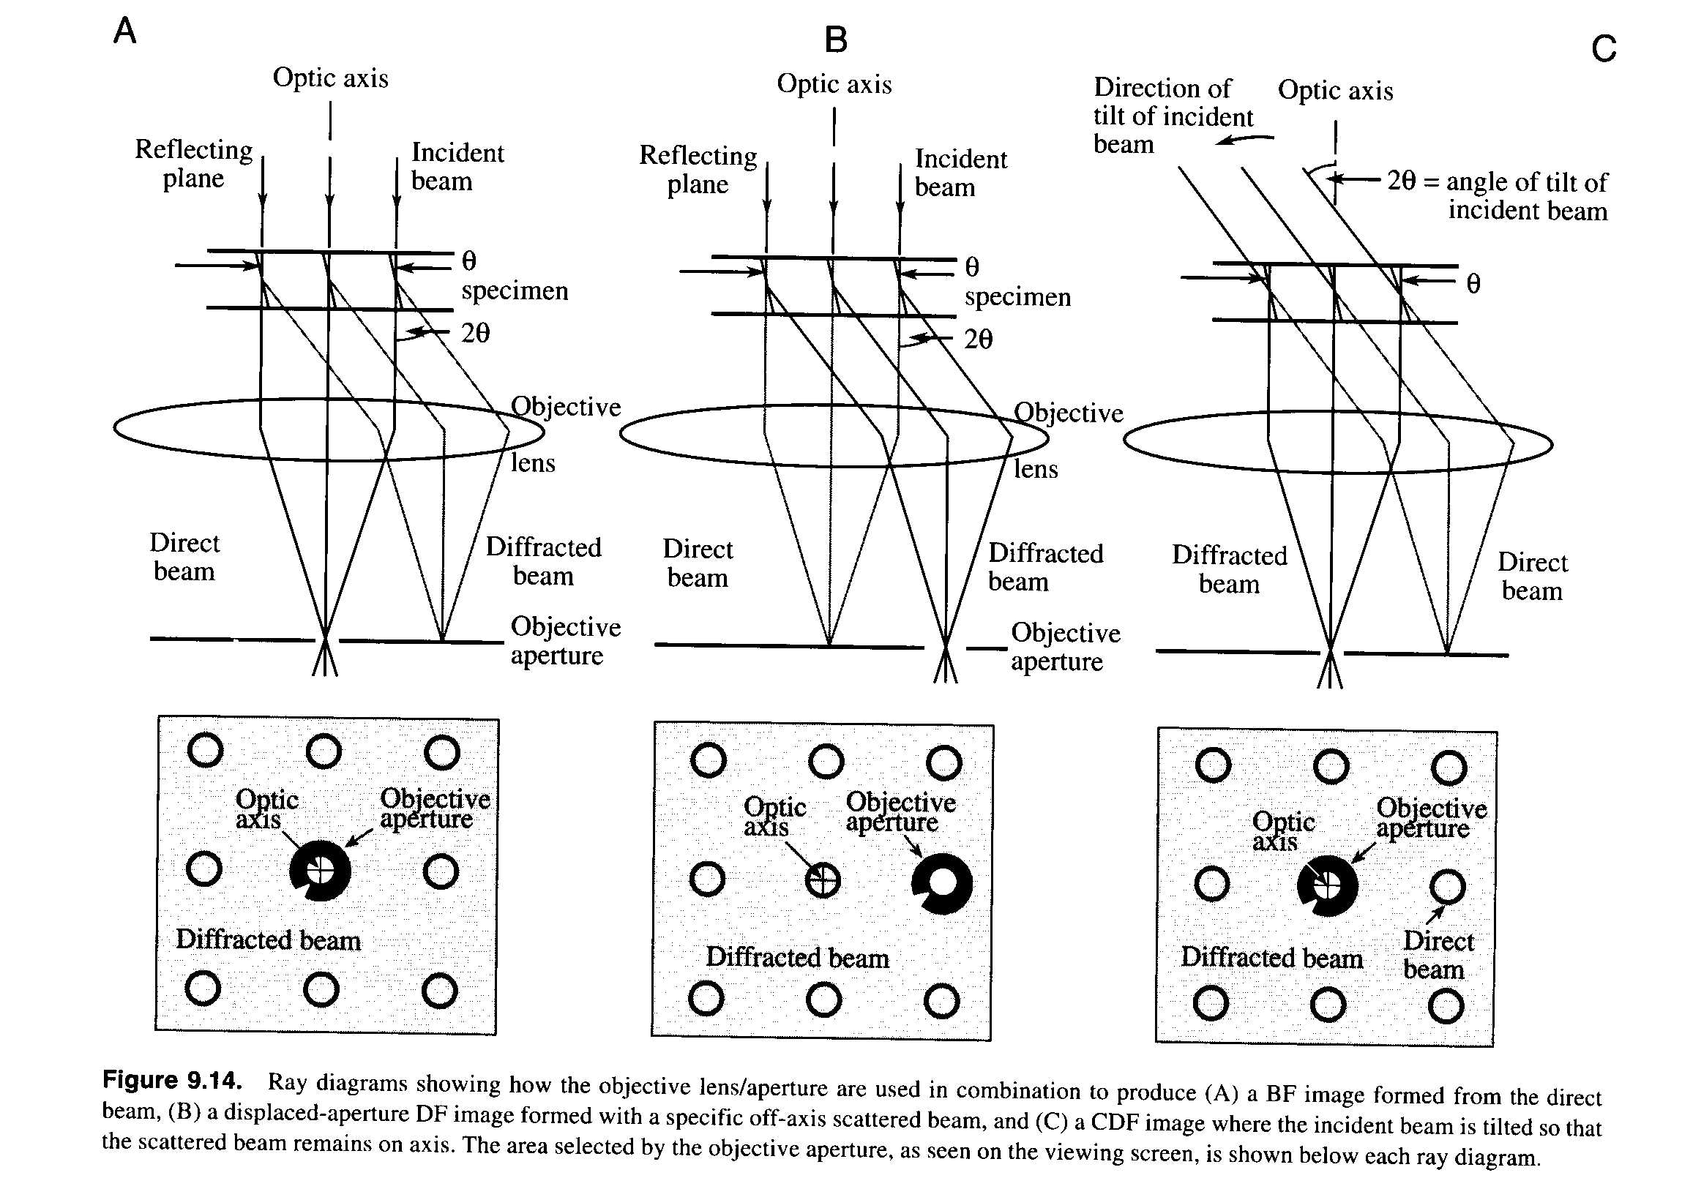
Bright Field and Dark Field in TEM
Bright Field
Dark Field
Transmission Electron Microscopy, A textbook for Materials Science, David B Williams and C Barry Carter, Springer, 2nd edition 2009

Slide 10

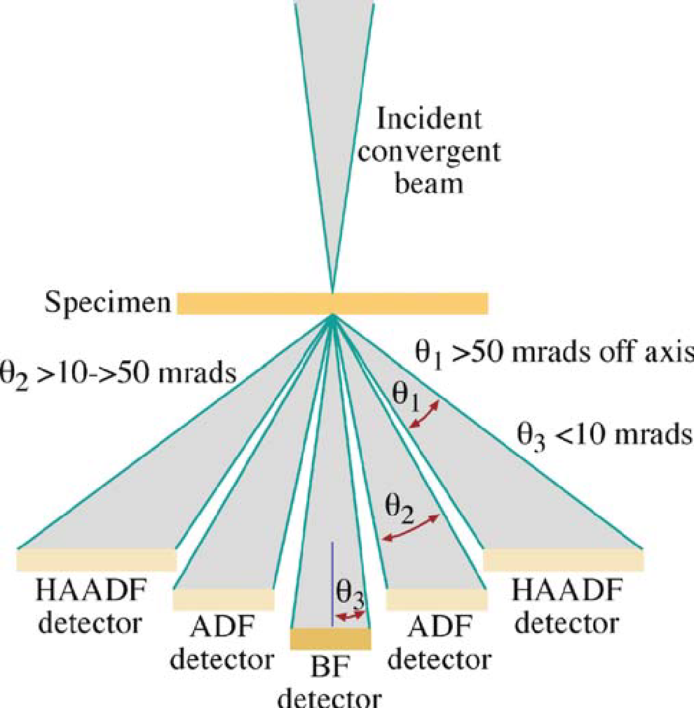
STEM imaging
ADF detector
BF Bright Field detector
ADF Annular Dark Field detector
HAADF High Angle Annular Dark Field detector
In STEM mode the electron beam is scanned on an area of the sample and the selected detector collects the signal from each point
Transmission Electron Microscopy, David Williams and Barry Carter, 2nded. (2009)

Slide 11
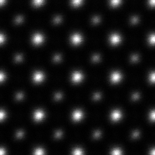
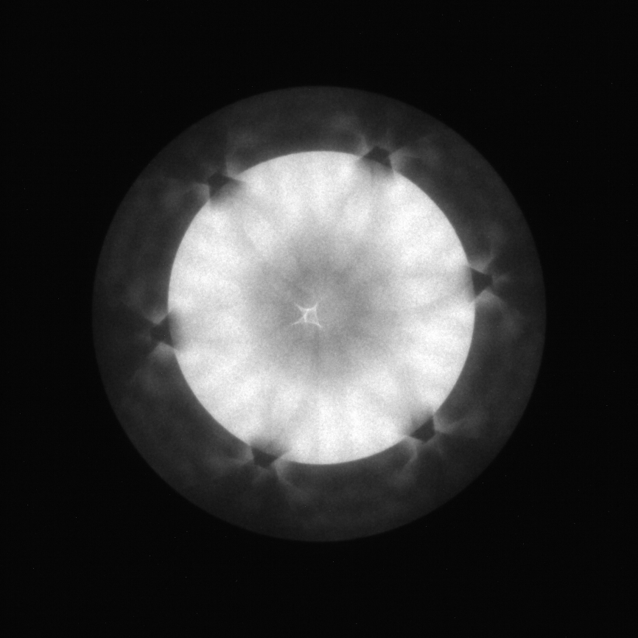
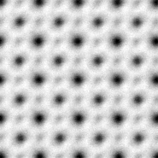
NEOARM Specifics for STEM Imaging
STEM Imaging Modes
High-angle annular dark field (HAADF)
Bright field (BF)
Annular bright field (ABF)
SrTiO₃ Example
HAADF
O
Sr
HAADF:
Z-contrast
Robust, easy to understand
Diffraction Pattern (STEM)
Ti+O
Z Contrast
BF:
Close to conventional TEM
Phase Contrast (not straightforward)
ABF
ABF:
Enhanced contrast for light elements
Robust, easy to understand
Light Element
Transmission Electron Microscopy, David Williams and Barry Carter, 2nded. (2009)
From JEOL

Slide 12
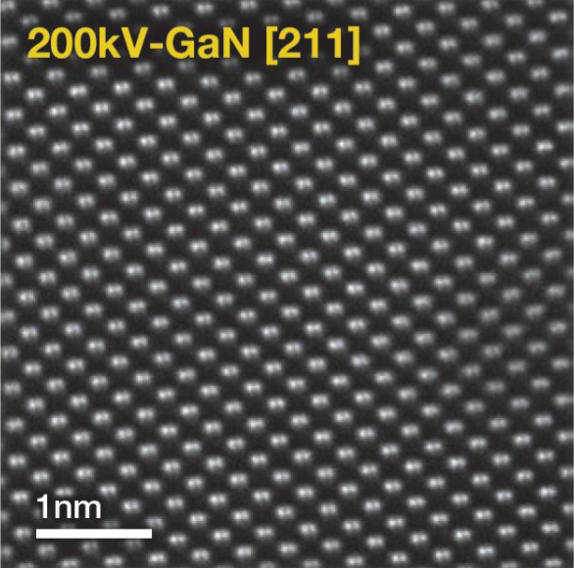
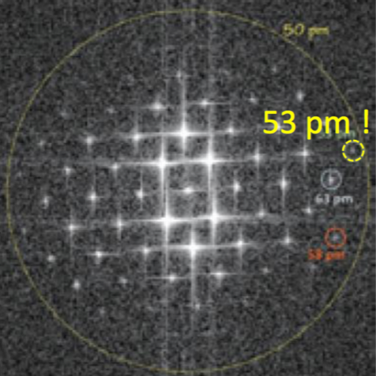
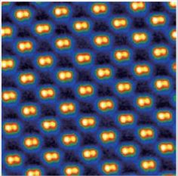

NEOARM Specifics
HAADF STEM Image
NEOARM
High-brightness Cold Field-Emission Gun
Column and Corrector alignments provided at 30 kV, 80 kV, 200 kV
Resolution of .23nm in TEM
+/- 35/30 degrees of tilt in X/Y
FFT
STEM C_{s}-Corrector
CEOS ASCOR – Second-generation, higher-order corrector
Enables high-resolution imaging with large convergence angles and high probe currents
JEOL COSMO automated Corrector alignment routine
Ga-Ga dumbbells split by 63 pm
From JEOL

Slide 13
JEOL NEOARM + CEFID Configuration
JEOL
STEM C_{s}-Corrected --Aligned at 30kV, 80kV, 200kV
Dual EDS
STEM HAADF, STEM ABF detectors
Segmented STEM (SAAF) Quad Detector
STEM Lorentz & NBD alignments
Biprism
PyJEM (Python-based) scripting control of JEOL + IDES
IDES
EDM Synchrony (Electrostatic Dose Modulator)
Luminary Micro
Relativity Sub-framing
CEOS/TVIPS/DECTRIS/PN Detector
CEFID energy filter
ELA detector
TVIPS XF416 detector
TVIPS XF416 Bottom mount
Use with IDES Relativity
PN Detector for STEM
Other
Gatan Straining Holder (654)
Simple Origin Dual Grid Cryo
Protochips Poseidon holder
Protochips Atmosphere holder
Protochips Fusion holder
200kV CFEG
EDM Synchrony
STEM Cs Corrector
Luminary Micro
Gatan 654
Dual Grid Cryo
EDS
Dual 100mm² SDD
HR pole piece
STEM detectors
Biprism
Relativity
SAAF Quad
PN STEM
TVIPS XF416
TVIPS XF416
CEOS CEFID
DECTRIS ELA
From JEOL

Slide 14
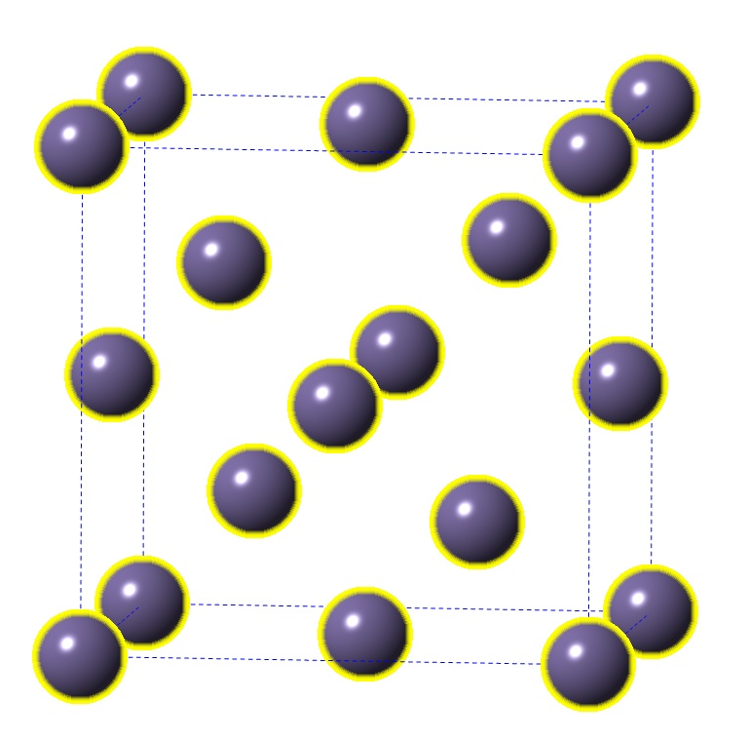
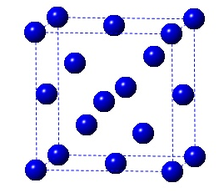
Sample 1 to be Analyzed
Ge
Si₂₀Ge₈₀
Si
Ge
a=0.5658 nm
Sample from Riss Card at UMD
Ge and Si are in group IV of the periodic table. However, Ge is heavier than Si and has larger lattice constant. The contrast between the Si_{1-x}Ge_{x} layers and pure Si layers depends on x.
ADF in STEM gives higher contrast because of the larger atomic mass of Ge compared to Si.
What to look for:
Thickness of SiGe layers
Sharpness of the Si/SiGe interfaces
Defects in the multilayer
Si
a=0.543 nm

Slide 15
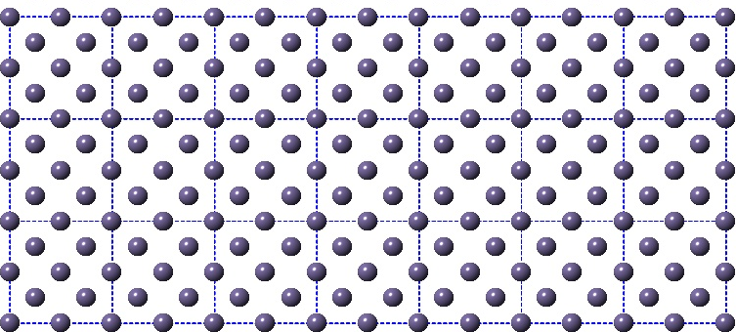
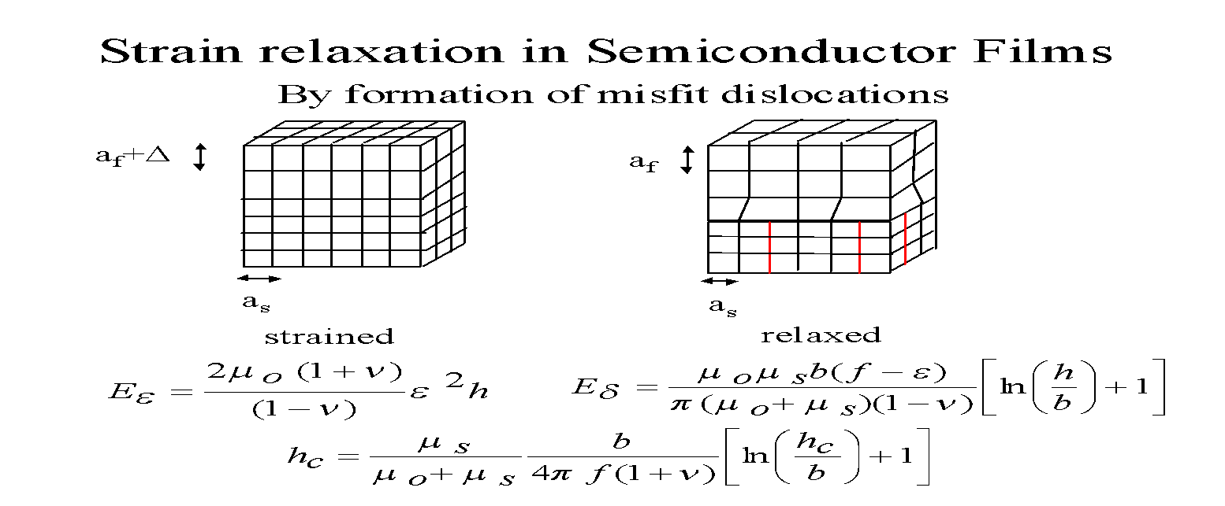
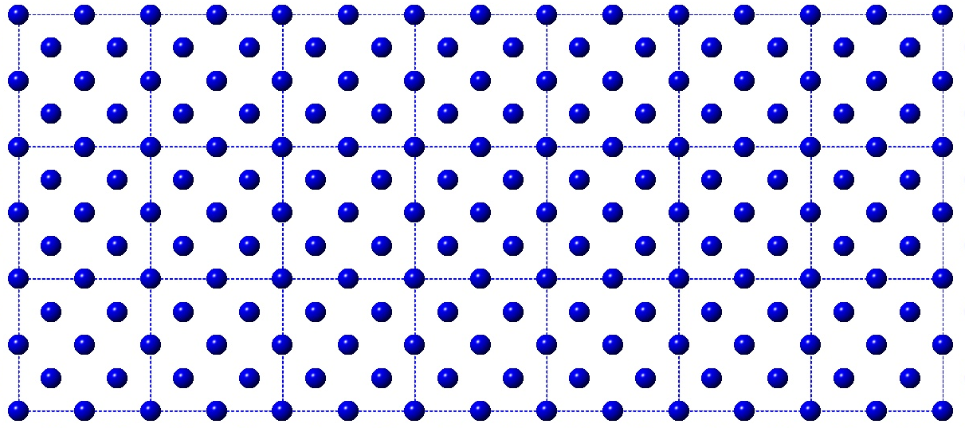
Misfit Dislocations
Film under strain
Partially relaxed film
Misfit dislocations (red) form at the interface between film and substrate. Dislocations degrade the properties of the sample.

Slide 16
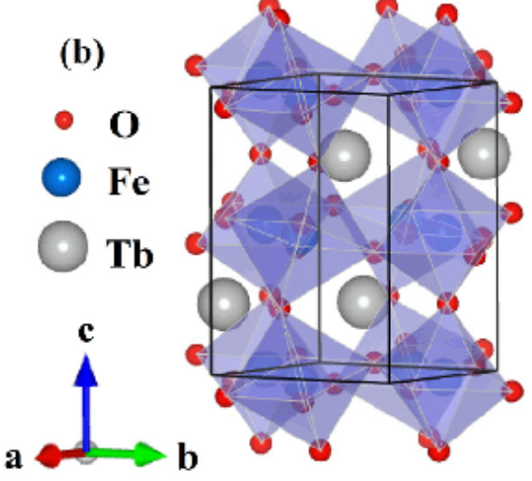
Sample 2 : TbFeO₃ on YSZ
Used for photocatalysis, electronics, and magnetic applications.
TbFeO₃ film deposited by PLD on Y₂O₃ stabilized zirconia Zr₂O₄ with hexagonal structure.
Y_{x}Zr_{1-x}O₃ the value of x determines the crystal structure of YSZ and this controls the crystal structure of TbFeO₃ and its properties
It is known that under special deposition/synthesis conditions, TbFeO₃ grows in a hexagonal structure, which has a completely different property compared to the orthorhombic one. Using autonomous deposition condition optimization experiment Dr. Takeuchi’s team found the best condition to fabricate phase pure metastable hexagonal phase, and this is what we show here.
This structure could also have defects that affect the properties.
Usual structure Orthorhombic
Cao, Yiming et. Al. (2016). Magnetic phase transition and giant anisotropic magnetic entropy change in TbFeO3 single crystal. Journal of Applied Physics. 119. 063904. 10.1063/1.4941105.

Slide 17
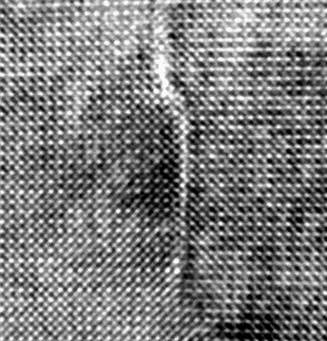

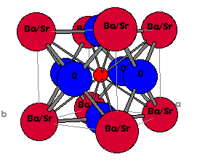
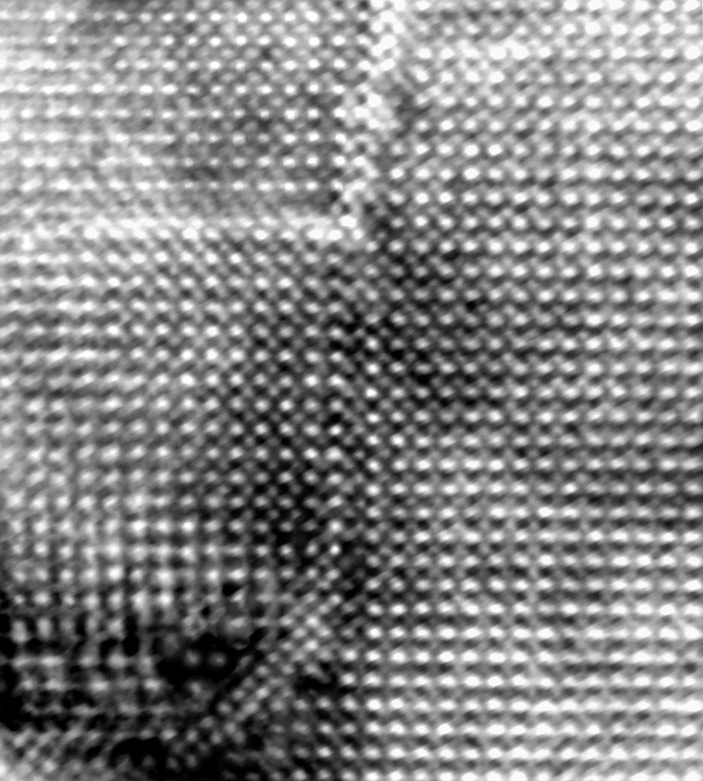
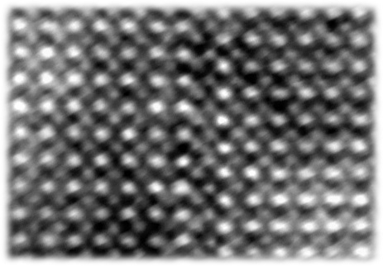
Antiphase Domain Boundaries In Ba(Sr) TiO₃
Ba/Sr
Ti
2nm
010
½[010]
100
ADB is Ba/Sr rich
Ba/Sr
Ti
Ba/Sr
Ti
010
2nm
100
ADB is Ti rich
H. Zheng, L. Salamanca-Riba, R. Ramesh, and H. Li, Appl. Phys. Lett. 85, 2905-7 (2004).

Slide 19
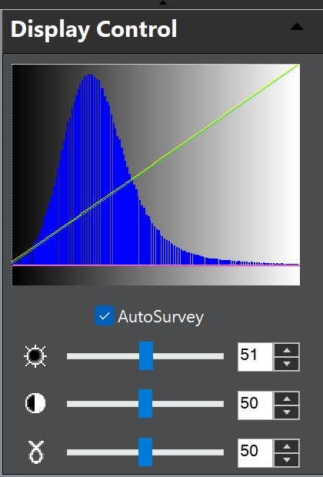
Secton 0.1.2 Histogram and Contrast in Photography
Dynamic range is the ratio between the maximum and minimum measurable light intensities (in photography) or signal amplitudes (in audio) a system can capture, typically measured in stops or decibels (dB). It represents the ability to retain detail in both extreme highlights and deep shadows simultaneously without clipping or noise. ¹
A linear detector (or linear image sensor) in electron microscopy is a detector where the signal output is directly proportional to the incident electron flux.
An annular dark field detector (ADF) is a linear detector made of an array of pixels that measure the number of electrons in each pixel to form an image. When a pixel is saturated information is lost because the pixel has reached its maximum charge capacity.
It is important to adjust the dynamical range so that no information is lost.
Contrast is the difference between bright and dark features in an image.
Gamma is a non-linear correction to adjust mid tones without affecting contrast. To enhance viewing of the image.
Histogram
Obtained from Gatan Digital Micrograph
1. https://en.wikipedia.org/wiki/Dynamic_range
‹#›

Slide 20
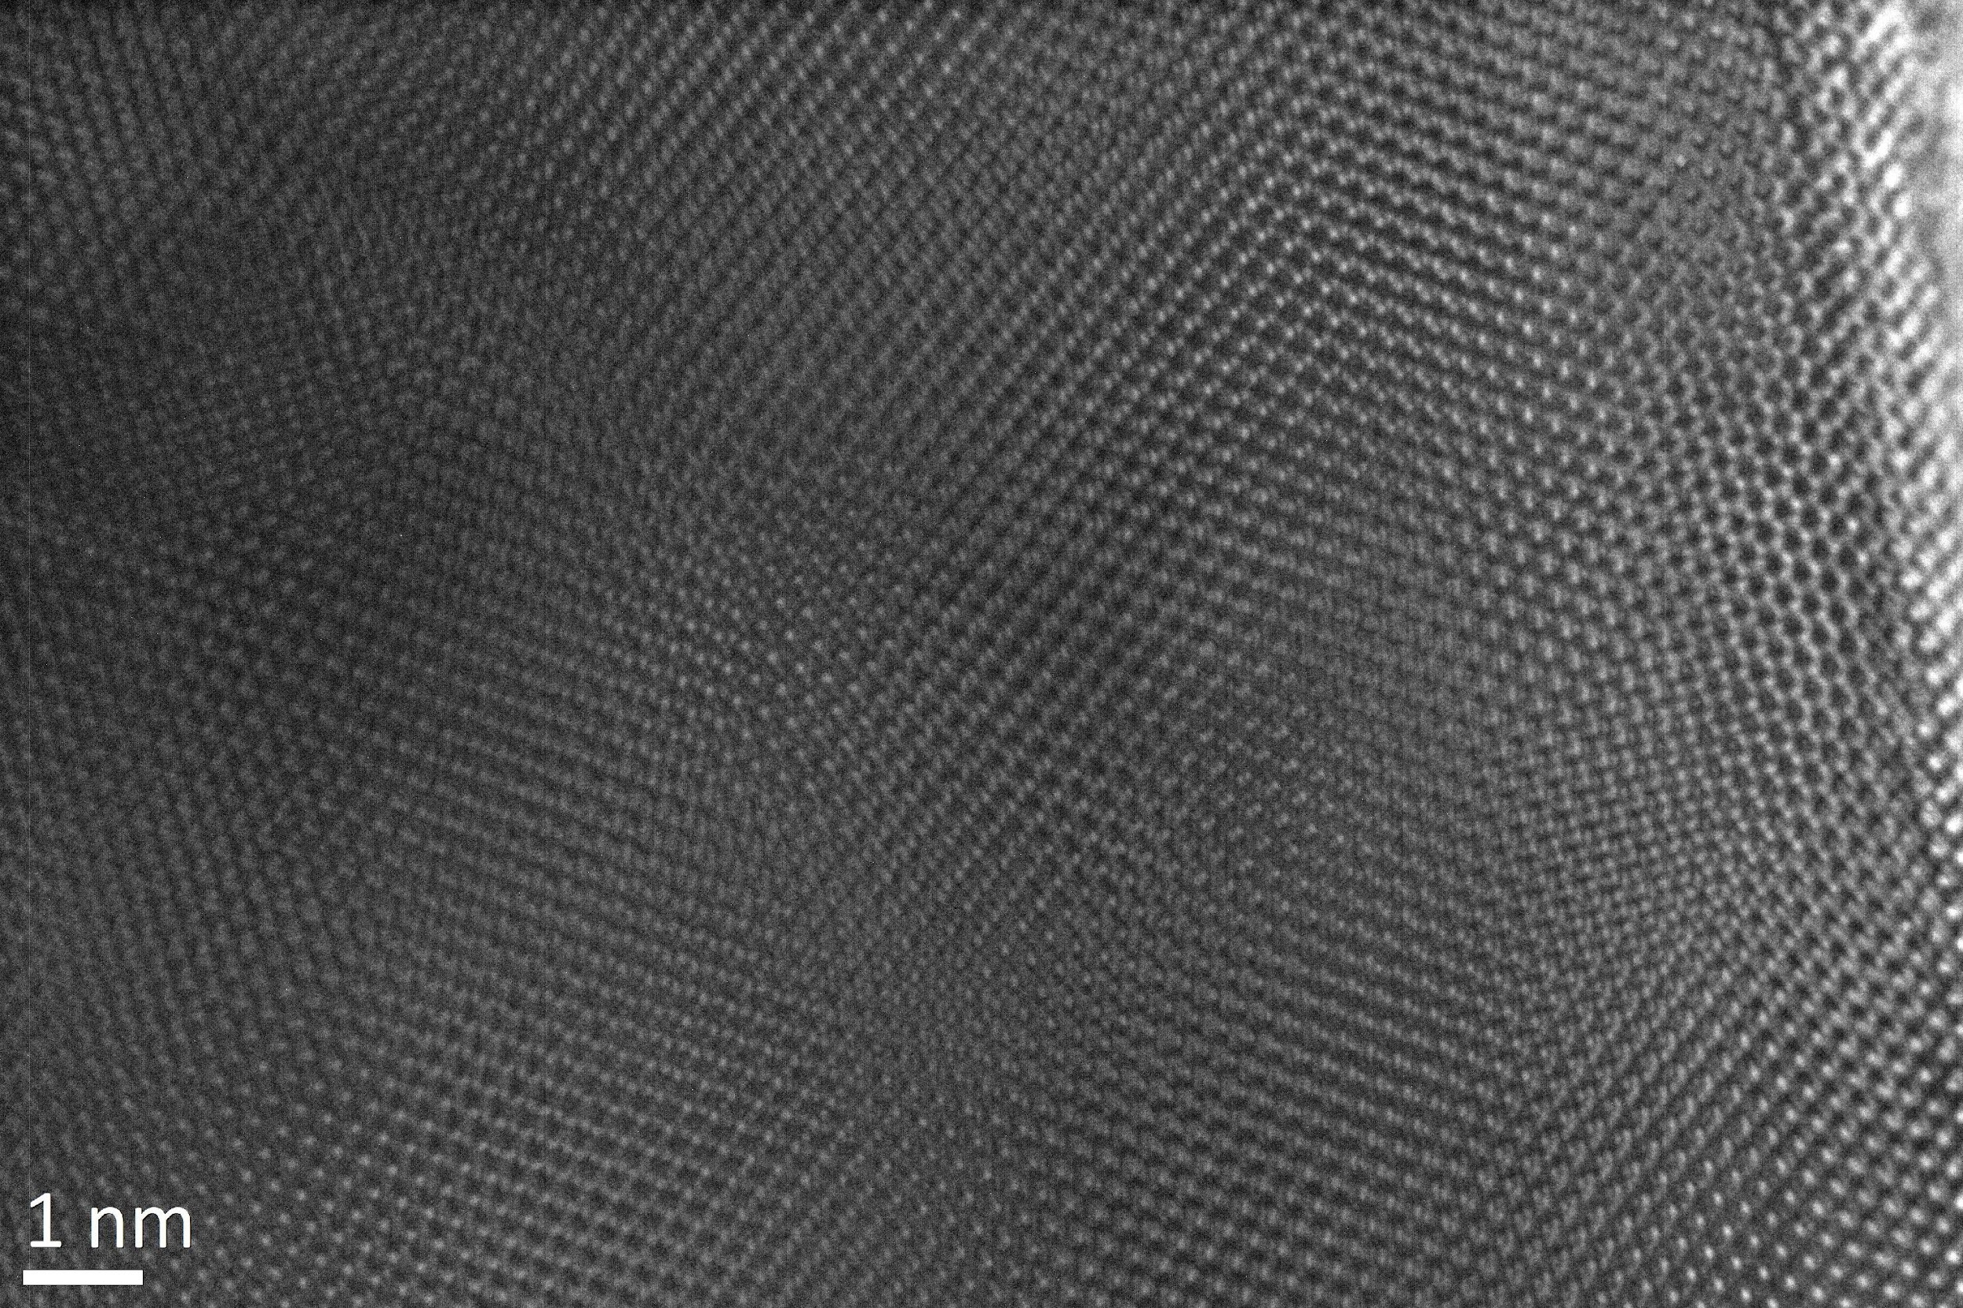
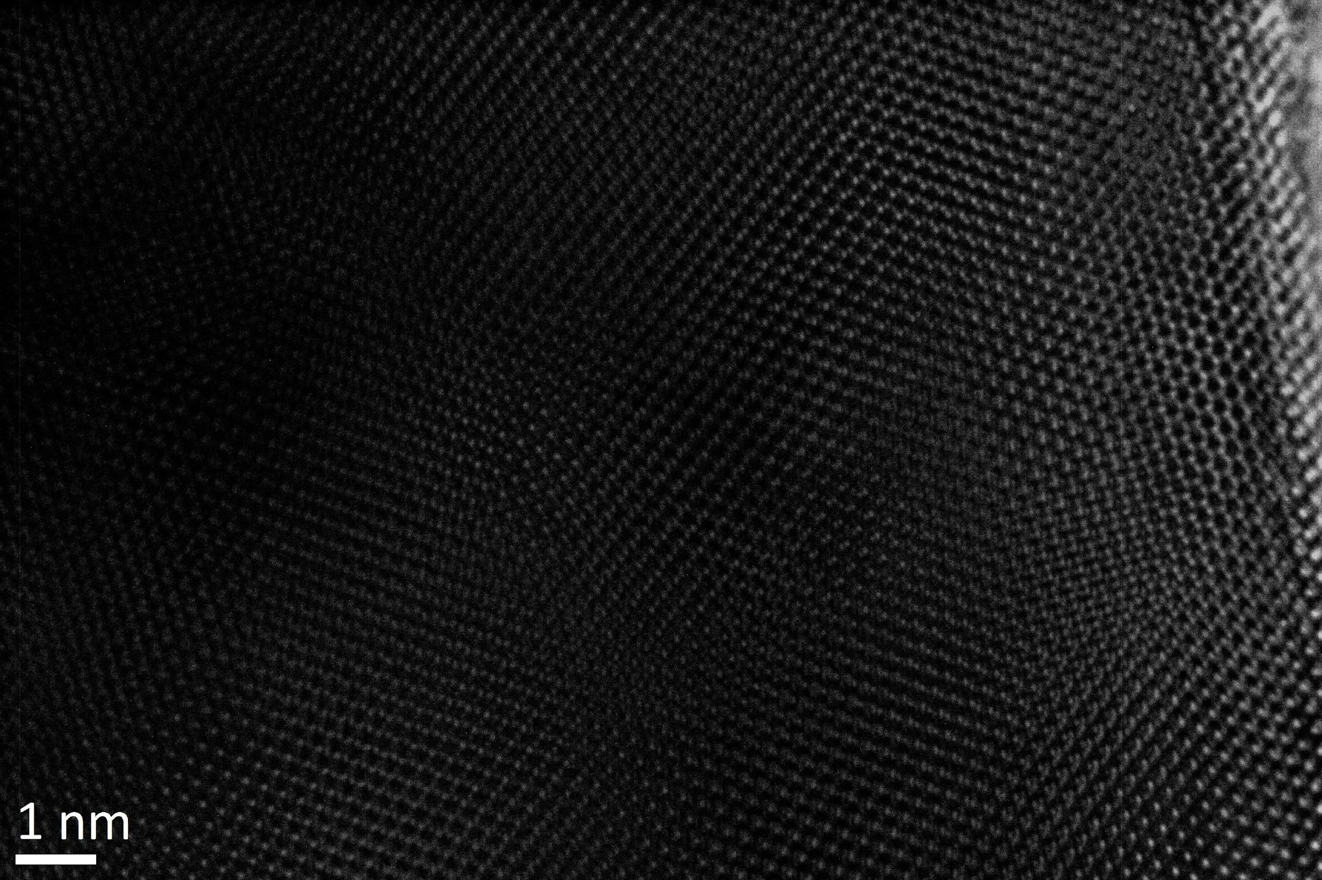
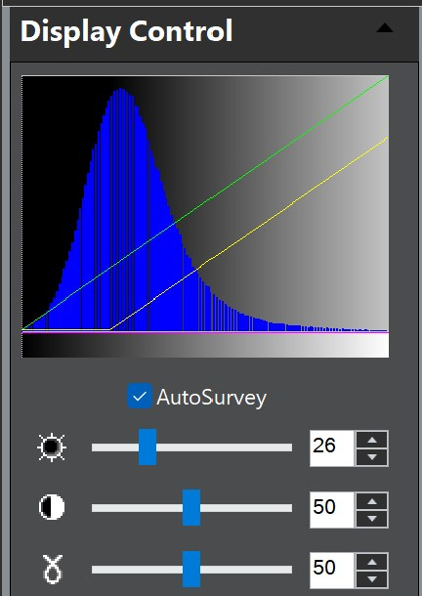
Effect of brightness

Slide 22
Section 0.1.3 Noise Correction in TEM/STEM
Sources of Noise
There can be many sources of noise in TEM/STEM
Shot noise- from fundamental Physics. Dominant in STEM. It arises from the statistical fluctuations in the number of incident electrons and electron scattering events.
Detector/Read noise. Variations in the electronics of the detectors in the microscope
Room temperature variations,
Variations in the accelerating voltage of the microscope
Sample modifications (from beam damage or instabilities under the beam, etc)
Scan jitter (of the e-beam)
Sample DRIF

Slide 23
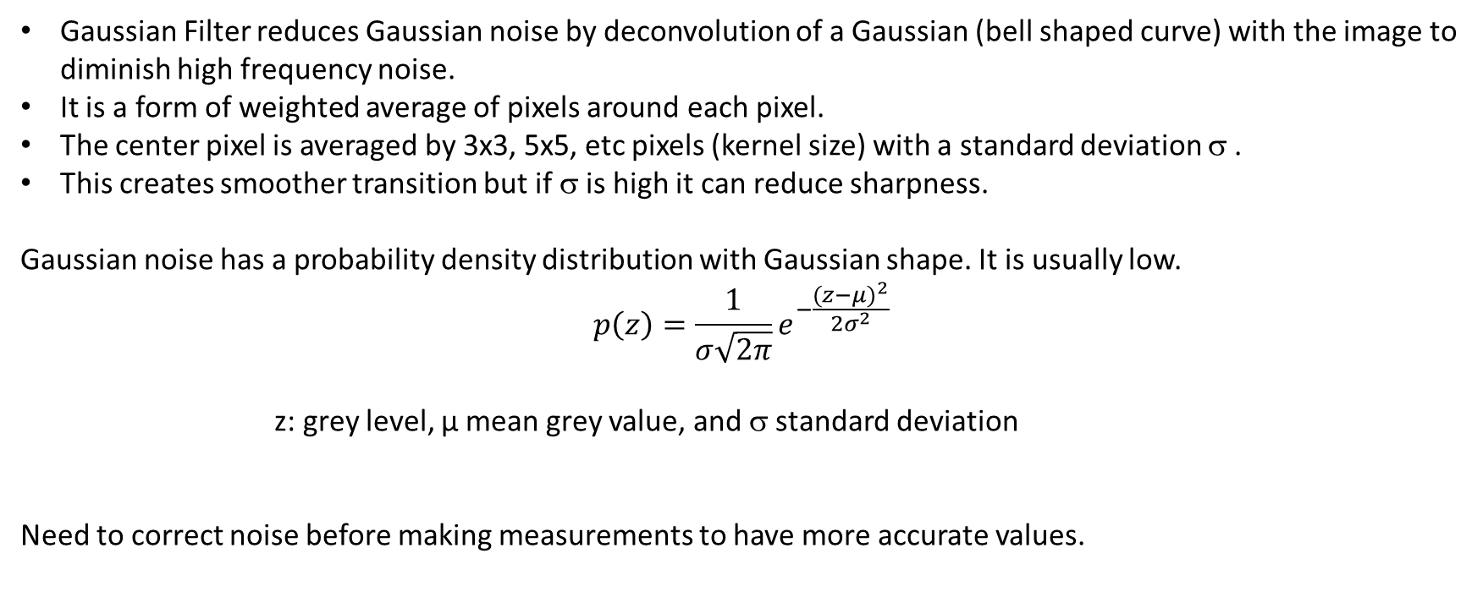
Noise Correction with Gaussian Filter
‹#›

Slide 25
Section 0.1.4 DRIFT Correction
In TEM an image is acquired with an exposure time of < 1 sec. During this time the sample could have drifted from original position giving rise to an image which appears to be out of focus.
In STEM an image is acquired as the beam is scanned over an area of the sample with a short dwell time (microsec- millisec) at every spot to minimize drift. This image is not optimized for contrast and brightness.
If a series of images is acquired from the same area they can be summed up to increase intensity and contrast. Prior to combining the images it is necessary to correct for sample drift from one image to the next.
‹#›

Slide 26
Drift Correction
Collection of several images from the same area of the sample.
Each image is obtained with short dwell time to minimize drift; not optimized for brightness and contrast
The images are then corrected for drift and summed up
Images are ready to be summed up to optimize brightness and contrast
ADF detector
Need to align images

Slide 28
Section 0.1.5 Measurement of Distances in HRTEM Images
HAADF STEM Image
Atomic Resolution Images to measure distances in fraction of nm (pm).
Interplanar Distances.-
Crystalline materials could have changes in their structure due to strain, changes in crystal structure.
It is important to have a well calibrated microscope to accurately measure distances. The microscope is calibrated using a standard sample, such as STEM images of Si or GaN of known interatomic distances, i.e, distance between Si-Si or Ga-Ga dumbells
Example: in the Si₂₀Ge₈₀/Si sample the properties of the device depend on the thickness of the Ge, and Si₂₀Ge₈₀ layers. Variations in the thickness of the Ge or SiGe layers affect the properties.
FFT
Ga-Ga dumbbells split by 63 pm
From JEOL

Slide 30
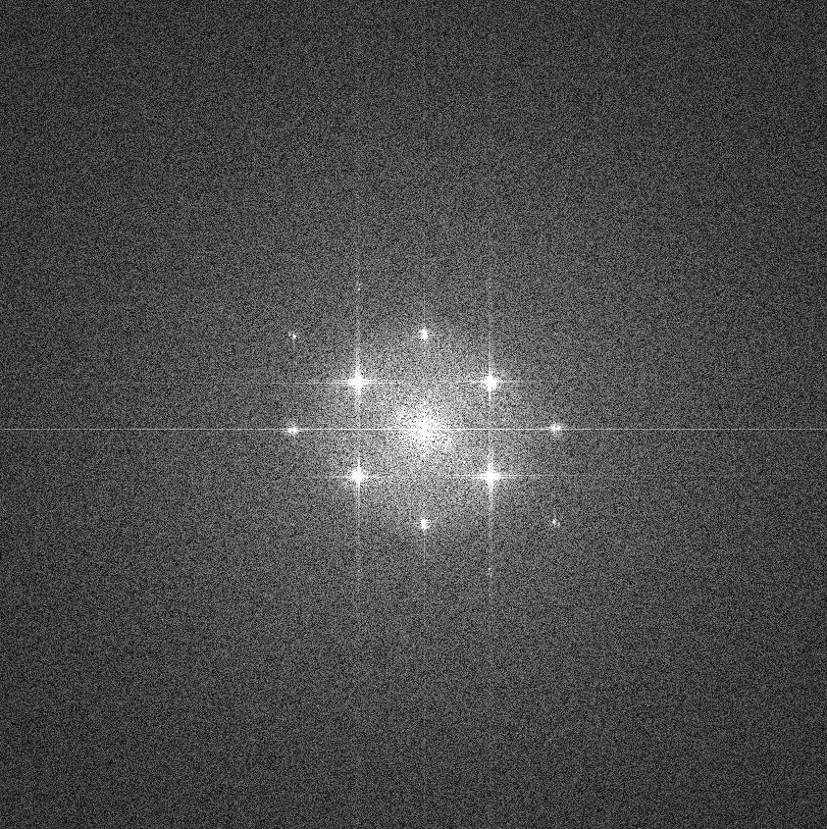
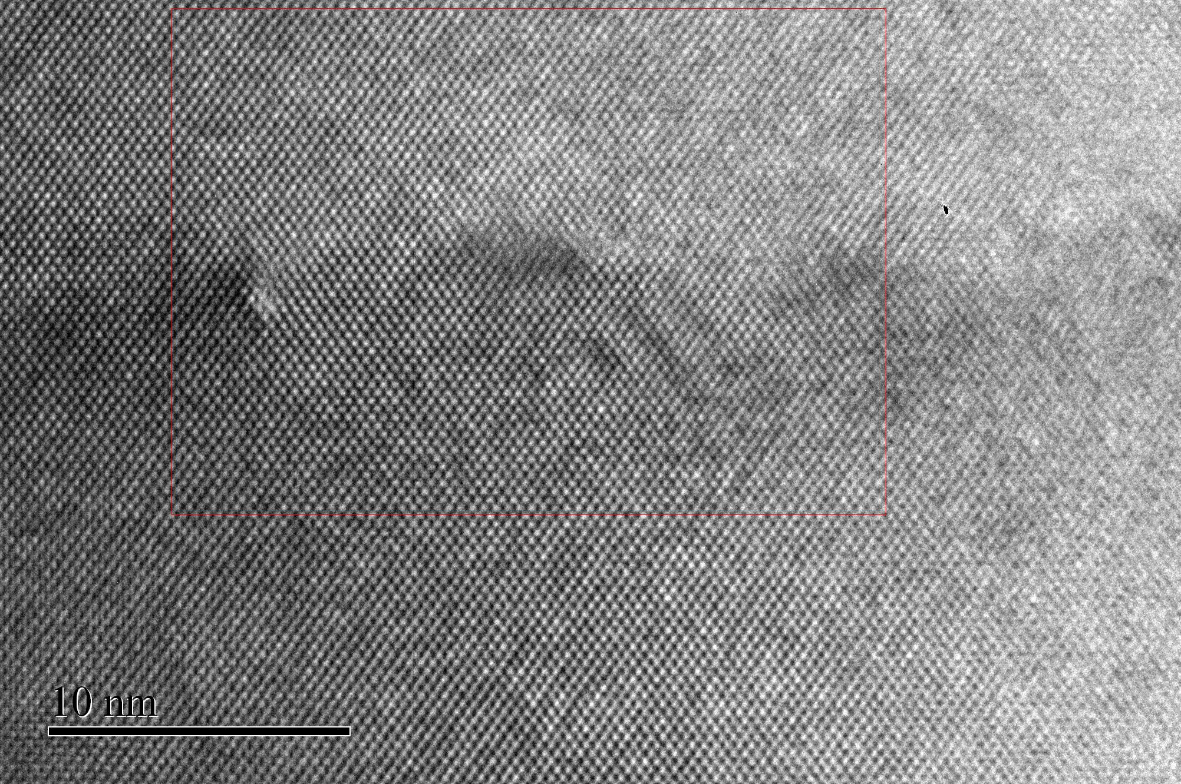

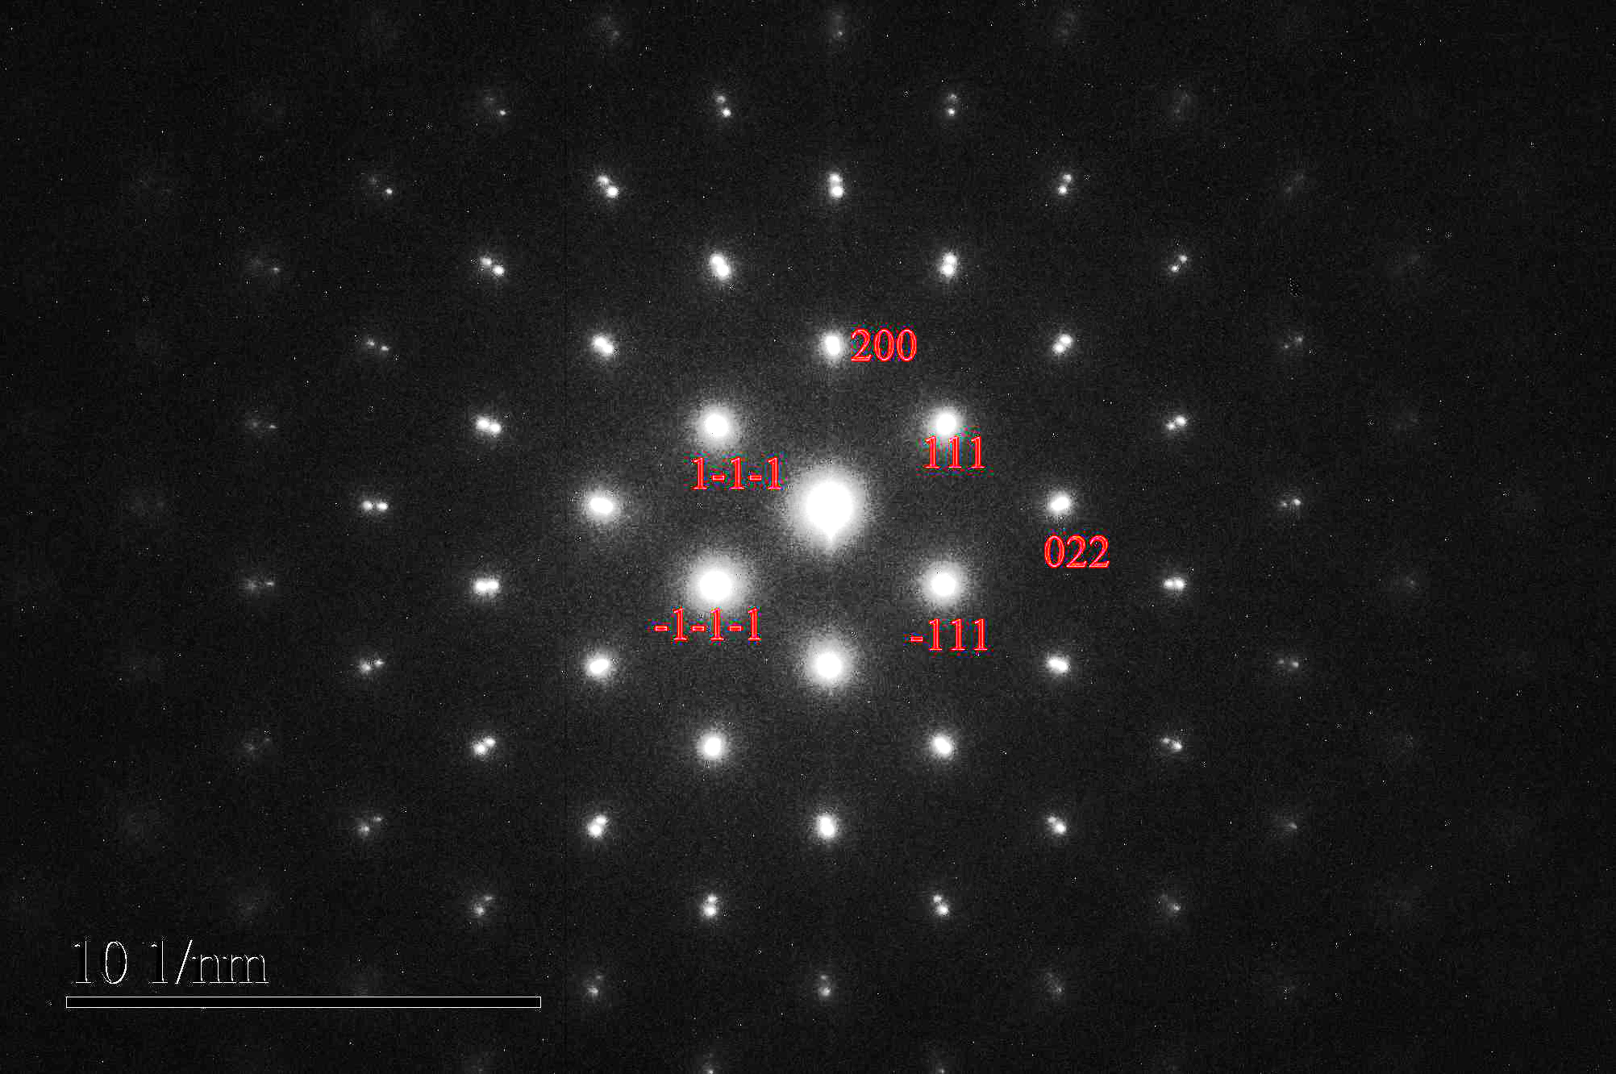
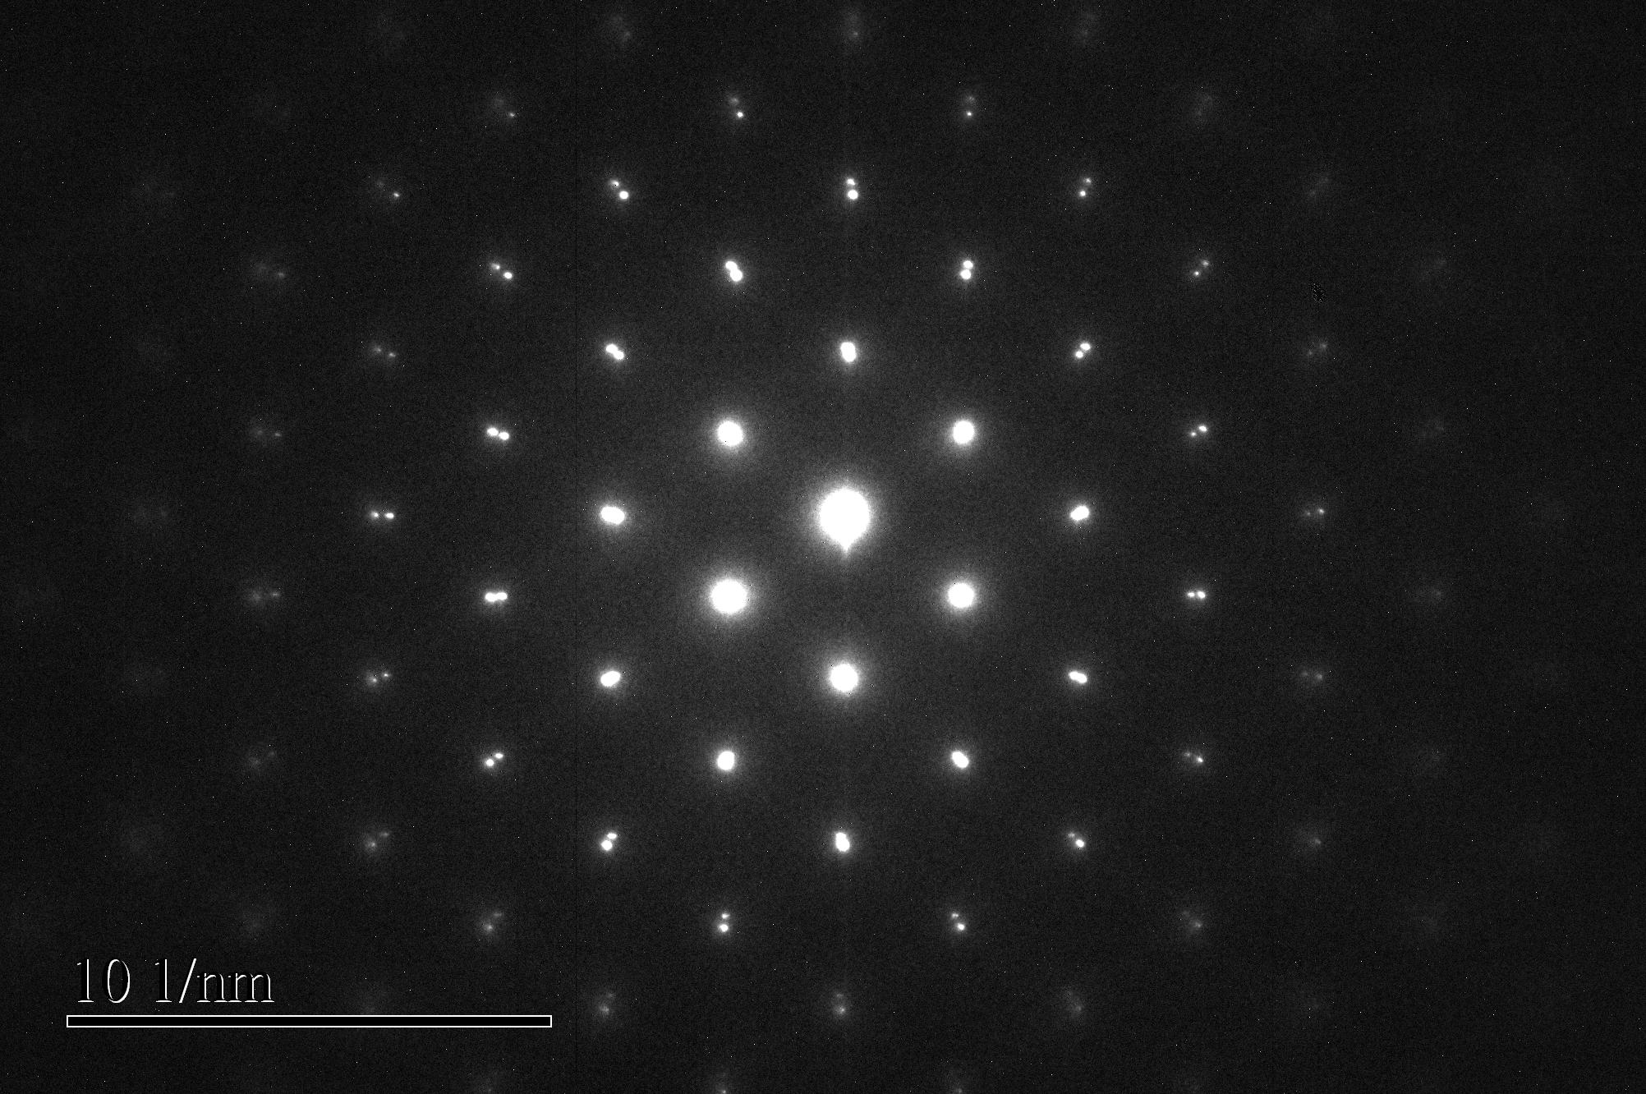
Section 0.1.6 FFT Analysis
InAs
FFT from red box
InP
Masked FFT

Slide 31
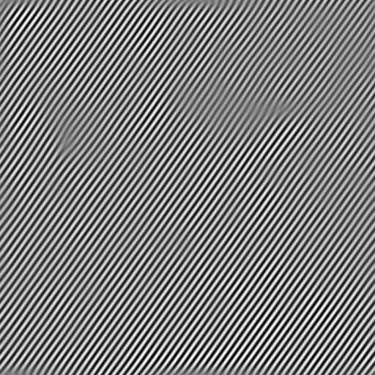
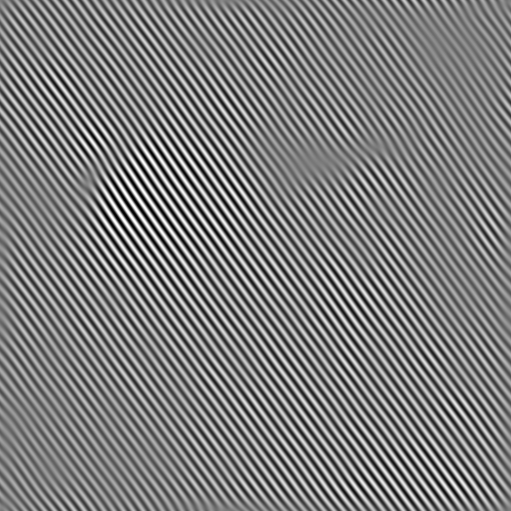
Inverse FFT (IFFT) Ba(Sr) TiO₃ Misfit Dislocations

Slide 32
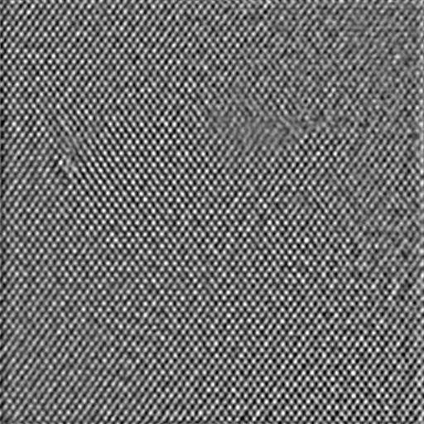
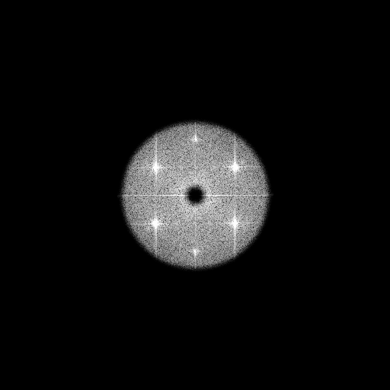
IFFT to Enhance Contrast Filter out noise
Annular filter

Slide 33
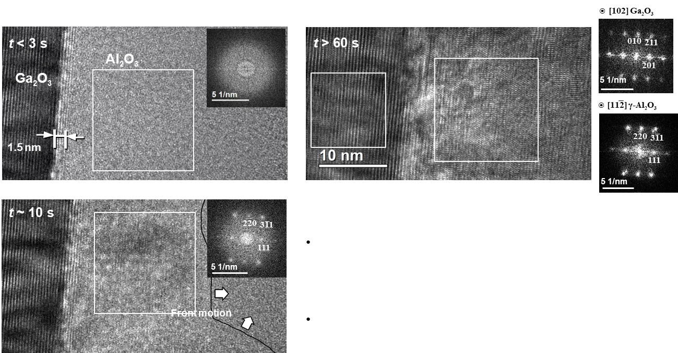
Electron Beam-induced Crystallization Ga₂O₃/Al₂O₃
Al₂O₃ layers crystallized fully after several seconds
of TEM beam exposure, outward from interface (not from the Al contact, or homogeneously)
Each of 3 samples showed the same qualitative effect, including one already annealed at 500 °C
C. Klingshirn, L. Salamanca-Riba et. al., Micron 140 (2021) 102954.

Slide 35
Thank you for participating in the workshop Questions?

