Slide 1
Foundations of TEM Data Management & Analysis
Why open science and reproducible workflows matter
CITEAM Workshop | May 20, 2026
University of Maryland | NSF Award #2519465, 2519466, and 2519467.
1
Notes:
- NSF Award Search: https://www.nsf.gov/awardsearch/show-award/?AWD_ID=2519466
Slide 1 — Foundations of TEM Data Management & Analysis
Welcome—this is a short context talk to explain why this workshop exists. TEM today is as much about the data as the instrument: the files are large and varied, and analysis choices can change the scientific claim. The goal is to give you low-barrier, practical habits—workflow, minimal metadata, and transparent steps—so your results are easier to trust, reuse, and share.

Slide 2
Why this workshop exists
from instrument to insight
The workshop is organized around three ideas:
Modern TEM work is not only imaging.
files are larger and more varied than before analysis choices affect the final scientific claim data without context becomes hard to trust or reuse
Collect well
good files + basic metadata
Analyze transparently
repeatable steps + saved parameters
Share responsibly
reusable data + code + provenance
Goal: to scale from individual tasks to real research workflows
2
Notes:
Slide 2 — Why this workshop exists: from instrument to insight
TEM isn’t “just imaging” anymore: you generate many files, make processing choices, and then need to store and publish responsibly. The workshop is organized around three ideas: collect well (good files + basic metadata), analyze transparently (repeatable steps + saved parameters), and share responsibly (reusable data + code + provenance). If you keep those three in mind, you’ll be able to scale from beginner tasks to real research workflows.

Slide 3
Open science in one minute
📄
🗂
</>
☰
Open papers
Open data
Open code
Open methods
publish so others can read
make datasets findable and reusable
save the exact steps you took
record enough detail to repeat the work
FAIR is the simple idea underneath this: make research outputs Findable, Accessible, Interoperable, and Reusable.
Wilkinson et al., “The FAIR Guiding Principles for scientific data management and stewardship,” Scientific Data (2016): https://www.nature.com/articles/sdata201618
3
Notes:
Slide 3 — Open science in one minute
Open science here means four things in plain language: people can read the paper, find and reuse the data, see the code/steps used to produce results, and understand the methods well enough to repeat them. The shortcut concept underneath is FAIR: make research outputs Findable, Accessible, Interoperable, and Reusable—not perfect, just meaningfully reusable.

Slide 4
From individual files to a data ecosystem
why this matters now
Repositories
Standards
Labs
Tools & open
infrastructure
National data ecosystem
Coordinated infrastructure across government, academia, and industry is needed so research data can actually be found, connected, and reused.
Campo et al., “Now Is the Time to Build a National Data Ecosystem for Materials Science and Chemistry Research Data,” ACS Omega (2022): https://pubs.acs.org/doi/10.1021/acsomega.2c00905
4
Notes:
Slide 4 — From individual files to a data ecosystem: why this matters now
Your work doesn’t live in isolation—labs, repositories, standards, and tools form an ecosystem that determines whether data can actually be discovered and reused. The “national data ecosystem” framing is basically: without coordinated infrastructure and shared practices, valuable research data stays fragmented and hard to connect. This workshop is a small, practical step toward making TEM data behave like a reusable scientific asset.

Slide 5
Why should you care? Three big wins
✓
↺
⇢
Replicability & trust
Reuse by others (and future you)
Scales to teams & AI
Sharing both data and analysis methods enables replicability (others can re-run the path from raw data to figure) and trust in your methods
Well-structured data; consistent file names, metadata, and code turn a one-off experiment into a reusable asset.
Well-structured data is what lets labs collaborate, automate, and learn faster.
It enables AI.
5
Notes:
Slide 5 — Why should you care? Three big wins
You get three concrete benefits. First, replicability and trust: you—or someone else—can re-run the path from raw data to figure. Second, reuse: good names, metadata, and saved steps turn one-off experiments into reusable building blocks. Third, scale: well-structured data is what lets teams collaborate and lets automation/AI work reliably.

Slide 6
Why TEM data need context
An image alone is often not enough to interpret later
metadata and workflow context include:
● sample ID / composition
● why this experiment was conducted ● mode: TEM, STEM, HAADF, EDS… ● instrument settings and calibration ● acquisition date, operator, notes ● processing steps and saved parameters
Just an image
The key point is that data without context becomes hard to trust or reuse
Taillon, J.S. et al, MaRDA recommendations on microscopy metadata and LIMS, l MRS Bulletin (2025) https://link.springer.com/article/10.1557/s43577-025-00882-2
6
Notes:
Slide 6 — Why TEM data needs context
An image alone is often not enough to interpret later—TEM data needs context: what sample it is, why you collected it, mode (TEM/STEM/HAADF/EDS), instrument settings and calibration, acquisition date, and what processing was applied. The key point is that data without context becomes hard to trust or reuse. A small amount of captured context can prevent “orphan data.”

Slide 7

Think in workflows, not “one and done”
A workflow is a repeatable path from instrument to result
If you can name the steps, save the parameters, and keep the files linked, you are on the path to robust science.
The “data trail” idea : keep a link between sample → experiment → settings → files → processing steps
R.J. Hanisch, et al, NIST Research Data Framework (RDaF), Version 1.5 (NIST Special Publication NIST SP 1500-18r1, National Institute of Standards and Technology, Gaithersburg, May 2023). https://doi.org/10.6028/NIST.SP.1500-18r1; https://nvlpubs.nist.gov/nistpubs/SpecialPublications/NIST.SP.1500-18r1.pdf
7
Notes:
Slide 7 — Think in workflows, not “one and done”
A workflow is just a repeatable path from instrument to result. If you can name the steps, save parameters, and keep files linked, you’re already doing reproducible science—even before you feel “good at coding.” Today’s workshop is built around learning that repeatable path so you can apply it to your own projects.
The “data trail” idea is: keep a link between sample → experiment → settings → files → processing steps,

Slide 8
Open code: own your analysis
Even a simple notebook helps because it records:
Notebook.ipynb
what file you opened what parameter you changed what output you saved what someone else would need to repeat it
Think of open code as transparent lab notes you can rerun.
FAIR applies not only to data but also to the algorithms, tools, and workflows that led to the data: https://www.nature.com/articles/sdata201618 FAIR principles for research software overview: https://www.nature.com/articles/s41597-022-01710-x
8
Notes:
Slide 8 — Open code: own your analysis
Even a simple notebook helps because it automatically records what file you opened, what parameter you changed, what outputs you saved, and what someone else would need to repeat it. You can think of “open code” as transparent lab notes you can rerun. The objective isn’t to turn everyone into a software engineer—it’s to keep your analysis legible and repeatable.

Slide 9
What is metadata?
plain-language version
Examples of data
Metadata = the information that makes a file understandable.
● what sample it is ● how the data were acquired ● what the units / scale are ● what processing already happened ● what terms and identifiers were used
image
stack
spectrum
notebook
9
Notes:
Slide 9 — What is metadata? plain-language version
Metadata is the information that makes a file understandable: what sample it is, how the data was acquired, what the units/scale are, what processing already happened, and what terms/identifiers you used. In microscopy, the same data type—image, stack, spectrum—can mean different things depending on settings and calibration. Metadata is what prevents ambiguity.

Slide 10
Minimum viable metadata for TEM
Sample ID
film_001
Start small. Be consistent.
Technique
TEM / STEM / SAED
● You do not need every possible field on day one. ● You do need enough context for another person to understand the file. ● Simple file name conventions, augmented by links to metadata and associated units*
Voltage (kV)
200
Magnification / pixel size
30,000x / 0.2 nm
Detector(s)
BF, HAADF, EDS
Acquisition date
2026-05-14
A short metadata template beats no template.
** Metadata recommendations grounded in MaRDA MRS Bulletin article: https://link.springer.com/article/10.1557/s43577-025-00882-2
* https://www.bipm.org/en/measurement-units
10
Notes:
Slide 10 — Minimum viable metadata for TEM
Start small, be consistent. You don’t need every possible field on day one, but you do need enough for another person to understand the file: sample ID, technique, voltage, magnification/pixel size, detector, acquisition date, and a brief note if needed. A short template beats no template, and it supports everything that comes after—analysis, collaboration, and eventual sharing.

Slide 11
Standard terms
“Casual labels”
Shared standard vocabulary
● “BF image” ● “bright field” ● “TEM BF” ● “bf1_final_reallyfinal”
● bright-field TEM ● detector = BF ● technique = TEM ● units = nm, kV
→
11
MaRDA recommendations discuss comprehensive metadata, standardized vocabularies/identifiers: https://link.springer.com/article/10.1557/s43577-025-00882-2
Notes:
Slide 11 — Standard terms and “data trails”
Messy labels are a silent productivity killer—“bf1_final_reallyfinal” is funny until you’re trying to compare datasets across months or across people. Standard terms—plus units—make data searchable and comparable.

Slide 12
Where do data and code go?
a simple repository map
Group or institution
Publication repository
Working storage
local / lab copy
(active project)
shared backed-up copy
(team and/or public access)
DOI + citation
(long-term sharing)
Best habit: publish the data and the analysis code together whenever possible.
- General best-practice synthesis from FAIR data/software sources: https://www.nature.com/articles/sdata201618 - Research software FAIR principles overview: https://www.nature.com/articles/s41597-022-01710-x
12
Notes:
Slide 12 — Where do data and code go? a simple repository map
Think in layers: working storage (active project), group/institutional storage (shared, backed-up access), and publication repositories (DOI + citation + long-term sharing). A strong habit is to publish data and analysis code together when possible, because it’s the combination that enables others to verify and reuse the result.
Digital Object Identifier—a global, unique, persistent identifier— unlike a url that can break, DOIs should resolve for ever to the data set that they identify.

Slide 13
Example repository: EMPIAR
A repository is not just storage; it is discovery + citation + reuse.
What it is
public archive for raw EM image data supports images underlying EMDB / cryo-EM and volume EM workflows entries are openly reusable under CC0
1 Prepare metadata
2 Upload files
3 Publish and make the dataset discoverable
- EMPIAR homepage: https://www.ebi.ac.uk/empiar/ - EMPIAR about page / CC0 reuse: https://www.ebi.ac.uk/empiar/about/ - EMPIAR policies: https://www.ebi.ac.uk/empiar/policies/
13
Notes:
Slide 13 — Example repository: EMPIAR
EMPIAR is a concrete example of what “sharing” looks like for electron microscopy: it’s not just dumping files—it’s metadata + upload + publication so datasets become discoverable and citable. The lesson isn’t that everyone must deposit everything; it’s that repositories define expectations for reuse: clarity, context, and a stable landing place for the data.

Slide 14
Materials data in the bigger picture
Materials Data Facility (MDF)
Bring it home for TEM
● example of a platform for publishing and discovering materials datasets ● connects data with code, publications, and community schemas ● shows what “data infrastructure” looks like beyond a single lab
● TEM users benefit from the same ecosystem logic: repositories, standards, metadata, and tooling all reinforce one another. ● This is why workshop skills matter.
- Materials Data Facility site: https://www.materialsdatafacility.org/ - Campo et al., “Now Is the Time to Build a National Data Ecosystem for Materials Science and Chemistry Research Data,” ACS Omega (2022): https://pubs.acs.org/doi/10.1021/acsomega.2c00905
14
Notes:
Slide 14 — Materials data in the bigger picture
The Materials Data Facility is an example of a broader materials-data infrastructure where datasets connect to code, publications, and schemas. The “bring it home for TEM” message is that microscopy benefits from the same ecosystem logic: repositories, standards, metadata, and tools reinforce one another. We all gain from learning practices that plug into that ecosystem.

Slide 15
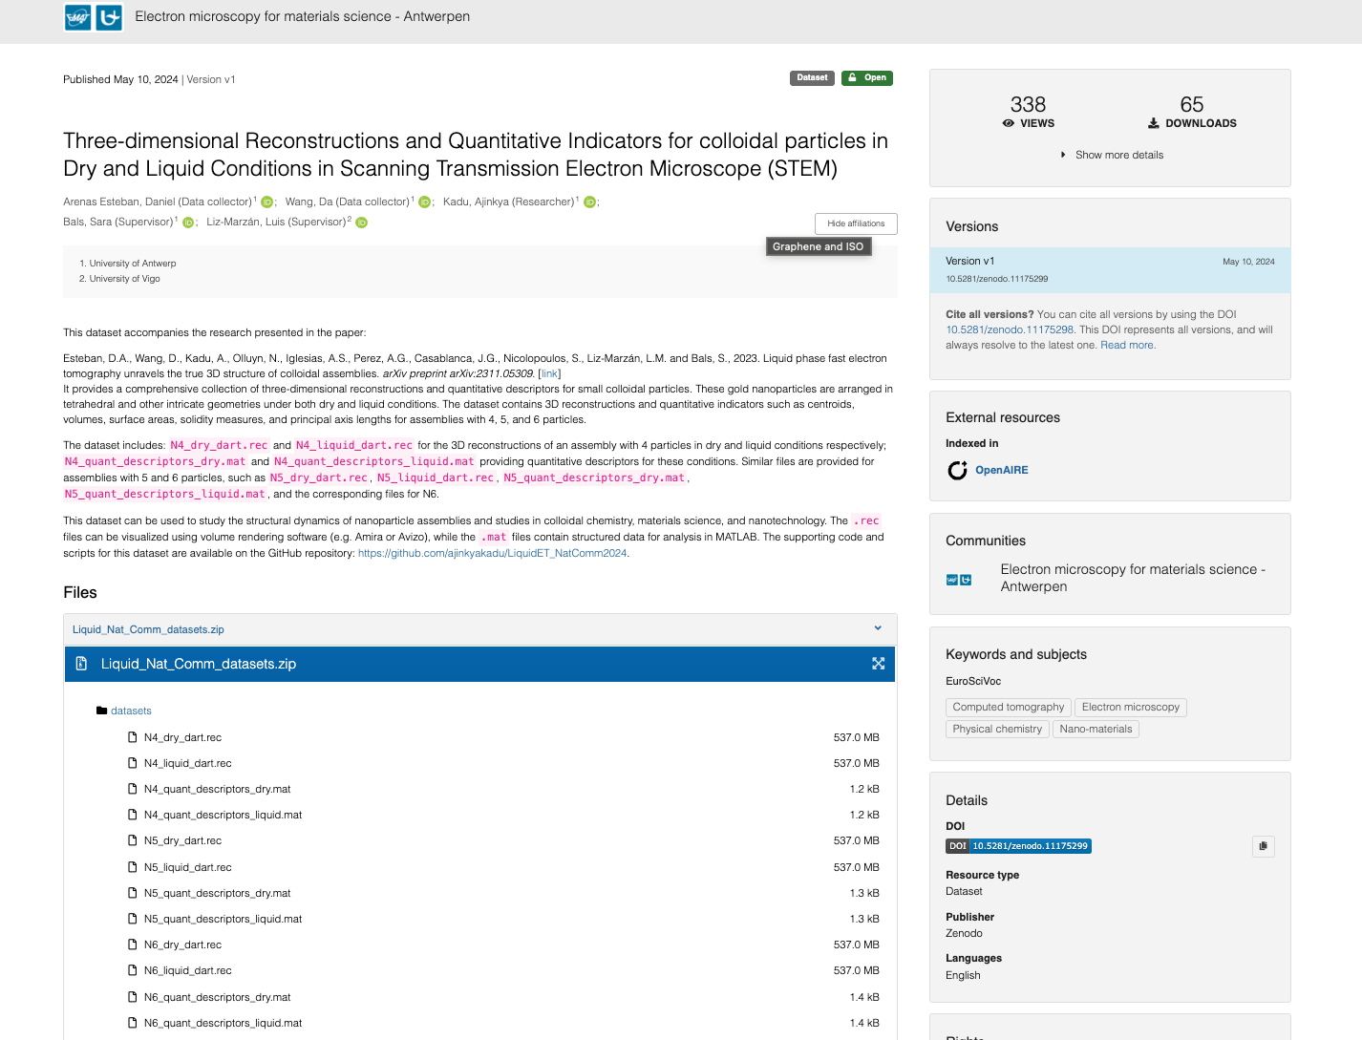
https://zenodo.org/records/11175299

Slide 16
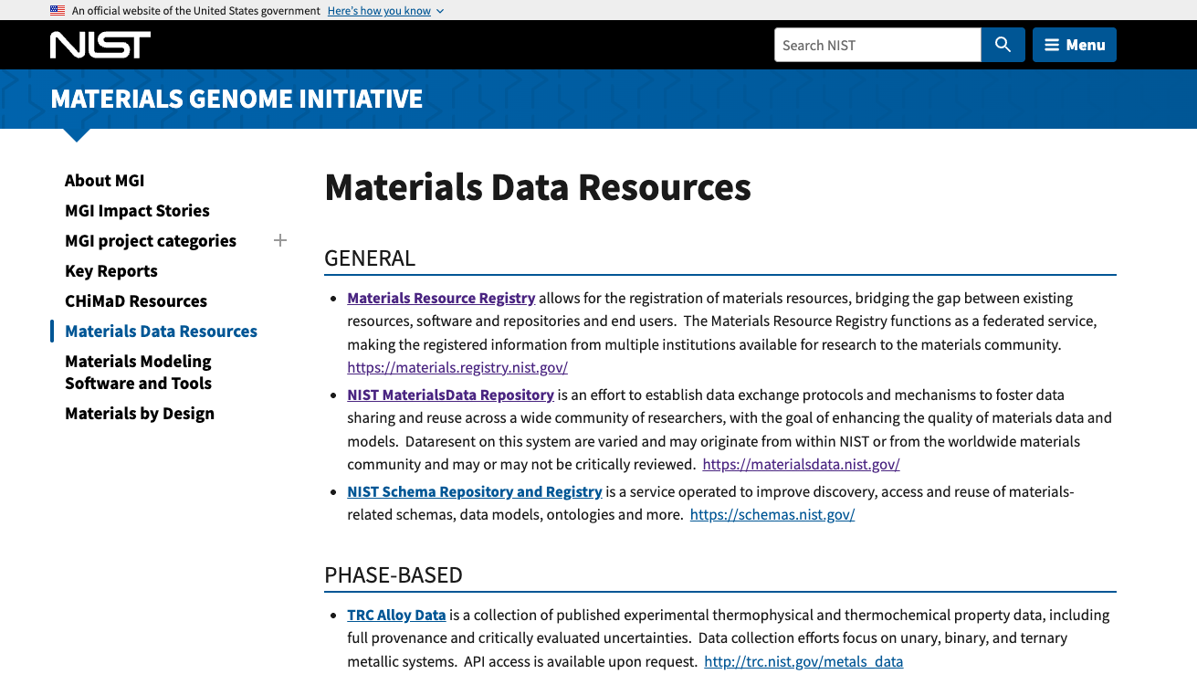

Slide 17
What you should leave with today
✓
A practical TEM workflow you can repeat
Open, well-managed data
= better science, improved efficiency, better return on investment- given potential for re-use.
✓
A minimum metadata template to describe your files
✓
Basic notebooks you can run and modify
✓
A clearer path to sharing code and data responsibly
Let the workflow carry some of the cognitive load so you can focus on the science.
✓
Appreciation for the value of open science
15
Notes:
Slide 15 — What you should leave with today
You should leave with four takeaways: a practical TEM workflow you can repeat, a minimum metadata template, beginner-friendly notebooks you can run and modify, and a clearer path to sharing data and code responsibly. The punchline is that good workflows and well-managed data reduce cognitive load—so you spend less time reconstructing what happened and more time doing science.

