Slide 1
RCA (Root Cause Analysis)
RCA Model
Probabilistic :
Bayesian Network
Traditional Model Based
System models: Cluster, Network switches and links, and Client
Fault tree
Evidence data trace:
Symptoms -> system components
Machine Learning
Monitoring data time series: pattern or distribution changes
Log files: text mining
Tomography inference
System Models
RCA Reasoning
Data
Deterministic :
SVM
Decision Tree
Neural Net

Slide 2
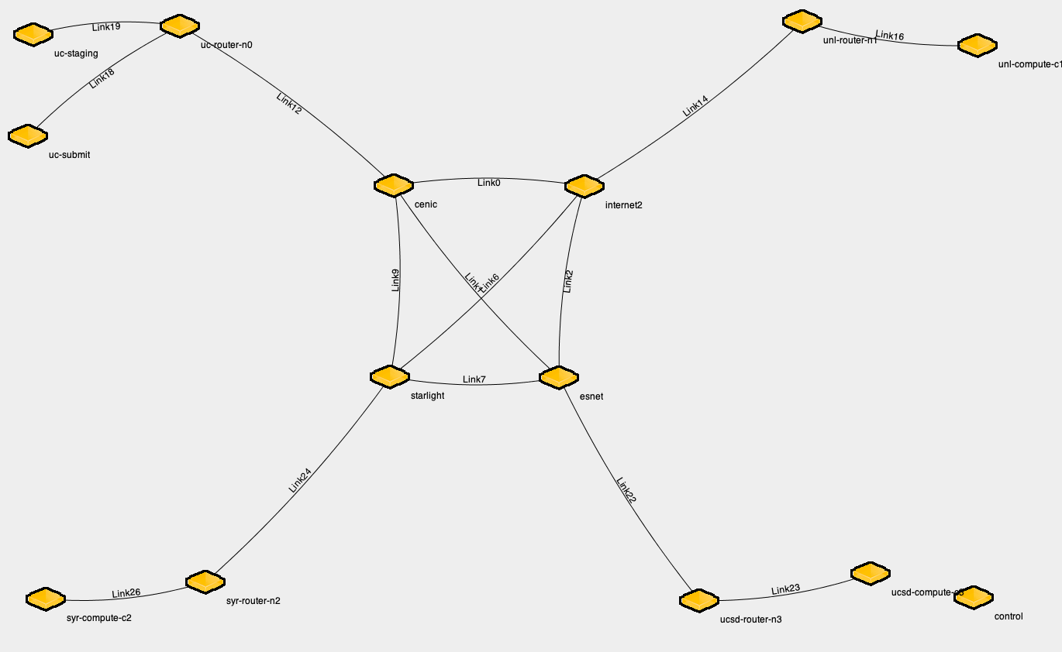
Flow 1 path : uc-submit, link 18, link12, link 1, link22, link 23, ucsd-compute—c3
Flow 2 path : syr-compute-c2, link 26, link 24, link 7, link22, link 23, ucsd-compute—c3
Flow 3 path : uc-stage, link 19, link 12, link 1, link22, link 23, ucsd-compute—c3

Slide 3
RCA (Root Cause Analysis)
Learning what?
Infer node/link labels (classes) from end-to-end flow-level monitoring
What-IF
Flows
Labels
uc-submit
link 18
F1 observed corruption
link12
Flow 1
link 1
Y
N
link22
F2 observed corruption
F2 observed corruption
Flow 2
link 23
syr-compute-c2
Y
N
link 26
Flow 3
link 24
F3 observed corruption
F3 observed corruption
link 7
uc-stage
link 19
Labels/classes
ucsd-compute—c3

Slide 4
RCA (Root Cause Analysis)
Learning what?
Topology unknown and Routes unknown
Infer node/link labels (classes) from end-to-end flow-level monitoring
Flows
Labels
Flows
Links/Nodes
uc-submit
link 18
F₁
L₁
link12
Flow 1
F₂
L₂
link 1
.
.
.
.
.
.
link22
?
Flow 2
link 23
F_{i}
L_{j}
syr-compute-c2
.
.
.
.
.
.
link 26
Flow 3
F_{n-1}
link 24
L_{k-1}
link 7
F_{n}
L_{k}
uc-stage
link 19
ucsd-compute—c3

Slide 5
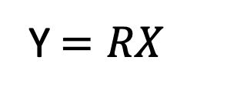
Literature
NetScope (2010)
IP packet | Link loss
Failure (KDD 2014)
IP Packet | Link loss ranking
NetPoirot (SigCom’16 )
TCP | Network or server
PingMesh (2015)
Packet Latency | Link Latency and Loss, Server and software latency | Ping measurement, Manual analysis
Detector (ATC’17)
Packet loss, routing Matrix | Link coverage, Identifiability | Efficient probe path Link rank
007 (Azure, 2018)
TCP retransmission | Path -> Link loss ranking
NetBouncer (NSDI 2019)
IP Packet | Link loss
Y$=RX$
RCA: Incomplete info + bigger scale:
mixed (continuous + categorical) features + unknown topology/routing
DiagNet (2020)
TCP, HTPP Client Measurement | Internet location performance
TCP and IP level RCA: Solved problem, matter of bigger scales
Matter of measurement coverage
numerical features + known routing

Slide 6
Design Space
Failure mode
Hard failure | Gray Failure
Topology information
Complete | Incomplete
Flows
All Node Pair | End Hosts Only
Flow Routing
Complete | Unknown
Monitoring
Active Probe | Passive monitoring
System
Production | Emulation
Fault
Passive monitoring | Injection

Slide 7
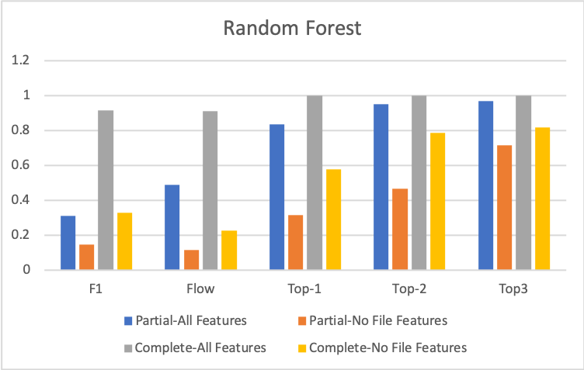
Emulation Experiments in ExoGENI (Small)

Slide 8
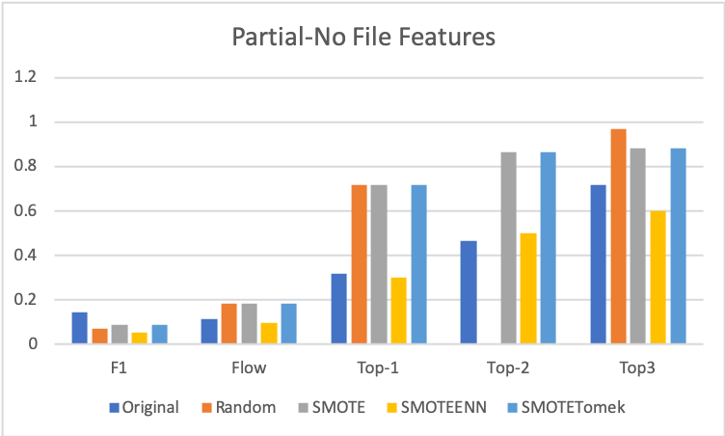
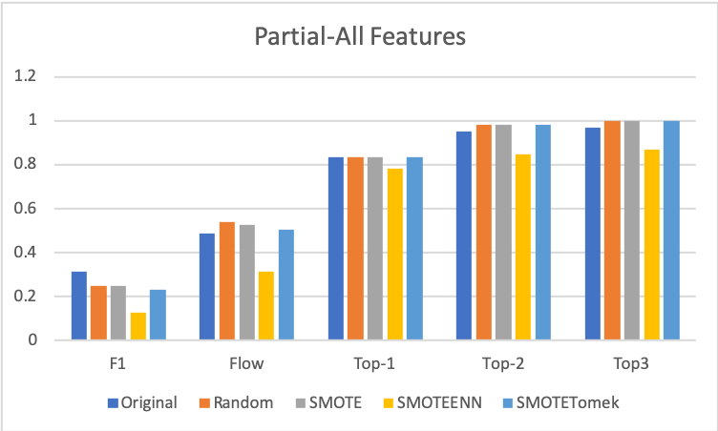

Slide 9
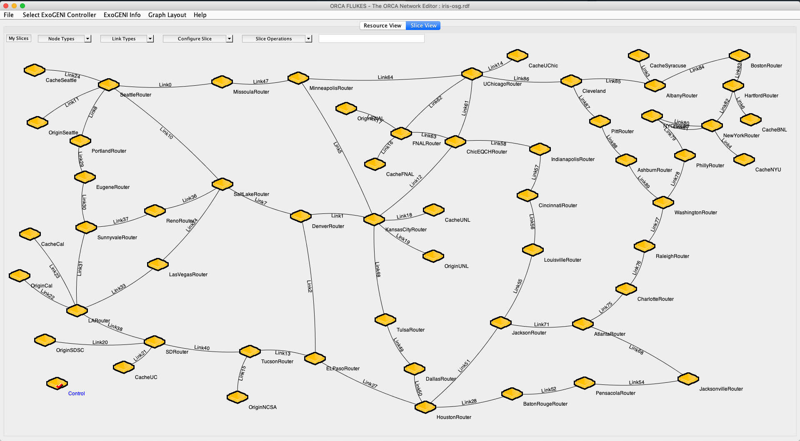
OSG Topology

Slide 10
IRIS ML Approach
Combined workflow and incomplete infrastructure features
Inference from end-to-end flow integrity checks
Training data generation from fault injection
Cast it as a network system RCA problem using ML approach
Decision Tree
SVM
NN

Slide 11





Emulation of a smaller OSG Network
G(V, E) = G((C,N,S,D), E)
Routes unknown
s1
d1
N1
c1
OSG Site 1
N5
d2
I2
N6
N2
c2
s2
N3
d3
N4
Network
c3
d4
OSG Site 2
Data Origin Sites
Control Host

Slide 12
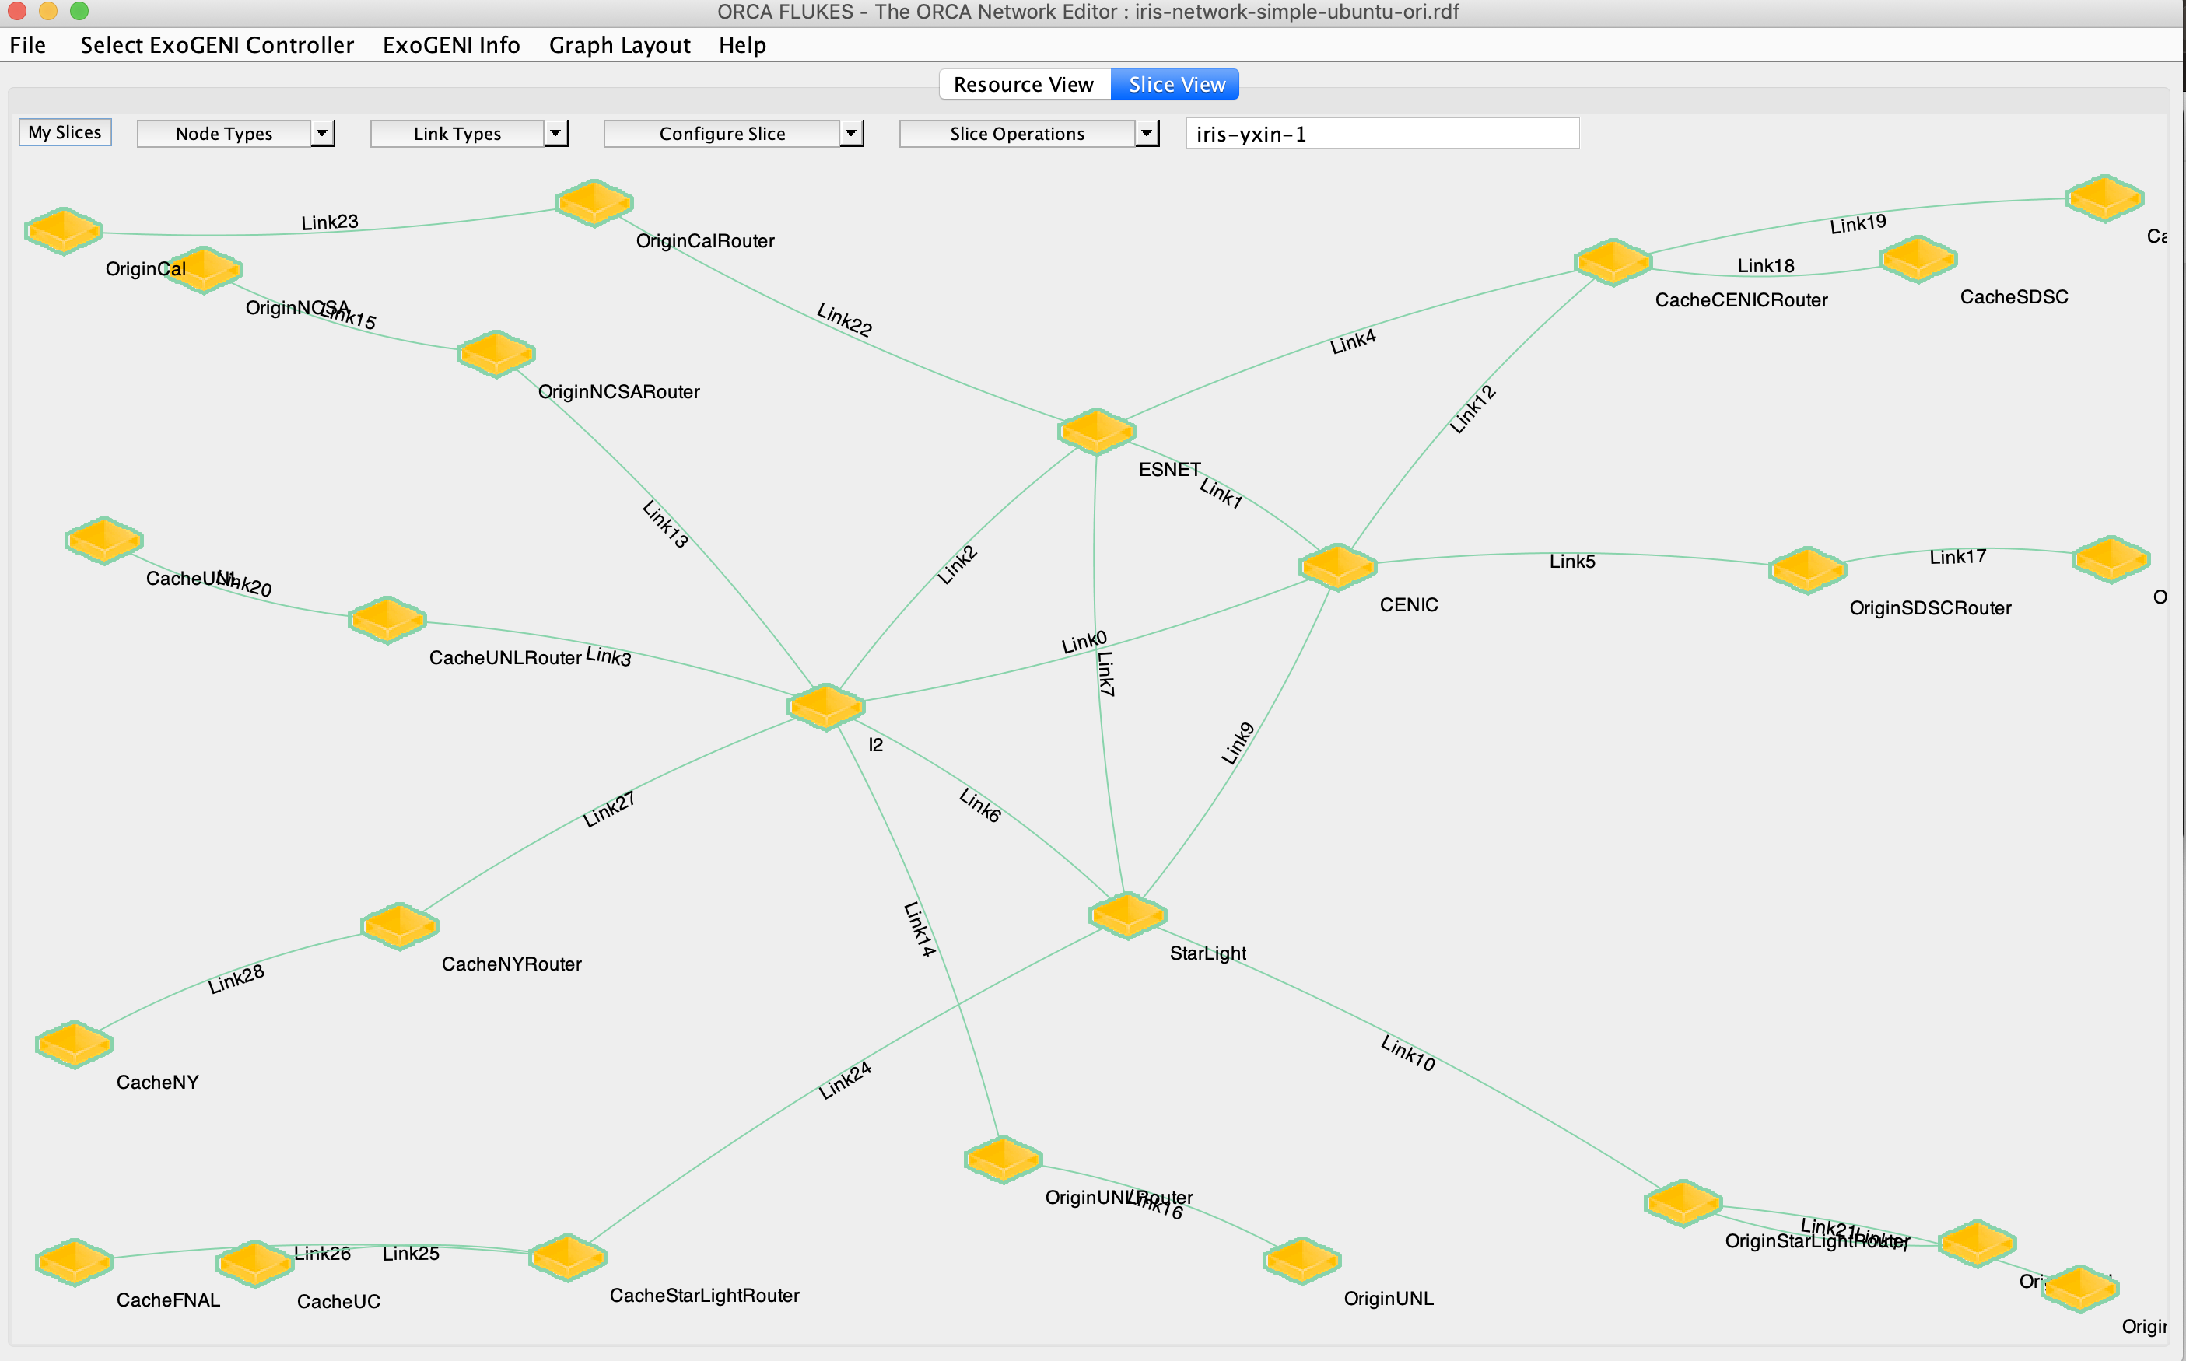
Bigger OSG network : automation
1. Experiment automation:
Postboot script
OSPF Configuration
2. Fault injection and Data Collection Automation
ChaoJungle injection on both router and host nodes
Data collection
3. Analysis and ML modeling in Jupyter

