Slide 1
Root Cause Analysis of Data Integrity Errors in Networked Systems with Incomplete Information
Yufeng Xin, Shih-Wen Fu, Anirban Mandal, Ilya Baldin
RENCI, UNC - Chapel HilL
Ryan Tanaka, Mats Rynge, Karan Vahi, Ewa Deelman
ISI, USC
Ishan Abhinit, Von Welch
CACR, Indiana University
Notes:
Hello, everyone, this is Yufeng from RENCI, University of north Carolina at Chapel Hill. I will be presenting our paper “Root Cause Analysis of Data Integrity Errors in Networked Systems with Incomplete Information”. This is a joint work with my colleagues at RENCI and our collaborators at ISI, USC and CACR, Indiana university.

Slide 2
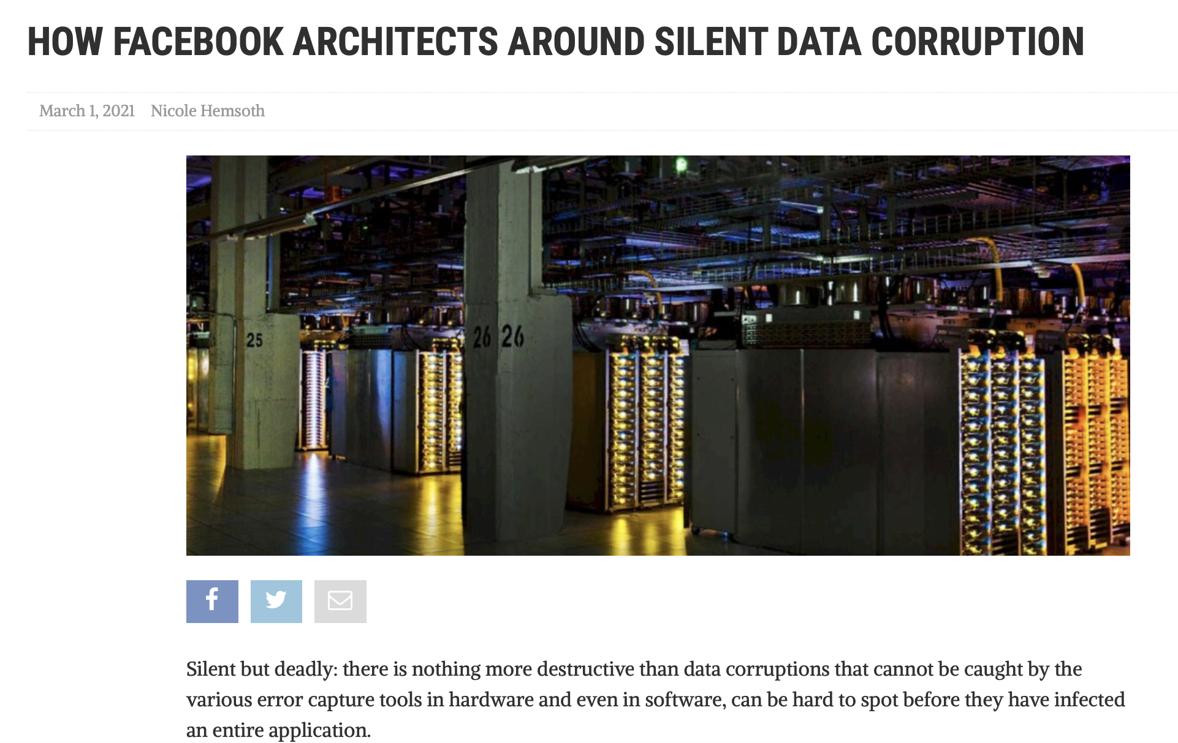
Data Integrity Error: Why bother (1)?
TCP checksum: 16-bits is too short
1 in 10 billions segments of undetected integrity error
Hardware (CPU, Switch, Storage, etc ) errors
Software errors
Lack of end-to-end coverage
Silent Data Corruption
Notes:
Assurance of data integrity has been one of the most fundamental aspects of networked system and Internet applications. Different mechanisms of error tolerance, detection, and mitigation have been widely implemented and deployed in different layers of the compute, storage, network, and applications systems.
However, these measures ar
e not sufficient to cover the data corruptions in large and complex networked systems.
For example, It is well known that the Ethernet CRC and TCP checksums are too small for modern data sizes.
Facebook recently reported a CPU bug that caused severe data corruptions in its hyper-scale data centers.
Comparing to the hard failures, data integrity errors can stay unnoticed for long time, thus it is often referred to “silent failures”.

Slide 3
Data Integrity Error: Why bother (2)?
Catastrophic consequences
Silent data corruption (vs hard failures)
Big data : low error rate matters
10 billion maximum Ethernet frames = 3.4 hours of data transfer on a 10gbps link.
Fault tolerance
High cost
Notes:
Due to the “silent” nature of the data integrity error, it can lead to catastrophic results with the resulted corrupted data. Even though its probability is low, given the sheer volume of the big data over nowadays networks, its occurrence can be quite often. For example, 10 billion maximum Ethernet frames only take about 3.4 hours of data transfer on a 10gbps link. Last but not the least, various fault tolerance measures can be very expensive to deploy widely.

Slide 4
How to Deal with Errors in the network?
Verification and Detection
End-to-end checksum
Root cause analysis (RCA)
Localization of the faults
Existing work: data center networks
Full topology and routing
Active probing
Large scale
Notes:
Because of above observations, there are renewed interests recently in handling data integrity errors in networked systems. From the network perspective though, integrity error is just a special case of network failures. There are multiple steps in handling network errors. First the system operators need to detect the errors. Secondly they will try to localize the faults in the system, and only after that they can try to remove the faulty elements. Our work focuses on the second step, which is often categorized as a type of “Root cause analysis”. Most of recent work in root cause analysis of network failures focused on the data center networks. In general, since the data center operators have full control of the network, these RCA systems can assume the knowledge of the full topology and traffic routing information. And one focused area is the design to efficient monitoring and active probing subsystem. As a result, one main challenge is the large scale of modern data center networks and therefore machine learning based approaches have been actively studied.

Slide 5
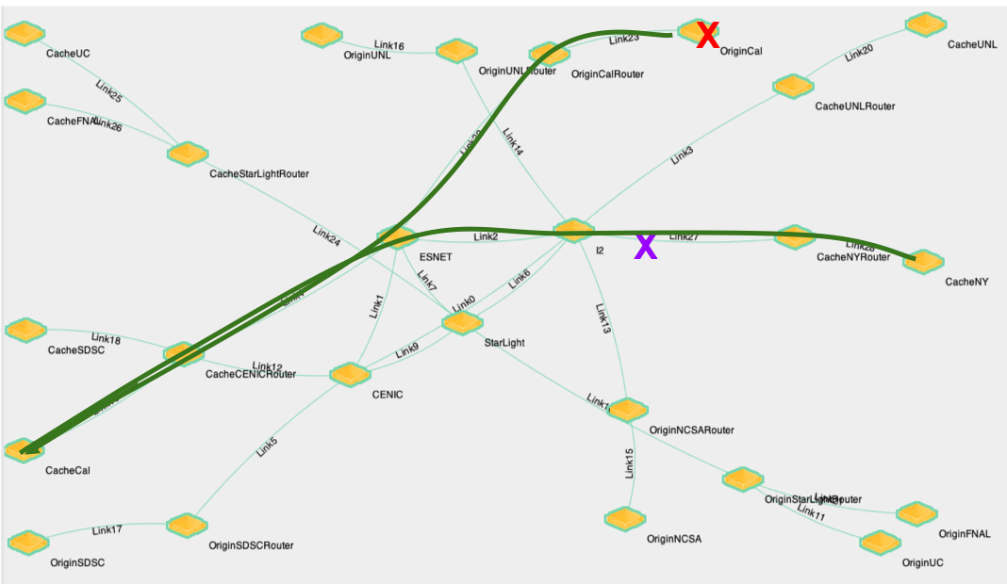
Network RCA Challenges
Gap between the application view and the network view
Invisibility in a multi-domain network environment
Flow measurement coverage
Notes:
In our study, we focused on the general wide area network settings, in which very limited system and monitoring information can become available. Specifically, our targeted network is a multi-domain environment where network topology and traffic routing information is not available and the full measurement coverage, either active or passive, is not practical at all. In this table, we summarize the major differences between the scope of our study and the existing work. An important observation is that there is a big gap between the application view and the network infrastructure view.

Slide 6

Our Approach (1)
An application-centric view > infrastructure-centric view
Prob (File i corrupted) = f ($F_{i}$, $\prod_{j ∈P_{i}}{Prob(j is Faulty})$)
(File i corrupted or not) can be provided by the applications or middleware (Pegasus, etc)
Notes:
In this study, we model the RCA problem from an application-centric view in an attempt to leverage the recent trend in adding end-to-end file checksum capabilities in modern Internet application or middleware systems. We first formulate the problem with this formula: the probability of a corrupted file transfer is a function of the file transfer characteristics (size, retransmission, throughput, etc), and the path elements that it passes. Apparently, a network element failure can cause multiple failed file transfers on all the paths over this particular element. For most existing work, the main task is to find the mapping between the flow level failures to the faulty elements because they assumed the path routing information is known. However, our targeted environment makes the problem even harder because the path routing information is not known beforehand. The diagram shows the mapping problem underneath the to be developed ML models.

Slide 7
Our Approach (2) : Machine Learning
Multi-class classification problem
Learn the mappings between the flow errors and the fault locations
The mappings between the flows and the paths in the underneath network
Notes:
Since we assume even less system model information, we adopted the ML based approaches. Specifically, we model our RCA problem as a multi-class classification problem, where the potential faulty elements are the labels and the data consist of the flow level data corruption measurements. A highly accurate model will be able to map the flow level corruptions to the correct faulty element. The model will also implicitly infer the flow routing paths.

Slide 8
Training Data Generation
Cloud testbed:
G(V, E) = G((C,N,S,D), E)
Routes automatically configured
Error injection
Node (Cache errors)
Router Interfaces (Network errors)
Data transfer applications
Notes:
In order to study the performance of the approach and generate training data in a controlled environment, we built a high-fidelity emulation environment in the NSF Exogeni Cloud testbed, where on-demand virtual networks of virtual machines, routings, and data transfer applications can be automatically created and instantiated. We also created a software tool to inject probabilistic integrity errors at the nodes and network interfaces. What is shown in the picture is an example virtual network.

Slide 9
Machine Learning Model Considerations for RCA (1)
Incomplete information
Topology unknown (network elements are known)
Routing unknown (Source and destinations are known)
Incomplete flow measurements
Between all pairs of end hosts
Between source and destination end hosts
Notes:
As we alluded earlier, we have to take the “incomplete information” assumptions into considering when training the ML models and evaluate which model is more suitable. We specifically compared two scenarios: when flow level measurement is possible between all the end hosts and when the end hosts is separated into source and destination groups. We note, almost all the existing studies assumed the flow level measurements between all the nodes including the routers in the system. In our case, we don’t assume we have the access to the router level flow information, that is to say, we have much limited measurement coverage. Under each category, we further looked into two sub-scenerios: when the file transfer statistics are available and unavailable.

Slide 10
Machine Learning Model Considerations for RCA (2)
Mixed numerical and categorical features
Data Imbalance
Flows and aggregated data samples
Top-k classification
Classification Granularity
Random Forest Model
Notes:
From machine learning perspective, our data consists of mixed numerical and categorical features and is inherently imbalanced between different classes. We also took customized measures in constructing the aggregated data samples, computing the Top-k classification results, and conducting the RCA at different granularities of the network.

Slide 11
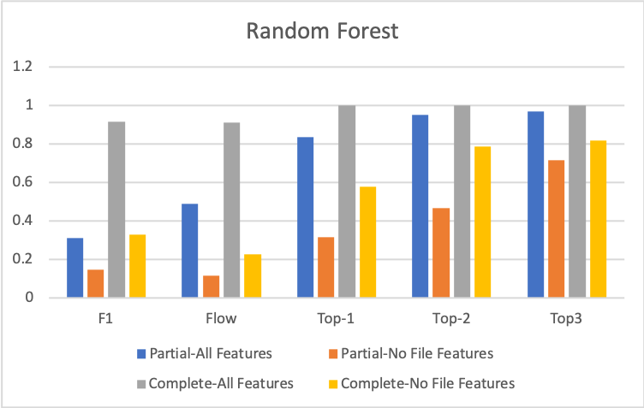
Evaluation results: Accuracy
Notes:
After training multiple types of ML models, the Random Forest was a clear winner in term of the accuracy. Therefore, in the evaluation section, we only present the result obtained from using model on an emulated system. As shown in the main result figure, we compared the performance between four different feature combinations. The one with flows between all pairs of end hosts can achieve close to perfect accuracy. Less available feature information can also achieve satisfactory Top-3 accuracy.

Slide 12
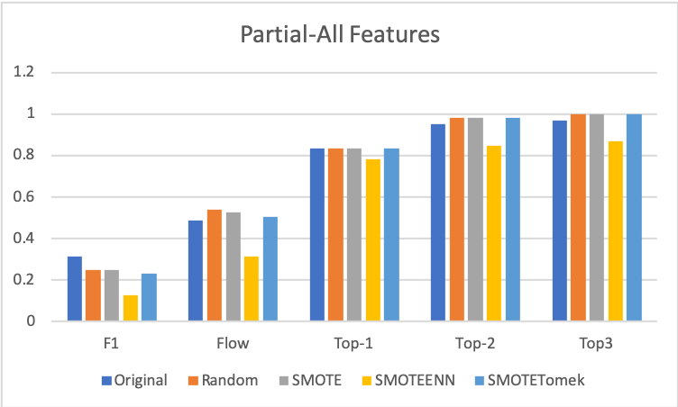
Evaluation results: Data Imbalance
Notes:
In the next, we specifically looked into the data imbalance problem, especially when only partial features are available. As shown in the result, certain imbalance techniques can help improve on the model accuracy.

Slide 13
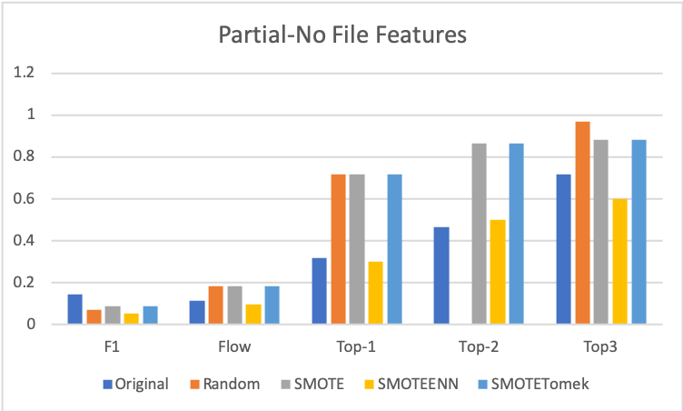
Evaluation results: Partial features
Notes:
The improvement is more noticeable with less features.

Slide 14

Conclusions
ML-based RCA for networked system with limited information
Automatic emulation and error ejection environment
Customized training and model selection lead to high classification accuracy
Need to study networks of larger scale
yxin@renci.org
Notes:
In conclusion, in this work, we studied the ML-based RCA for networked system with limited information. We built a high-fidelity emulation environment to support this and future studies. Our results validated this solution approach. More technical details can be found in the paper. We are working on improving the model performance for networks of larger scales. Thank you very much. Please drop me an email if you have any questions and suggestions.

