Slide 1
RCA (Root Cause Analysis)
Traditional Model Based
System models: Cluster, Network switches and links, and Client
Fault tree
Evidence data:
Symptoms -> system components
Machine Learning
Topology unknown
Routes unknown
Infer from end-to-end flow-level monitoring
Flows
Links/Nodes
F₁
L₁
F₂
L₂
.
.
.
.
.
.
F_{i}
L_{j}
.
.
.
.
.
.
F_{n-1}
L_{k-1}
F_{n}
L_{k}

Slide 2
Design Space
Failure mode
Hard failure | Gray Failure
Topology information
Complete | Incomplete
Flows
All Node Pair | End Hosts Only
Flow Routing
Complete | Unknown
Monitoring
Active Probe | Passive monitoring
System
Production | Emulation
Fault
Passive monitoring | Injection

Slide 3
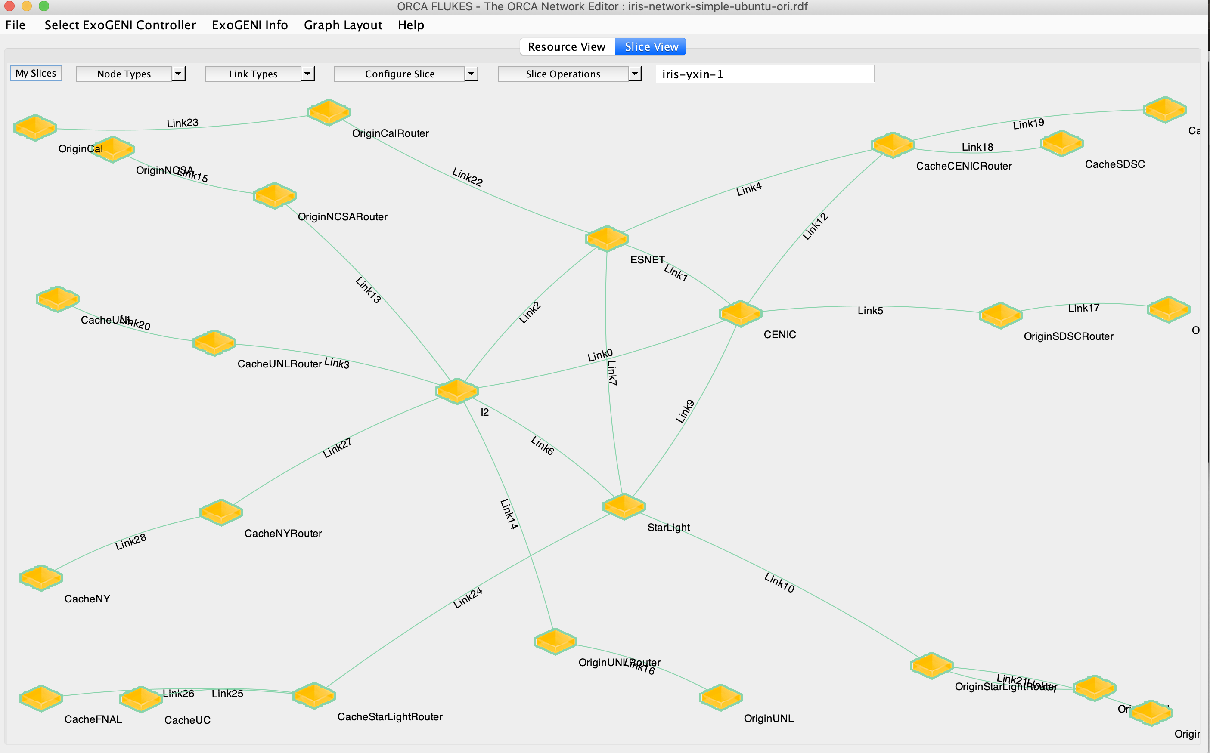
Bigger networks : automation
1. Experiment automation:
Postboot script
OSPF Configuration
2. Fault injection and Data Collection Automation
ChaoJungle injection on both router and host nodes
Data collection
3. Analysis and ML modeling in Jupyter

Slide 4
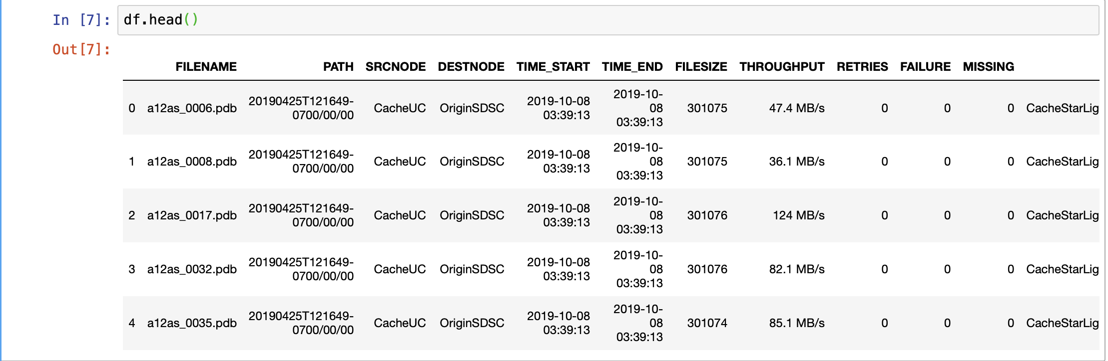
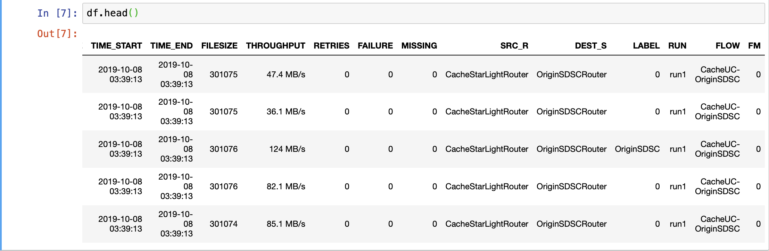

Slide 5
Decision Tree

Slide 6
SVM

