Slide 1
Workflow Infrastructure Abstraction, Root Cause Machine learning and Experiment in ExoGeni
7/15/2019

Slide 2




OSG Data Federation Overlay Network
~100 Clusters: ~100,000 cores
Data Federation:
6 Data origins
9 Caches
I2
Cache
CENIC
Data Origin
Submit Host
OSG Site

Slide 3

Abstraction Example
Flow1: dc1 – I2 – osg1
Flow2: dc1-I2-CENIC-osg2
Flow3: dc1-I2-osg1
Flow4: dc3-CENIC-osg2
Flow5: dc4-CENIC-I2-osg1
dc1
I2
Site Cache
Node Cache
dc2
osg1
CENIC
Sand-ci.org
dc3
GeoIP
osg2
CVMFS
dc4
Expand the right side
Data Cache
Submit Host
OSG Site

Slide 4
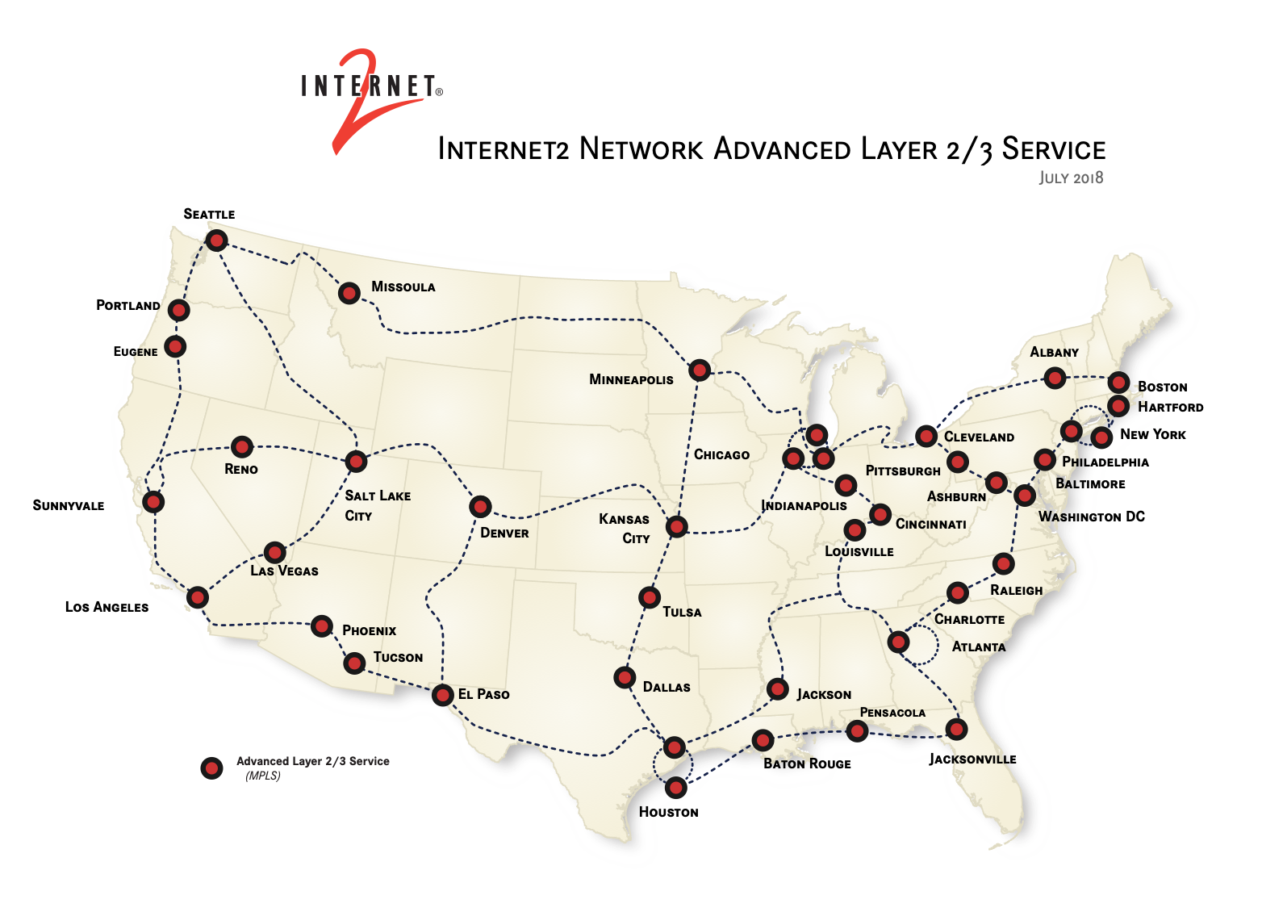
Internet2 AL3S Topology

Slide 5

Experiments for learning the root cause
G(V, E) = G((C,N,S,D), E)
Routes unknown
s1
d1
N1
c1
OSG Site 1
N5
d2
I2
N6
N2
c2
s2
N3
d3
N4
Network
c3
d4
OSG Site 2
Data Origin Sites
Control Host

Slide 6
Training data
Seq# | file_id | directory | size | features | origin | OSG site | src | dest | src-r | dest-s | Start time | End time | retries | failure | Label
1 | 0000 | /x/y | 100 | block |  |  | c1 | d1 | N1 | s1 | t₁ |  | 3 | 1 | c1
2 | 0000 |  | 100 | ? |  |  | c1 | d1 | N1 | s1 | t₂ |  | 3 | 1 | c1
3 | 111 |  | 10000 |  |  |  | c1 | d3 | N1 | s2 |  |  |  | 1 | N1
4 | 111 |  |  |  |  |  | c2 | d2 | N2 | s1 |  |  |  | 0 | e2
5 |  |  |  |  |  |  | c2 | d4 | N2 | s2 |  |  |  | 0 | 0
6 |  |  |  |  |  |  |  |  |  |  |  |  |  |  | 0
7 |  |  |  |  |  |  |  |  |  |  |  |  |  |  | N6
… |  |  |  |  |  |  |  |  |  |  |  |  |  |  | S2
Training Data Set Generation
Injecting one error each time period
P(c₁₌₁) = 0.0001
P(e₁₌₁) = 0.00001
P(s₂₌₁) = 0.001
P(N₂₌₁) = 0.01
T₁
T₂
T_{i}
T_{j}
T_{k}
T

Slide 7
Root Causes
Data origin failure: same data file(s) from the same data caches (c_{i}) keep failing, to different OSG sites (d_{i})
Site Caches (s_{i}) failure: different data file(s) from different data origins (c_{j}) to the same OSG site keep failing
Network Router Node (N_{i}) failure: inferred (learned) routing
Network Router Link (e_{i}) failure: inferred (learned) routing

Slide 8
Inference
Probabilistic thresholds of different types of failures: how to distinguish between the site cache node and the network router? E.g., s₁ and N₅
A set of file transfers and their error stats, a single file transfer is not enough

Slide 9
Machine learning Models
SVM: Classification
Decision trees
BN
NN

Slide 10
Experiment development
Control host : automate the error injection, error checking, and data generation
End hosts deployment:
File transfer (scp)
Maybe HTTP server/client
Maybe Squid latter
Network deployment: software routers: VM running Quagga (Linux forwarding, Openflow controller may be more time consuming) OSPF for automatic layer 3 routing
ExoGENI testbed (Chameleon is not as easy to build a network)

Slide 11
Reference
Survey on Models and Techniques for Root-Cause Analysis, Solé-Simó, Marc and Muntés-Mulero, Victor and Rana, Annie and Estrada, Giovani, 2017
Machine Learning-based Link Fault Identification and Localization in Complex Networks, S. M. {Srinivasan} and T. {Truong-Huu} and M. {Gurusamy}, IEEE Internet of Things Journal, 2019
Machine-Learning Based Active Measurement Proxy for IoT Systems,W. {Yan} and C. {Flinta} and A. {Johnsson}, 2019 IFIP/IEEE Symposium on Integrated Network and Service Management (IM), 2019
Recent Advances in Fault Localization in Computer Networks, A. {Dusia} and A. S. {Sethi}, IEEE Communications Surveys Tutorials, 18(4), 2016
TE-Based Machine Learning Techniques for Link Fault Localization in Complex Networks, S. {Madapuzi Srinivasan} and T. {Truong-Huu} and M. {Gurusamy, 2018 IEEE 6th International Conference on Future Internet of Things and Cloud (FiCloud), Aug. 2018
A comprehensive survey on machine learning for networking: evolution, applications and research opportunities, Boutaba, Raouf and Salahuddin, Mohammad A. and Limam, Noura and Ayoubi, Sara and Shahriar, Nashid and Estrada-Solano, Felipe and Caicedo, Oscar M., Journal of Internet Services and Applications, 9(1), 2018

