Slide 1
RCA (Root Cause Analysis)
RCA Model
Probabilistic :
Bayesian Network
Traditional Model Based
System models: Cluster, Network switches and links, and Client
Fault tree
Evidence data:
Symptoms -> system components
Machine Learning
Monitoring data time series: pattern or distribution changes
Log files: text mining
Tomography inference
System Models
RCA Reasoning
Data
Deterministic :
SVM
Decision Tree
Neural Net

Slide 2
RCA (Root Cause Analysis)
Traditional Model Based
System models: Cluster, Network switches and links, and Client
Fault tree
Evidence data:
Symptoms -> system components
Machine Learning
Topology unknown
Routes unknown
Infer from end-to-end flow-level monitoring
Flows
Links/Nodes
F₁
L₁
F₂
L₂
.
.
.
.
.
.
F_{i}
L_{j}
.
.
.
.
.
.
F_{n-1}
L_{k-1}
F_{n}
L_{k}

Slide 3
IRIS ML Approach
Combined workflow and incomplete infrastructure features
Inference from end-to-end flow integrity checks
Training data generation from fault injection
Cast it as a network system RCA problem using ML approach
Decision Tree
SVM
NN

Slide 4
Design Space
Failure mode
Hard failure | Gray Failure
Topology information
Complete | Incomplete
Flows
All Node Pair | End Hosts Only
Flow Routing
Complete | Unknown
Monitoring
Active Probe | Passive monitoring
System
Production | Emulation
Fault
Passive monitoring | Injection

Slide 5





Emulation of OSG Network
G(V, E) = G((C,N,S,D), E)
Routes unknown
s1
d1
N1
c1
OSG Site 1
N5
d2
I2
N6
N2
c2
s2
N3
d3
N4
Network
c3
d4
OSG Site 2
Data Origin Sites
Control Host

Slide 6
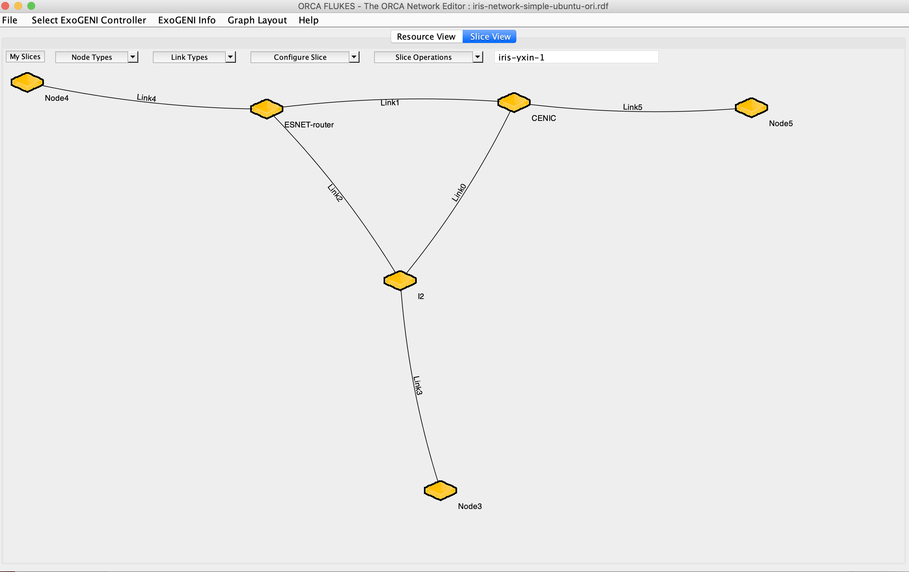
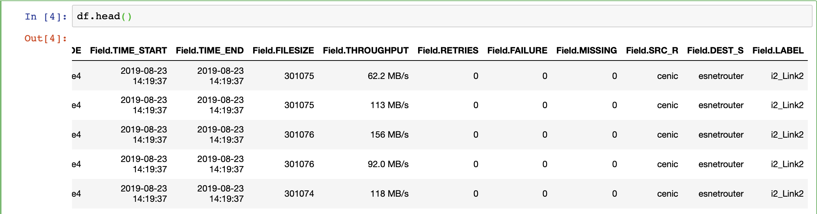
Emulation Experiments in ExoGENI (Simple)

Slide 7
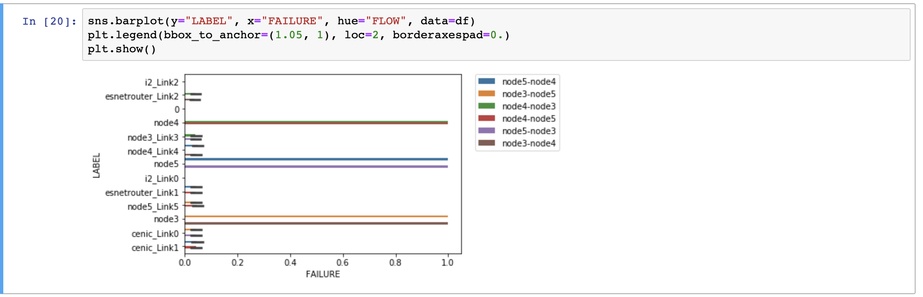
Data Statistics and Decision Tree

Slide 8
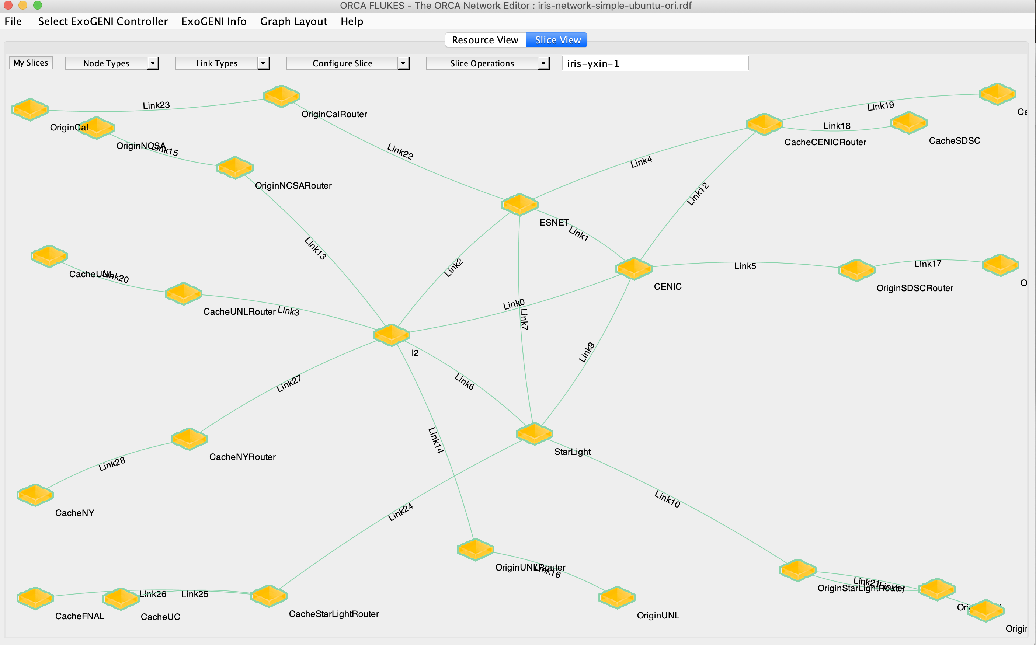
Bigger networks : automation
1. Experiment automation:
Postboot script
OSPF Configuration
2. Fault injection and Data Collection Automation
ChaoJungle injection on both router and host nodes
Data collection
3. Analysis and ML modeling in Jupyter

