Slide 1
Systems Fundamentals
Linux, command line, scripting Anirban Mandal, Erik Scott, Sajith Sasidharan (RENCI, UNC Chapel Hill) Ewa Deelman, Karan Vahi, Mats Rynge (ISI, USC) Matthew Miller, Werner Sun, Peter Ko, Kelly Nygren, Keara Soloway, Rolf Verberg (CHESS, Cornell) Brandon Sorge (IUPUI)

Slide 2
Preliminaries

Slide 3
Who are you people?
https://xcitecourse.org/theme2/sf100/
Getting into CLASSE Linux systems
Notes:
I do not have a good idea about the audience of this workshop. What is your background?
Do you know how to launch a terminal?
Do you know use ssh?
Do you use JupyterLab?
Do you use command line?
Do you use Windows, macOS, or Linux?

Slide 4
Assumptions
You have your CLASSE accounts set up.
Talk to CLASSE staff otherwise!
Options:
Use ssh
Use NoMachine
Use JupyterLab

Slide 5
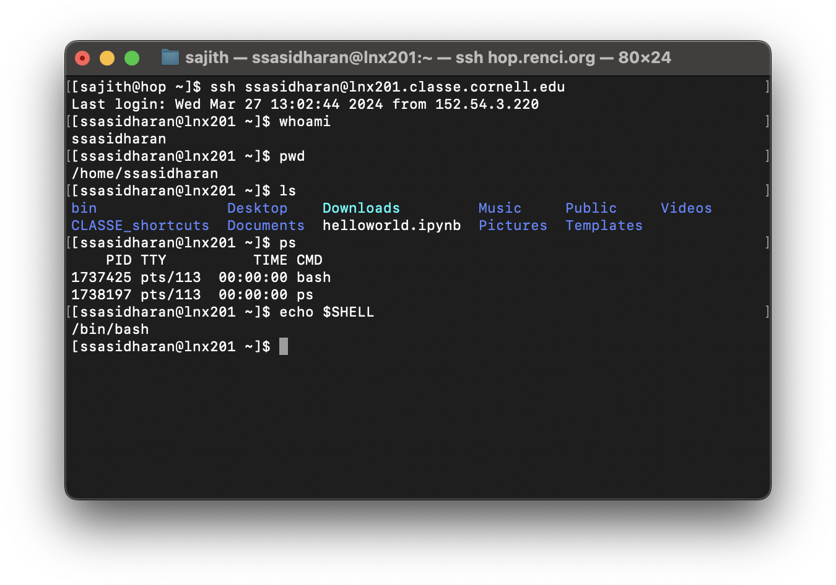
Use SSH

Slide 6
ssh ${username}@lnx201.classe.cornell.edu
Use terminal or iTerm on macOS.
Use whichever terminal you want on Linux.
Use PuTTY (https://putty.org/) on Windows.
Notes:
Use terminal or iTerm on macOS. There are other choices too, but these seem popular.
Use whatever terminal you want on Linux. You know what you are doing, and you know how to figure out stuff.
Use PuTTY on Windows. I am not up to speed on Windows.

Slide 7
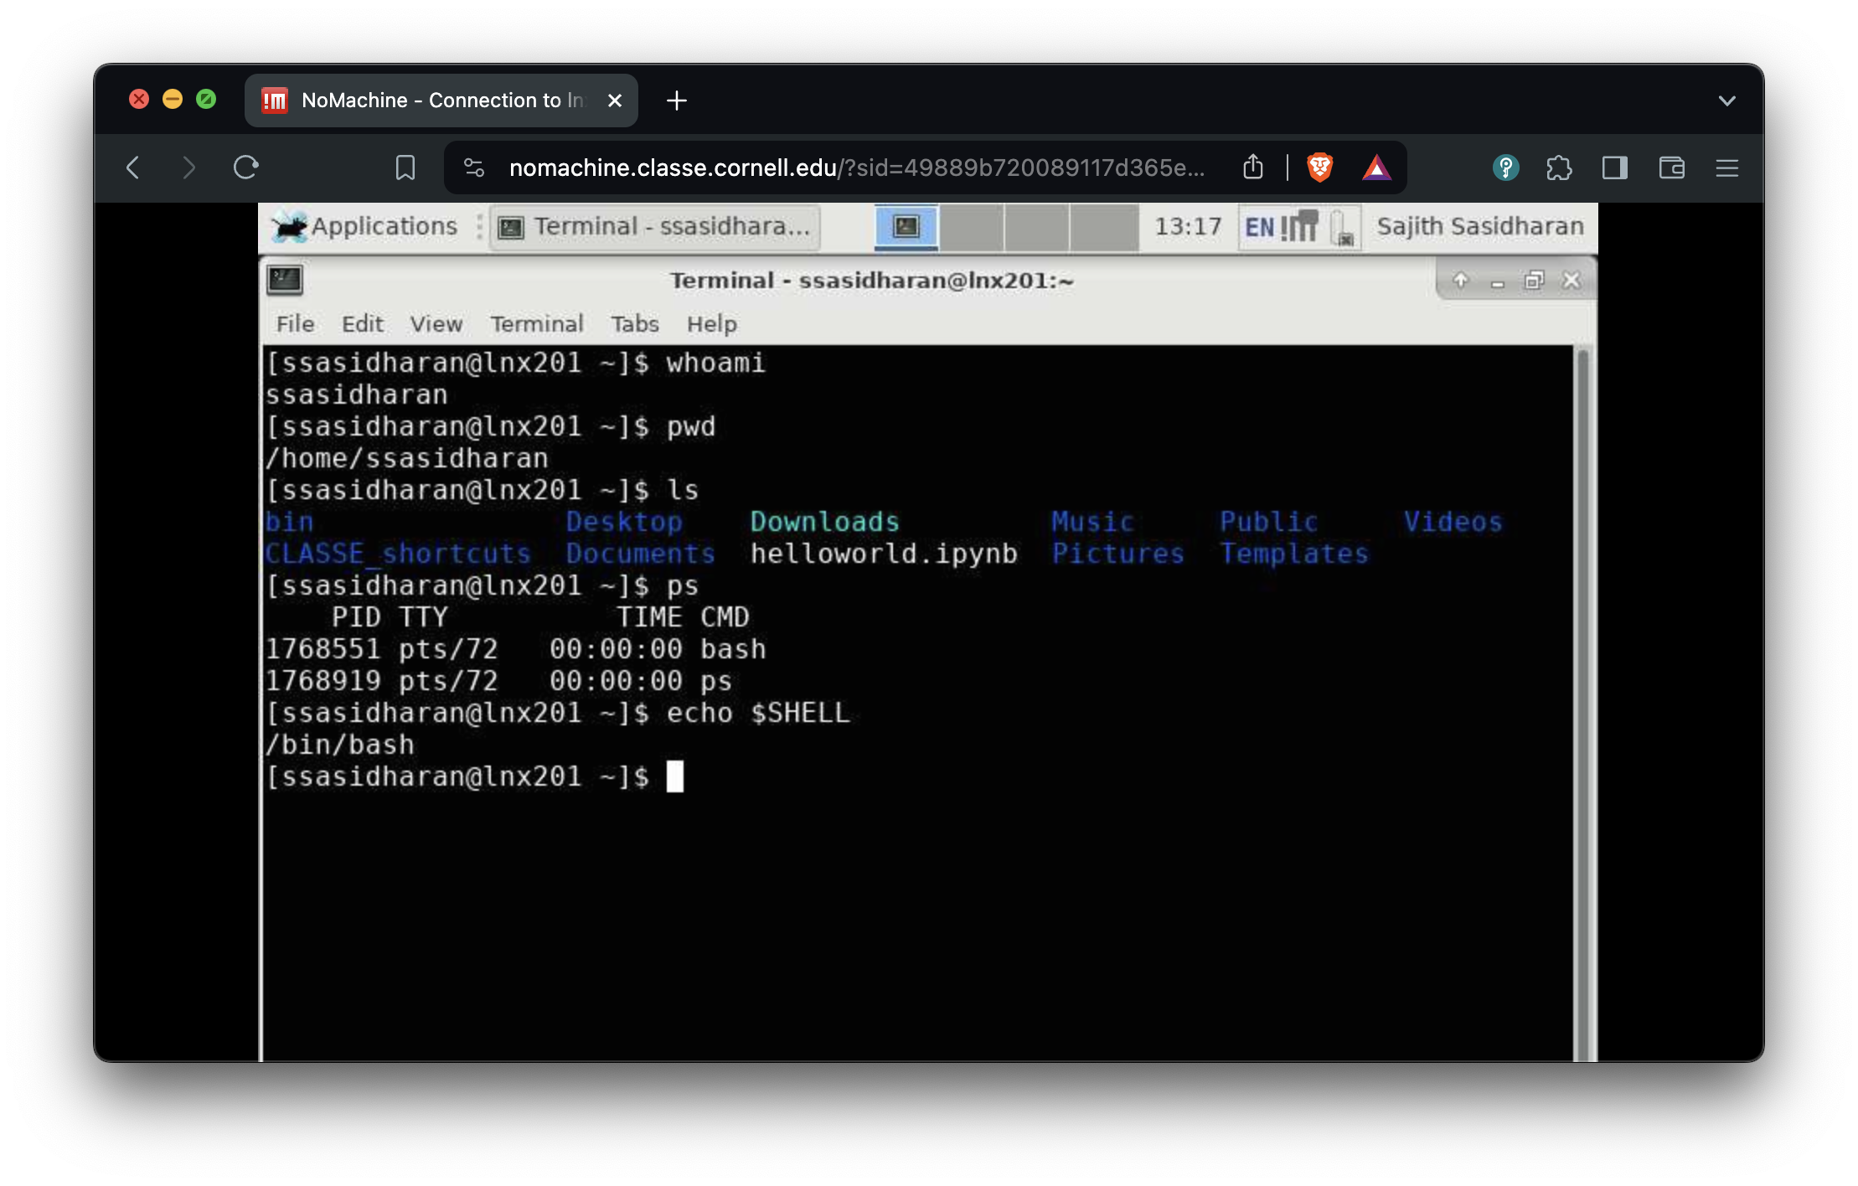
Use NoMachine

Slide 8
https://wiki.classe.cornell.edu/Computing/NoMachine
Notes:
There is a client that you can install.
There is also web access, which I have used a few times. Seemed shaky.

Slide 9
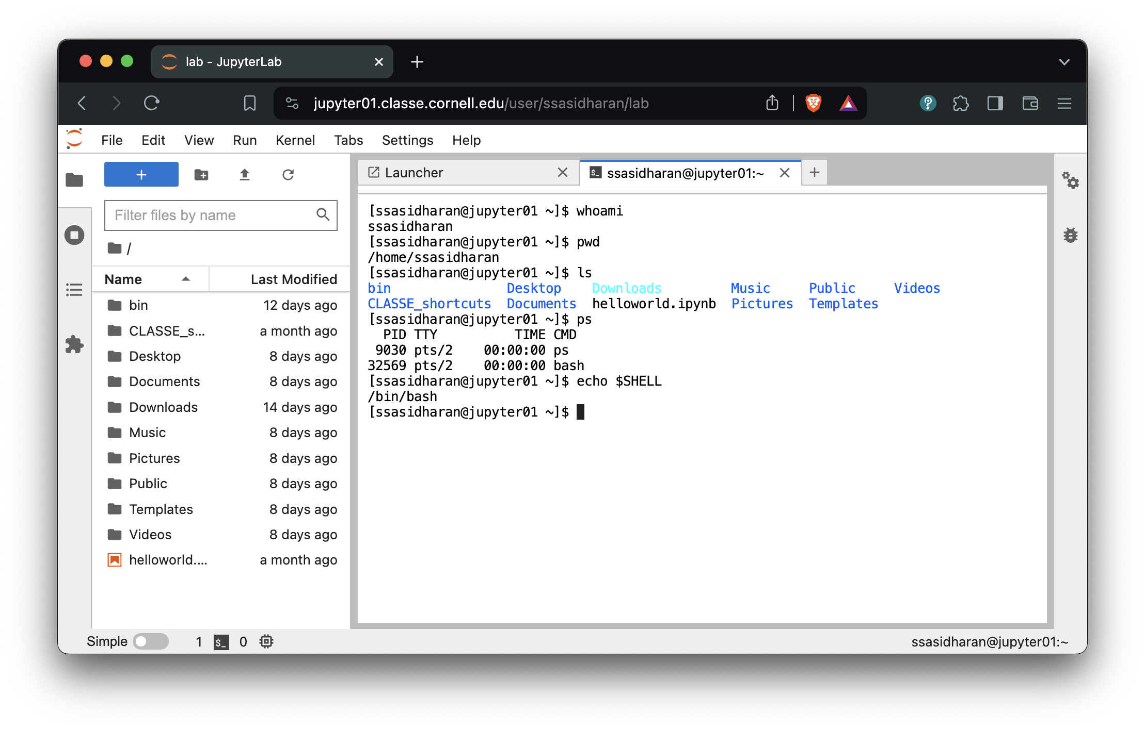
Use JupyterLab

Slide 10
https://jupyter01.classe.cornell.edu/
Notes:
Use the terminal icon on the launcher.
Or use File -> New -> Terminal

Slide 11
Linux, command line, etc.

Slide 12
Linux
A popular operating system.
(Actually an OS kernel, plus userland from various other projects. But those are details…)
Unix-like, which traces back to 1969, therefore has accumulated quirks.
Expect “hysterical raisins”.

Slide 13
lnx201
The Linux host we’ll be using is lnx201.classe.cornell.edu.
Runs a distribution called Scientific Linux.
Good enough for general use.
Do not run anything resource heavy on lnx201.
“Heavy” in terms CPU, memory, network usage etc.
lnx201 is a shared resource.
There is a Compute Farm to run heavy things.
Notes:
I am not the expert on lnx201 or compute farm. I just happen to present today!

Slide 14
The command line

Slide 15
You will type commands in a shell, at the shell prompt, hit enter key, and then things happen.
Notes:
All of this is a text user interface.
As opposed to clicking on GUI widgets.
The prompt is that piece of text that begins with [ and ends with ] $. They can look different too.

Slide 16
Commands
Commands are either programs or shell builtins.
Use one of these commands to read documentation:
man ${command}
info ${command}
or ${command} --help (sometimes!)
Notes:
Programs can be compiled or scripts.
They live somewhere in your $PATH.

Slide 17
The shell
A program that accepts commands, and passes those commands to the OS to execute.
A popular shell is bash, which is the default on lnx201.
Notes:
Of course there are other shells too: zsh (default on newer versions of macOS, fish, ksh, etc.

Slide 18
Bash
“Bourne-again shell”
Based on an earlier Bourne shell, thus the “again”.
Developed by the GNU project.
On lnx201, /bin/bash is the program.
For documentation: info bash or man bash.
Notes:
GNU people made a lot of the software early on.
Also Unix people, BSD people, X11 people, and a whole bunch of other people.
Then the Linux kernel came along, became successful, and people started to call the whole combination of all these things “Linux”.

Slide 19
Bash niceties: history and completion
You do not have to re-type commands that you have used in the past!
Use up and down arrow keys to go back and forth in your command history.
Use Ctrl-R (Control+R) to “search” command history.
Use history command to list your shell history.
Use tab key for command completion, after typing a few characters.

Slide 20
Files and directories

Slide 21
Unix slogan: Everything is a file!

Slide 22
Some helpful commands
Command | Task | Example Syntax
ls | list the files in a directory | ls [/tmp]
cd | move into a directory | cd [/tmp]
pwd | show curent working directory | pwd
cp | copy a file to into another directory, or make a copy with a different name | cp [file.txt] [/tmp/file.txt]
cp -r | copy a folder to into another directory | cp [file.txt] [/tmp/file.txt]
mv | rename or move a file into another directory | mv [file.txt] [file1.txt]
rm | delete a file | rm [file.txt]
rm -r | remove a directory, recursively | rm -r [dir]
mkdir | create a directory | mkdir [dir]
find | find a file | find [/tmp] -name [file]
grep | search for a text pattern inside a file | grep [text] [/tmp/file.txt]
less | to view the text of a text file, one screen at a time | less [/tmp/file.txt]
exit | exit and logout of a Terminal (Terminal-xfce4) session | exit

Slide 23
Source: https://wiki.classe.cornell.edu/Computing/SummerStudentOrientation#Linux_Command_Line_40ls_44_cd_44_mv_44_find_44_grep_etc_41

Slide 24
Directory navigation
[ssasidharan@lnx201 ~]$ tree -d -L 1 / / ├── bin -> usr/bin ├── boot ├── cdat ├── cifs ├── cvmfs ├── dev ├── etc ├── home ├── lib -> usr/lib ├── lib64 -> usr/lib64 ├── media ├── misc ├── mnt ├── net ├── nfs ├── opt ├── proc ├── root ├── run ├── sbin -> usr/sbin ├── srv ├── sys ├── tmp ├── usr └── var 25 directories
Notes:
Directories and files are organized in a tree like structure.
Well, an inverted tree, maybe.
At the bottom (or top?), you have the “/” directory.

Slide 25
Your home directory
You have a “home” directory.
You can write your files and create directories here.
Usually, and on lnx201, this will be /home/$USER
Also known as $HOME
Notes:
The stuff that follows $ are environment variables aka env vars. They are sort of key-value pairs managed by the shell.
There are a set of standard env vars such as $USER, $HOME, $SHELL etc.
Don’t write too much on your home directory.
There are better places top store large amounts of data.
I am not the expert here. Ask around, or wait for the next presenter.

Slide 26
Those $WHATEVER things
What are $HOME, $USER, $PATH, $SHELL, etc.?
They are called environment variables, or env vars.
Env vars are pieces of information maintained by the shell.
Programs can use them during execution.
Use printenv or env command to list them.

Slide 27
The current working directory
At any time in the shell, you are “inside” a single directory, called the current working directory.
When you do ls, files in current working directory will be listed, etc.
When you log in, your current working directory will be your home directory: /home/$USER aka $HOME.
You will use cd (change directory) to move around.
Use the command pwd to find where you are.
Or echo $PWD.

Slide 28
Absolute and relative paths
File/folder names are also referred to as paths.
Absolute path names begin with the root directory, /.
Example: /home/ssasidharan/Documents/hello.txt
Relative paths start with the working directory.
Example: ./Documents/hello.txt (or just Documents/hello.txt) when I’m in my home directory.

Slide 29
Some fun facts about file names
Names that begin with “.” are “hidden”.
They are omitted from directory listing when you do ls.
Do ls -a (or ls --all) to list them.
. and .. are special directory names.
. stands for the current directory.
.. stands for the directory above the current directory.

Slide 30
Some more fun facts about file names
File and directory names are case sensitive.
Depends on filesystem, but that is a detail.
It is better to avoid spaces in file names, because they are a hassle.
Use _ (underscore character) instead (example: file_name), or CamelCase (example: FileName).
Quote paths within " and " if they happen to have spaces, or “escape” each space with \.

Slide 31
Wildcards
Some characters are given special treatment:
* matches any set of characters.
[ssasidharan@lnx201 ~]$ ls /usr/bin/ab* /usr/bin/ab /usr/bin/abs2rel
? matches any one character.
[ssasidharan@lnx201 ~]$ ls /usr/bin/?abc* /usr/bin/kabc2mutt /usr/bin/kabcclient

Slide 32
Standard input, output, and error
Input is read from standard input (or stdin).
Output is written to standard output (or stdout).
Error messages are written to standard error (or stderr).
Note
They are files too: /dev/stdin, /dev/stdout, and /dev/stderr.

Slide 33
I/O redirection
You can redirect stdout to a file with > operator:
[ssasidharan@lnx201 ~]$ ls -l > ls-output.txt
Or append with >>:
[ssasidharan@lnx201 ~]$ ls -l >> ls-output.txt
To direct a file to a programs input, use < operator:
[ssasidharan@lnx201 ~]$ cat < sonnet18.txt Shall I compare thee to a summer’s day?

Slide 34
Pipes
Using the | (“pipe”) operator, you can “chain” programs such that one programs output is another programs input:
[ssasidharan@lnx201 ~]$ ls -l /bin/ | less
You can create longer pipes:
[ssasidharan@lnx201 ~]$ ls /bin /sbin | sort | uniq | wc 4289 4288 46820

Slide 35
Users and Groups

Slide 36
You belong (to groups)
Your account belongs to several groups:
[ssasidharan@lnx201 ~]$ id uid=63499(ssasidharan) gid=262(chess) groups=262(chess),750(classeuser) [ssasidharan@lnx201 ~]$ groups chess classeuser

Slide 37
Permissions and ownership
Do a “long” file listing (with ls -l) and behold:
$ ls -l total 8 drwxr-xr-x 2 ssasidharan chess 44 May 8 10:42 bin drwxr-xr-x 2 ssasidharan chess 144 Mar 12 00:27 CLASSE_shortcuts drwxr-xr-x 2 ssasidharan chess 52 Apr 2 00:27 Desktop drwxr-xr-x 2 ssasidharan chess 28 Apr 2 00:27 Documents lrwxrwxrwx 1 ssasidharan chess 31 Mar 26 15:21 Downloads -> /cdat/tem/ssasidharan/Downloads -rw-r--r-- 1 ssasidharan chess 54 Jun 2 12:38 hello.sh drwxr-xr-x 2 ssasidharan chess 28 Apr 2 00:27 Music drwxr-xr-x 2 ssasidharan chess 28 Apr 2 00:27 Pictures drwxr-xr-x 2 ssasidharan chess 28 Apr 2 00:27 Public drwxr-xr-x 2 ssasidharan chess 28 Apr 2 00:27 Templates drwxr-xr-x 2 ssasidharan chess 28 Apr 2 00:27 Videos
What do those characters mean?

Slide 38
Changing permissions
Use chmod command to change file mode bits (the first column in the previous listing).
[ssasidharan@lnx201 ~]$ chmod +x test.sh [ssasidharan@lnx201 ~]$ ls -l test.sh -rwxr-xr-x 1 ssasidharan chess 0 Mar 28 13:39 test.sh [ssasidharan@lnx201 ~]$ chmod -x test.sh [ssasidharan@lnx201 ~]$ ls -l test.sh -rw-r--r-- 1 ssasidharan chess 0 Mar 28 13:39 test.sh
Use chown and chgrp commands to change owner and group (the third and fourth columns in the previous listing).
Probably not immediately useful; just know that they exist.

Slide 39
Processes

Slide 40
Listing processes
List running processes using ps command:
[ssasidharan@lnx201 ~]$ ps PID TTY TIME CMD 694411 pts/81 00:00:00 ps 3479688 pts/81 00:00:00 bash
The four columns:
PID is process id.
TTY is the terminal associated with the process.
TIME is the elapsed CPU time for the process.
CMD is the command that created the process.
Notes:
(Also see: top and htop.)

Slide 41
Background and foreground processes
Some processes run in the foreground:
They read input, write output, etc.
They are “attached” to a terminal.
Background processes, well, run in the background. Send things to the background with &:
[ssasidharan@lnx201 ~]$ sleep 100 & [1] 949751
Bring a background process to foreground using fg command, and terminate it using Ctrl-C:
[ssasidharan@lnx201 ~]$ fg 2 sleep 100 ^C

Slide 42
Terminating processes
kill PID command to end one process.
killall command to end many processes.
You can’t kill other user’s processes.

Slide 43
Other tools of the trade

Slide 44
Text editors
Many choices! Use:
Emacs
Vim
Nano
JupyterLab

Slide 45
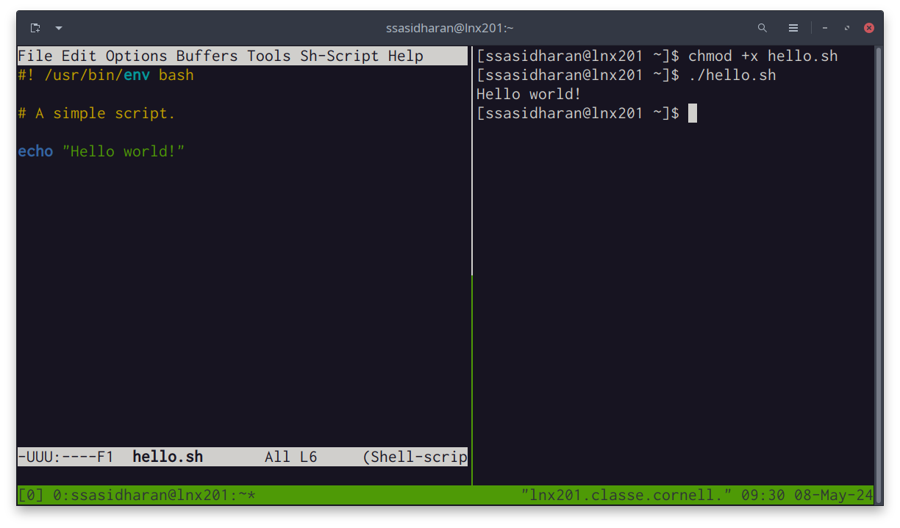
Terminal multiplexers
screen and tmux are two options. Here’s tmux.
Notes:
You can “multiplex” your terminal.
Different shells in different “windows”.
You can split panes vertically or horizontally.
You can detach and re-attach, and resume your work.

Slide 46
Shell scripts

Slide 47
Hello world!
#! /bin/bash # A simple script. echo "Hello $USER!"
Line 1
The “shebang”
Line 3
A comment.
Line 5
An actual line of code.
Make the thing executable with chmod +x hello.sh
Run the thing with ./hello.sh

Slide 48
Other things
Bash supports a programming language with:
if statements
for, while, until statements
functions
et cetera.
Take a peek at /etc/bashrc and $HOME/.bashrc for a taste
BUT
This is not really in scope of this presentation.

Slide 49
Demo maybe?
ssh
tmux
that shell script
chmod
run the shell script

Slide 50
Some resources

Slide 51
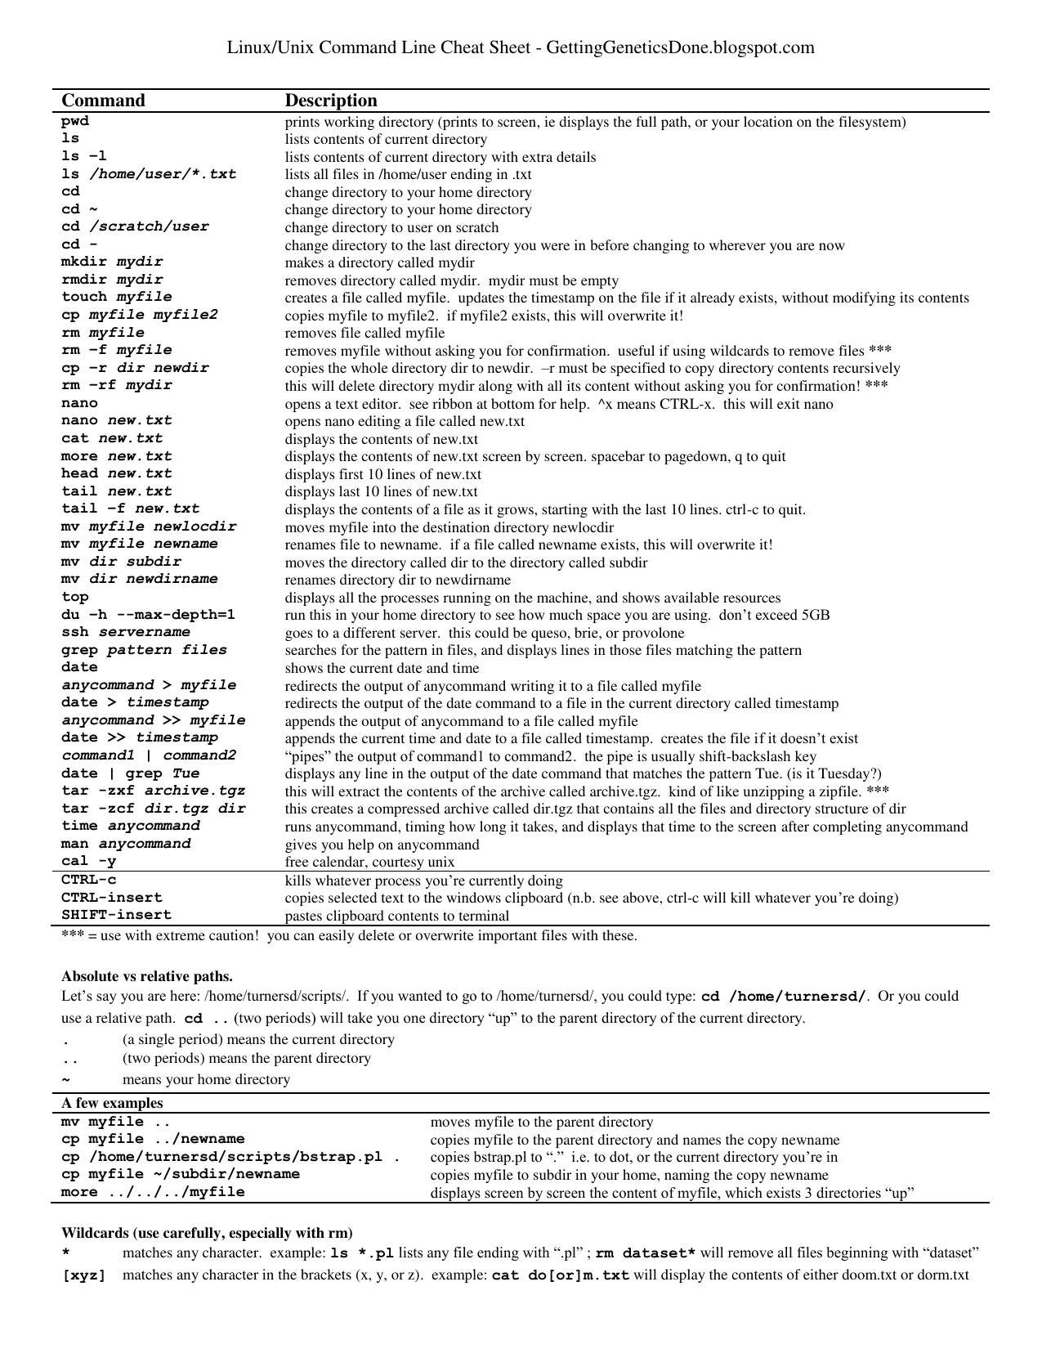
A cheat sheet

Slide 52
(Via Stephen Turner.)

Slide 53
Resources elsewhere
The Linux Command Line, A Complete Introduction by William E. Shotts, Jr. The book is freely available under a Creative Commons license, and contains a good discussion about shell scripting.
The Unix Programming Environment by Brian W. Kernighan and Rob Pike. Old classic, still useful. Places things in a historical context.
Shell Tools and Scripting module of MIT “The Missing Semester of Your CS Education” class.

Slide 54
Other resources
The Internet is pretty great. Use it.
However: DO NOT trust everything you read on the Internet.
Do not copy and paste commands from the Internet indiscriminately.
Understand how things work, and then use it.

Slide 55
Fin!

Slide 56
https://xcitecourse.org/theme2/sf100/
Contributions are welcome!
Notes:
Report issues!
Send your pull requests!

