Slide 1

Company presentation
19 June 2026

Slide 2
– We have thoroughly analysed the market over time and recognize that the need for high-quality care homes will only continue to grow.
Johan Hamre
Chief Executive Officer of REQ

Slide 3
REQ Real Estate Fund I
Key information
Status | Fully investedd
Vintage | 2021
Fund term | 8 years
Fund type | Value-add
 | Article 8-fund according to SFDR
Half-year report H1 2026

Slide 4
REQ Real Estate Fund I
Half-year report H1 2026
REQ is a manager of alternative investment funds. Our aim is to provide best in class
long term performance based on local knowledge, a unique strategy, years of experience and professional curiosity.
Our team has a strong track record from previous roles in the commercial real
estate market.
We know from experience that real estate
is local and that good deals don’t travel.
REQ has a hands-on philosophy to our investment approach, value creation
and risk management with team members covering all aspects of investment and
asset management.

Slide 5
REQ is a manager of alternative investment funds.
Real Estate

Slide 6
Listed Equities
REQ Global Compounders
REQ Nordic Compounders

Slide 7
REQ Fund I initial investment
REQ Alternative Investments through its first fund,
REQ Fund I, will be part of the establishment of
SVG Property – a leading commercial real estate company within the region of Rogaland. The established company is owned by a consortium
of seven real estate investment companies.
113^{k}
4.5^{bln}
Total building area in the portfolio
is approximately 113 000 sqm.
Total asset value of NOK 4,5 bln with a
total rental income of NOK 200 mln in 2022.

Slide 8
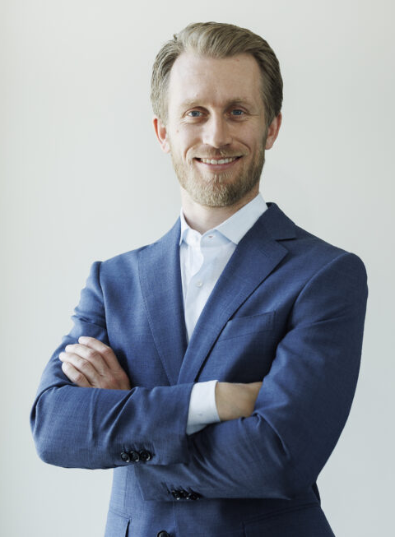
Meet our team
Management
Johan Hamre
Chief Executive Officer
+47 400 77 650
jh@req.no
Johan has more than 15 years of experience across different functions within investment management and real estate. He has previously been partner and CEO of UNION Eiendomskapital.
Johan has a Bachelor in Business Administration and has studied
Real Estate Finance at the University
of Amsterdam.

