Slide 1
W 207– Applied Machine Learning
Cornelia Ilin, PhD
School of Information
UC Berkeley
Linear Regression – part I

Slide 2
About you
Undergraduate major
Current job (if any)
Why Data Science at UC Berkeley?
Why are you interested in ML?
What is your favorite National Park?

Slide 3
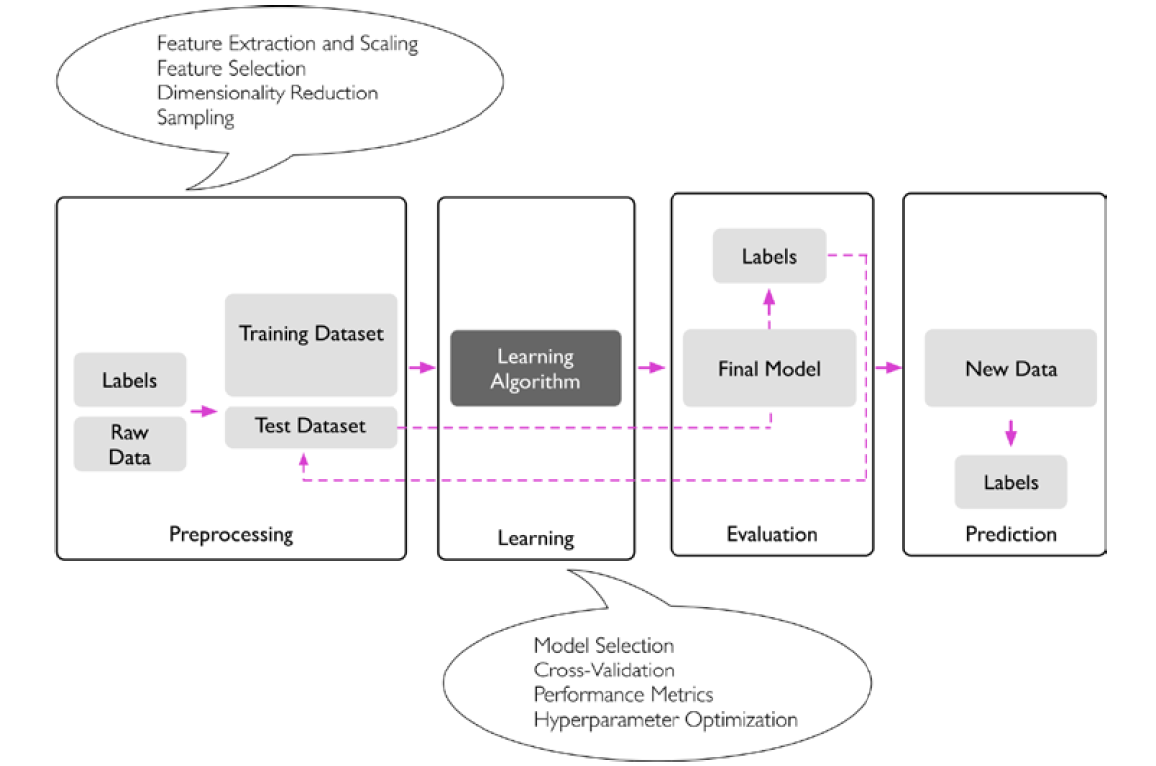
Last week
General concepts of Machine Learning (ML)
Roadmap for building ML systems
Review of Numpy arrays
Course website:
https://corneliailin.github.io/datasci_w207_summer2022/
Image source: S. Raschka and V. Mirjalili, Python Machine Learning

Slide 4
Today’s learning objectives
General concepts of Linear regression and Gradient Descent
Making predictions using the diabetes dataset (1. Linear_regression (gradient descent).ipynb)
Introduction to TensorFlow2 (2. Tensorflow_introduction.ipynb)

Slide 5
Linear regression
Q1: What is the assumed relationship between outcome (y) and features (X)?

Slide 6

Linear regression
Q1: What is the assumed relationship between outcome (y) and features (X)?

Slide 7
Linear regression
Q2: What are the parameters of the model?

Slide 8
Linear regression
Q2: What are the parameters of the model?

Slide 9
Linear regression
Q3: How do we choose the optimal value of these parameters?

Slide 10
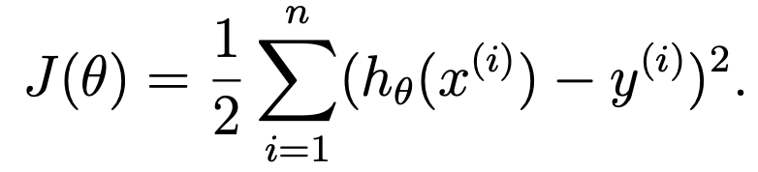

Linear regression
Q3: How do we choose the optimal value of these parameters?
Define a cost (loss) function:
and pick parameters to minimize J(θ) so that is very close to y (at least in the training data)
using a search algorithm (e.g., gradient descent), or by
explicitly taking J(θ) derivatives with respect to the θj’s, and setting them to zero.

Slide 11
Gradient descent
Q3: How does gradient descent work?

Slide 12
Gradient descent
Q3: How does gradient descent work?
Start with some “initial guess” for θ or use transfer learning.
Continue until hopefully we converge to a value of θ that minimizes J(θ).

Slide 13
Gradient descent
Q4: Can you reach a local minima using gradient descent for linear regression?

Slide 14
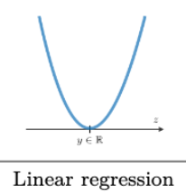
Gradient descent
Q4: Can you reach a local minima using gradient descent for linear regression?
No, gradient descent always converges to the global minima in the linear regression model (assuming the learning rate is not too large).

Slide 15
Gradient descent
Q5: What is the difference between stochastic gradient descent (SGD) and batch gradient descent (BGD)?

Slide 16
Gradient descent
Q5: What is the difference between stochastic gradient descent (SGD) and batch gradient descent (BGD)?
BGD scans through all training examples before making a single step (costly operation if N is large)
SGD starts making progress right away and continues to make progress with each example it looks at. Also:
- gets θ “close” to the minimum much faster
- can escape local minima in non-linear models (the gradient on the whole dataset
could be 0 at some point, but at that same point, the gradient of the batch could
be different)

