Slide 1
W 207– Applied Machine Learning
Cornelia Ilin, PhD
School of Information
UC Berkeley
Introduction

Slide 2
About me
Current:
Faculty in the School of Information at UC Berkley
Research at the intersection of health and environment
Before:
Research Scientist at Stanford University
Postdoc in the School of Information at UC Berkeley
PhD in Applied Economics (UW Madison)

Slide 3
About you
Undergraduate major
Current job (if any)
Why Data Science at UC Berkeley?
Why are you interested in ML?
What is your favorite National Park?

Slide 4
Course websites
Live Session material will be uploaded on the course website: https://corneliailin.github.io/datasci_w207_summer2022/
Grades will be posted on ISVC: https://learn.datascience.berkeley.edu/

Slide 5
Live sessions organization
Each session is 90 minutes
30 minutes Q&A related to the topic of the week
30 minutes Code demonstration
30 minutes Breakout room exercises

Slide 6
Today’s learning objectives
General concepts of Machine Learning (ML)
Roadmap for building ML systems (1. Introduction.ipynb)
Review of Numpy arrays (2. Numpy_review.ipynb)

Slide 7
General concepts of ML
Q1: Can you make predictions about the future using ML? Provide an example.

Slide 8
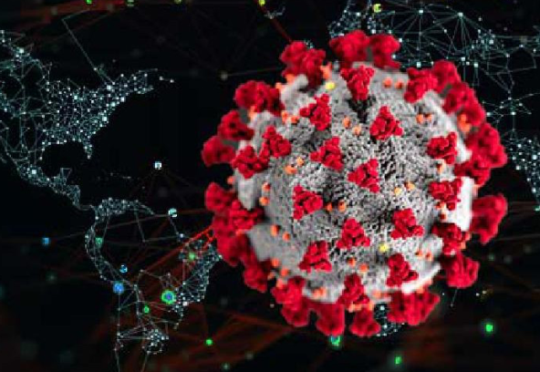
General concepts of ML
Q1: Can you make predictions about the future using ML? Provide an example.
Yes!
Example: predict number of COVID-19 cases and deaths

Slide 9
General concepts of ML
Q2: Name and explain the 3 types of ML supervision

Slide 10
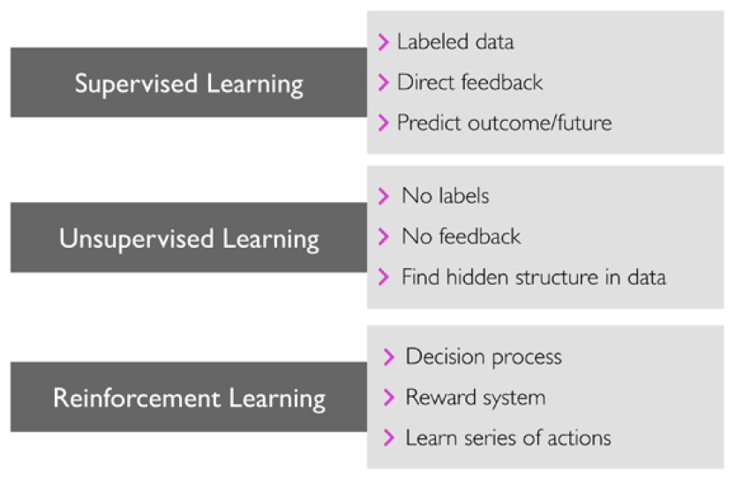
General concepts of ML
Q2: Name and explain the 3 types of ML supervision
Image source: S. Raschka and V. Mirjalili, Python Machine Learning

Slide 11
General concepts of ML
Q3: Name the 2 types of supervised ML models

Slide 12
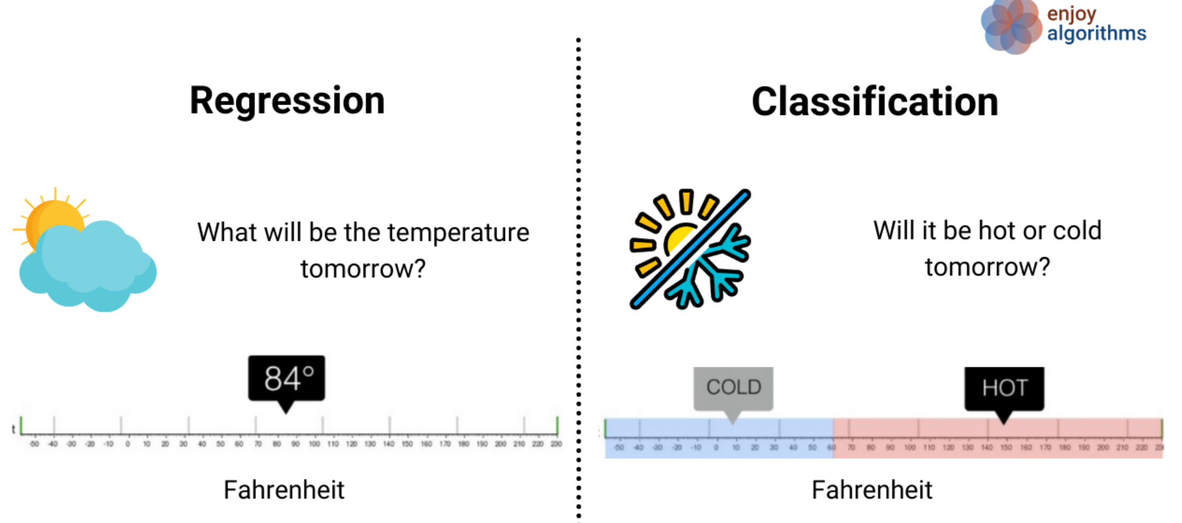
General concepts of ML
Q3: Name the 2 types of supervised ML models
Image source: https://www.enjoyalgorithms.com/

Slide 13
General concepts of ML
Q4: True or False? Clustering is a technique used for structuring information and deriving meaningful relationships from data.

Slide 14
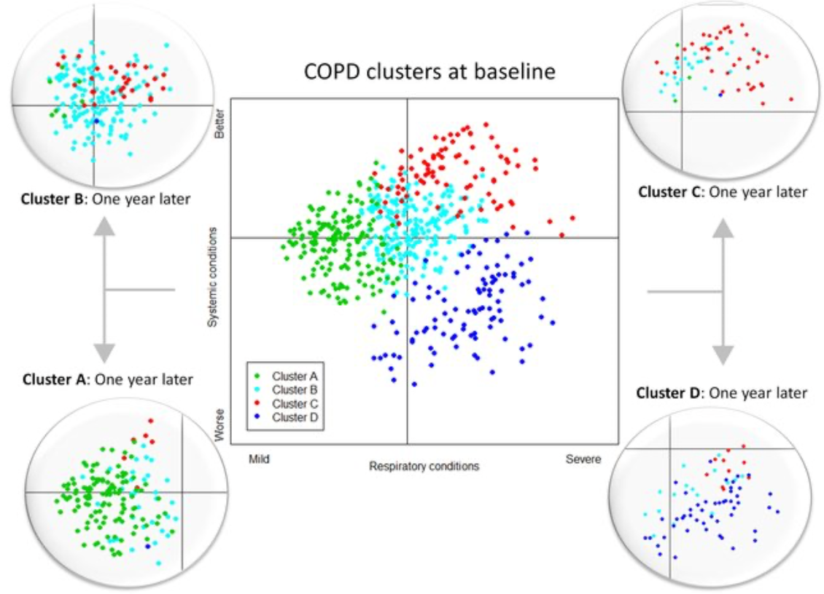
General concepts of ML
Q4: True or False? Clustering is a technique used for structuring information and deriving meaningful relationships from data.
True, it’s an unsupervised learning technique used to find subgroups in data.
Example: discover patient groups based on their diagnosis history in order to develop distinct treatment plans.
Image source: https://www.researchgate.net/publication/307969853_Chronic_Obstructive_Pulmonary_Disease_Subtypes_Transitions_over_Time/figures

Slide 15
General concepts of ML
Q5: What is Principal Component Analysis (PCA)?

Slide 16
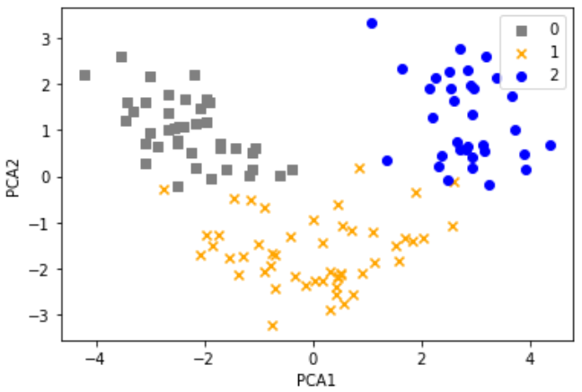
General concepts of ML
Q5: What is Principal Component Analysis (PCA)?
PCA is an unsupervised learning technique, useful when working with data of high dimensionality or for visualizing data.
Example: Common to combine PCA and clustering!

Slide 17
General concepts of ML
Q6: What is a typical workflow for using ML in predictive modeling?

Slide 18
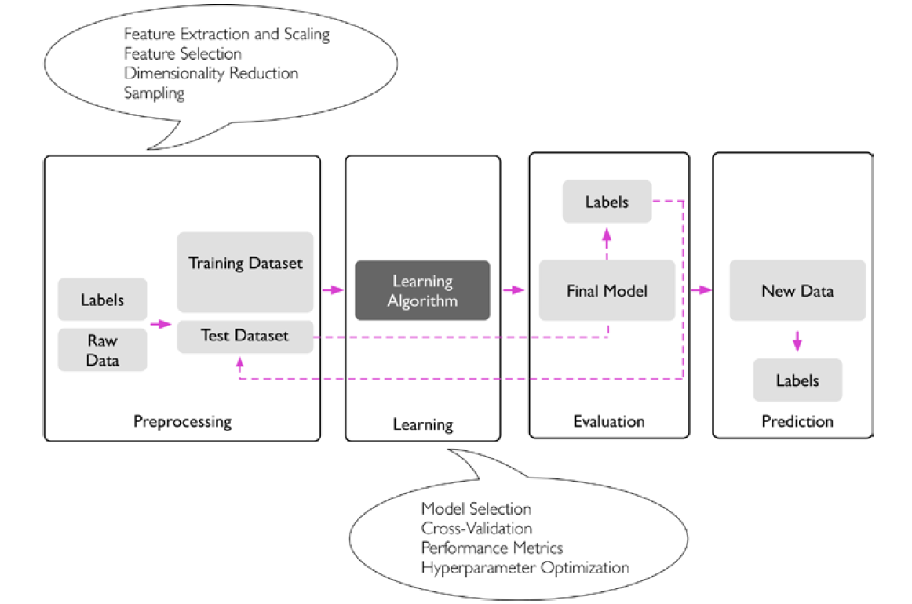
General concepts of ML
Q6: What is a typical workflow for using ML in predictive modeling?
Example: Introduction.ipynb (CI)
Image source: S. Raschka and V. Mirjalili, Python Machine Learning

Slide 19
General concepts of ML
Q7: Why do we need a train-test split? How do you evaluate prediction?
What is meant by generalization?
Image source: S. Raschka and V. Mirjalili, Python Machine Learning

