Slide 1
Linux commands
Submitted by
Reshma S J
9 FEB 2021

Slide 2
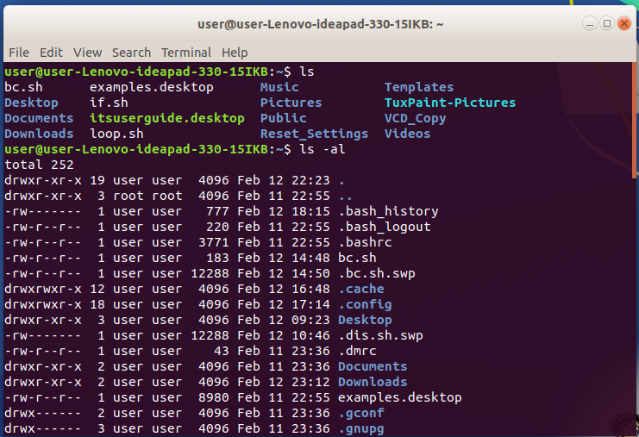
1. ls - Directory listing
2. ls -al - Formatted listing with hidden files
3. ls -lt - Sorting the Formatted listing by time modification
4. cd dir- Change directory to dir
5. cd - Change to home directory
6. pwd - Show current working directory
7. mkdir dir - Creating a directory dir
8. cat >file - Places the standard input into the file
9. more file - Output the contents of the file
10. head file - Output the first 10 lines of the file
11. tail file - Output the last 10 lines of the file
12. tail -f file -Output the contents of file as it grows,starting with the last 10 lines

Slide 3
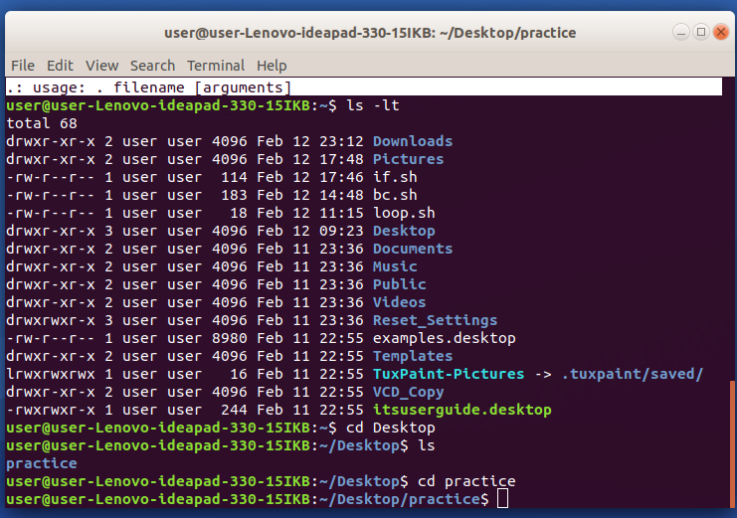
13. touch file- Create or update file
14. rm file - Deleting the file
15. rm -r dir - Deleting the directory
16. rm -f file - Force to remove the file
17. rm -rf dir - Force to remove the directory dir
18. cp file1 file2 - Copy the contents of file1 to file2
19. cp -r dir1 dir2 - Copy dir1 to dir2;create dir2 if not present
20. mv file1 file2- Rename or move file1 to file2,if file2 is an existing directory

Slide 4
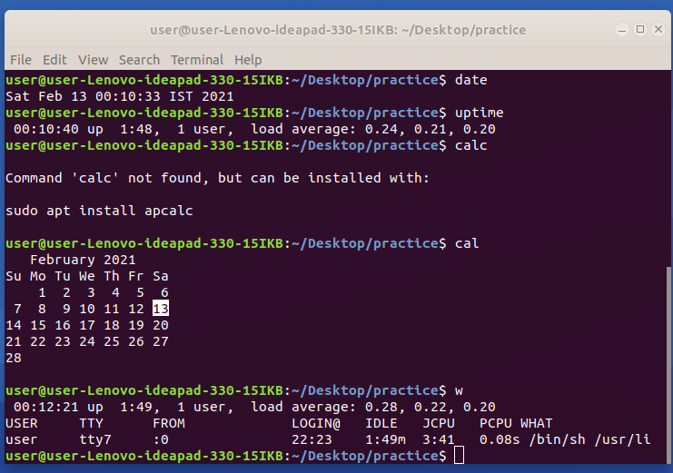
21. date - Show the current date and time
22. cal- Show this month's calender
23. uptime - Show current uptime
24. w - Display who is on line
25. whoami- Who you are logged in as

Slide 5
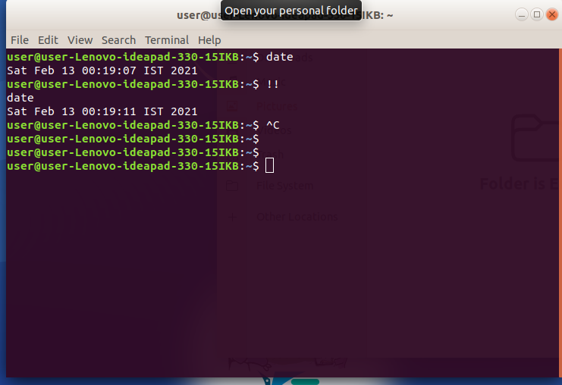
1. ctrl+c Halts the current command
2. ctrl+z Stops the current command, resume with fg in the
foreground or bg in the background
3. ctrl+d Logout the current session, similar to exit
4. ctrl+w Erases one word in the current line
5. ctrl+u Erases the whole line
6. ctrl+r Type to bring up a recent command
7. !! Repeats the last command
8. exit Logout the current session

