Slide 1
Vi editor
12 Feb 2021
Submitted by
Reshma S J

Slide 2
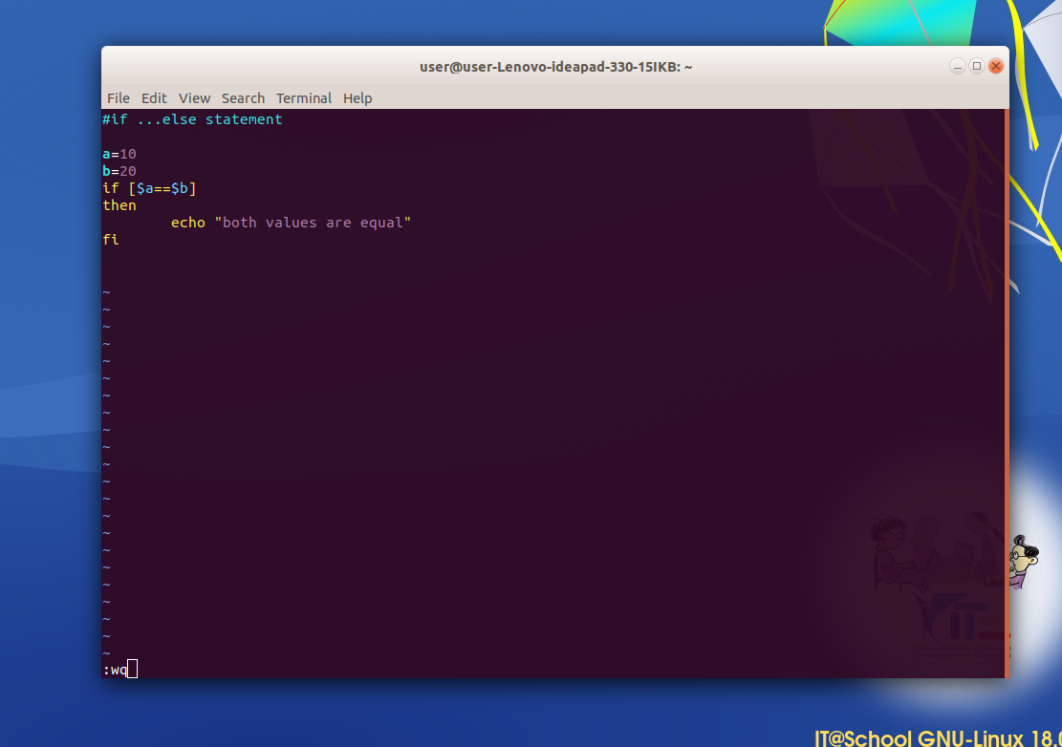
Vi editor
If ....else statement

Slide 3
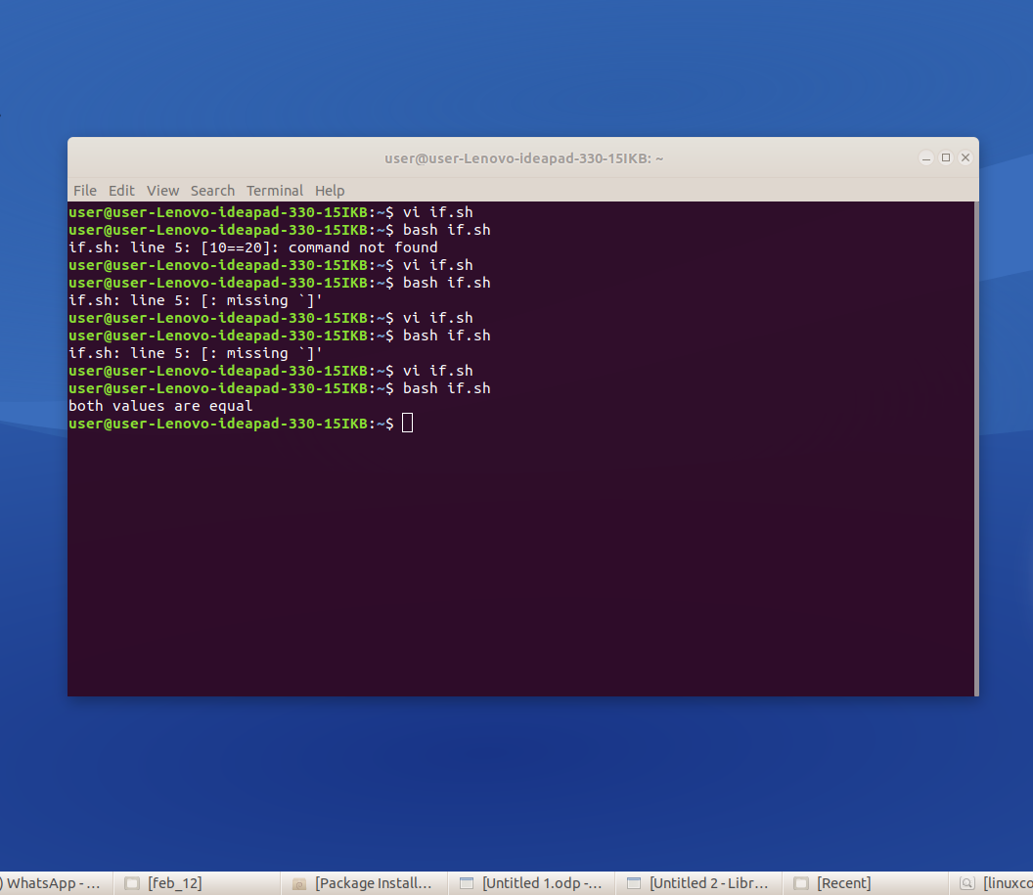

Slide 4
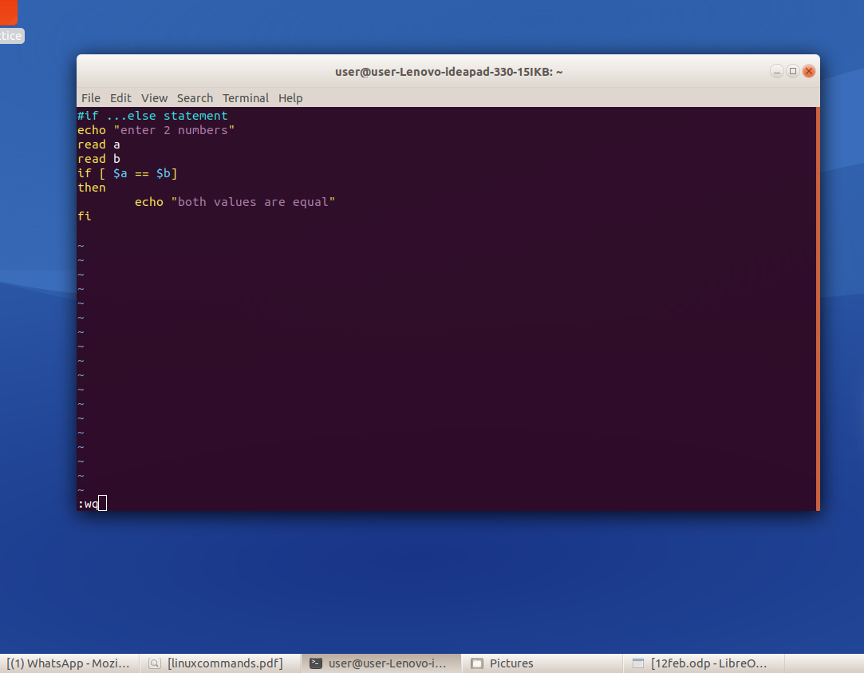

Slide 5
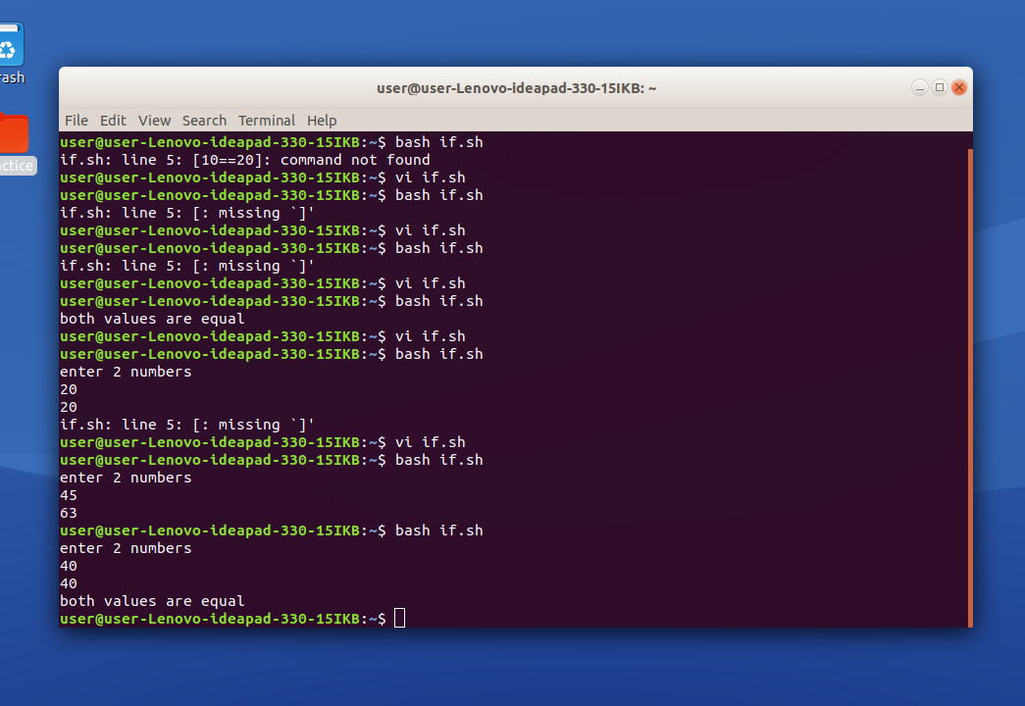
To read the numbers from console and check using if else

