Slide 1


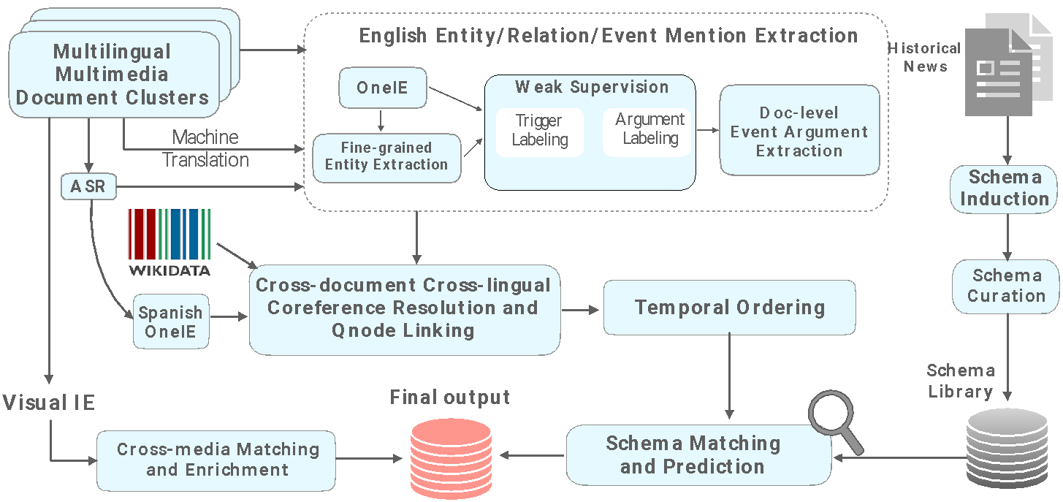
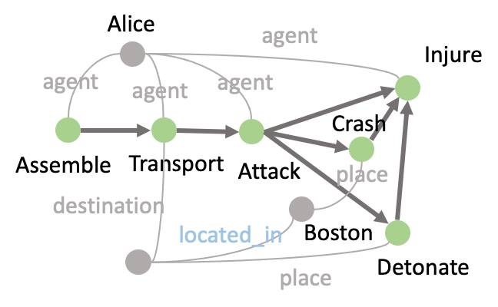
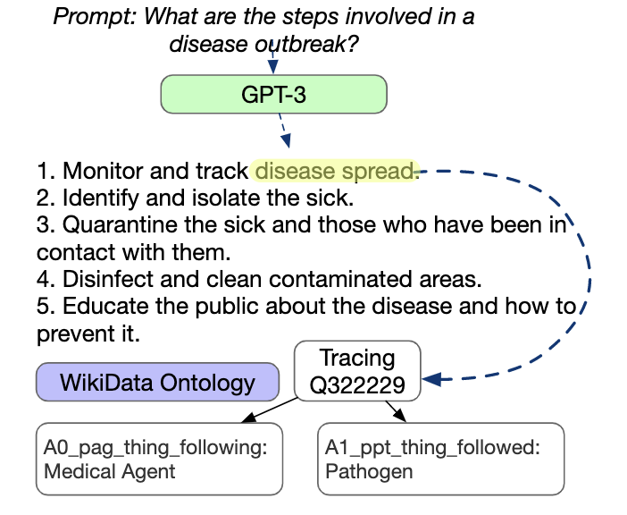
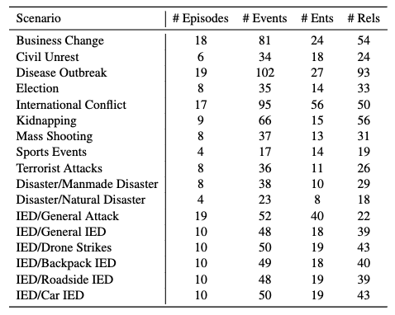
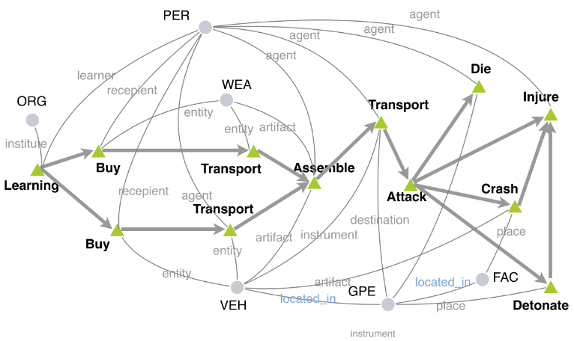
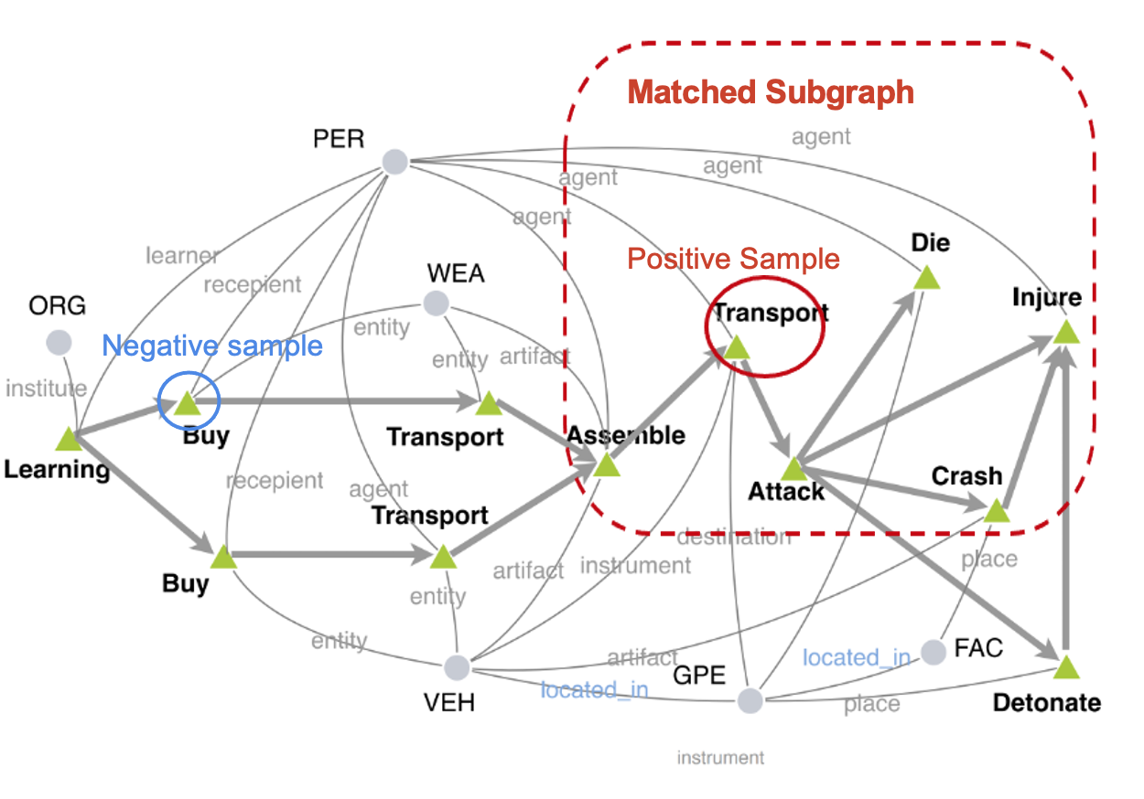
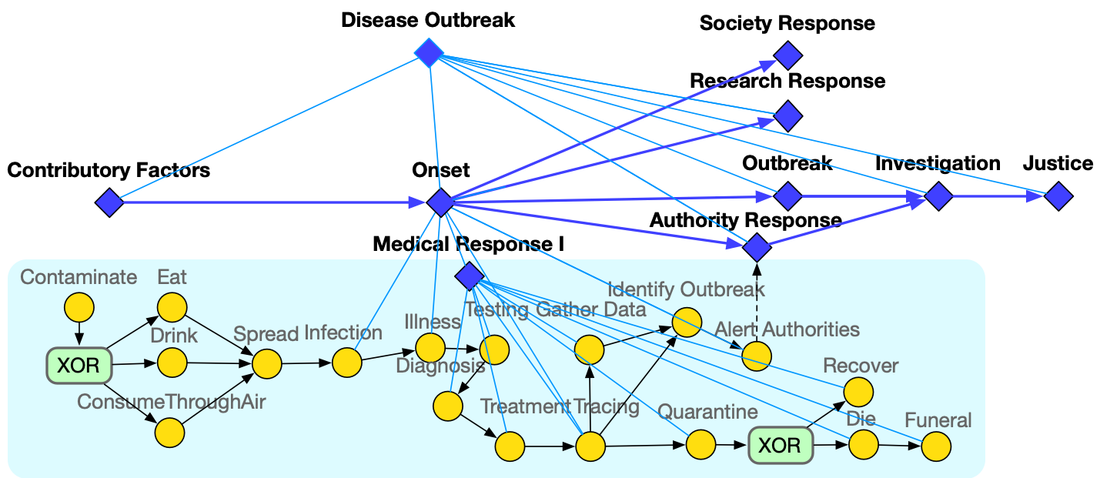
RESIN 11: Schema-Guided Event Prediction for Eleven Newsworthy Scenarios
Xinya Du, Zixuan Zhang, Sha Li, Heng Ji and the RESIN team
System Overview
Open Domain IE from Speech and Text
Speech data is converted to text by ASR (Amazon Transcribe)
Our IE system is the combination of several models
We make use of a Wikidata-based system for entity linking (Lai et al., 2022).
The system has a novel candidate retrieval paradigm based on entity profiling.
Cross-media Info Grounding and Fusion
Visual event and argument role
Cross-media event coreference resolution
Extracting templates/events from documents.
We focus on string fills (and also event type fills) in this work.
]
Schema Induction and Curation
Schema Matching
Zero-shot schema induction with GPT3 generated documents
Schema-Guided
New Event Prediction
Take-Away
Github: https://github.com/RESIN-KAIROS/RESIN-11
Demo Website: http://18.221.187.153:11000/kairos

