Slide 1
RESIN Kidnapping Schema
Quizlet 9

Slide 2
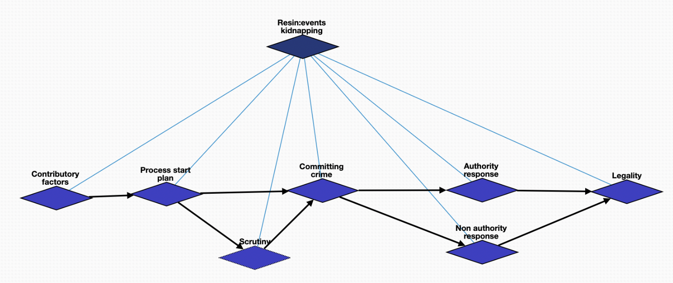
Overview

Slide 3
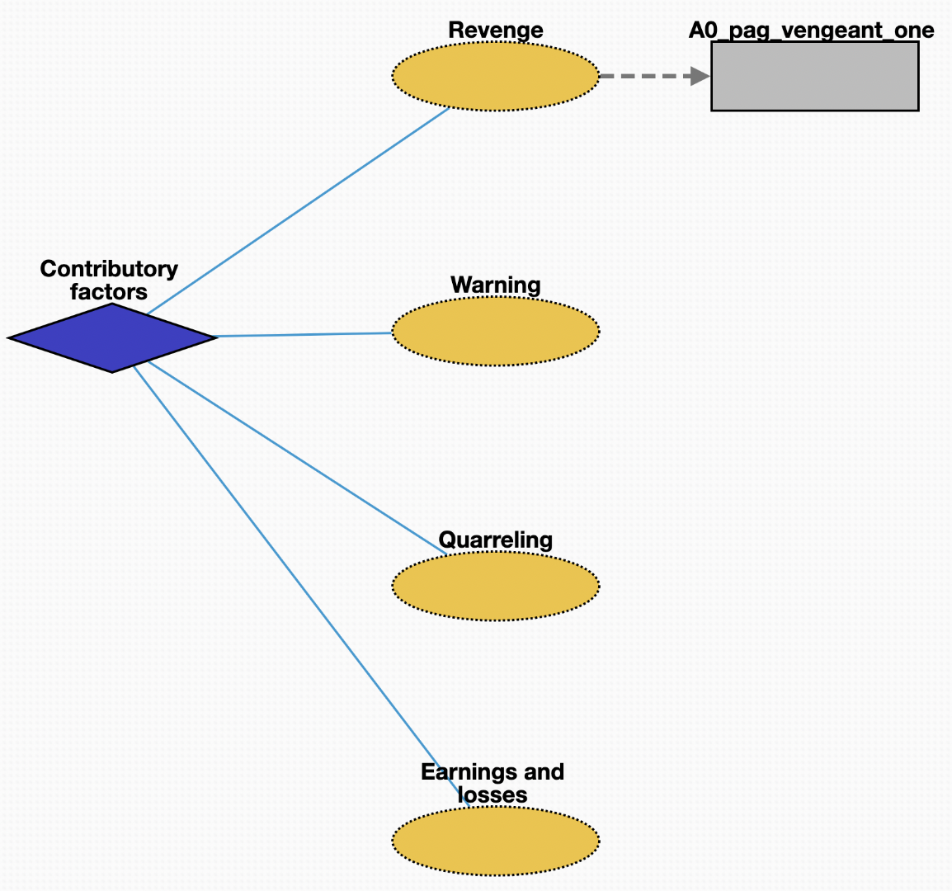
Contributory factors
Revenge: harmful action in response to a grievance
Earnings and losses: consumption and savings opportunity gained by an entity within a specified timeframe
Warning: preventative measure taken to ensure someone's health
Quarreling: struggle for agency or power in society

Slide 4
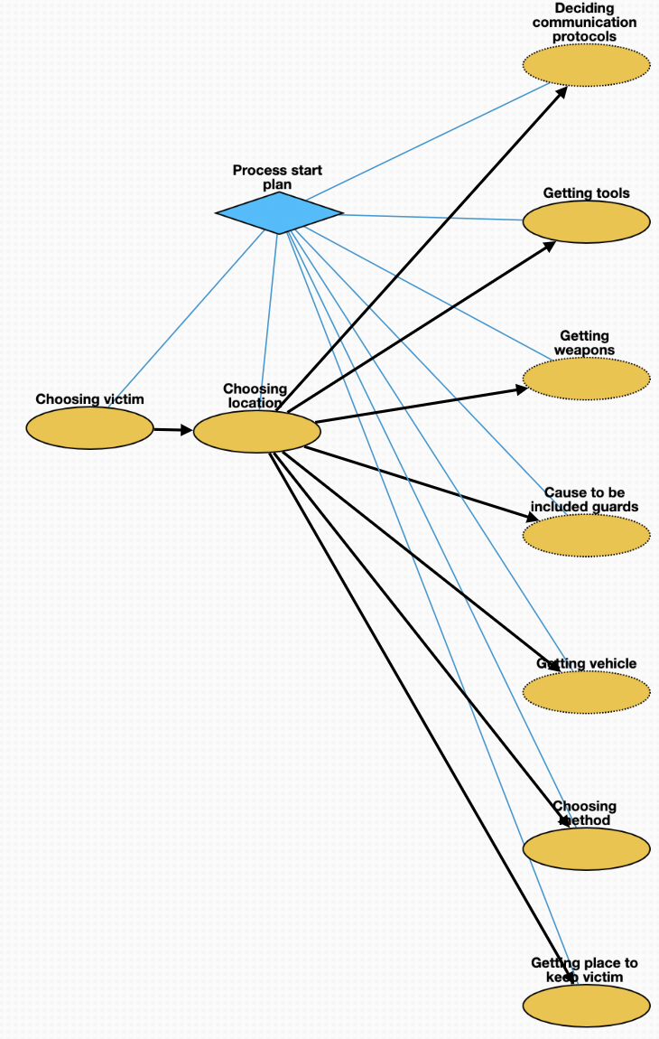
Planning
Choosing victim: act of selecting one or more victims
Choosing location: act of selecting location where to kidnap victim
Cause to be included guards: employment of personnel needed to guard victim
Getting weapons: purchase of weapons needed for crime
Getting place to keep victim: acquisition of location where victim will stay
Deciding communication protocols: deliberation about how kidnappers should communicate before, during, and after the crime
Getting tools: purchase of tools necessary for crime
Choosing method: act of judging the merits of multiple kidnapping methods and selecting one or more of them
Getting vehicle: purchase of vehicle needed for crime

Slide 5
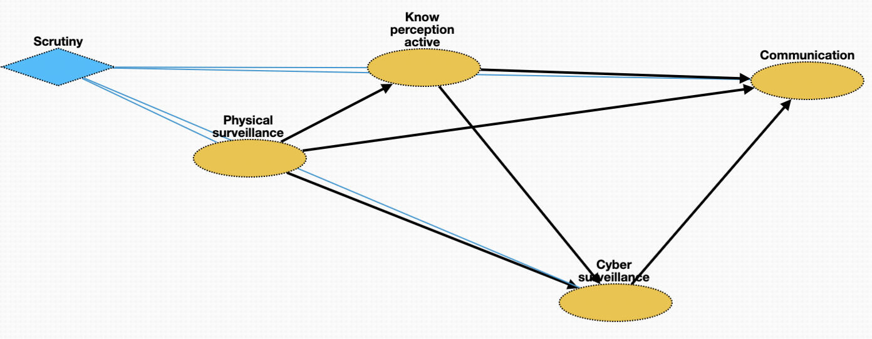
Scrutiny
Physical surveillance: monitor of behavior, activities, or other changing information about victim
Know perception active: mental process; act of recognizing attributes of victim
Cyber surveillance: clandestine acquisition of confidential information about victim via online resources
Communication: act of conveying intentions about kidnapping to other members of criminal network

Slide 6
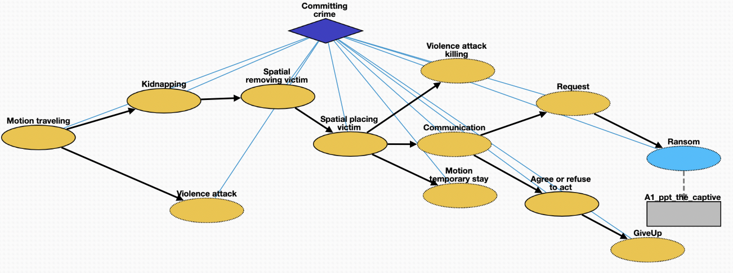
Committing crime
Motion traveling: movement of kidnapper from a place to location where is planned
Attack: control of victim by kidnapper
Kidnapping: taking away or transportation of a person against that person's will
Removing victim: process removing the victim from a location
Placing victim: net movement of victim from one location to another
Killing: death of victim as a result of action by kidnapper
Temporary stay: short stay of victim in safehouse or other location
Communication: act of conveying intended meanings from kidnapper to authorities or non-authorities
Request: act of asking formally for something in return for safety of victim
Ransom: practice of holding a prisoner or item to extort money or property
Agree or refuse to act: understanding between entities to follow a specific course of conduct
GiveUp: form of surrender when kidnapper decides to stop crime

Slide 7
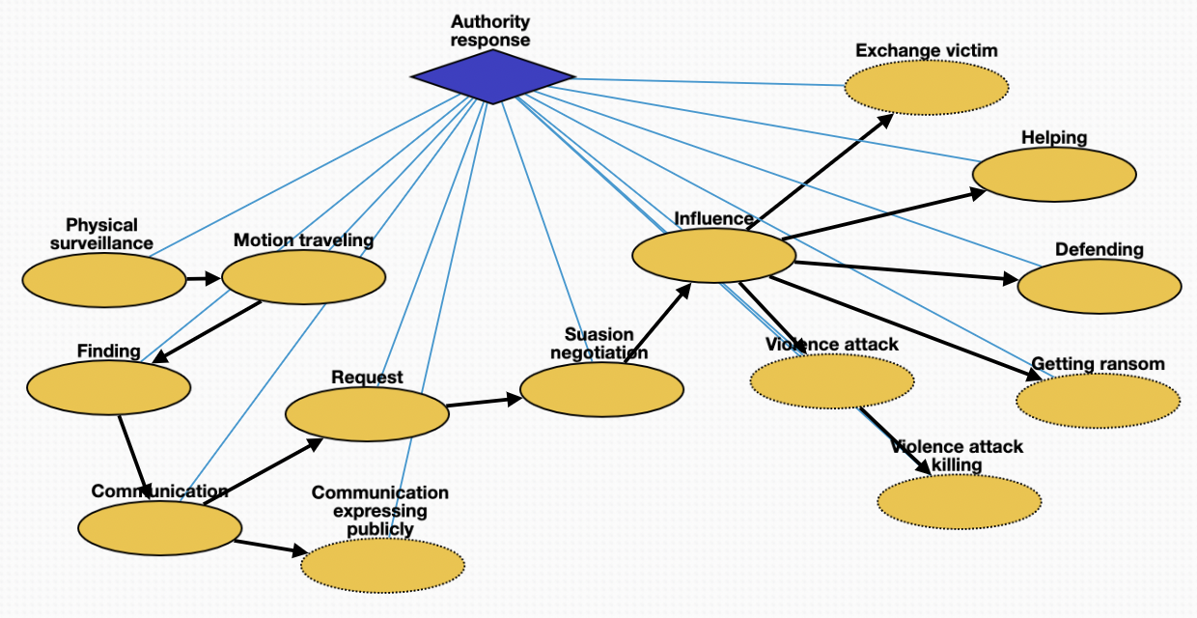
Authority response
Physical surveillance: monitoring of behavior, activities, or other changing information about kidnapper
Traveling: movement of authorities to location of kidnapper or victim
Finding: physical finding of location of kidnapper or victim
Communication: act of conveying intended meanings between authorities
Expressing publicly: revealing of restricted information about crime to public
Request: act of asking formally for demands of kidnapper
Negotiation: meeting held between authorities and kidnapper
Influence: umbrella term of influence and mode of communication
Helping: cooperation between authorities and people impacted by crime
Defending: act of protecting victim from attack
Exchange victim: voluntary exchange of victim for other person or resource
Getting ransom: money made available to secure safety of victim
Attack: attempt to control situation by authorities
Killing: act of killing the kidnapper or accidental killing of victim

Slide 8
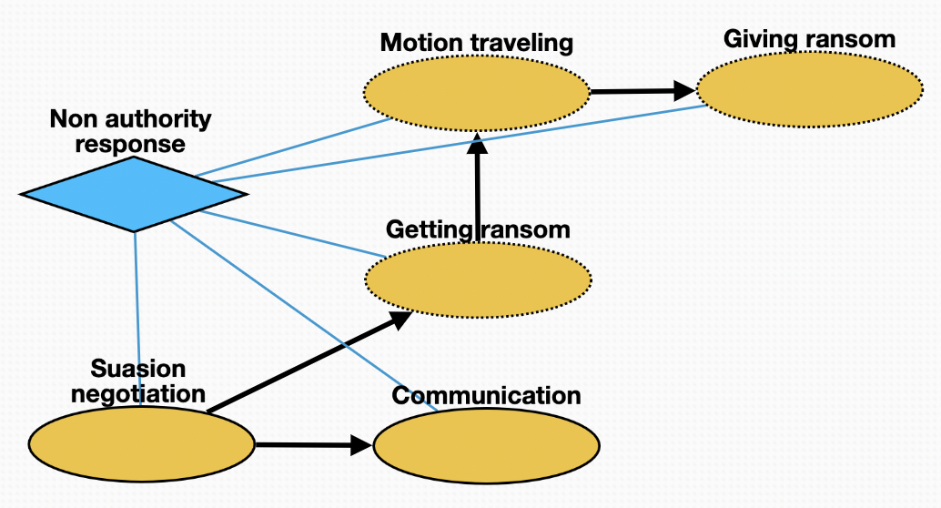
Non-authority response
Negotiation: meeting held between non-authorities and kidnapper
Communication: conveying meaning between non-authorities and kidnapper
Getting ransom: procuring money to secure safety of victim
Traveling: movement of non-authorities to location for delivery of ransom
Giving ransom: handing over ransom to kidnapper

Slide 9
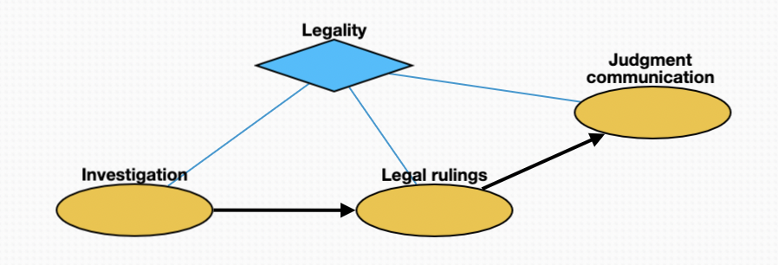
Legality
Investigation: investigation of crimes by police
Legal rulings: proceedings in any civil lawsuit or criminal prosecution
Judgment communication: instruction directed by law, judgment or administrative act to defendant or litigant to obey a certain behavior

