Slide 1
Business Change Schema Quizlet 9
Carl Edwards
{cne2}@illinois.edu

Slide 2
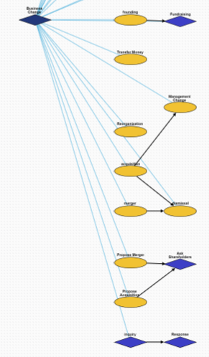
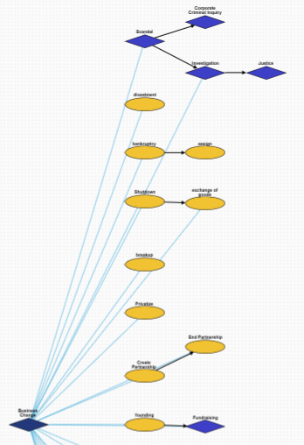
Overview

Slide 3
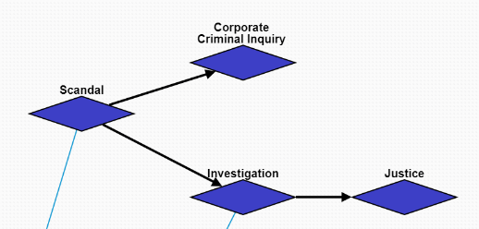
Scandal
Scandal: A scandal occurs at the company.
Investigation->Justice: This branch involves the investigation and justice of an individual person.
Corporate Criminal Inquiry: This branch involves the company as a whole being investigated for crimes.

Slide 4
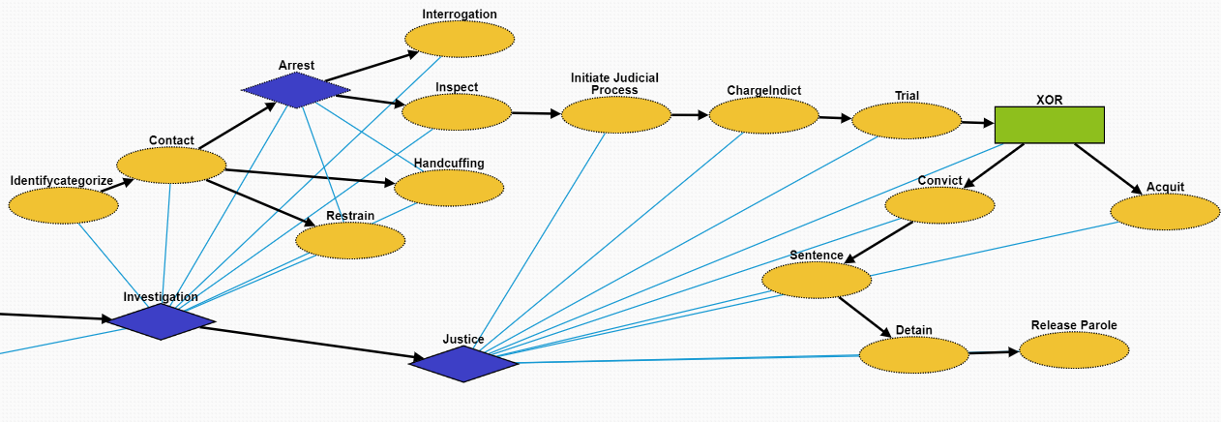
Investigation
This is the same as Criminal Justice in Quizlet 8.
Identifycategorize: Identification of the suspect.
Contact: Make contact with the suspect
Arrest: Taking the suspect who violated laws during the outbreak into custody
Handcuffing: Using handcuffs to secure a suspect who violated law
Restrain:Physical restraint on the suspect
Interrogation: Interviewing with the goal of eliciting useful information related to suspected crime
Inspect: Organized examination or formal evaluation on the suspect

Slide 5
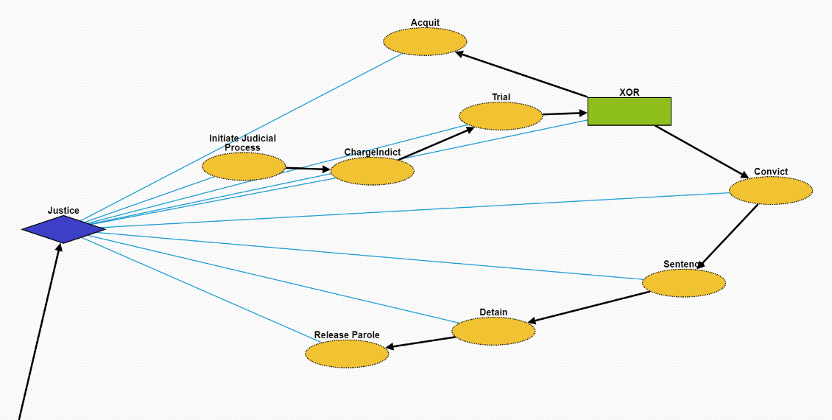
Justice
This is the same as Criminal Justice in Quizlet 8.
Initiate Judicial Process: Initiate a legal proceeding on the suspect.
ChargeIndict: Formal accusation made by a governmental authority on the suspect.
Trial: Coming together of parties to a dispute, to present information in a tribunals on the case.
Acquit: In common law jurisdictions, an acquittal certifies that the accused is free from the charge of an offense, as far as the criminal law is concerned
Convict: A state or private citizen lawfully holds the criminal responsible by removing their freedom or liberty at that time.
Sentence:
Detain:
Release Parole: Release or early release of the criminal responsible.

Slide 6
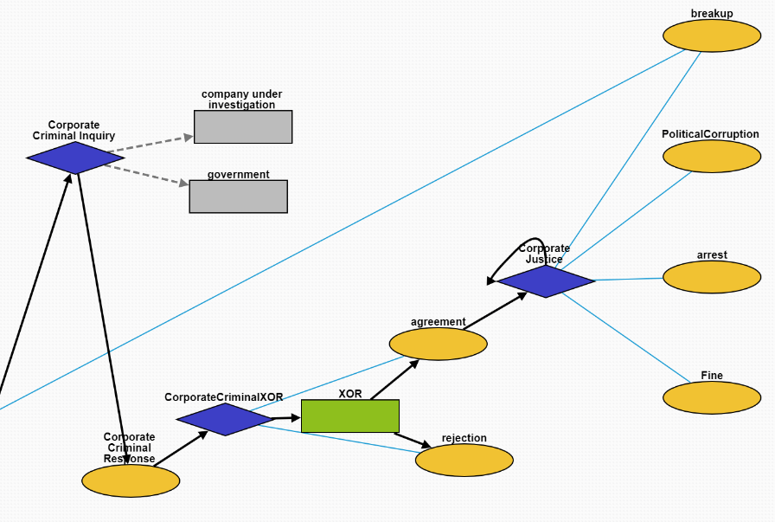
Corporate Criminal Inquiry
Corporate Criminal Response: A response to a corporate criminal investigation. Created to distinguish from criminal response against people.
CorporateCriminalXOR: Node to enable XOR children.
agreement: The government decides a corporation broke the law.
rejection: The government decides a corporation did not break the law.
Corporate Justice: Government actions taken as a result of investigating a corporation.
breakup: Government breaks up a company.
PoliticalCorruption: The execs send money to their politician friends who pull some strings.
Arrest: Executives are arrested for crimes they committed carrying out their duties.
Fine: The government fines a company for doing something wrong.

Slide 7
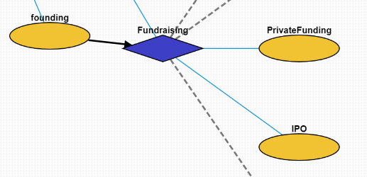
Fundraising
founding: A company is founded.
Fundraising: The company raises money for some goal.
PrivateFunding: The company raises money from private investors (the opportunity is not available to the public).
IPO: The company becomes publicly listed on a stock exchange.

Slide 8
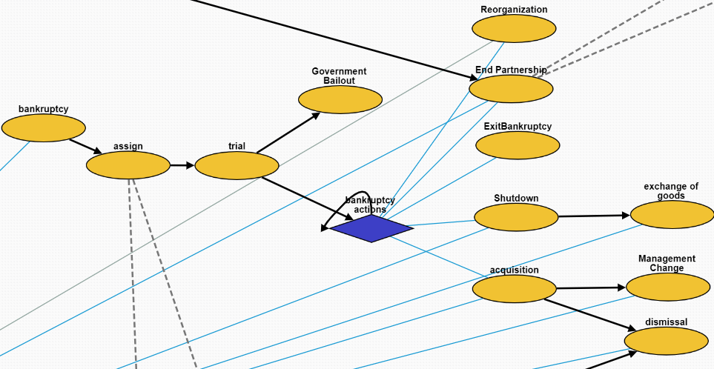
Bankruptcy
assign: Government assigns a trustee to the bankruptcy case.
trial: A bankruptcy case begins.
Government Bailout: The government loans a lot of money to a company when it's 'too big too fail' without damaging the economy.
bankruptcy actions: Different actions taken when the company is undergoing the bankruptcy process.
Reorganization: The company is reorganized.
End Parternship: Two companies decide to end their partnership.
ExitBankruptcy: A company leaves bankruptcy.
Shutdown: A company has to close for some reason.
acquisition: A company is acquired by another company.
exchange of goods: A company sells its assets.
Management Change: The management is changed.
dismissal: A bunch of employees are fired.

Slide 9
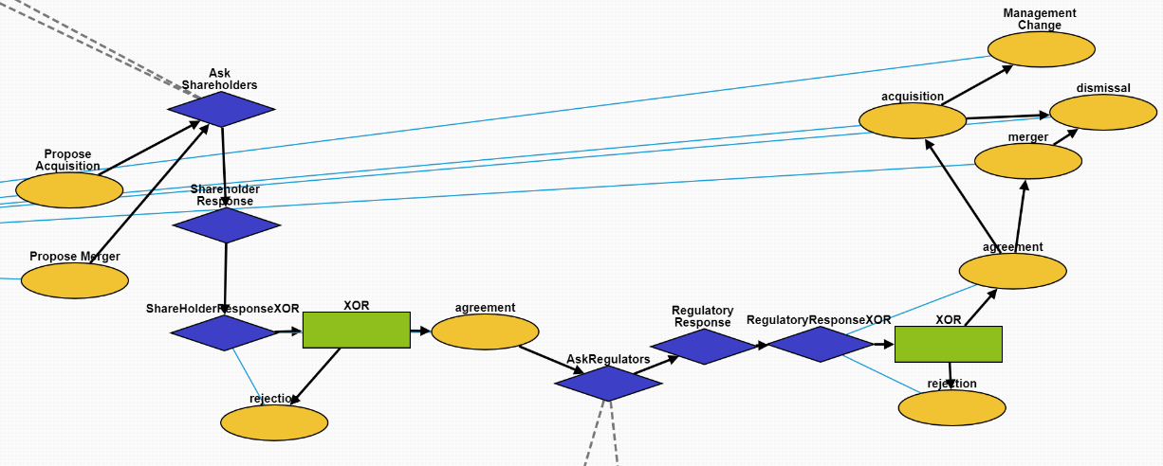
Propose Acquisition/Merger
Propose Acquisition: One company proposes acquiring another company.
Propose Merger: Two companies decide to try and become one company.
Ask Shareholders: The companies ask their shareholders for approval.
Shareholder Response: The shareholders respond.
There is also a XOR version to indicate only one child answer.
agreement: A positive response.
rejection: A negative response.
AskRegulators: Ask the regulators to approve the merger/acquisition.
Regulatory Response: The regulators respond.
There is also a XOR version to indicate only one child answer.
merger: The companies merge together.
acquisition: One company acquires another.
dismissal: Employees are fired from a company.
Management Change: The managers of a company are
replaced with new managers.

Slide 10
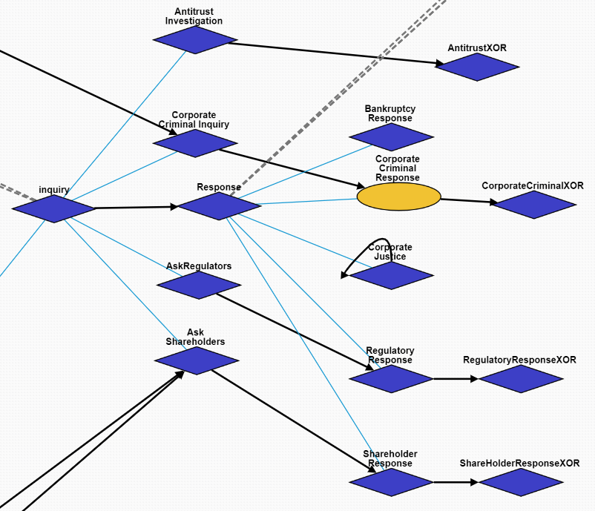
Inquiry/Response Superclasses
Overall hierarchy structure of Inquiry and Response

Slide 11
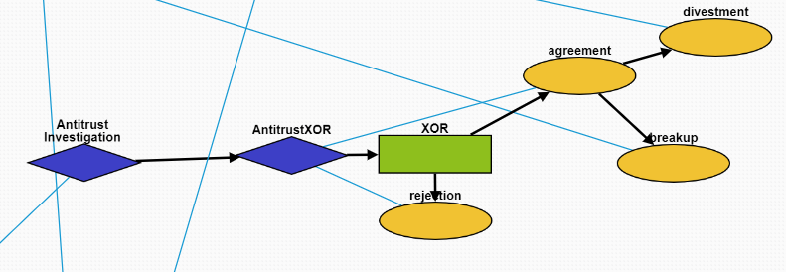
Antitrust Investigation
Antitrust Investigation: The government investigates whether a company is a monopoly.
There is also a XOR version to indicate only one child answer.
agreement: A positive response.
rejection: A negative response.
divestment: The company is forced to sell off parts of its business by the government.
breakup: The company is broken up into smaller pieces by the government.

Slide 12
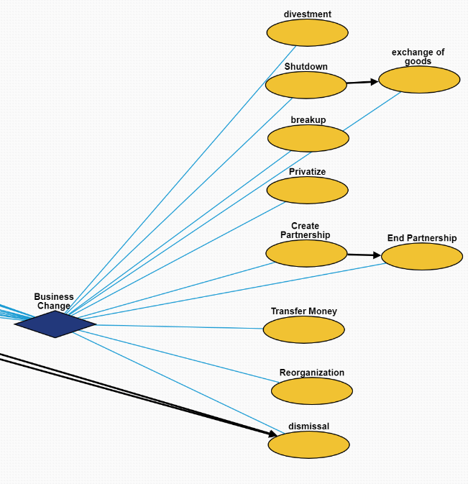
Other Business Change Events
divestment: A company divests assets.
Shutdown: A company shuts down.
exchange of goods: A company sells assets.
breakup: A company breaks up into smaller companies.
Privatize: A public company’s stocks are bought up and it becomes private again.
Create Partnership: Two companies partner together to do something mutually beneficial. They remain seperate entities.
End Partnership: Two companies stop working together.
Transfer Money: Money is transferred between two parties. This can be internal in a company.
Reorganization: The structure of a company is reorganized.
dismissal: Workers are fired.

