Slide 1
RESIN Kidnapping Schema
Curated by Michael Regan
Updated March 20, 2022

Slide 2
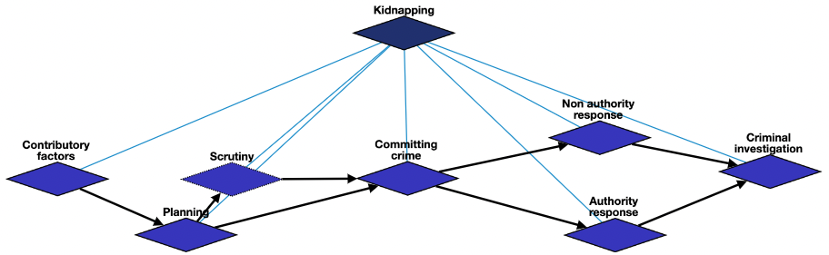
Overview

Slide 3
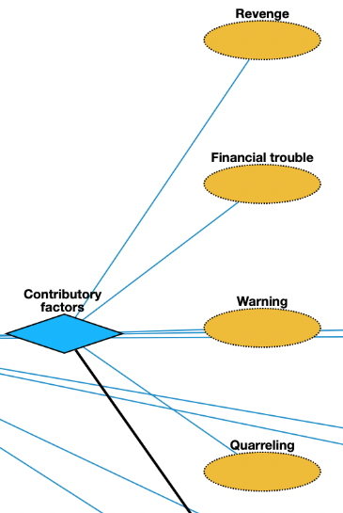
Contributory factors
Revenge: harmful action in response to a grievance
Warning: preventative measure taken to ensure someone's health
Quarreling: struggle for agency or power in society
Financial trouble: consumption and savings opportunity gained by an entity within a specified timeframe

Slide 4
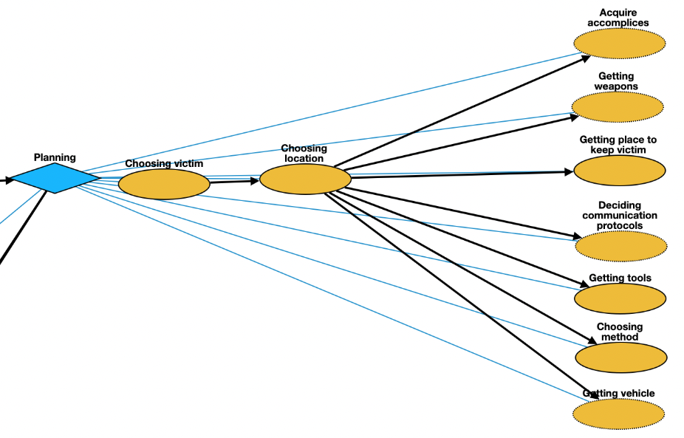
Planning
Choosing victim: act of selecting one or more victims
Choosing location: act of selecting location where to kidnap victim
Acquire accomplices: employing other parties to ensure victim does not escape and is otherwise taken care of
Getting weapons: purchase of weapons needed for crime
Getting place to keep victim: acquisition of location where victim will stay
Deciding communication protocols: deliberation about how kidnappers should communicate before, during, and after the crime
Getting tools: purchase of tools necessary for crime
Choosing method: act of judging the merits of multiple kidnapping methods and selecting one or more of them
Getting vehicle: purchase of vehicle needed for crime

Slide 5
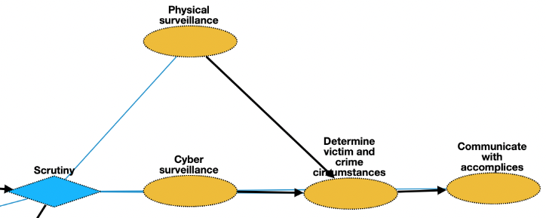
Scrutiny [optional]
Physical surveillance: monitor of behavior, activities, or other changing information about victim
Cyber surveillance: clandestine acquisition of confidential information about victim via online resources
Determine victim and crime circumstances: planning stage involving thinking about victim and circumstances about crime
Communication with accomplices: act of conveying intentions about kidnapping to other members of criminal network

Slide 6
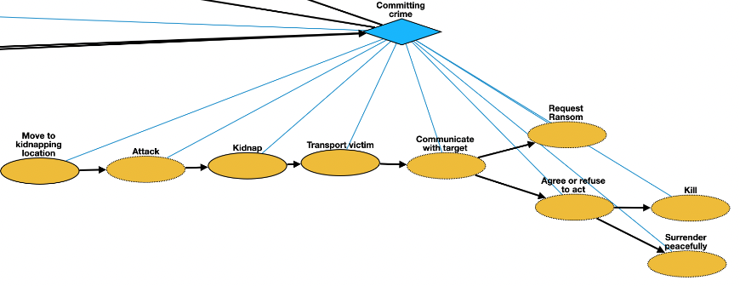
Committing crime
Move to kidnapping location: movement of kidnapper from a place to location where is planned
Attack: control of victim by kidnapper
Kidnapping : taking away or transportation of a person against that person's will
Transport victim: net movement of victim from one location to another
Communicate with Target: act of conveying intended meanings from kidnapper to authorities or non-authorities
Request Ransom: practice of holding a prisoner or item to extort money or property
Agree or refuse to act: understanding between entities to follow a specific course of conduct
Killing: death of victim as a result of action by kidnapper
Surrender: form of surrender when kidnapper decides to stop crime

Slide 7
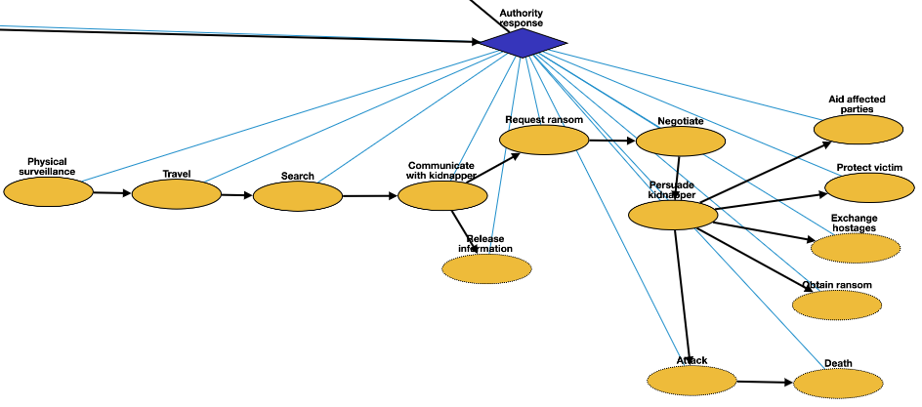
Authority response
Physical surveillance: monitoring of behavior, activities, or other changing information about kidnapper
Travel: movement of authorities to location of kidnapper or victim
Search: physical finding of location of kidnapper or victim
Communication with kidnapper: act of conveying intended meanings between authorities
Release Information: revealing of restricted information about crime to public
Request: act of asking formally for demands of kidnapper
Negotiation: meeting held between authorities and kidnapper
Persuade kidnapper: attempts to prevent additional crimes through discussion or police action
Aid affected parties: cooperation between authorities and people impacted by crime
Protect victim: act of protecting victim from attack
Exchange hostages: voluntary exchange of victim for other person or resource
Obtain ransom: money made available to secure safety of victim
Attack: attempt to control situation by authorities
Killing: act of killing the kidnapper or accidental killing of victim

Slide 8
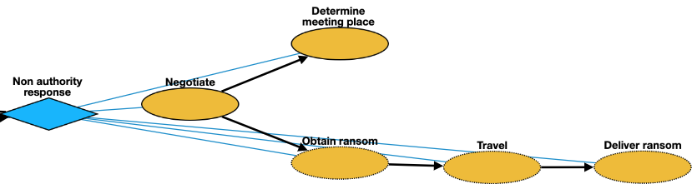
Non-authority response
Negotiate: meeting held between non-authorities and kidnapper
Determine meeting place: act of conveying intended meanings between non-authorities and kidnapper
Obtain ransom: procuring money to secure safety of victim
Travel: movement of non-authorities to location for delivery of ransom
Deliver ransom: handing over ransom to kidnapper

Slide 9
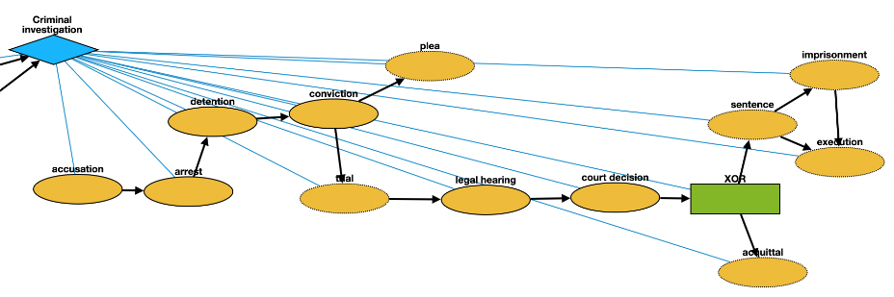
Criminal Investigation
Accusation: act of accusing or charging another with a crime
Arrest: detention of a person and taking it into custody, usually because it has been suspected of committing a crime
Detention: removal of the freedom of liberty by a state
Conviction: verdict that results when a court of law finds a defendant guilty of a crime
Plea: answer to a claim made by someone in a criminal case under common law using the adversarial system
Trial: coming together of parties to a dispute, to present information in a tribunal
Legal hearing:
Court decision: formal decision made by a court
Sentence: decree of punishment in law
Imprisonment: restraint of a person's liberty by judicial or other detention
Execution: homicide as capital punishment
Acquittal: the legal result of a verdict of not guilty

