Slide 1
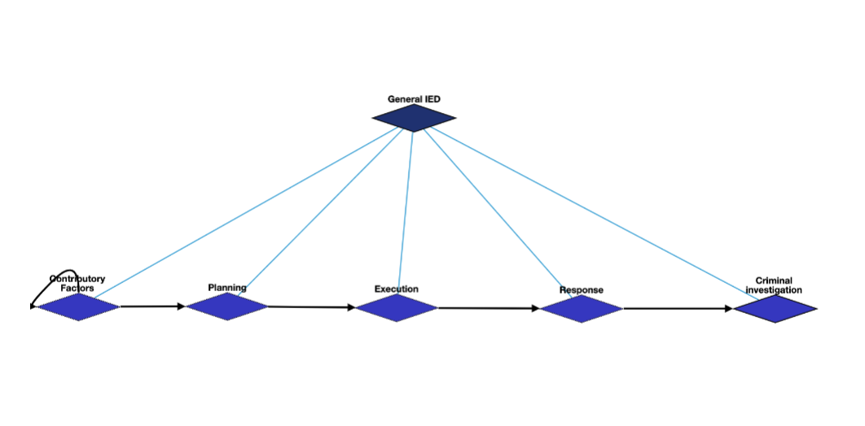
General IED Schema Overview

Slide 2
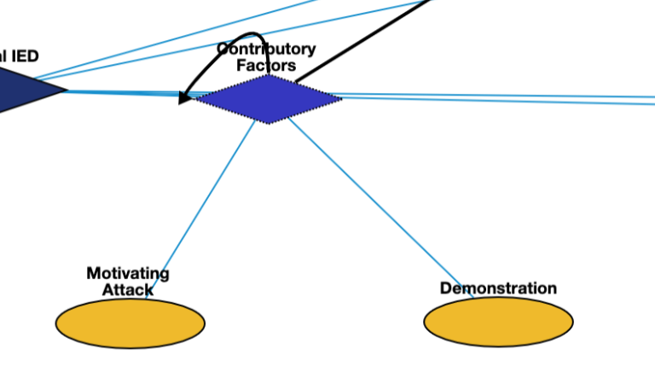

General IED: Contributory Factors
Motivating Attack | Q1174599 | Motivation for attack
Demonstration | Q175331 | demonstration that triggered the bomb

Slide 3
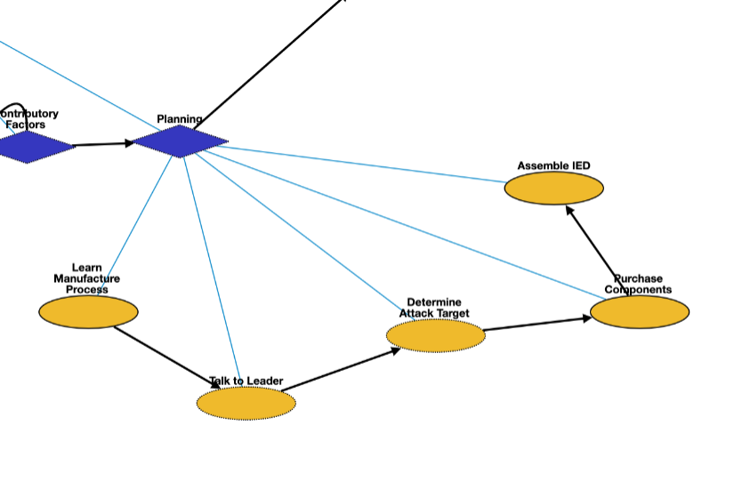
General IED: Planning
Learn manufacture process | Q8434 | learn about the manufacture process
Talking to leader | Q1472062 | asking the leader about the bomb plan
Determine attack target | Q1665268 | requester asks to determine a specific target
Purchase components | Q21651837 | buy the materials to make the bomb
Assemble IED | Q187939 | manufacturing the bomb

Slide 4
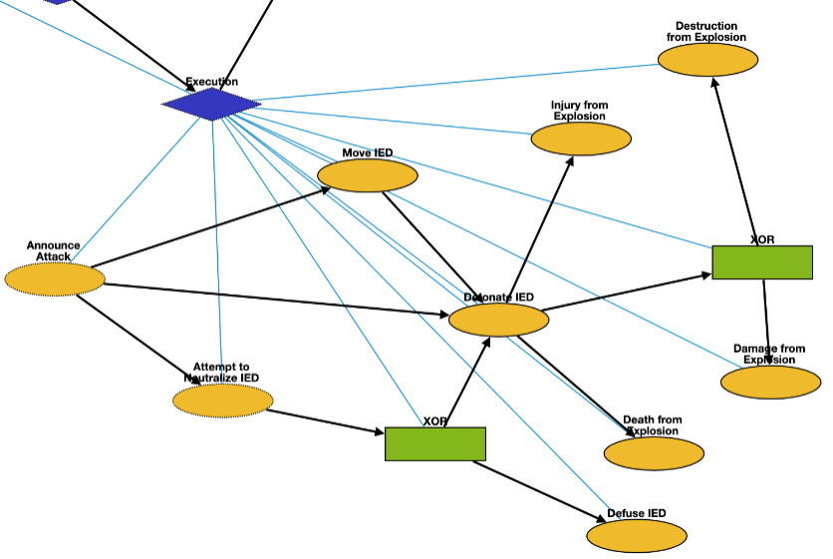
General IED: Execution
Announce Attack | Q325980 | announce the possible bombing
Attempt to Neutralize IED | Q5185976 | police move in to interfere with and neutralize IED
Move IED | Q7590 | transport the bomb to the target
Detonate IED | Q891854 | bomb attack starts
Defuse IED | Q649416 | leave the bomb
Death from Explosion | Q4 | death of victims
Damage from Explosion | Q481609 | damage of the target
Injury from Explosion | Q193078 | injury of victims
Destruction from Explosion | Q17781833 | destruction of the target

Slide 5
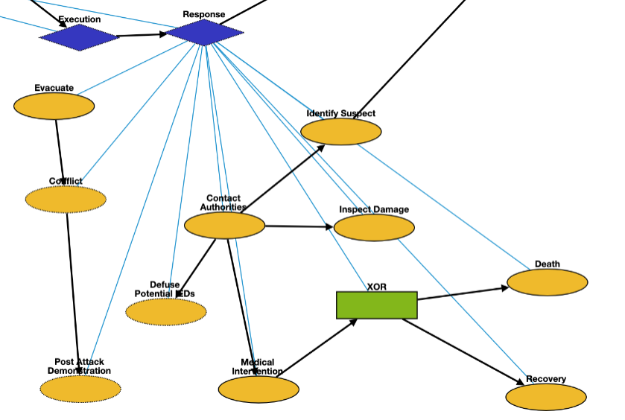
General IED: Response
Evacuate | Q606332 | emergency_evacuation
Conflict | Q1174599 | attack after the bombing
Post Attack Demonstration | Q175331 | demonstration after the bombing
Defuse Potential IEDs | Q649416 | Defuse potential IEDs still in the area
Contact Authorities | Q1472062 | contacting authorities and inform them of the explosion
Medical Intervention | Q179661 | Treat victims injured by the IED explosion
Identify Suspect | Q3265221 | identification of the bomber
Inspect Damage | Q193181 | Observe damage of the target location
Death | Q4 | Death after medical intervention
Recovery | Q7302970 | Victim recovers from injury

Slide 6
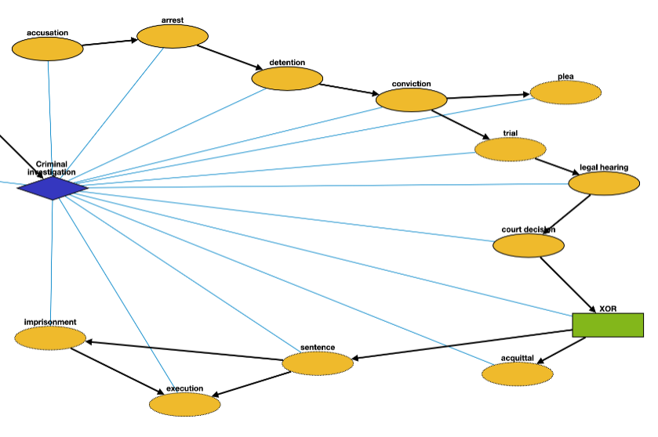
General IED: Criminal Investigation
Accusation | Q19357312 | Accusing or charging another with a crime
Arrest | Q1403016 | Arrest a person
Detention | Q1071447 | Removal of the freedom
Conviction | Q2916183 | Find a defendant guilty of a crime
Plea | Q15916459 | Answer to a claim
Trial | Q8016240 | Present information in a tribunal
Legal Hearing | Q545861 | A legal hearing
Court Decision | Q327000 | Formal decision made by a court
Acquittal | Q1454723 | The legal result of a verdict of not guilty
Sentence | Q1763090 | Decree of punishment in a law
Execution | Q3966286 | Homicide as capital punishment
Imprisonment | Q841236 | Restraint of a person’s liberty

Slide 7
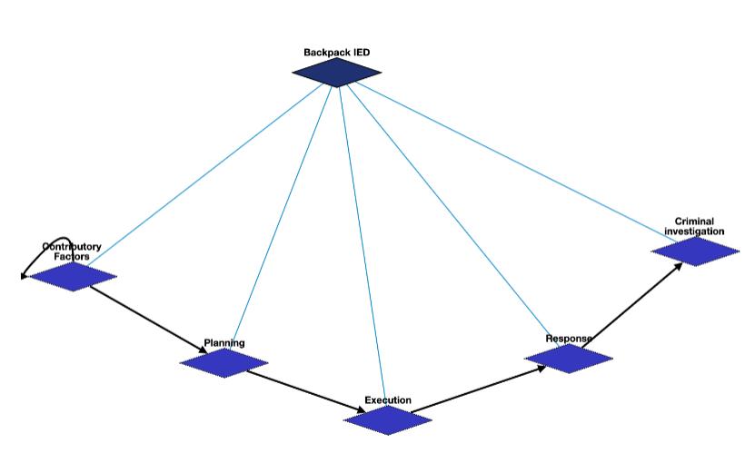
Backpack IED

Slide 8
Backpack IED: Contributory Factors
Motivating Attack | Q1174599 | Motivation for attack
Demonstration | Q175331 | demonstration that triggered the bomb

Slide 9
Backpack IED: Planning
Learn manufacture process | Q8434 | learn about the manufacture process
Talking to leader | Q1472062 | asking the leader about the bomb plan
Determine attack target | Q1665268 | requester asks to determine a specific target
Purchase components | Q21651837 | buy the materials to make the bomb
Assemble IED | Q187939 | manufacturing the bomb

Slide 10
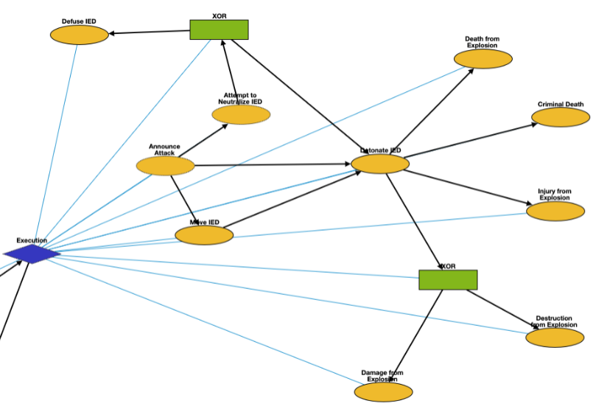
Backpack IED: Execution
Announce Attack | Q325980 | announce the possible bombing
Attempt to Neutralize IED | Q5185976 | police move in to interfere with and neutralize IED
Move IED | Q7590 | transport the bomb to the target
Detonate IED | Q891854 | bomb attack starts
Defuse IED | Q649416 | leave the bomb
Death from Explosion | Q4 | death of victims
Criminal Death | Q4 | Criminal is killed in explosion
Damage from Explosion | Q481609 | damage of the target
Injury from Explosion | Q193078 | injury of victims
Destruction from Explosion | Q17781833 | destruction of the target

Slide 11
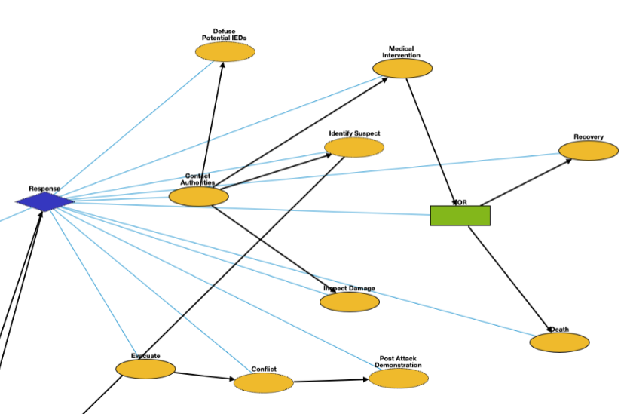
Backpack IED: Response
Evacuate | Q606332 | emergency_evacuation
Conflict | Q1174599 | attack after the bombing
Post Attack Demonstration | Q175331 | demonstration after the bombing
Defuse Potential IEDs | Q649416 | Defuse potential IEDs still in the area
Contact Authorities | Q1472062 | contacting authorities and inform them of the explosion
Medical Intervention | Q179661 | Treat victims injured by the IED explosion
Identify Suspect | Q3265221 | identification of the bomber
Inspect Damage | Q193181 | Observe damage of the target location
Death | Q4 | Death after medical intervention
Recovery | Q7302970 | Victim recovers from injury

Slide 12
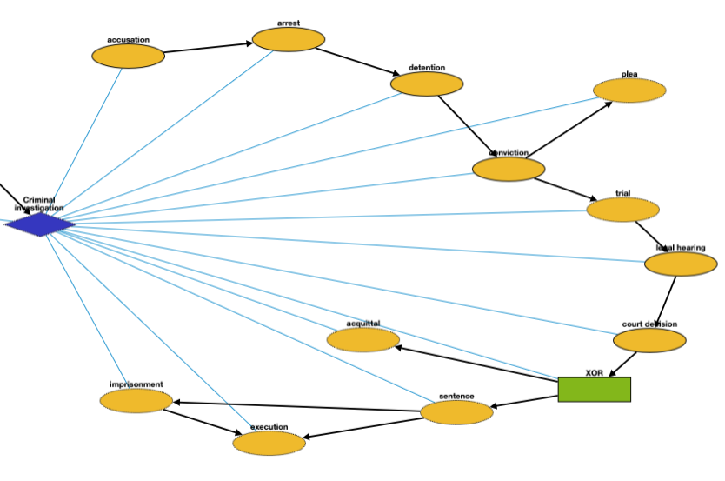
Backpack IED: Criminal Investigation
Accusation | Q19357312 | Accusing or charging another with a crime
Arrest | Q1403016 | Arrest a person
Detention | Q1071447 | Removal of the freedom
Conviction | Q2916183 | Find a defendant guilty of a crime
Plea | Q15916459 | Answer to a claim
Trial | Q8016240 | Present information in a tribunal
Legal Hearing | Q545861 | A legal hearing
Court Decision | Q327000 | Formal decision made by a court
Acquittal | Q1454723 | The legal result of a verdict of not guilty
Sentence | Q1763090 | Decree of punishment in a law
Execution | Q3966286 | Homicide as capital punishment
Imprisonment | Q841236 | Restraint of a person’s liberty

Slide 13
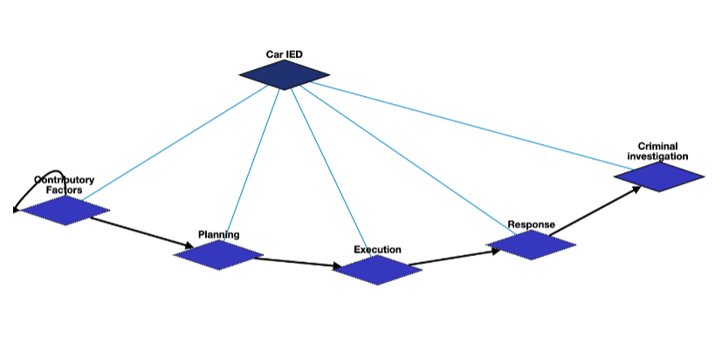
Car IED

Slide 14
Car IED: Contributory Factors
Motivating Attack | Q1174599 | Motivation for attack
Demonstration | Q175331 | demonstration that triggered the bomb

Slide 15
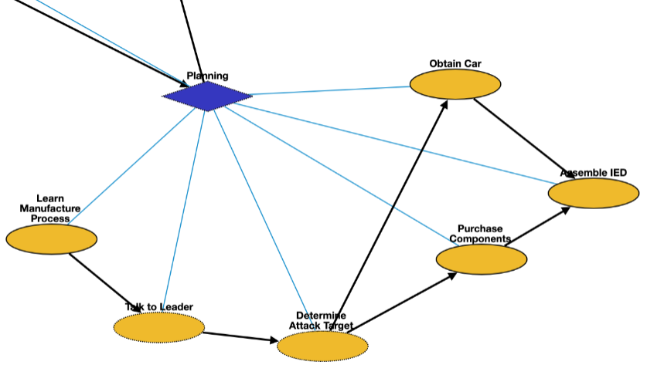
Car IED: Planning
Learn manufacture process | Q8434 | learn about the manufacture process
Talking to leader | Q1472062 | asking the leader about the bomb plan
Determine attack target | Q1665268 | requester asks to determine a specific target
Purchase components | Q21651837 | buy the materials to make the bomb
Assemble IED | Q187939 | manufacturing the bomb
Obtain Car | Q21651837 | Obtain car to hold the IED with

Slide 16
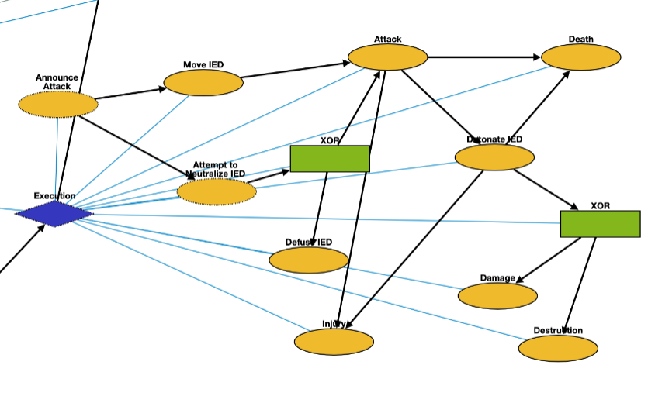
Car IED: Execution
Announce Attack | Q325980 | announce the possible bombing
Attempt to Neutralize IED | Q5185976 | police move in to interfere with and neutralize IED
Move IED | Q7590 | transport the bomb to the target
Detonate IED | Q891854 | bomb attack starts
Defuse IED | Q649416 | leave the bomb
Attack | Q1174599 | Terrorists attack target location with car
Death | Q4 | death of victims
Injury | Q193078 | injury of victims
Damage | Q481609 | damage of the target
Destruction | Q17781833 | destruction of the target

Slide 17
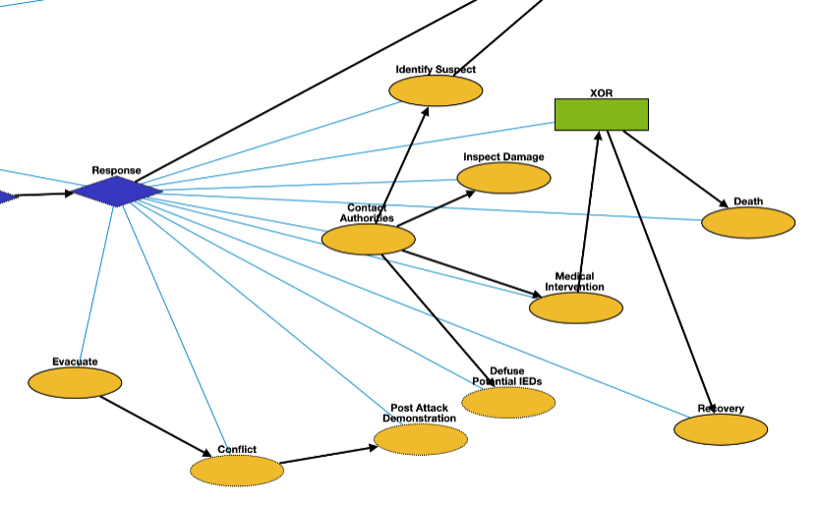
Car IED: Response
Evacuate | Q606332 | emergency_evacuation
Conflict | Q1174599 | attack after the bombing
Post Attack Demonstration | Q175331 | demonstration after the bombing
Defuse Potential IEDs | Q649416 | Defuse potential IEDs still in the area
Contact Authorities | Q1472062 | contacting authorities and inform them of the explosion
Medical Intervention | Q179661 | Treat victims injured by the IED explosion
Identify Suspect | Q3265221 | identification of the bomber
Inspect Damage | Q193181 | Observe damage of the target location
Death | Q4 | Death after medical intervention
Recovery | Q7302970 | Victim recovers from injury

Slide 18
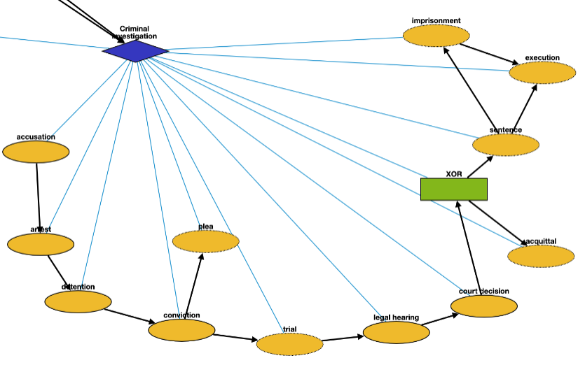
Car IED: Criminal Investigation
Accusation | Q19357312 | Accusing or charging another with a crime
Arrest | Q1403016 | Arrest a person
Detention | Q1071447 | Removal of the freedom
Conviction | Q2916183 | Find a defendant guilty of a crime
Plea | Q15916459 | Answer to a claim
Trial | Q8016240 | Present information in a tribunal
Legal Hearing | Q545861 | A legal hearing
Court Decision | Q327000 | Formal decision made by a court
Acquittal | Q1454723 | The legal result of a verdict of not guilty
Sentence | Q1763090 | Decree of punishment in a law
Execution | Q3966286 | Homicide as capital punishment
Imprisonment | Q841236 | Restraint of a person’s liberty

Slide 19
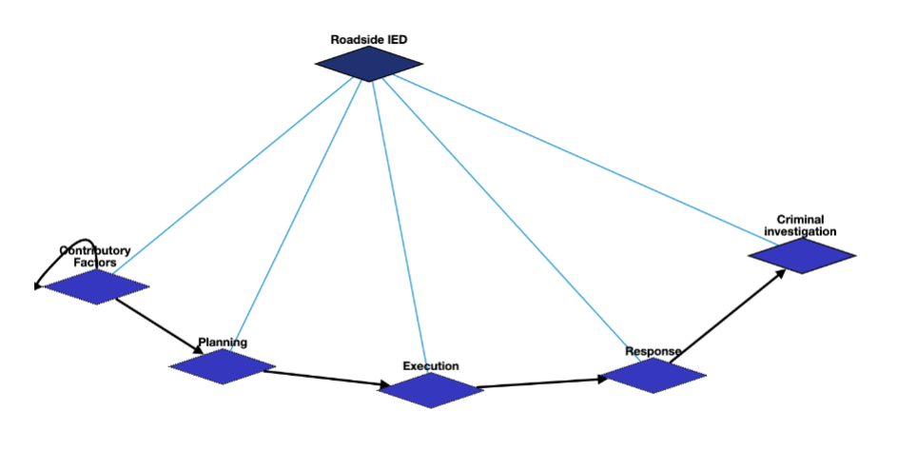
Roadside IED Schema Overview

Slide 20
Roadside IED: Contributory Factors
Motivating Attack | Q1174599 | Motivation for attack
Demonstration | Q175331 | demonstration that triggered the bomb

Slide 21
Roadside IED: Planning
Learn manufacture process | Q8434 | learn about the manufacture process
Talking to leader | Q1472062 | asking the leader about the bomb plan
Determine attack target | Q1665268 | requester asks to determine a specific target
Purchase components | Q21651837 | buy the materials to make the bomb
Assemble IED | Q187939 | manufacturing the bomb

Slide 22
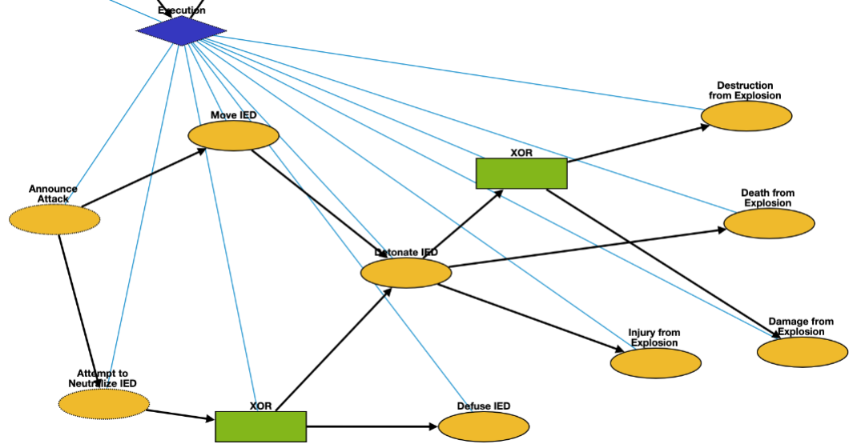
Roadside IED: Execution
Announce Attack | Q325980 | announce the possible bombing
Attempt to Neutralize IED | Q5185976 | police move in to interfere with and neutralize IED
Move IED | Q7590 | transport the bomb to the target
Detonate IED | Q891854 | bomb attack starts
Defuse IED | Q649416 | leave the bomb
Death from Explosion | Q4 | death of victims
Damage from Explosion | Q481609 | damage of the target
Injury from Explosion | Q193078 | injury of victims
Destruction from Explosion | Q17781833 | destruction of the target

Slide 23
Roadside IED: Response
Evacuate | Q606332 | emergency_evacuation
Conflict | Q1174599 | attack after the bombing
Post Attack Demonstration | Q175331 | demonstration after the bombing
Defuse Potential IEDs | Q649416 | Defuse potential IEDs still in the area
Contact Authorities | Q1472062 | contacting authorities and inform them of the explosion
Medical Intervention | Q179661 | Treat victims injured by the IED explosion
Identify Suspect | Q3265221 | identification of the bomber
Inspect Damage | Q193181 | Observe damage of the target location
Death | Q4 | Death after medical intervention
Recovery | Q7302970 | Victim recovers from injury

Slide 24
Roadside IED: Criminal Investigation
Accusation | Q19357312 | Accusing or charging another with a crime
Arrest | Q1403016 | Arrest a person
Detention | Q1071447 | Removal of the freedom
Conviction | Q2916183 | Find a defendant guilty of a crime
Plea | Q15916459 | Answer to a claim
Trial | Q8016240 | Present information in a tribunal
Legal Hearing | Q545861 | A legal hearing
Court Decision | Q327000 | Formal decision made by a court
Acquittal | Q1454723 | The legal result of a verdict of not guilty
Sentence | Q1763090 | Decree of punishment in a law
Execution | Q3966286 | Homicide as capital punishment
Imprisonment | Q841236 | Restraint of a person’s liberty

Slide 25
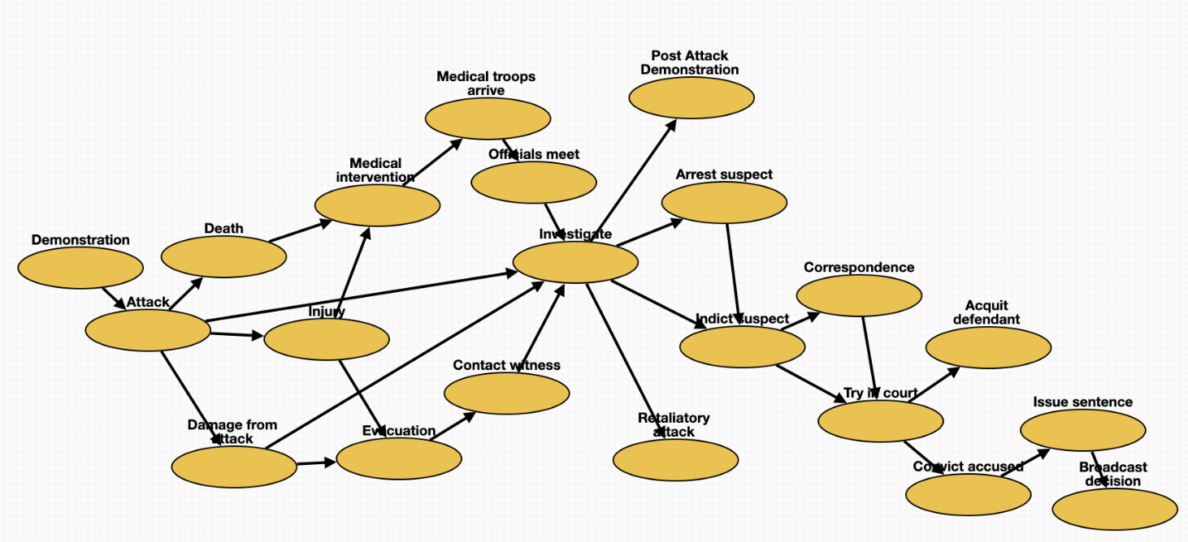
General Attack Schema
Medical intervention | Q179661 | treatment of the victims
Arrest suspect | Q1403016 | arrest suspects
Try in court | Q545861 | legal_hearing
Officials meet | Q21170798 | meeting with officials
Investigate | Q1964968 | criminal_investigation
Evacuation | Q606332 | emergency_evacuation
Contact witness | Q11024 | communication with witness
Demonstration | Q175331 | demonstration that triggered the attack
Post-Attack Demonstration | Q175331 | demonstration after the attack
Retaliatory attack | Q1174599 | attack after the previous attack
Indict suspect | Q19357312 | accusation of the attacker
Correspondence | Q1472062 | remote_communication
Convict accused | Q2916183 | conviction of the attacker
Broadcast decision | Q567303 | announcement
Issue sentence | Q1763090 | sentence
Attack | Q1174599 | attack happens
Damage from attack | Q481609 | damage from the attack
Acquit defendant | Q1454723 | acquittal of the attacker
Death | Q4 | death of the victims
Medical troops arrive | Q7590 | medical team arrives
Injury | Q193078 | injury of victims

Slide 26
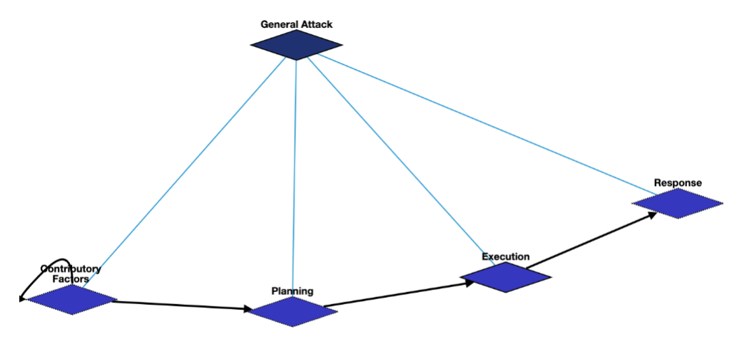
General Attack

Slide 27
General Attack: Contributory Factors
Motivating Attack | Q1174599 | Motivation for attack
Demonstration | Q175331 | demonstration that triggered the bomb

Slide 28
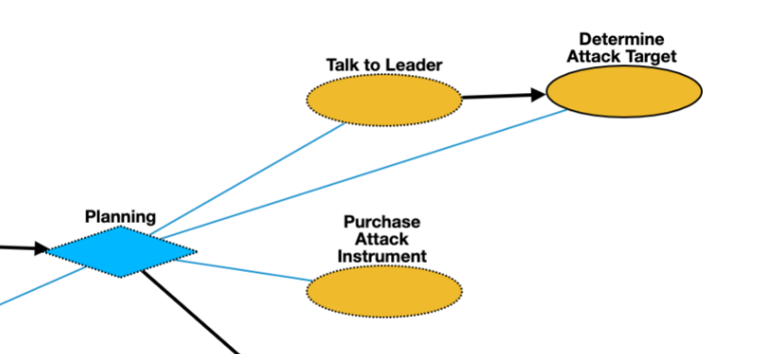
General Attack: Planning
Talk to leader | Q1472062 | asking the leader about the bomb plan
Determine attack target | Q1665268 | requester asks to determine a specific target
Purchase Attack Instrument | Q21651837 | Purchase Attack Instrument

Slide 29
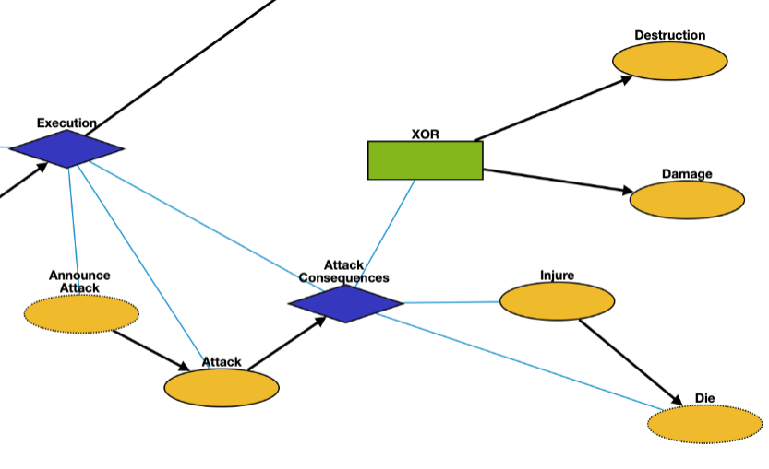
General Attack: Execution
Announce Attack | Q325980 | announce the possible bombing
Attack | Q1174599 | attack
Death | Q4 | death of victims
Damage | Q481609 | damage of the target
Injure | Q193078 | injury of victims
Destruction | Q17781833 | destruction of the target

Slide 30
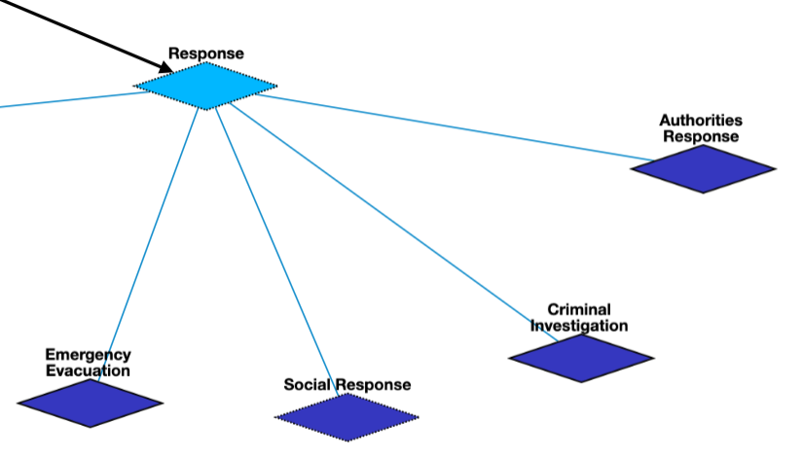
General Attack: Response

Slide 31
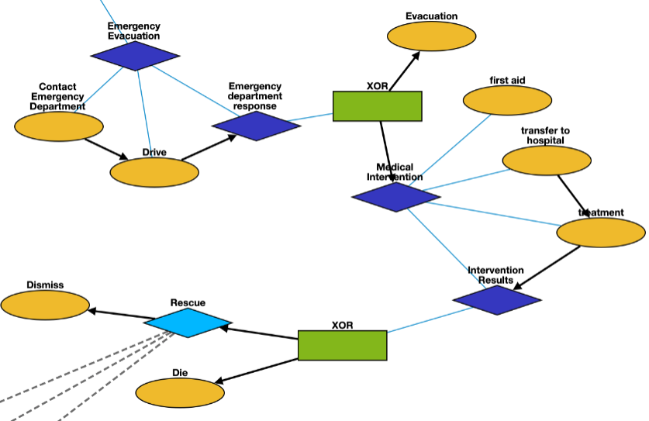
General Attack: Emergency Evacuation
Contact Emergency Department | Q1472062 | Contact the emergency department for help
Drive | Q7590 | Medical team drives to attack site
Evacuation | Q606332 | Evacuate target premises
First Aid | Q133981 | On-site intervention, including first and immediate assistance
Transfer to Hospital | Q7590 | Drive to medical facility
Treatment | Q179661 | Medical intervention at hospital
Die | Q4 | Ultimate death in the hospital when medical intervention is unsuccessful
Dismiss | Q47328472 | Dismiss from hospital

Slide 32
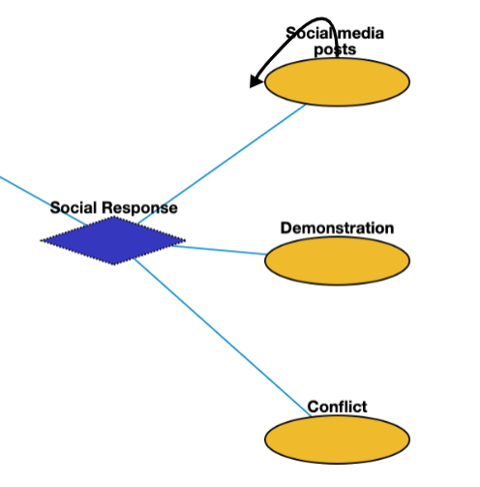
General Attack: Social Response
Social media postsc | Q7216866 | Social media posts
Demonstration | Q175331 | Post-attack demonstration
Conflict | Q180684 | Conflict after the attack, possibly directed towards a group that the crime committer is a part of

Slide 33
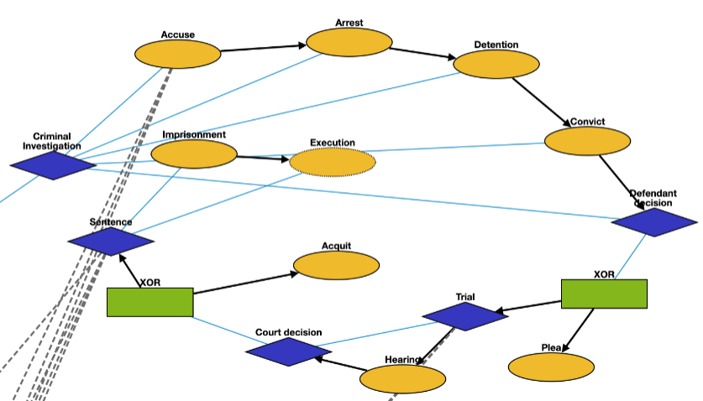
General Attack: Criminal Investigation
Accuse | Q19357312 | Accusing or charging another with a crime
Arrest | Q1403016 | Arrest a person
Detention | Q1071447 | Removal of the freedom
Convict | Q2916183 | Find a defendant guilty of a crime
Plea | Q15916459 | Answer to a claim
Hearing | Q545861 | A legal hearing
Acquit | Q1454723 | The legal result of a verdict of not guilty
Execution | Q3966286 | Homicide as capital punishment
Imprisonment | Q841236 | Restraint of a person’s liberty

Slide 34
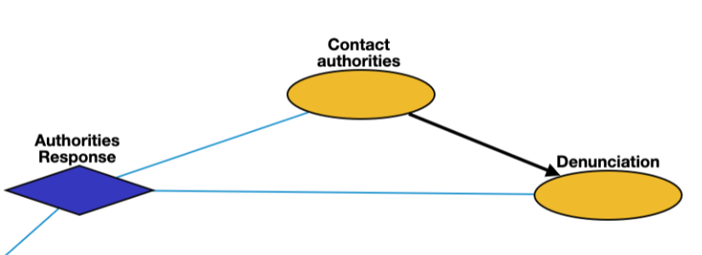
General Attack: Criminal Investigation
Contact authorities | Q1472062 | Contact authorities and inform them of the attack
Denunciation | Q1189956 | denunciation

