Slide 1
RESIN International Conflict Schema
Qi Zeng

Slide 2
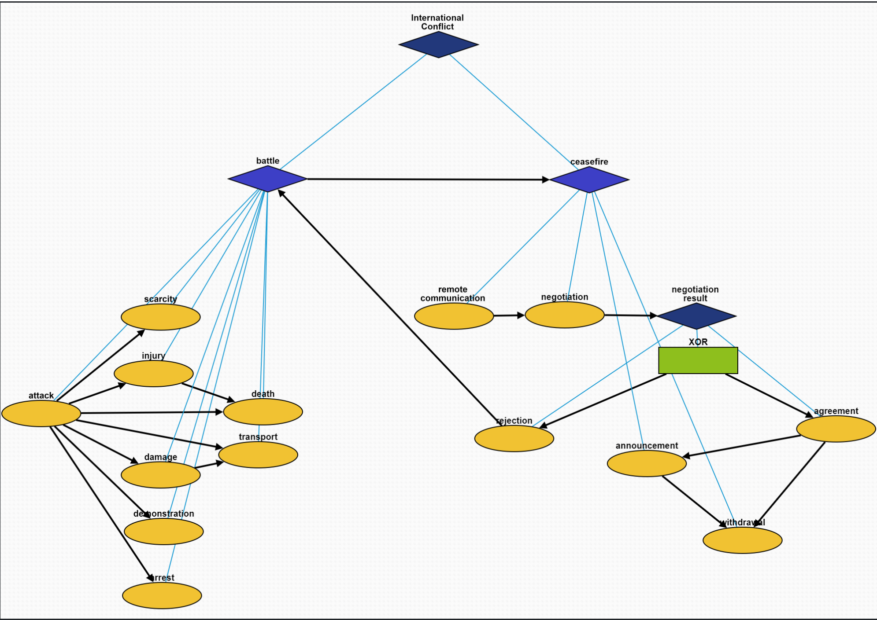
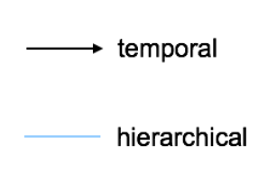
Overview

Slide 3
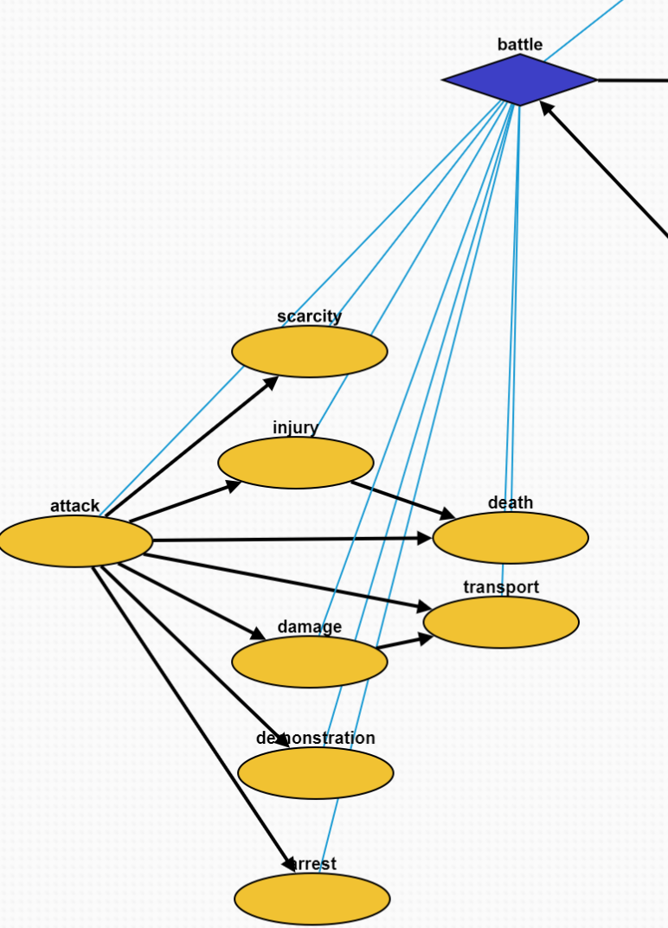
Battle Episode
Attack: A conflict between two countries
Scarcity: Food or resource shortage caused by the attacks
Injury: Victims get injured because of the attacks
Death: Victims die because of the attack
Damage: Constructions are damaged because of the attack
Transport: Victims have to migrate to other places
Demonstration: People demonstrate to against the battle
Arrest: People triggering this attack is arrested

Slide 4
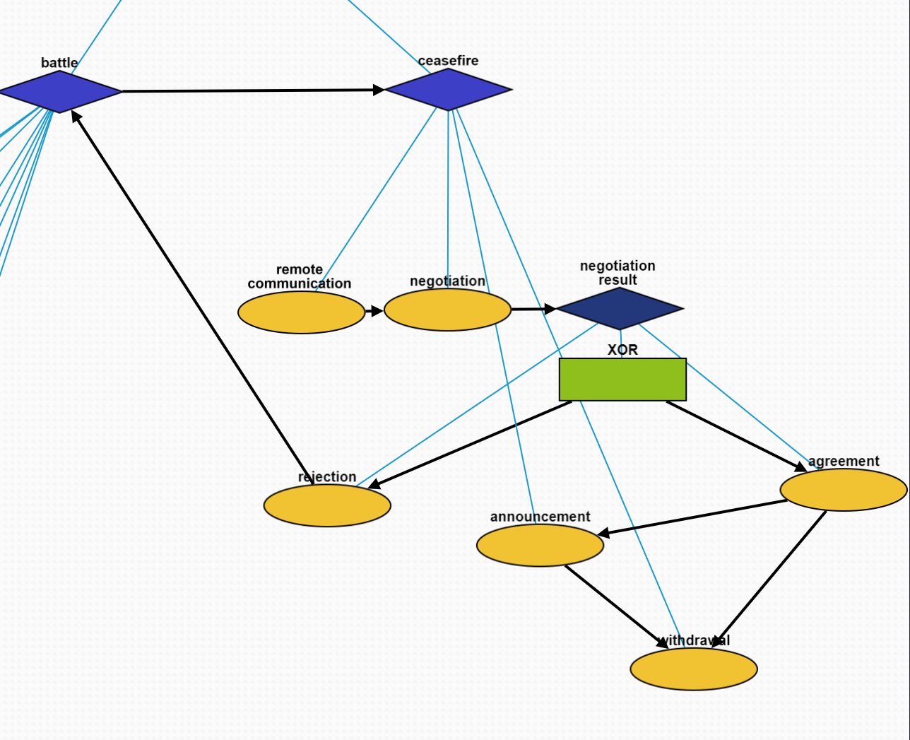
Ceasefire Episode
Remote Communication: A third-party organization requests ceasefire
Negotiation: Battle participants negotiate a ceasefire agreement
Negotiation Result: a container
Rejection: Battle participants do not reach an agreement
Agreement: Battle participants reach an agreement
Announcement: The ceasefire agreement is announced
Withdrawal: The attacking army is withdrawn

