Slide 1
Business Change Schema Quizlet 9
Iris Liu
iris.liu@colorado.edu

Slide 2
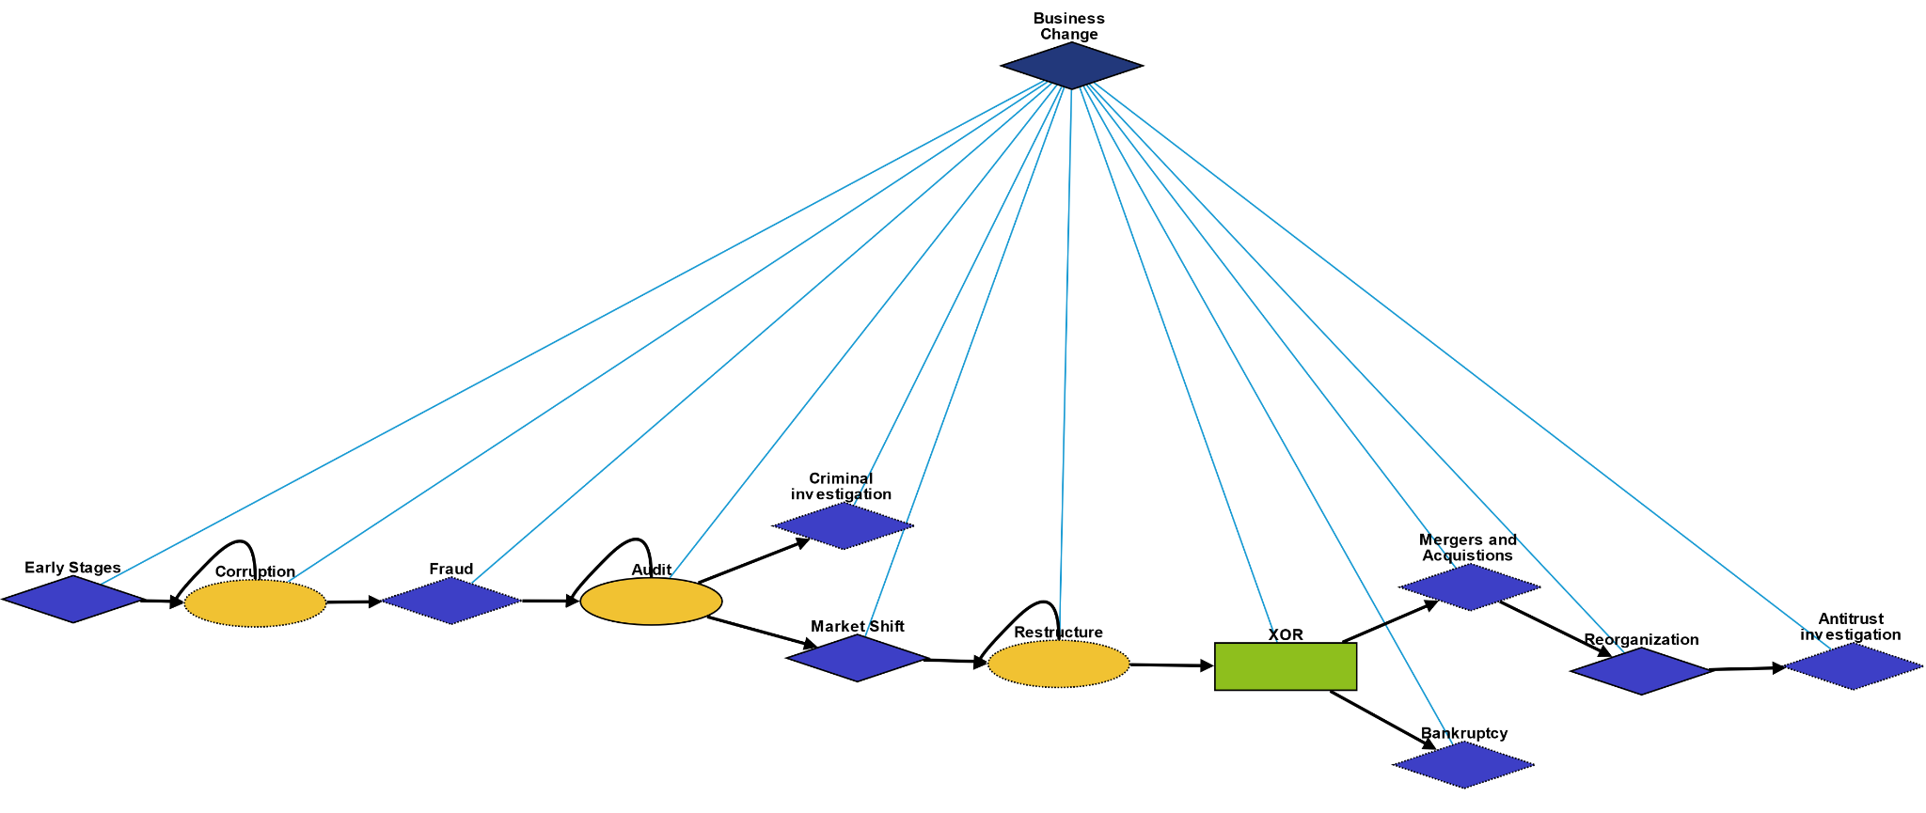
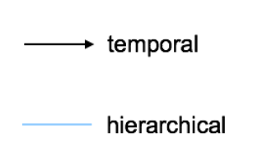
Overview
Early Stages: Events happening in the early stages of a business
Corruption: Some form of corruption happens amongst the people in the business
Fraud: Types of business fraud
Audit:Type of audit conducted to ensure "financial statements" are in accordance with specified criteria
Criminal investigation: Financial records could not be validated, a criminal investigation case is opened
Market Shift: Events leading to the business suffering economically
Restructure: Company restructures to avoid bankruptcy
Mergers and Acquisitions: Process to merge or be acquired by another company
Bankruptcy: Process in which a business files bankruptcy
Reorganization: Legal process after M&A or filing bankruptcy
Antitrust investigation: The government may sue a business if they have reason to believe the business is becoming a monopoly

Slide 3
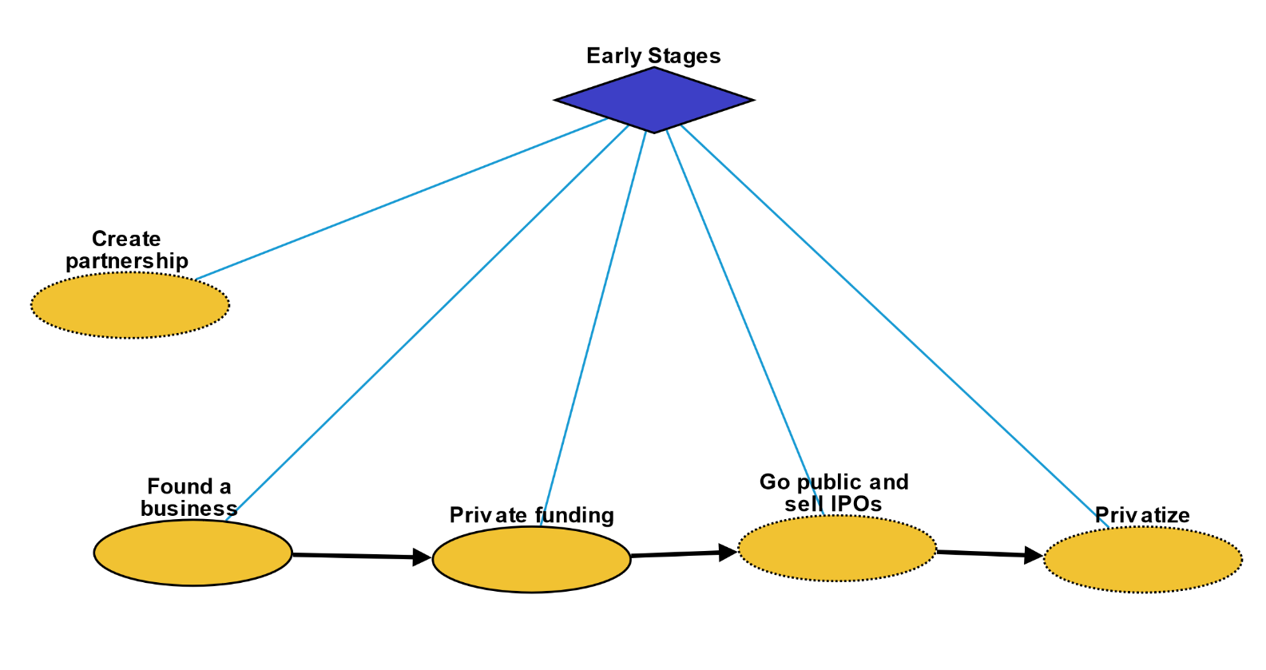
Early Stages
Create partnership: Two companies form a partnership, but remain separate entities
Found a business: A person founds a business
Private funding: Company is funded by private investors
Go public and sell IPOs: Company goes public and lists stock on the public market
Privatize: Company goes private and sells all their stock to a private equity firm

Slide 4
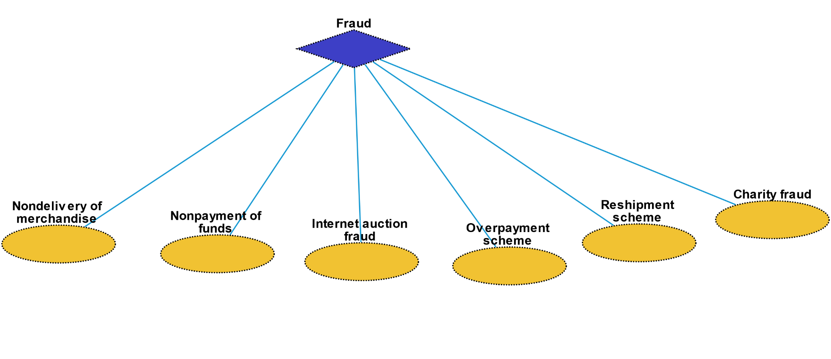
Fraud
Non-delivery of merchandise: Fraud occurring when a payment is sent but the goods and services ordered are never received.
Non-payment of funds: Fraud occurring when goods and services are shipped or rendered but payment for them is never received.
Internet auction fraud: A fraudulent transaction or exchange that occurs in the context of an online auction site.
Overpayment scheme: An individual is sent a payment significantly higher than an owed amount and is instructed to deposit the money in their bank account and wire transfer the excess funds back to the bank of the individual or company that sent it.
Reshipment scheme: An individual is recruited to receive merchandise at their place of residence and subsequently repackage the items for shipment, usually abroad.
Charity fraud: Using deception to get money from individuals believing they are making donations to legitimate charity organizations, especially charities representing victims of natural disasters shortly after the incident occurs.

Slide 5
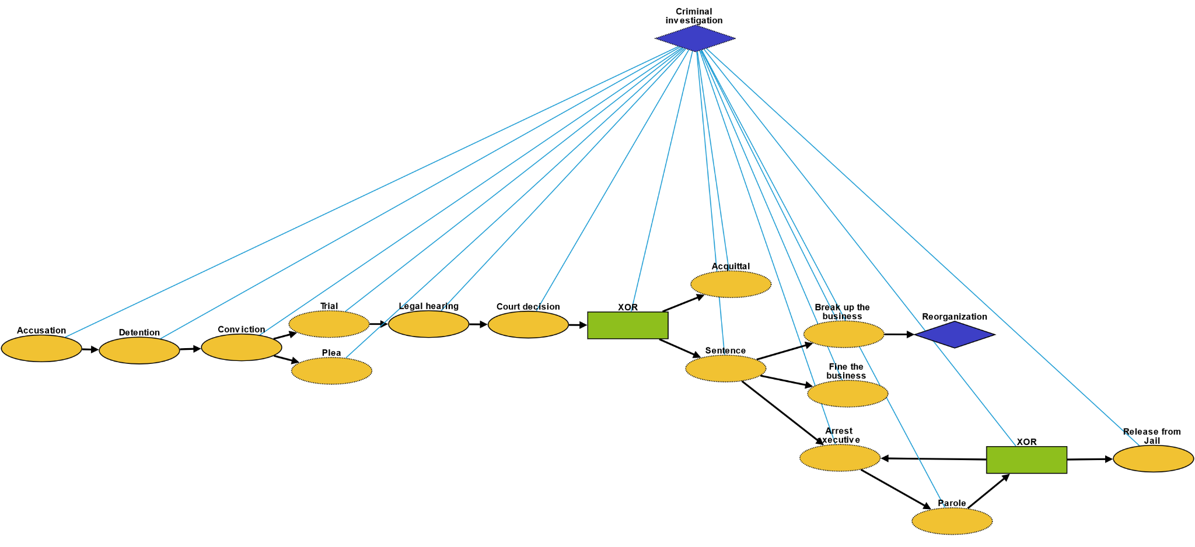
Criminal Investigation
Accusation: act of accusing or charging another with a crime
Detention: removal of the freedom of liberty by a state
Conviction: verdict that results when a court of law finds a defendant guilty of a crime
Plea: answer to a claim made by someone in a criminal case under common law using the adversarial system
Trial: coming together of parties to a dispute, to present information in a tribunal
Legal hearing: A legal hearing
Court decision: formal decision made by a court
Acquittal: the legal result of a verdict of not guilty
Sentence: decree of punishment in law
Break up the business: Government breaks company up into multiple, smaller companies
Fine the business: Government fines the business
Arrest executive: Goverment arrests an executive of the company
Parole: Executive goes on parole
Release from Jail: Executive is officially released

Slide 6
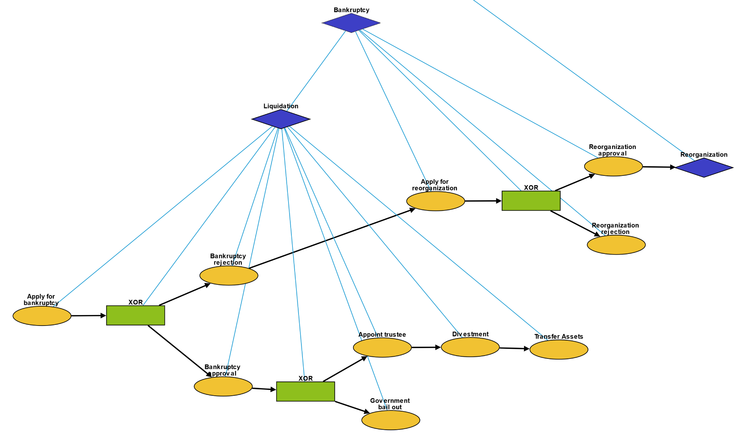
Bankruptcy
Apply for bankruptcy: Company officially applies for bankruptcy
Bankruptcy approval: Government approves the bankruptcy
Bankruptcy rejection: Government rejects the bankruptcy
Appoint trustee: Government appoints a trustee to oversee the reorganization
Divestment: Trustee liquidates assets
Transfer assets: Trustee distributes assets to creditors
Government bail out: Government lends company money, because the company bankruptcy would damage the economy
Apply for reorganization: Company officially applies for reorganization
Reorganization approval: Government approves the reorganization
Reorganization rejection: Government rejects the reorganization

Slide 7
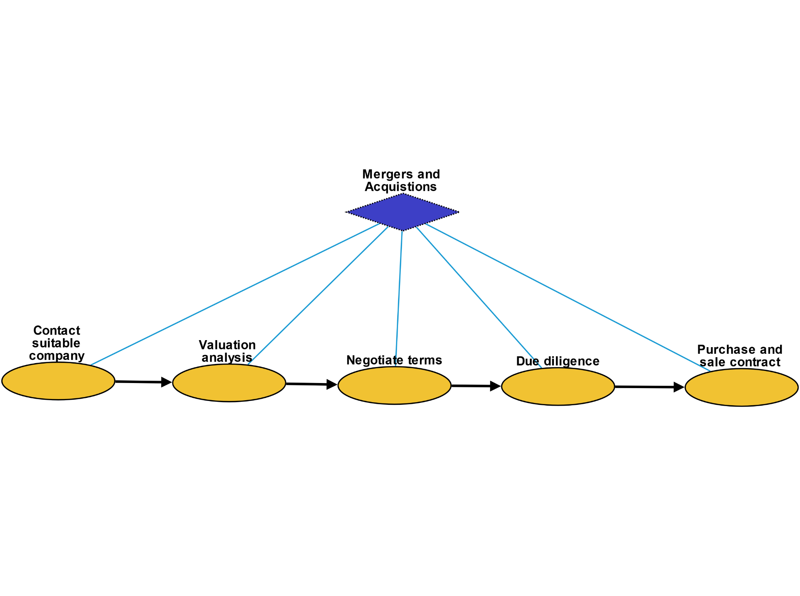
Mergers and Acquisitions
Contact suitable company: A company contacts a candidate company to propose merge / acquisition
Valuation analysis: Company performs valuation on the candidate company
Negotiate terms: Companies negotiate terms of merge / acquisition
Due diligence: Company performs due diligence on candidate company
Purchase and sale contract: Companies sign a contract and officially merge / become acquired

Slide 8
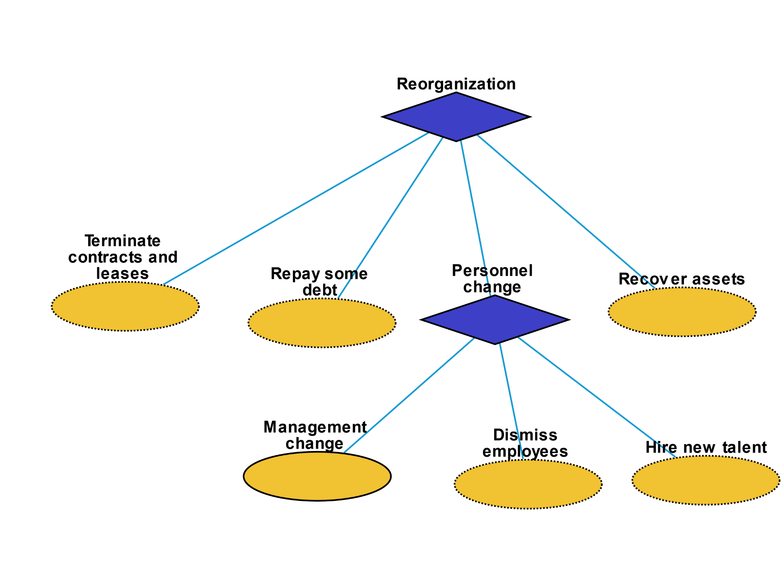
Reorganization
Terminate contracts and leases: Company terminates some contracts and leases
Repay some debt: Company repays some debt to its creditors
Recover assets: Liquidate or re-use some assets
Management change: A new CEO or executive is hired
Dismiss employees: Company fires some employees
Hire new talent: Company hires new talent

Slide 9
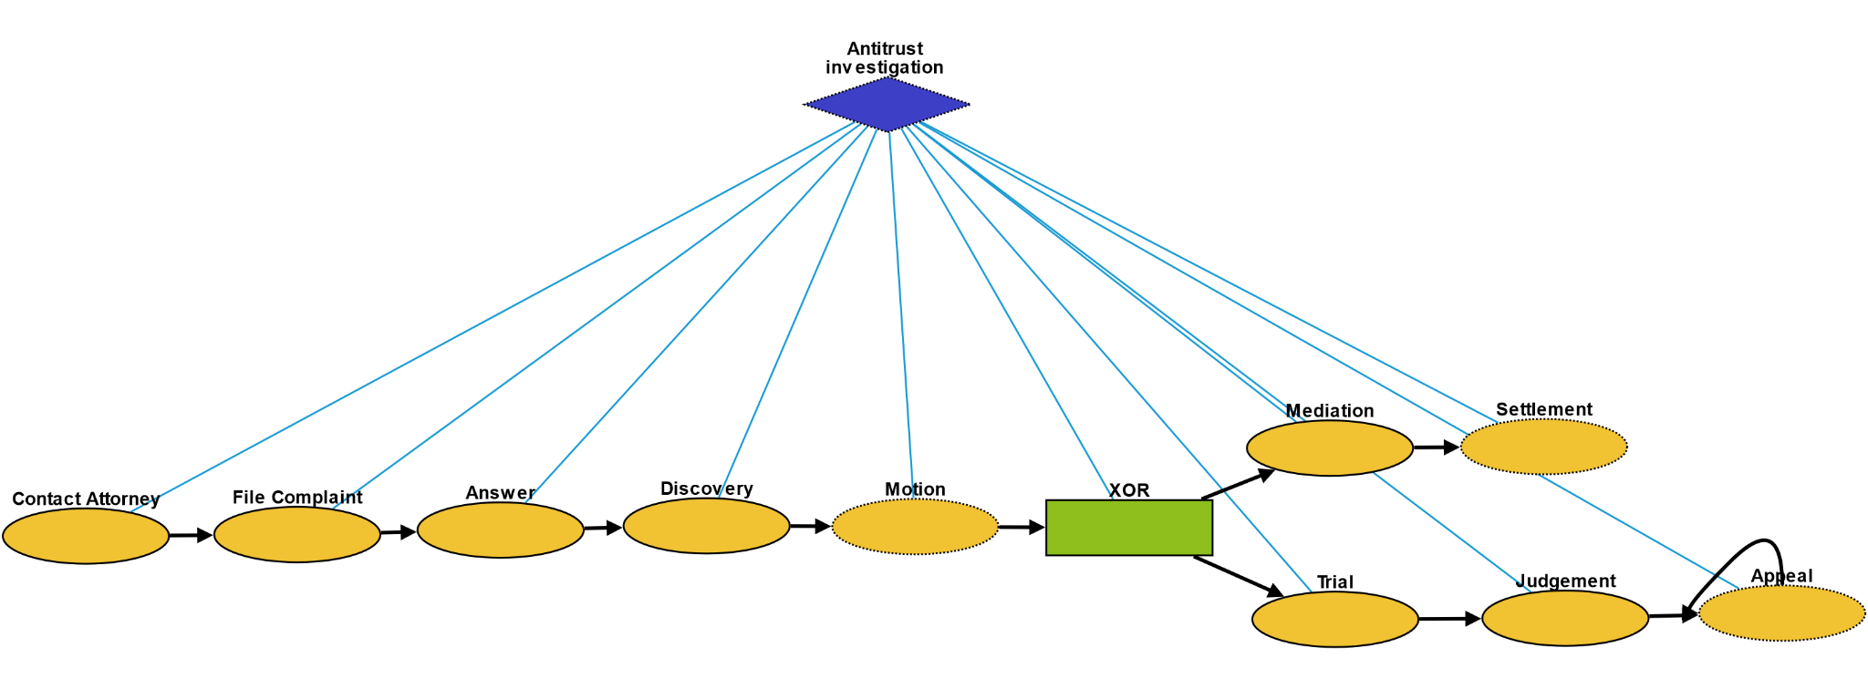
Antitrust Investigation
Contact attorney: Government contacts attorney to begin filing a lawsuit
File complaint: Plaintiff files a complaint to initiate a lawsuit
Answer: In law, a solemn assertion in opposition to someone or something by the defendant
Discovery: Pre-trial procedure in common law countries for obtaining evidence
Motion: In US law, a procedural device to bring a limited, contested issue before a court for decision
Mediation: Dispute resolution with assistance of an impartial third party moderator throughthe use of communication and negotiation techniques
Settlement: The dispute is resolved through a payment of money.
Trial: Coming together of parties to a dispute, to present information in a tribunal
Judgement: The formal decision made by a court following a lawsuit
Appeal: Resort to a superior court to review the decision of an inferior court or administrative agency

