Slide 1
RESIN Civil Unrest Schema
Curated by Yizhu Jiao
Updated March 20, 2022

Slide 2
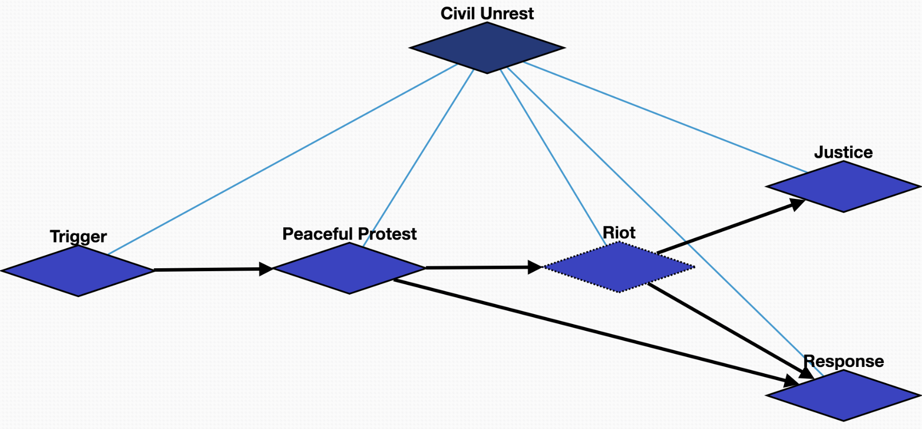
Overview

Slide 3
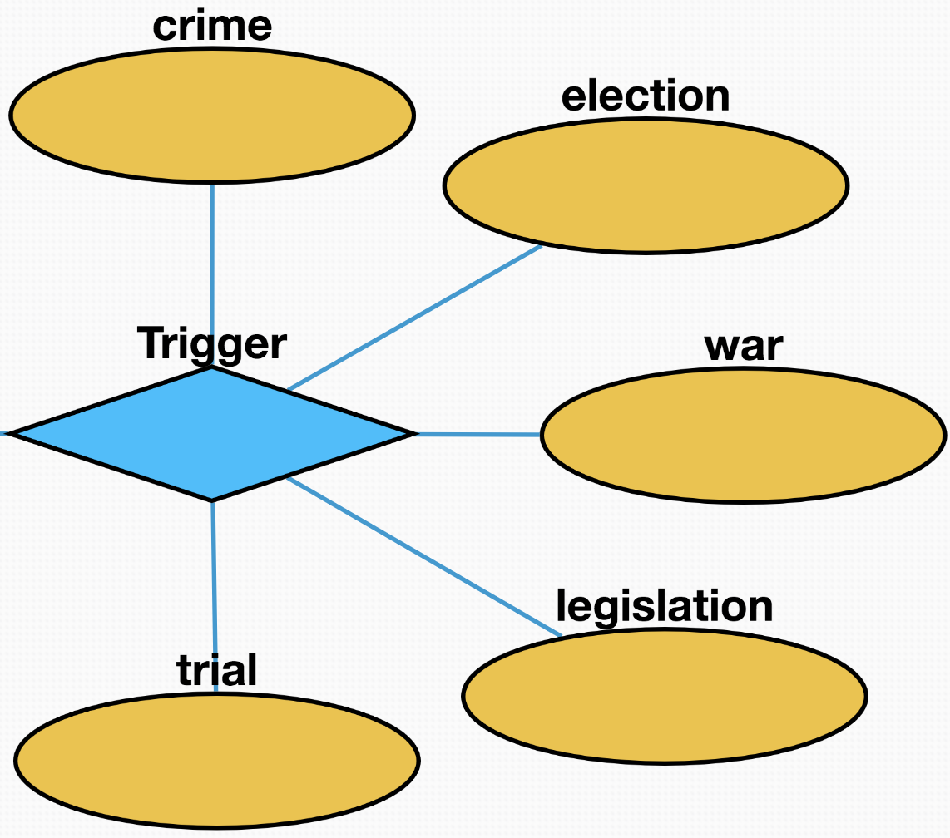
Trigger
Crime: crimes that seriously threaten social security and cause widespread concerns
Election: the results of the election did not meet the expectations of some people or the fairness of the election was questioned
War: people suffer from injustice or protracted wars
Legislation: the legal provisions are unreasonable or against the requirements of some people
Trial: trials of legal cases do not meet public expectations

Slide 4
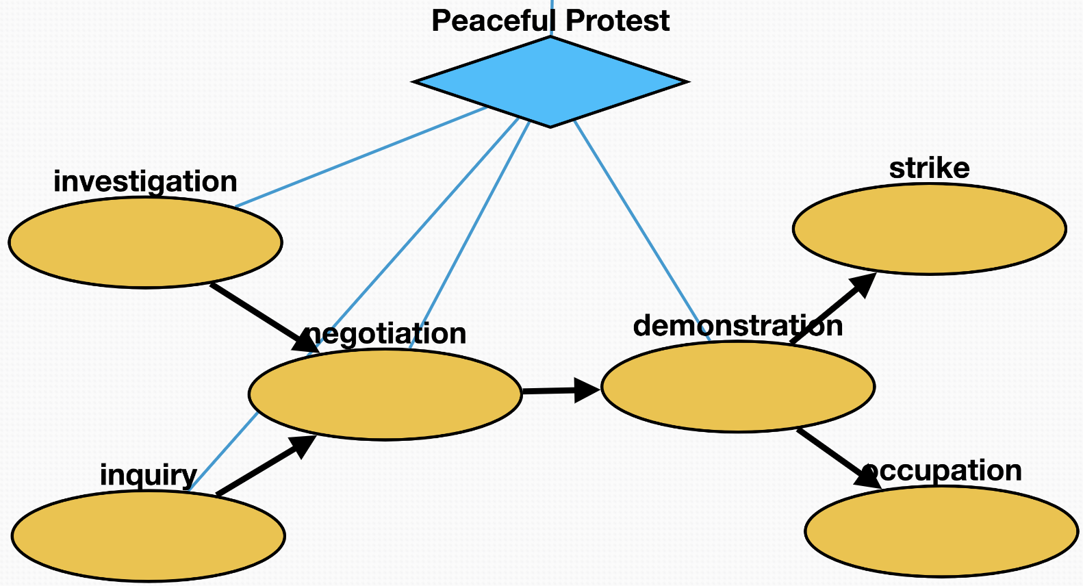
Peaceful Protest
Inquiry: people seek more information about the trigger
Investigation: people investigate the process or truth of the trigger
Negotiation: protesters try to communicate and negotiate to look for a solution
Demonstration: protest activity taking the form of a public gathering of people in a rally or walking in a march
Strike: workers refuse to work as a typical form of protest to gain a concession
Occupation: protesters hold public spaces or critical infrastructure as an act of protest

Slide 5
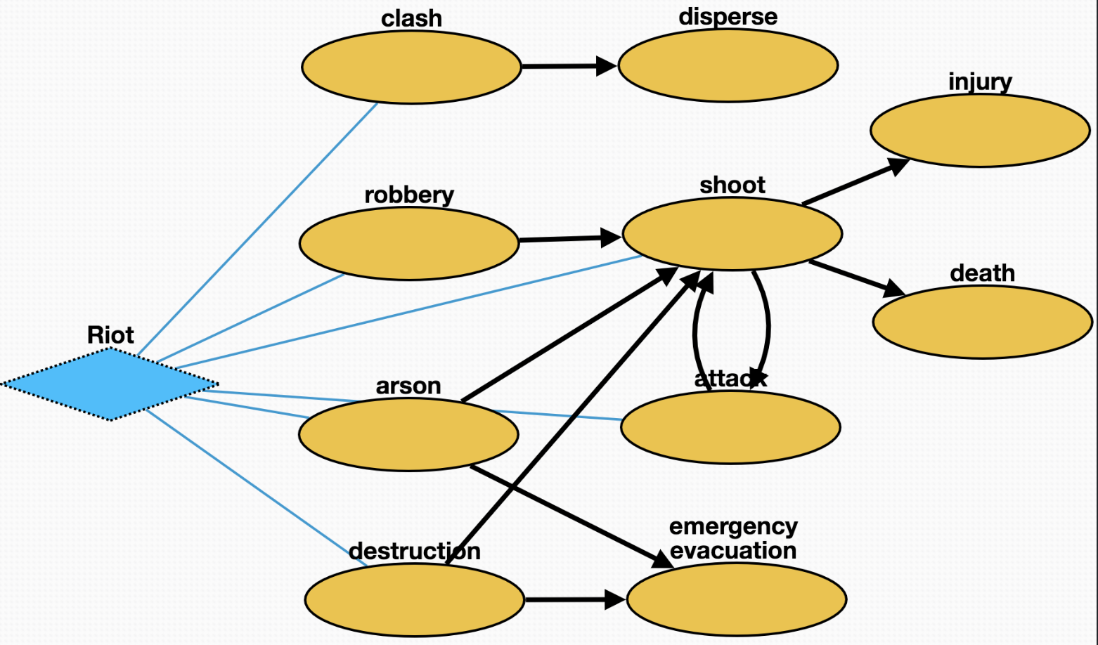
Riot [optional]
Clash: Protesters clash with police
Disperse: police ordered the crowd to disperse
Robbery: protesters looted surrounding shops or residents
Arson: protesters set fire to surrounding buildings or objects
Destruction: protesters causing damage to residents' property
Shoot: police shoot criminals to maintain order
Injury: people get injured in conflict
Death: people die in conflict
Attack: protesters attack police during clash
Emergency_evacuation: residents evacuated from burning or destroyed buildings

Slide 6
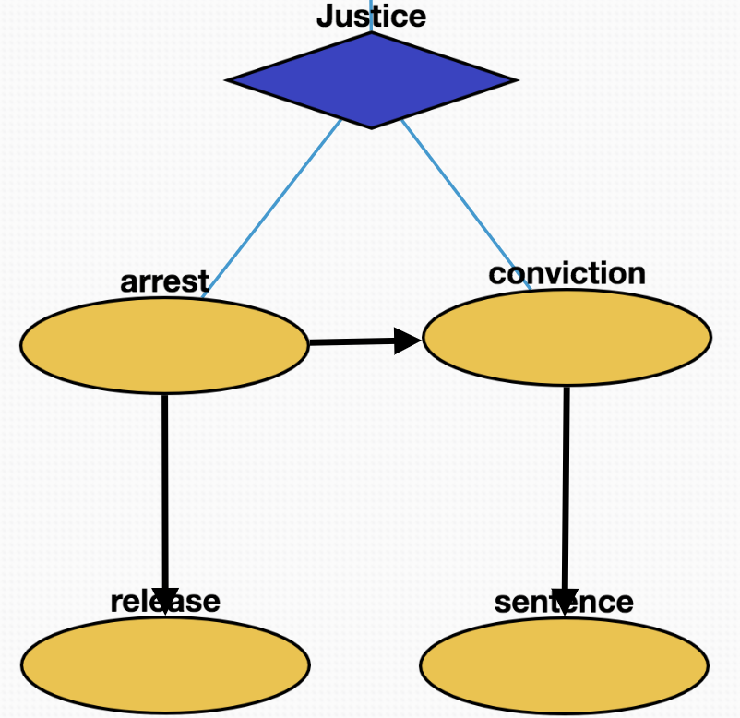
Justice
Arrest: police arrest some criminal or protester
Conviction: protester guilty of breaking the law
Sentence: protesters for breaking the law sentenced
Release: protesters with minor or no offenses released

Slide 7
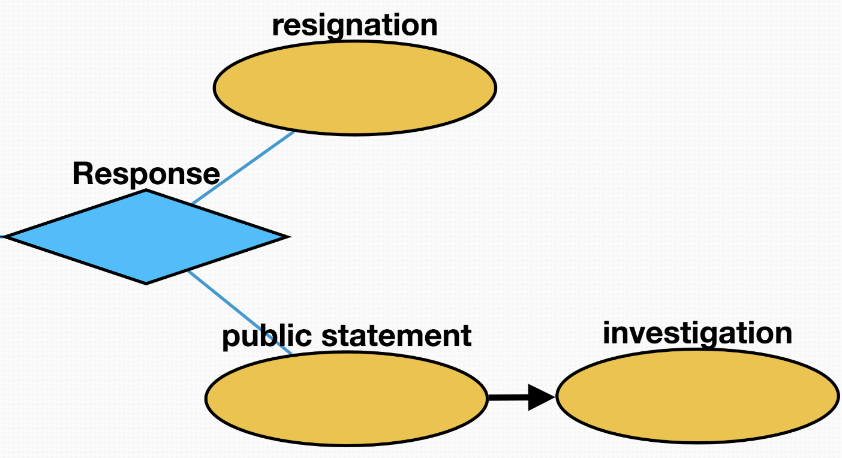
Response
Resignation: the directors responsible for the incidence resign from the position
Public statement: the head of government makes a public speech to call for clam and provide resolutions to the problem
Investigation: head of government promises to re-investigate to meet public expectations

