Slide 1
RESIN Election Schema Quizlet 9
Charles Yu

Slide 2
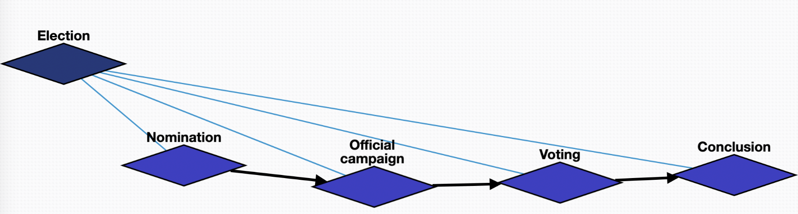
Overview

Slide 3
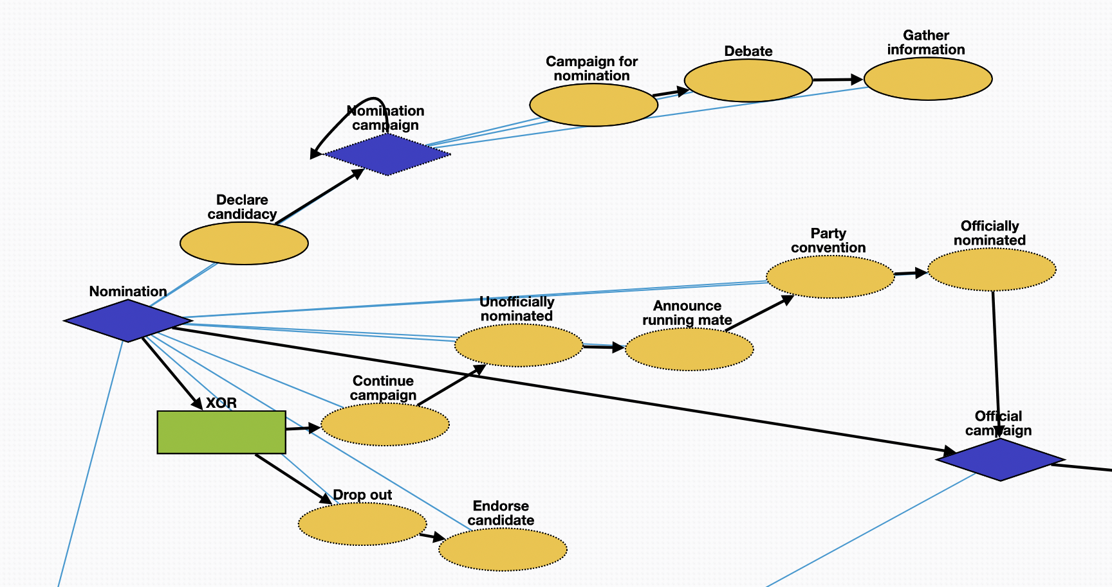
Nomination episode
Nomination – container for the episode Declare candidacy – a person declares themselves a candidate for nomination
Nomination campaign – container for a repeatable sub-episode of campaigning Campaign for nomination – a candidate campaigns throughout the political region Debate – a candidate attends debates with other candidates to clarify their political platform
Gather information – a candidate or related parties may gather information via polling/surveying to find what location and issues to prioritize Drop out – a candidate may drop out of the race Endorse candidate – a candidate who has dropped out will typically endorse a different candidate whose views best align with theirs
Continue campaign – during the campaign, as more information is revealed, a candidate may decide to continue campaigning Unofficially nominated – a candidate is unofficially nominated (i.e., they received a majority of votes already) Announce running mate – a candidate will announce their running mate for their ticket Party convention – a political party will hold a convention to discuss their overall platform for the election Officially nominated – a candidate is officially declared a party’s nominee Official campaign – next episode

Slide 4
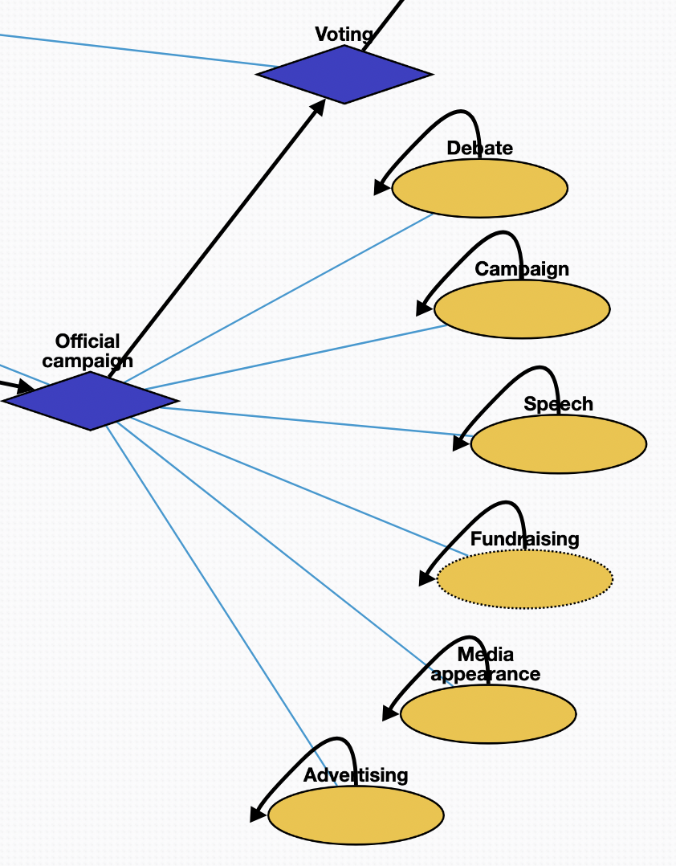
Official campaign episode
Official campaign – container for the episode Debate – candidate will attend debates with other candidates Campaign – candidate will hold rallies or meet and greets to generate support Speech – a candidate will give a speech about their platform to generate hype and support Fundraising – candidate will (optionally) raise funds to support their campaign
Media appearance – candidate will appear in the media via interviews and events Advertising – candidate will run advertisements to reach a wider audience Voting – next episode

Slide 5
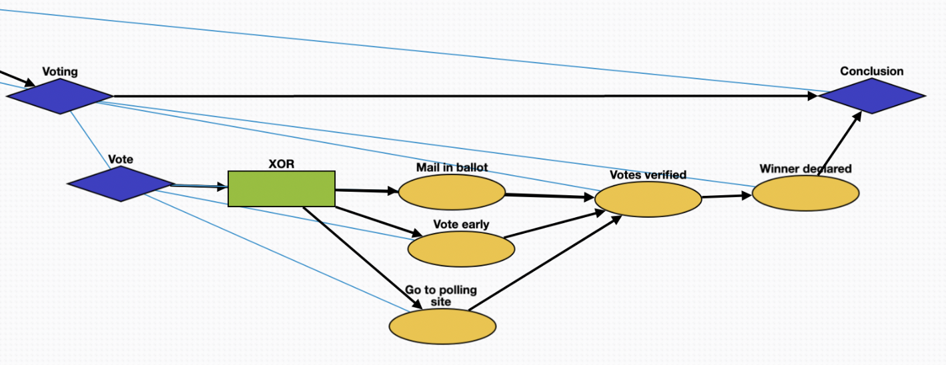
Voting episode
Voting – container for the episode
Vote – container for the event encompassing the process of a vote Mail in ballot – some voters will mail in a ballot to vote Vote early – some voters will follow a special process to vote early Go to polling site – some voters will vote on election day at the polling site Votes verified – votes are counted and verified to prevent fraud Winner declared – the winner of the election is declared based on the votes
Conclusion – next episode

Slide 6
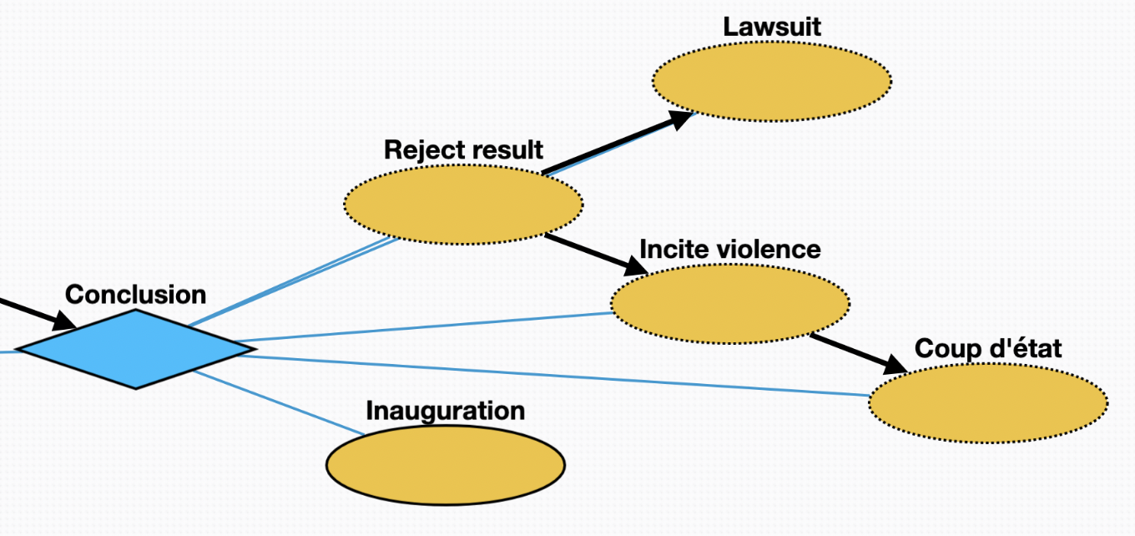
Conclusion episode
Conclusion – container for the episode Inauguration – the winner of the election is inaugurated Reject result – a loser of the election may deny the result of the election Lawsuit – a loser of the election may sue in order to attempt to overturn the result Incite violence – a loser of the election may incite violence to try to overturn the result Coup d'état – a loser of the election may attempt a coup

