Slide 1
RESIN Terrorist Mass Shooting Schema Updated March 20, 2022
Ghazaleh Kazeminejad, Sha Li, Iris Liu, Michael Regan,
Susan Brown, Martha Palmer, Heng Ji

Slide 2
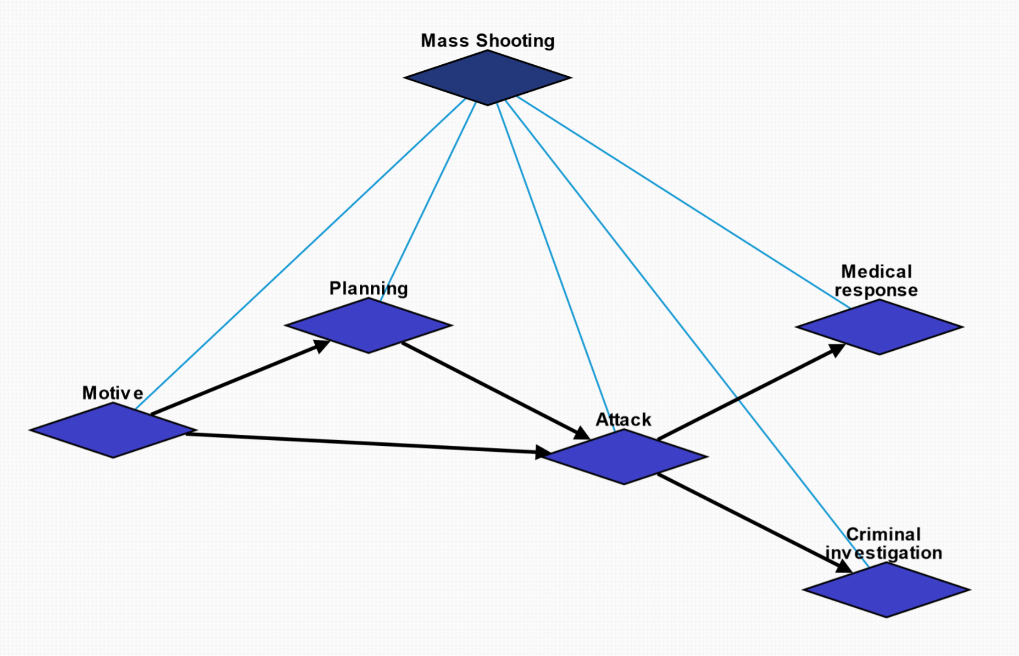
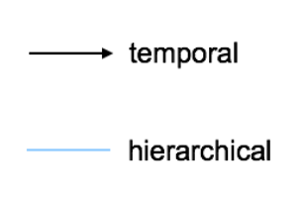
Overview

Slide 3
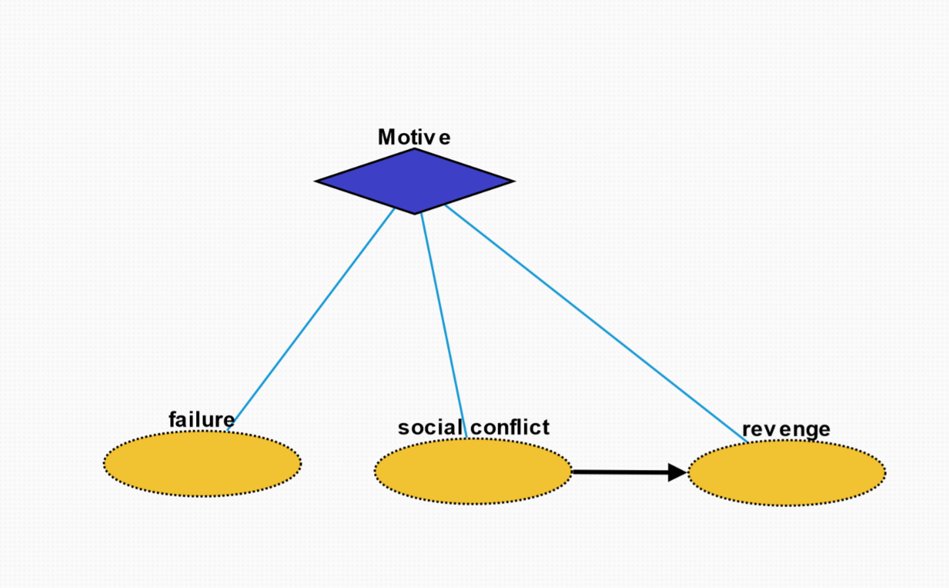
Motive
Failure: state or event of not meeting a desirable or intended objective, relative to a particular observer or belief system
Social conflict: struggle for agency or power in society, when two or more actors oppose each other in social interaction
Revenge: harmful action in response to a grievance

Slide 4
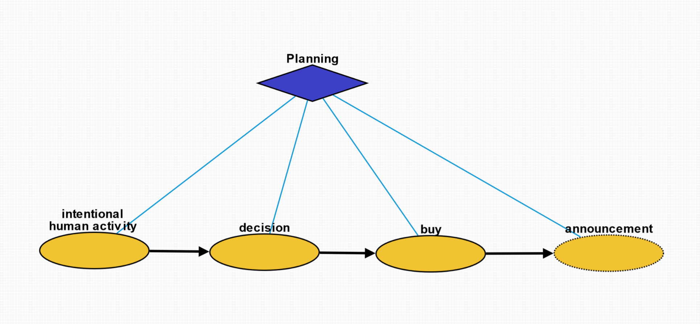
Planning
Intentional human activity: human activity driven by purposeful motives
Decision: result of deliberation
Buy: purchase weapon for crime
Announcement: printed, spoken, or published statement or notice of intent of mass shooting

Slide 5
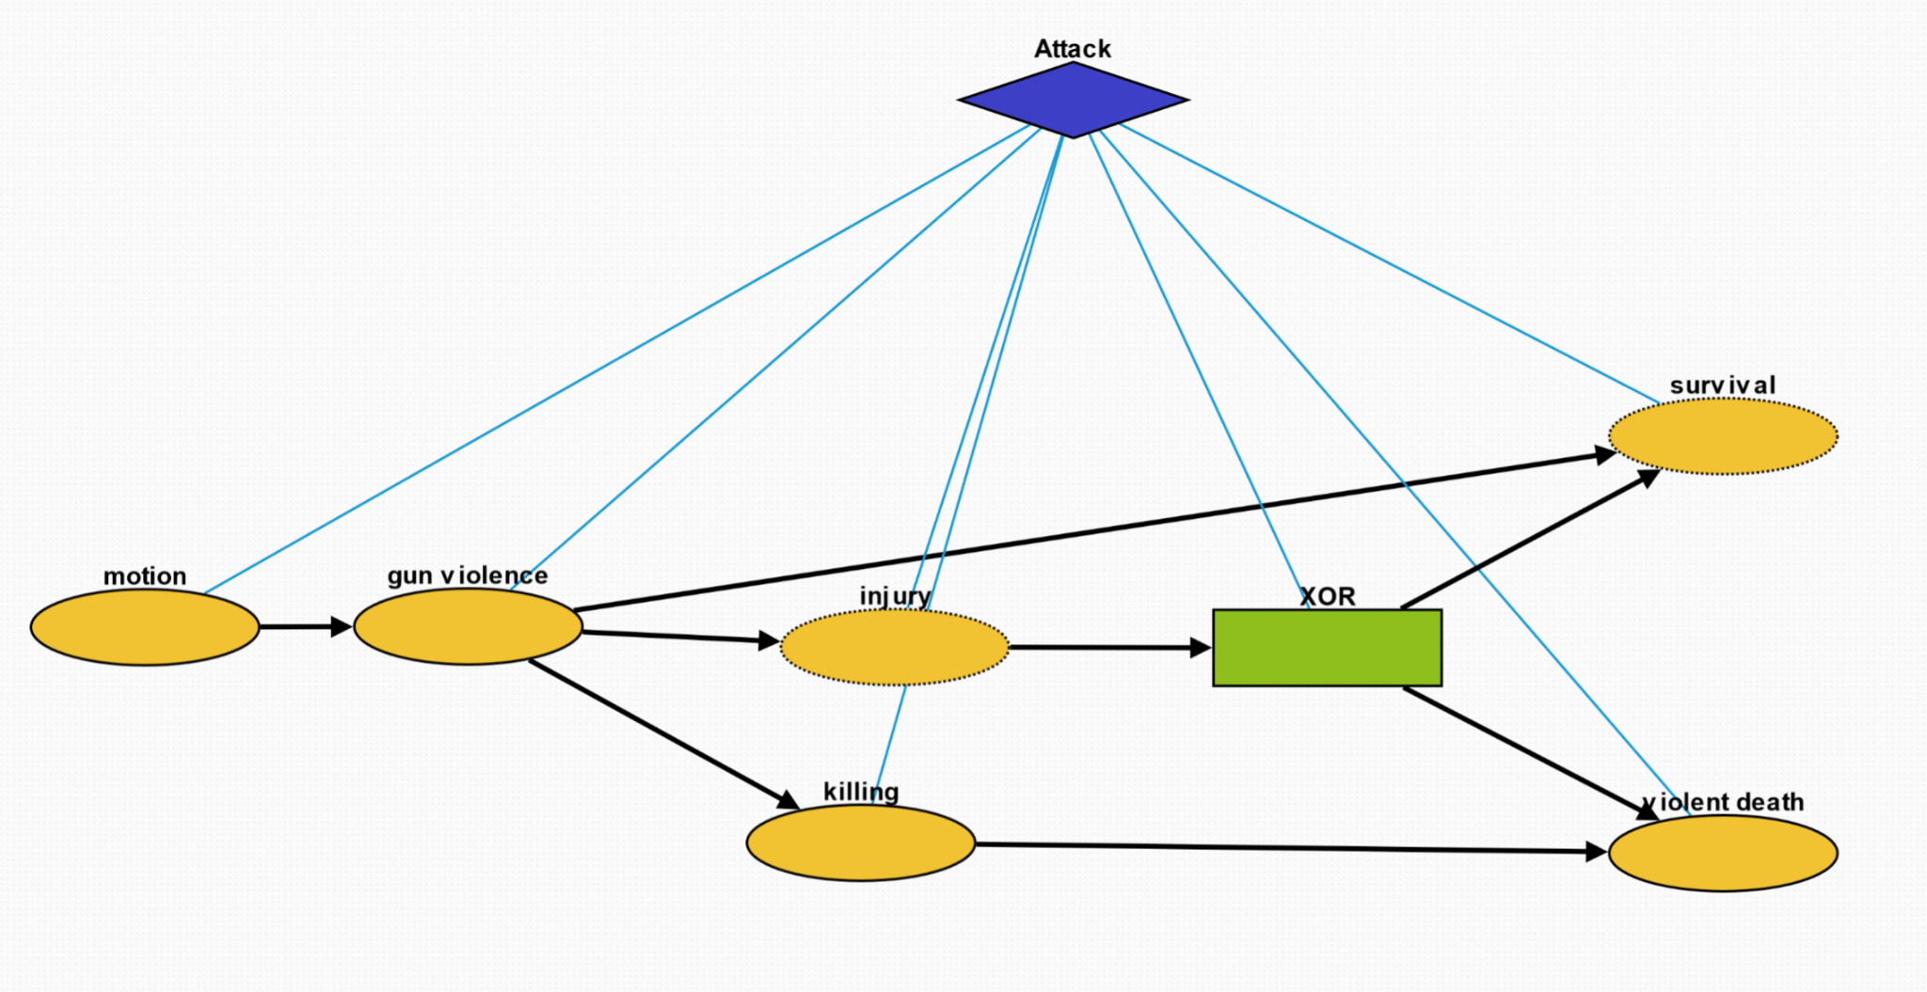
Attack
Motion: change in position of an object over time; a body is said to be in motion if it changes its position with respect to its immediate surroundings
Gun violence: broadly defined as violence committed with the use of a gun
Injury: physiological wound caused by shooter
Killing: act of killing a living being
Survival: act of being still alive after a threatening or dangerous situation
Violent death: death caused by violence through the shooting

Slide 6
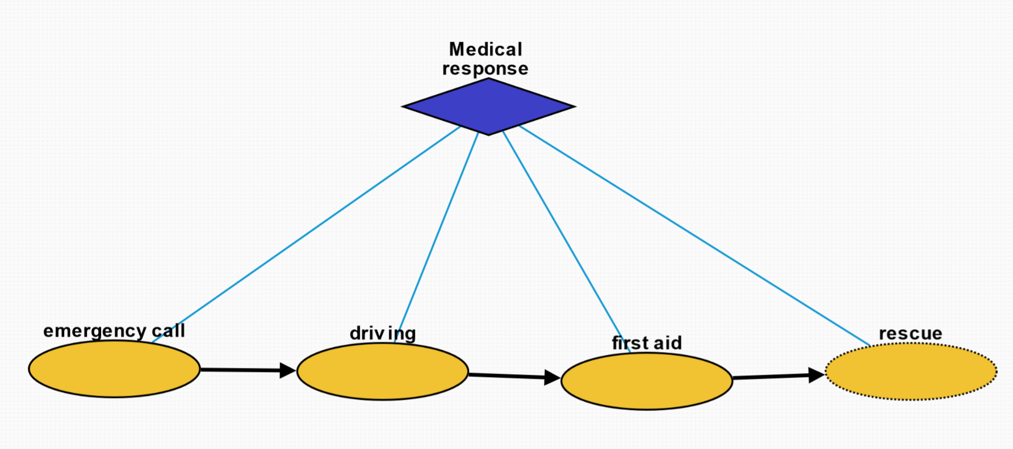
Medical Response
Emergency call: way of contacting an emergency call center usually by a phone to an emergency telephone number
Driving: operation of a vehicle to the crime scene
First aid: first and immediate assistance given to any person suffering from shooting injury
Rescue: comprises responsive operations that usually involve the saving of life, or prevention of injury

Slide 7
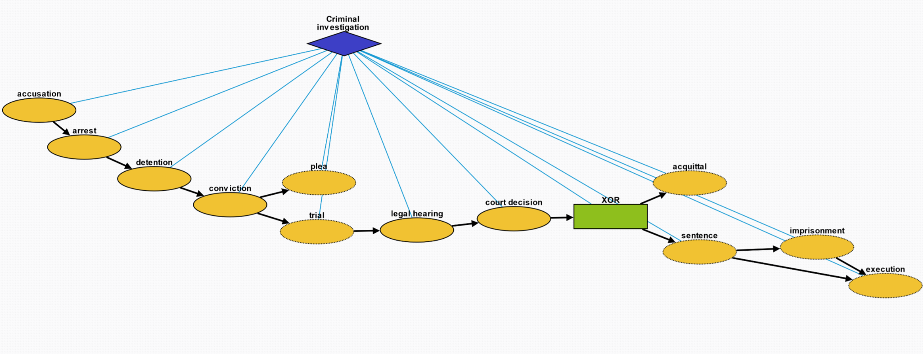
Criminal Investigation
Accusation: act of accusing or charging another with a crime
Arrest: detention of a person and taking them into custody, usually because it has been suspected of committing a crime
Detention: removal of the freedom of liberty by a state
Conviction: verdict that results when a court of law finds a defendant guilty of a crime
Plea: answer to a claim made by someone in a criminal case under common law using the adversarial system
Trial: coming together of parties to a dispute, to present information in a tribunal
Legal hearing: A legal hearing about the crime
Court decision: formal decision made by a court
Acquittal: the legal result of a verdict of not guilty
Sentence: decree of punishment in law
Imprisonment: restraint of a person's liberty by judicial or other detention
Execution: homicide as capital punishment

