Slide 1
RESIN Sports_Games Schema

Slide 2
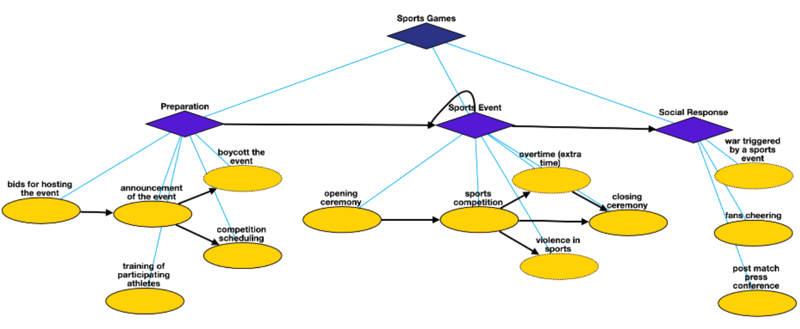
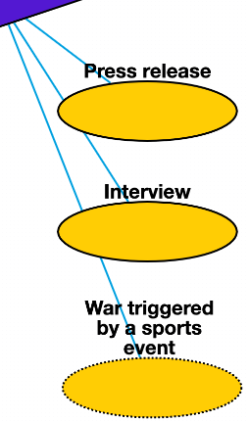
Overview

Slide 3
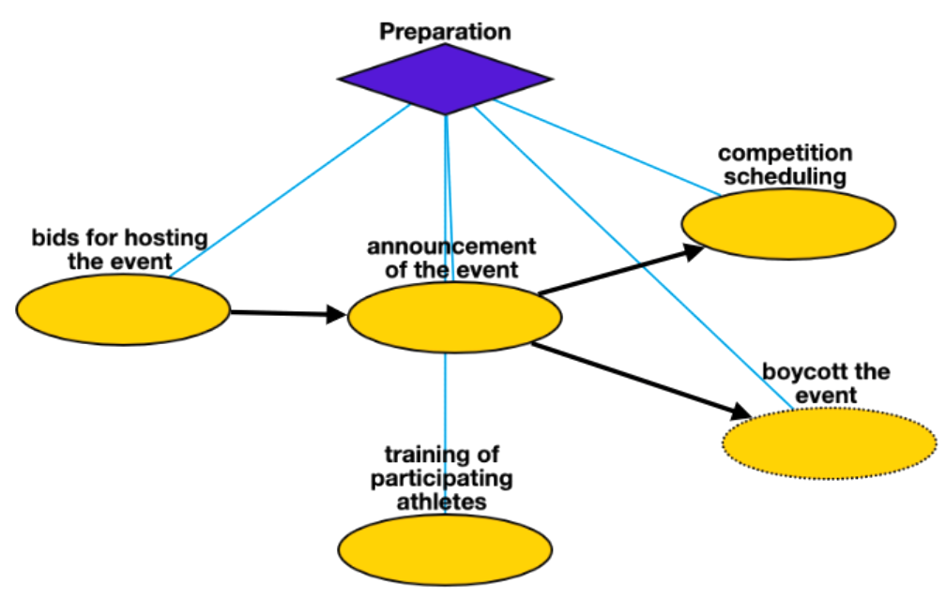
Preparation
Bids for hosting the event: for major sports events, such as modern Olympics games and various National Games, nations or cities should put forth bids for hosting the event.
Announcement of the event: the decision of bids are typically announced through a press conference.
Competition scheduling: to schedule the grouping and matching of participating teams, and settling down the time and location of matches.
Boycott the event: sometimes certain nations or individual athletes will boycott a sports game for political or humanitarian reasons.
Training of participating athletes: before major competitions, athletes needs specific training to achieve better performance.

Slide 4
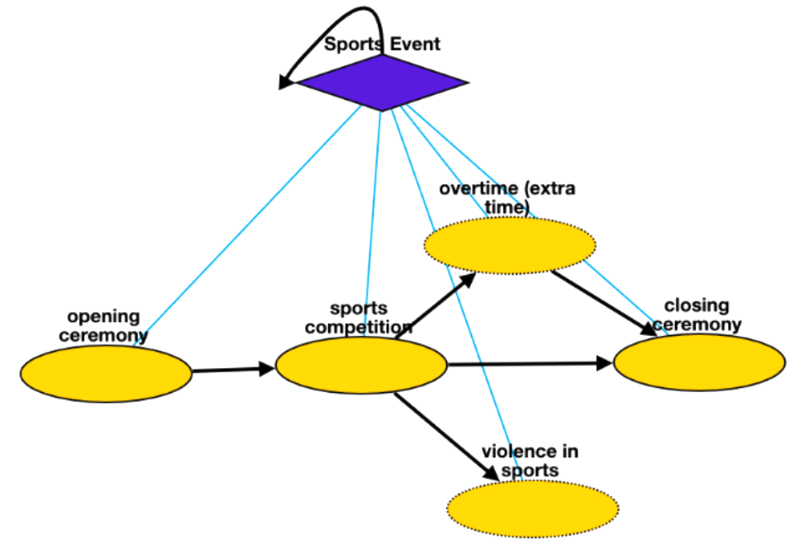
Sports Event
Opening ceremony: opening ceremony represents the official commencement of a major sports event.
Sports competition: a specific competition in which the participants rival with each other to win the game
Overtime (extra time): Overtime or extra time is an additional period of play specified under the rules of a sport to bring a game to a decision and avoid declaring the match a tie or draw where the scores are the same.
Violence in sports: violent and often unnecessarily harmful intentional physical acts committed during, or motivated by, a sports game. This may include violence between athletes or fan violence.
Closing ceremony: the official ceremony which marks the end of the sports event.

Slide 5
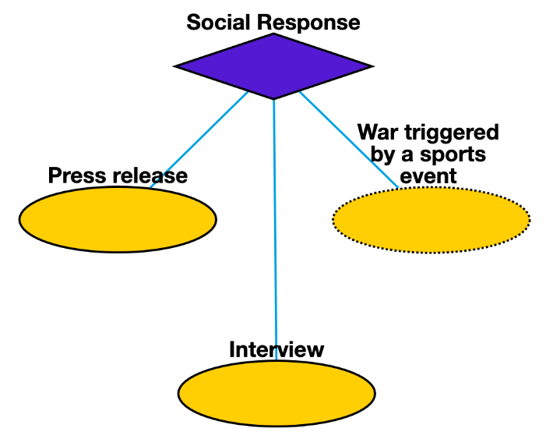
Social Response
Press release: the official general post-match press conference for each match, covering topics related to the event, such as commentary, opinions, and fan responses.
Interview: (mostly after winning) athletes and coaches are interviewed about feelings and critical success factors, etc.
War triggered by a sports event: in very rare cases, the riots happened in a sports game will escalate to wars between participating nations, such as the 1969 Football War between El Salvador and Honduras.

