Slide 1
RESIN Terrorist Attacks Schema Quizlet 9
Iris Liu, Sha Li, Michael Regan,
Susan Brown, Martha Palmer, Heng Ji

Slide 2
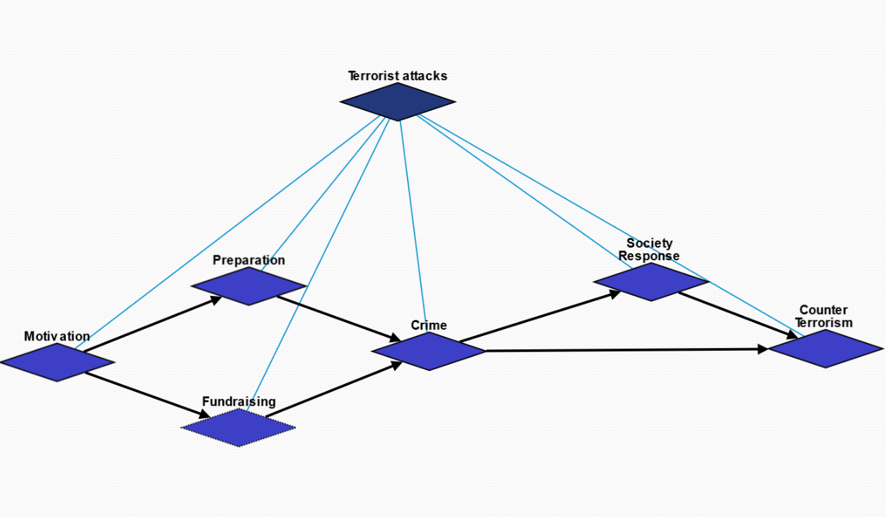
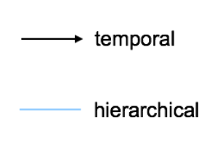
Overview

Slide 3
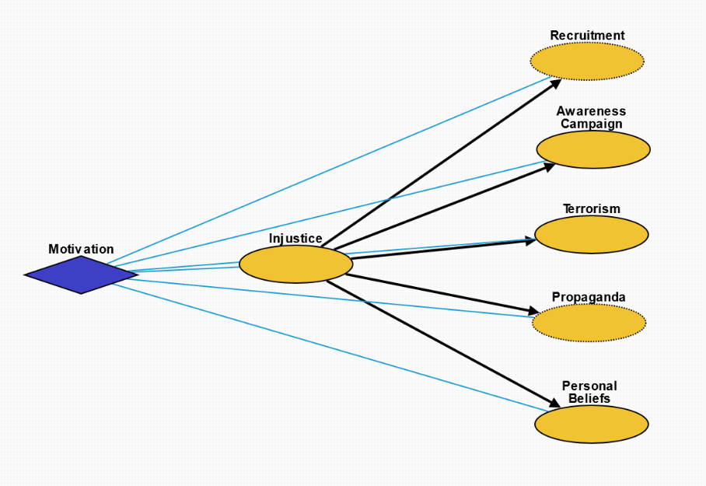
Motivation (10184)
Injustice (10190): Injustice, whether objective or perceived, towards a group or individual.
Recruitment (10194): Inspire people to join the cause.
Propaganda (10191): Crime as propaganda to inspire people for the cause.
Awareness Campaign (10192): Raise awareness and receive attention from the media on the cause.
Terrorism (10193): Incite fear in the general population.
Personal Beliefs (10195): Personal beliefs that something about the world is inherently wrong.

Slide 4
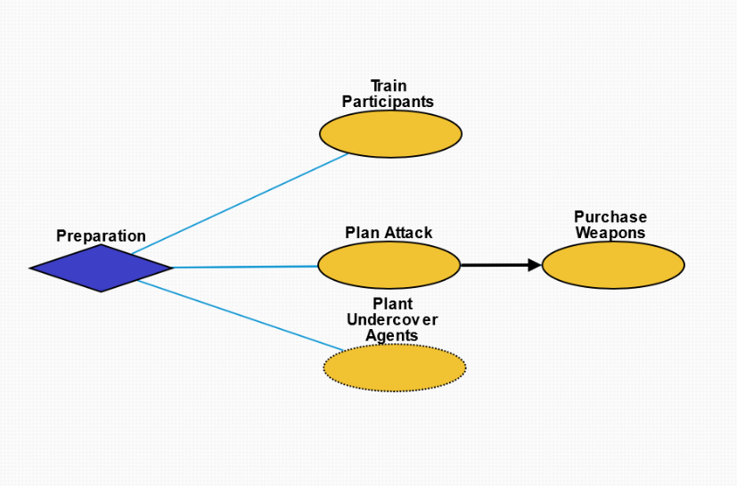
Preparation (10185)
Train Participants (10197): Train participants who will execute the attack.
Plan Attack (10196): Plan the specifics of attack.
Purchase Weapons (10199): Obtain weapons for the crime.
Plant Undercover Agents (10198): Plant spies in the target group to obtain information.

Slide 5
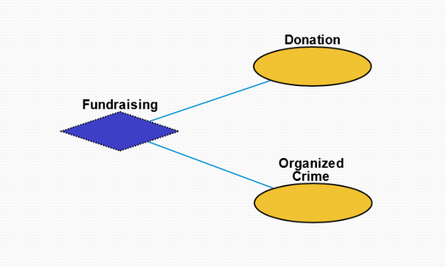
Fundraising (10186)
Donation (10200): Monetary donation from supporters.
Organized Crime (10201): Criminal enterprises for the purpose of profit.

Slide 6
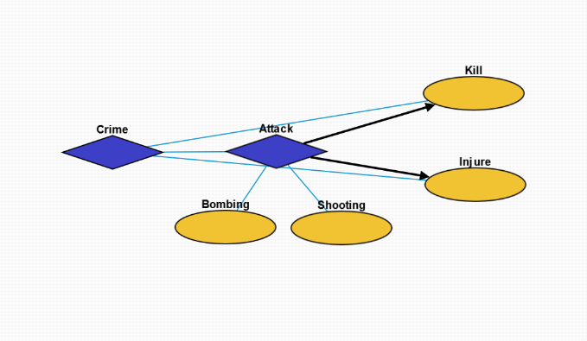
Crime (10187)
Attack (10202): Terrorist action to injure another organism.
Bombing (10205): Action whereby a bomb is used to kill one or more people or to damage or destroy objects
Shooting (10206): Act or process of firing firearms or other projectile weapons
Kill (10204): Killing an individual or group.
Injure (10203): Injuring an individual or group.

Slide 7
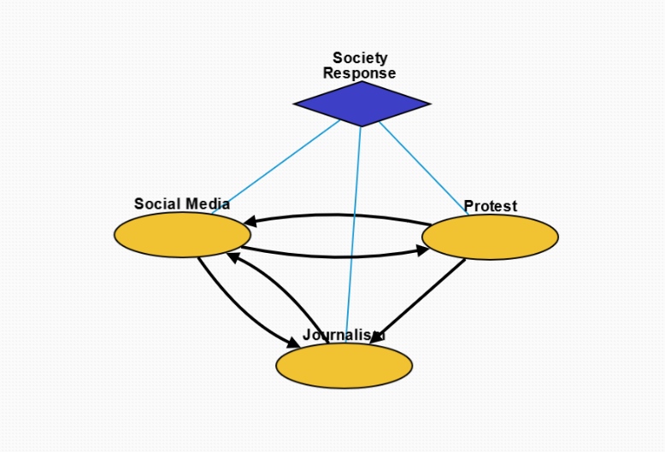
Society Response (10189)
Social Media (10207): Interaction among people in which they create, share, and/or exchange information and ideas in virtual communities and networks.
Protest (10217): Collective action by people to protest the terrorist attack and injustice.
Journalism (10208): Investigation and reporting of events, issues and trends to a broad audience.

Slide 8
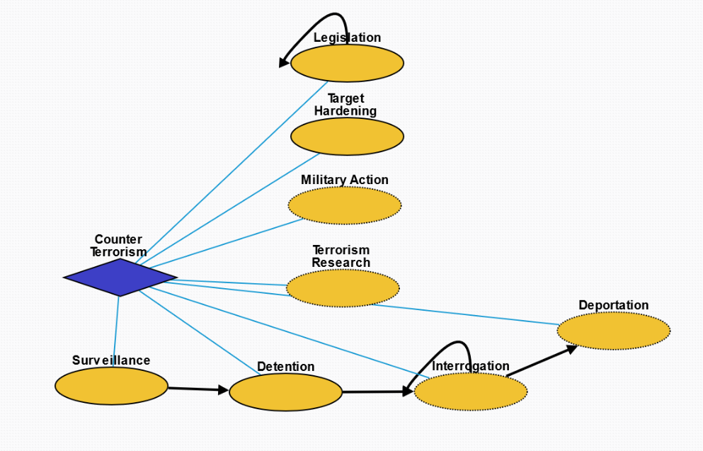
Counter Terrorism (10188)
Legislation (10211): Laws enacted against terrorism.
Target Hardening (10214): Process of securing or strengthening security of an area suspected to be targeted by terrorism.
Military Action (10209): Control of people by others through violence in order to prevent further terrorist activity.
Terrorism Research (10215): Systematic research into the cause of terrorism and its impact as well as preventative measures.
Surveillance (10216): Monitoring of behavior, activities, or other changing information, for the purpose of influencing, managing or directing.
Detention (10212): Removal of the freedom of liberty by a state.
Interrogation (10213): Interviewing employed by law enforcement officers, military personnel, and intelligence agencies with the goal of eliciting information about affiliation with any terrorist group.
Deportation (10210): Expulsion of the people from a place or country.

