Slide 1
RESIN Terrorist Mass Shooting Schema Quizlet 9
Ghazaleh Kazeminejad, Sha Li, Iris Liu, Michael Regan,
Susan Brown, Martha Palmer, Heng Ji

Slide 2
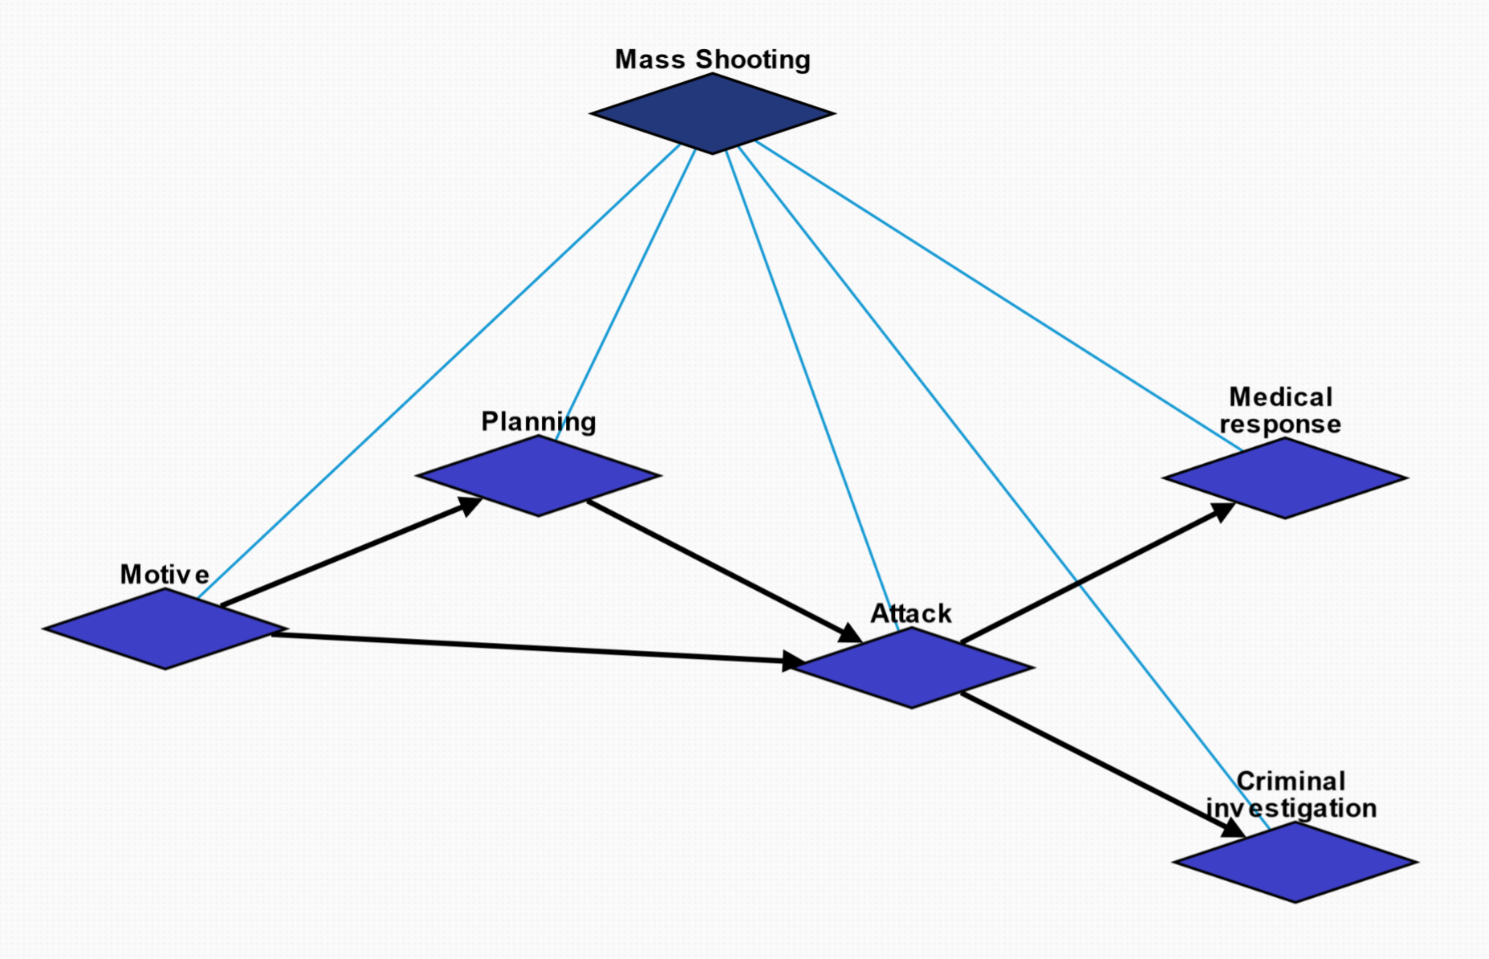
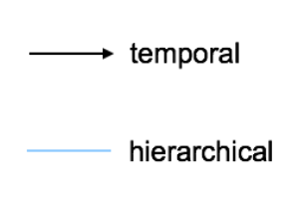
Overview

Slide 3
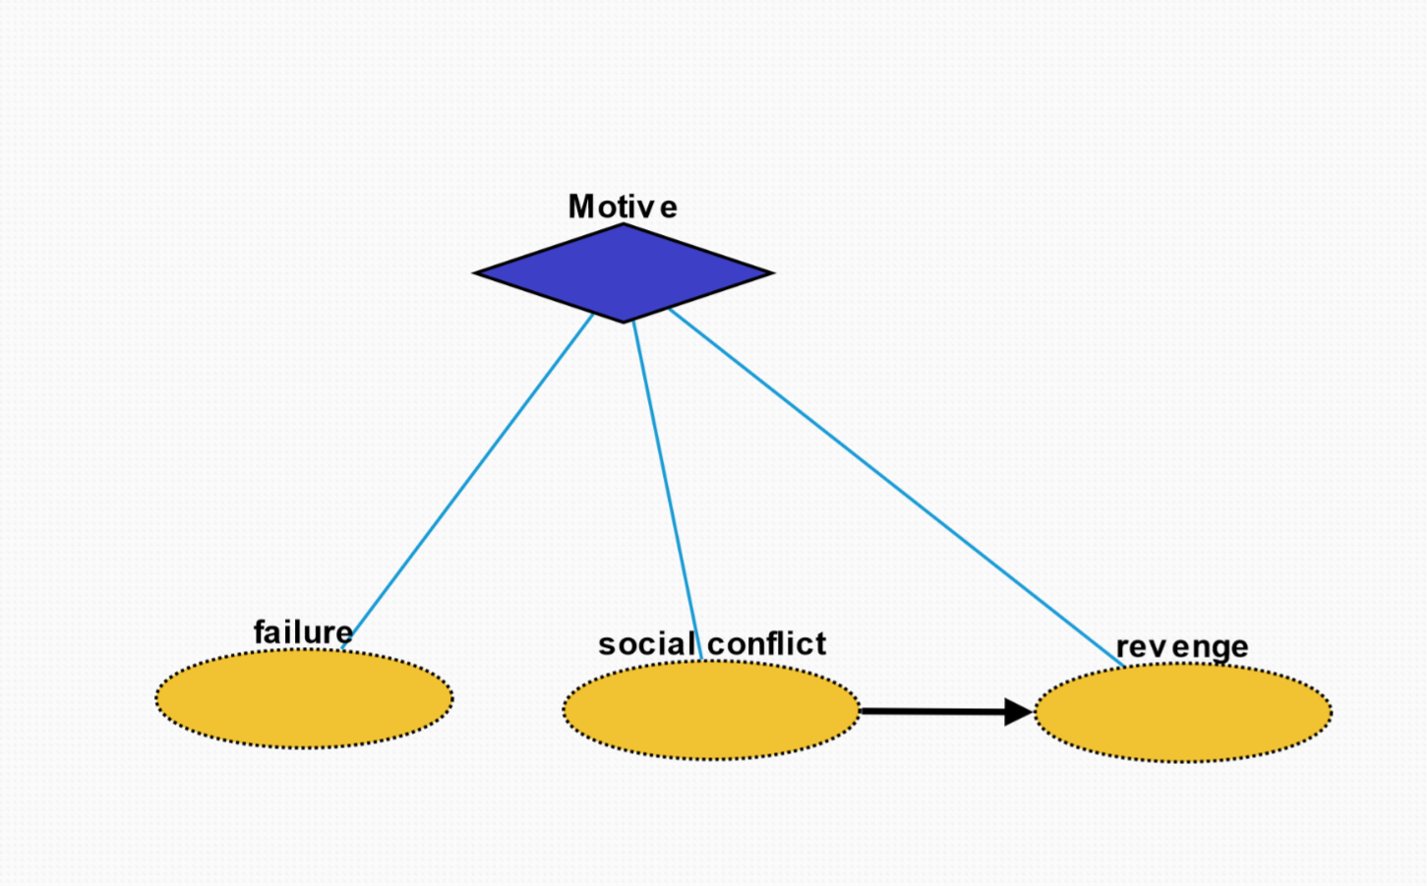
Motive (10296)
Failure (10303): state or event of not meeting a desirable or intended objective, relative to a particular observer or belief system
Social conflict (10301): struggle for agency or power in society, when two or more actors oppose each other in social interaction
Revenge (10302): harmful action in response to a grievance

Slide 4
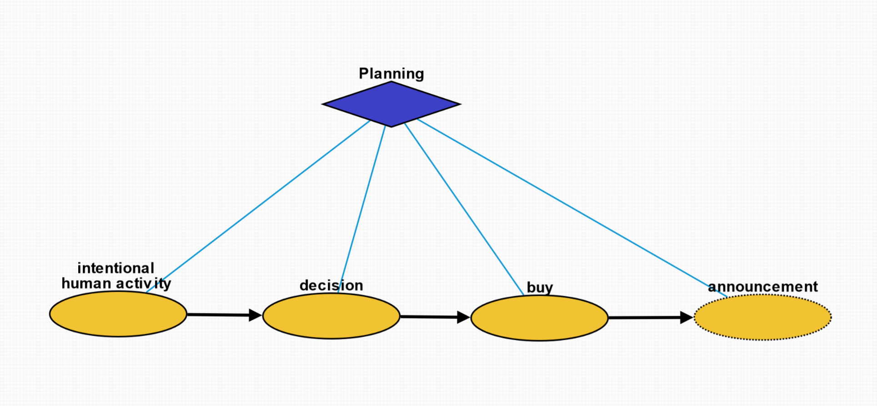
Planning (10297)
Intentional human activity (10304): human activity driven by purposeful motives
Decision (10305): result of deliberation
Buy (10306): purchase weapon for crime
Announcement (10307): printed, spoken, or published statement or notice of intent of mass shooting

Slide 5
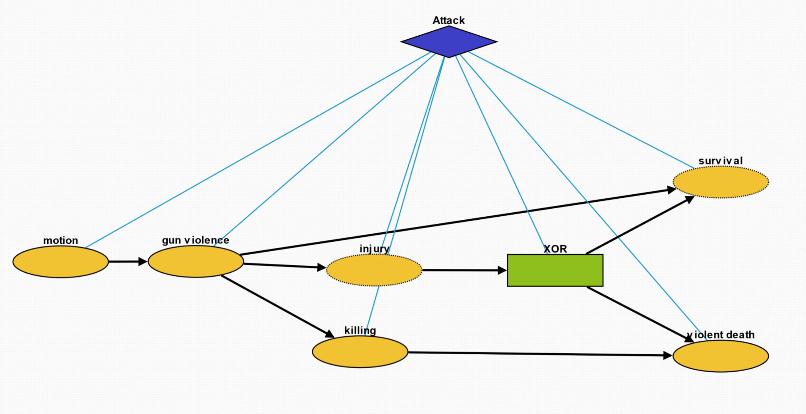
Attack (10298)
Motion (10308): change in position of an object over time; a body is said to be in motion if it changes its position with respect to its immediate surroundings
Gun violence (10309): broadly defined as violence committed with the use of a gun
Injury (10312): physiological wound caused by shooter
Killing (10311): act of killing a living being
Survival (10313): act of being still alive after a threatening or dangerous situation
Violent death (10310): death caused by violence through the shooting

Slide 6
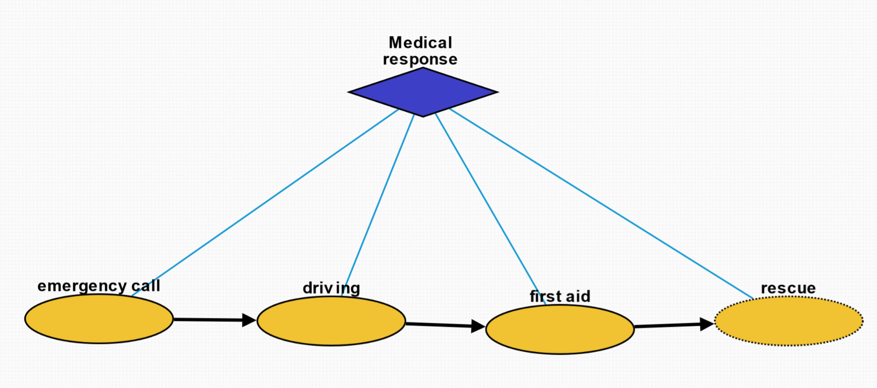
Medical Response (10299)
Emergency call (10314): way of contacting an emergency call center usually by a phone to an emergency telephone number
Driving (10315): operation of a vehicle to the crime scene
First aid (10316): first and immediate assistance given to any person suffering from shooting injury
Rescue (10317): comprises responsive operations that usually involve the saving of life, or prevention of injury

Slide 7
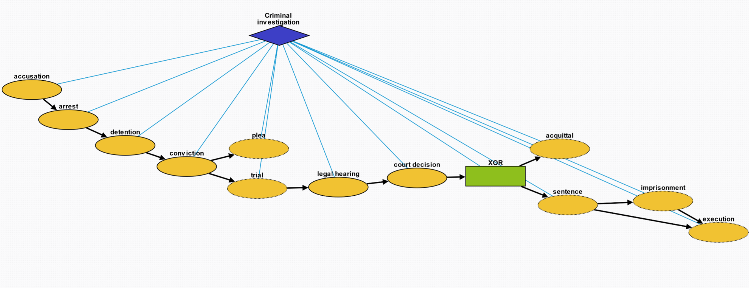
Criminal Investigation (10300)
Accusation (10318): act of accusing or charging another with a crime
Arrest (10319): detention of a person and taking them into custody, usually because it has been suspected of committing a crime
Detention (10320): removal of the freedom of liberty by a state
Conviction (10321): verdict that results when a court of law finds a defendant guilty of a crime
Plea (10322): answer to a claim made by someone in a criminal case under common law using the adversarial system
Trial (10323): coming together of parties to a dispute, to present information in a tribunal
Legal hearing (10324): A legal hearing about the crime
Court decision (10325): formal decision made by a court
Acquittal (10327): the legal result of a verdict of not guilty
Sentence (10326): decree of punishment in law
Imprisonment (10328): restraint of a person's liberty by judicial or other detention
Execution (10329): homicide as capital punishment

