Slide 1
RESIN International Conflict Schema

Slide 2
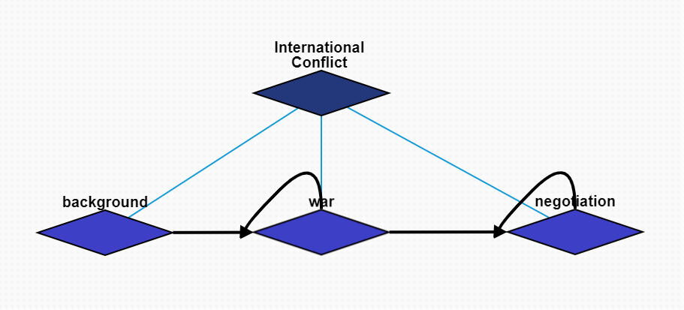
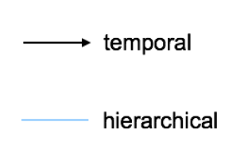
Overview: International Conflict
Three major episodes:
Background
War
Negotiation

Slide 3
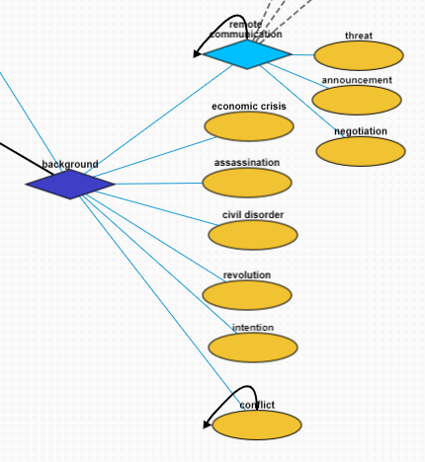
Episode Background
Remote Communication
Threat: one person's statement that they intend to harm another, or another's property
Announcement: printed, spoken, or published statement or notice of an event or other news
Negotiation: dialogue between two or more people or parties intended to reach a beneficial outcome
Economic Crisis: sharp deterioration in economic situation and perspectives
Assassination: murder of a prominent person, often a political leader or ruler
Revolution: fundamental change in power or organizational structures that takes place in a relatively short period of time
Civil Disorder: civil unrest against war
Intention: a country has the intention to join an organization
Conflict: friction, disagreement, or discord within a group or between different groups

Slide 4
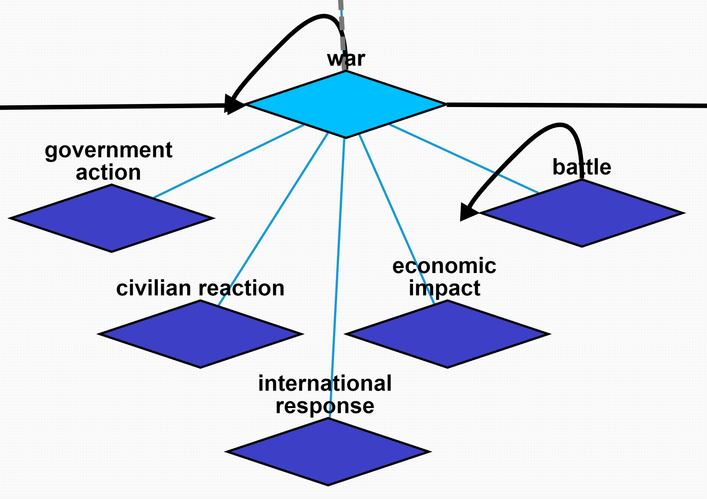
Episode War
Five sub-episodes:
Government Action
Civilian Reaction
International Response
Economic Impact
Battle

Slide 5
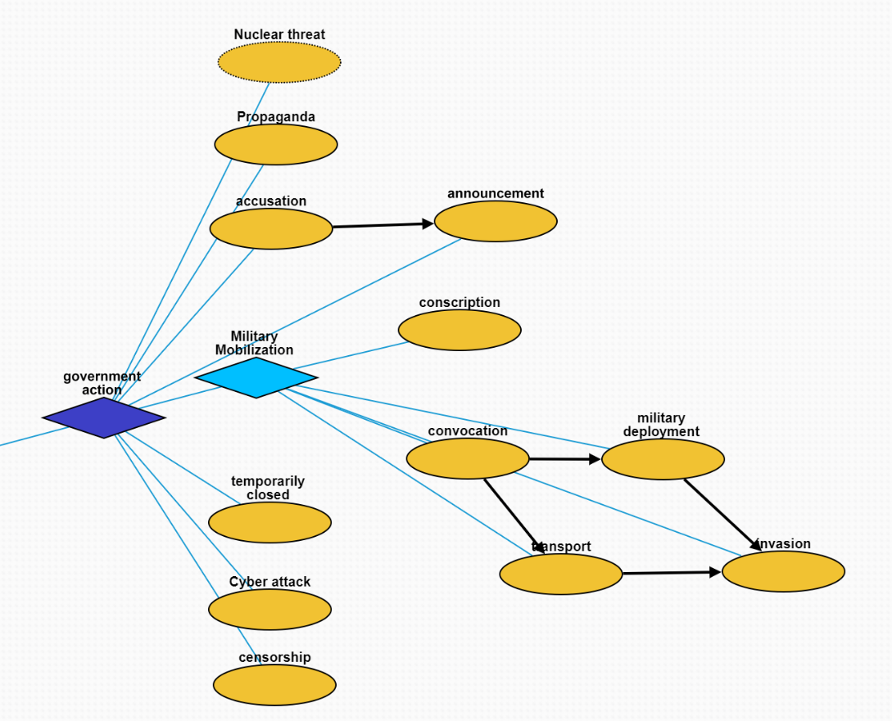
War: Government Action
Nuclear Threat: a type of threat
Propaganda: form of communication intended to sway the audience through presenting only one side of the argument
Accusation
Announcement: announcing war
Military Mobilization: assembling and readying troops and supplies for war
Conscription: compulsory enlistment into national or military service
Convocation: assemble army
Military Deployment: deploying troops
Transport: transporting troops
Invasion: entering territory
Temporarily Closed: facility shutdown
Cyber Attack: cyber crime
Censorship: practice of suppressing speech or other public communication

Slide 6
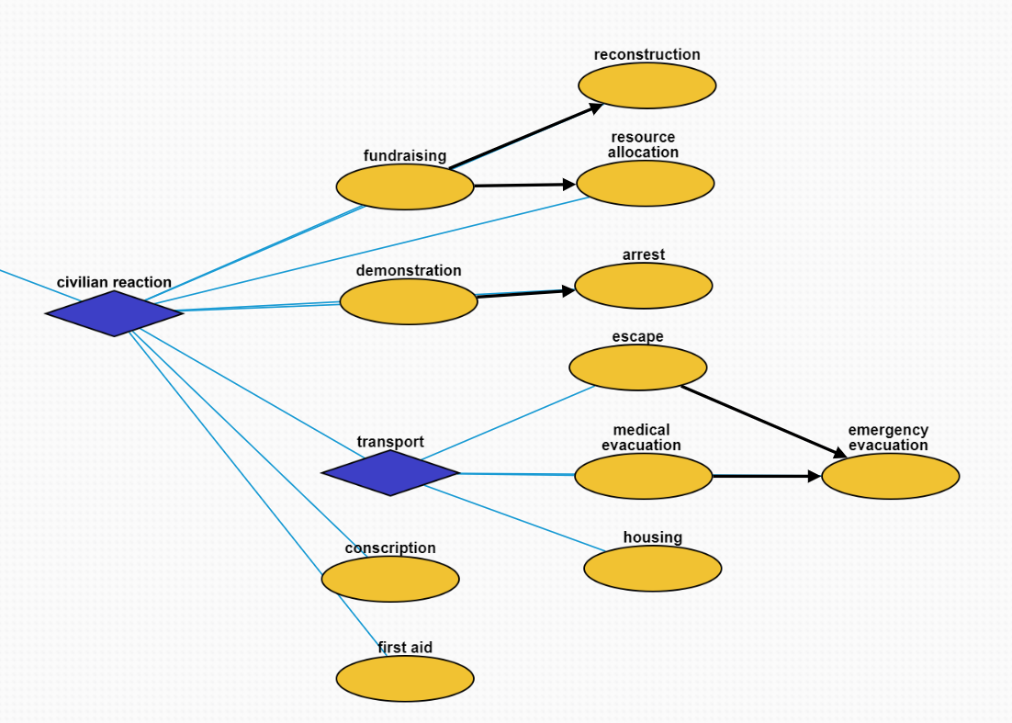
War: Civilian Reaction
Fundraising: process of gathering voluntary contributions of money or other resources
Reconstruction: rebuild infrastructure
Resource Allocation: allocation of resources among possible uses
Demonstration: demonstration against war
Arrest: arresting protesters
Transport
Escape: flee to other countries
Medical Evacuation: evacuate refugee
Emergency Evacuation: seeking asylum
Housing: seeking shelter for bombing
Conscription: enlist for the army
First Aid: first and immediate assistance given to any person suffering from either a minor or serious illness or injury

Slide 7
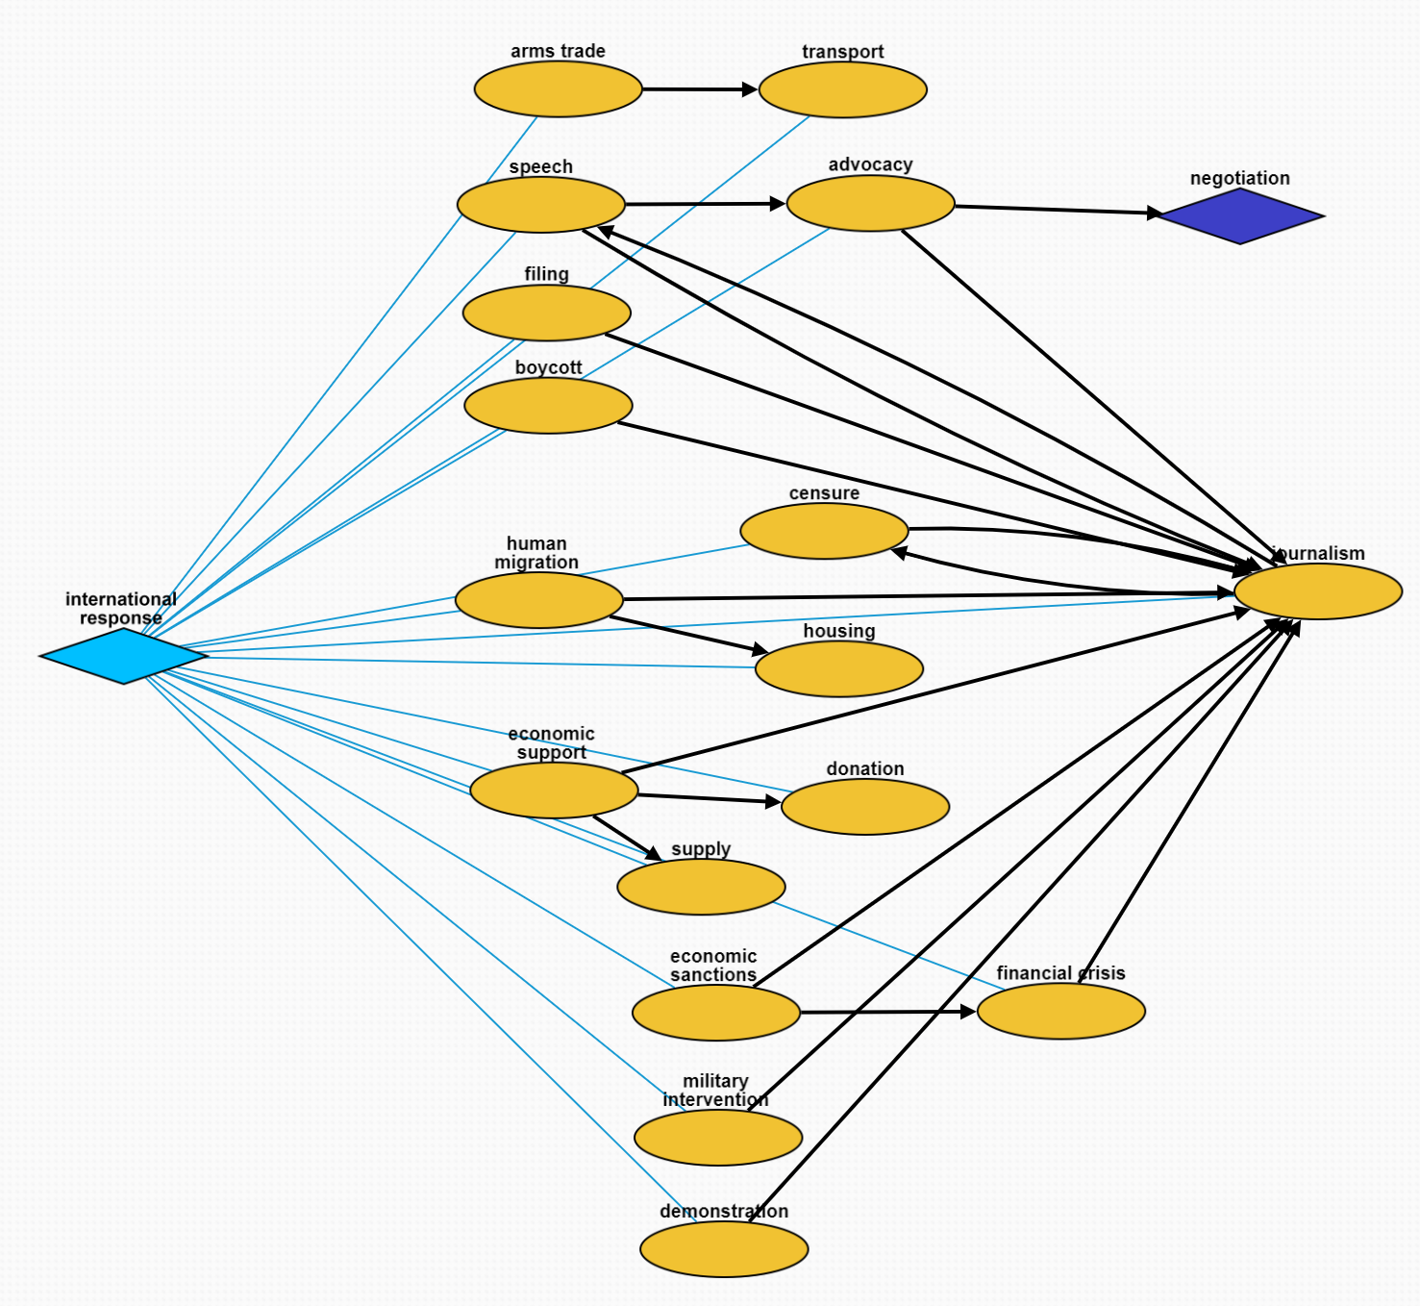
War: International Response
Arms trade: purchase weapons
Transport: transport weapons for support
Speech: government leader gives speech
Advocacy: call for ceasefire
Filing: file a case for war crime
Boycott: act of voluntarily abstaining from using, buying, or dealing with a person, organization, or country
Journalism: media coverage
Human Migration: refugee migration
Censure: condemn at social media
Housing: refugee housing
Economic Support: economic benefit paid to persons who cannot support themselves
Donation: gift given by physical or legal persons, typically for charitable purposes and/or to benefit a cause
Supply: economic activity aimed at covering the consumption needs of an economic unit
Economic Sanctions: international economic sanctions
Financial Crisis: domestic and international financial crisis
Military Intervention: use of force by a State over foreign territory
Demonstration: protest against war

Slide 8
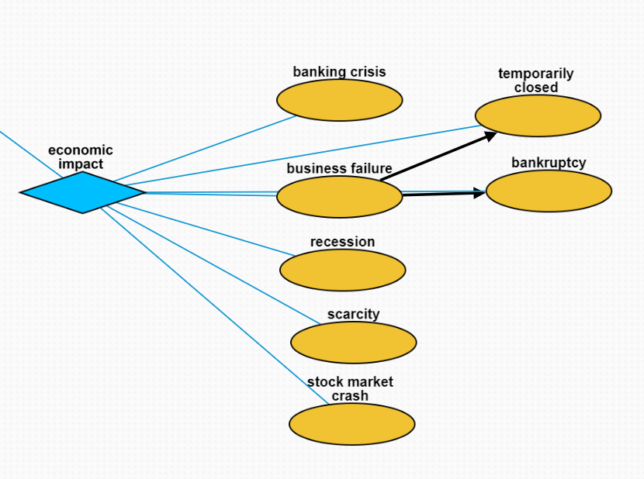
War: Economic Impact
Banking Crisis: abrupt instability in the banking industry
Business Failure: a company ceasing operations following its inability to make a profit or to bring in enough revenue to cover its expenses
Temporarily Closed: state that indicates that a building, installation, park, etc. is not accessible because it is closed
Bankruptcy: legal process through which people or other entities who cannot repay debts to creditors may seek relief from some or all of their debts
Recession: business cycle contraction; general slowdown in economic activity
Scarcity: resource scarcity
Stock Market Crash: sudden dramatic decline of stock prices across a significant cross-section of a stock market

Slide 9
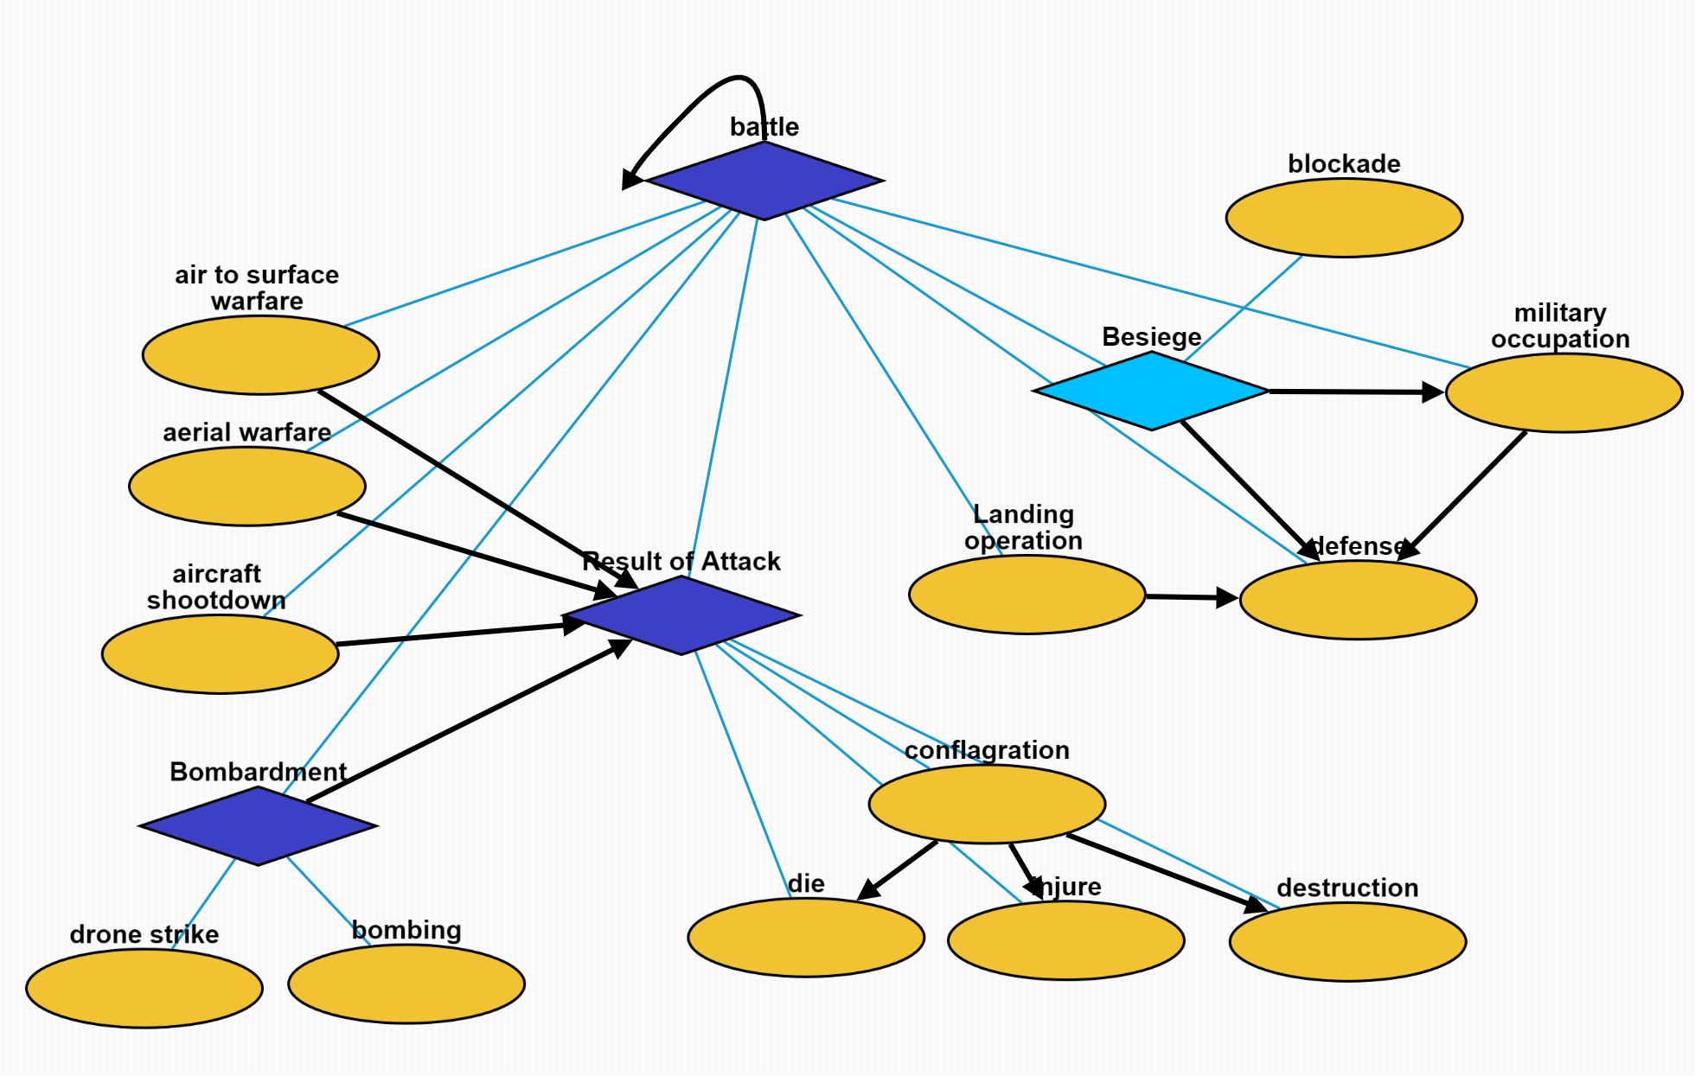
War: Battle
Air-to-surface Warfare: military mission utilizing aircraft to combat enemy forces on land or at sea
Aerial Warfare: warfare and military operations conducted by, amongst, and against aircraft and other aerial systems
Aircraft Shootdown: shooting down of a civilian or military aircraft
Bombardment
Drone Strike: conventional combat mission on an individual or small-scale basis
Bombing: attack by artillery fire or by dropping bombs from aircraft
Result of Attack
Conflagration: large and destructive fire that threatens human life, animal life, health, and/or property
Die: death
Injure: injury
Destruction: damage to an object, system or an idea
Landing Operation: type of military action
Defense: protection from attack in military operations
Besiege: military blockade of a city or fortress
Blockage: effort to cut off supplies from a particular area by force
Military Occupation: effective provisional control of a certain power over a territory

Slide 10
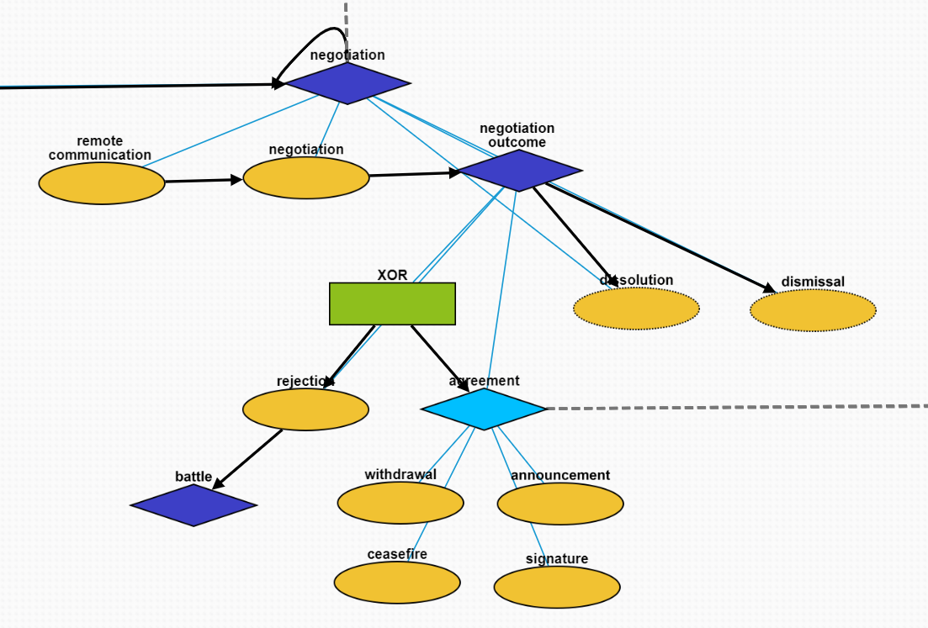
Episode Negotiation
Remote Communication: a third-party organization requests ceasefire
Negotiation: battle participants negotiate a ceasefire agreement
Negotiation Outcome: a container
Rejection: battle participants do not reach an agreement on ceasefire
Agreement: battle participants reach an agreement
Announcement: announcing the ceasefire agreement
Withdrawal: withdrawing the attacking army
Ceasefire: temporary stoppage of war
Signature: signing of the ceasefire agreement
Dissolution: organization or country dissolves after negotiation
Dismissal: personnel change after negotiation

