Slide 1
RESIN Epidemic Schema Updated Mar 19, 2022
Sha Li, Manling Li, Ghazaleh Kazeminejad, Michael Regan, Susan Brown, Martha Palmer, Jiawei Han, Heng Ji
{shal2,hengji}@illinois.edu

Slide 2
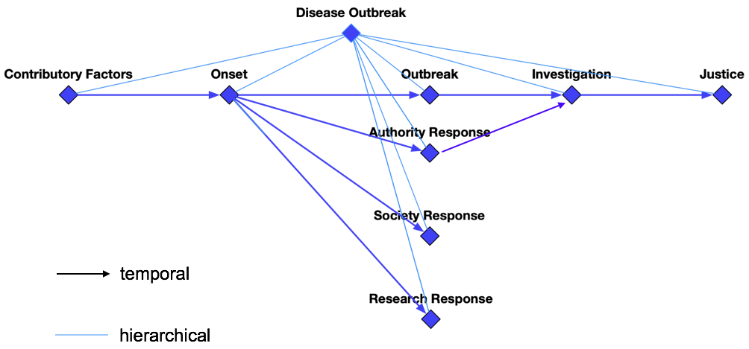
Overview

Slide 3
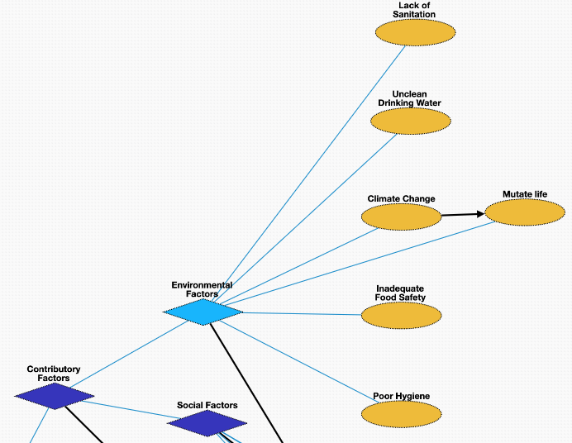
Contributory Factors- Environmental Factors
Lack of Sanitation [negated] : public health conditions related to clean drinking water and adequate disposal of human excreta and sewage
Unclean Drinking Water [negated]: water not safe for consumption
Inadequate Food Safety [negated]: scientific discipline describing handling, preparation, and storage of food in ways that prevent foodborne illness
Poor Hygiene [negated]: set of practices performed for the preservation of health
Climate Change: Contemporary climate change may contribute to the disease outbreak, i.e., global warming
Mutate Life: The virus may undergo an alteration in the nucleotide sequence of the genome during the disease outbreak

Slide 4
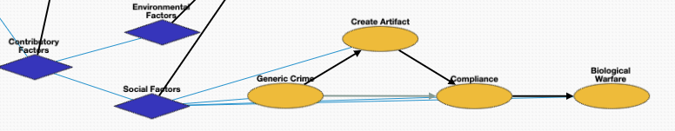
Contributory Factors- Social Factors
Generic Crime: The disease outbreak could be the result of a crime, i.e., someone polluting the water with a chemical
Create Artifact: Creation of a disease by laboratories or organizations
Compliance[negated]: Compliance to a rule or regulation. Often negated, for example violating health regulations.
Biological Warfare: The disease outbreak may result from the use of biological toxins or infectious agents such as bacteria, viruses, insects, and fungi with the intent to kill, harm or incapacitate humans, animals or plants as an act of war

Slide 5
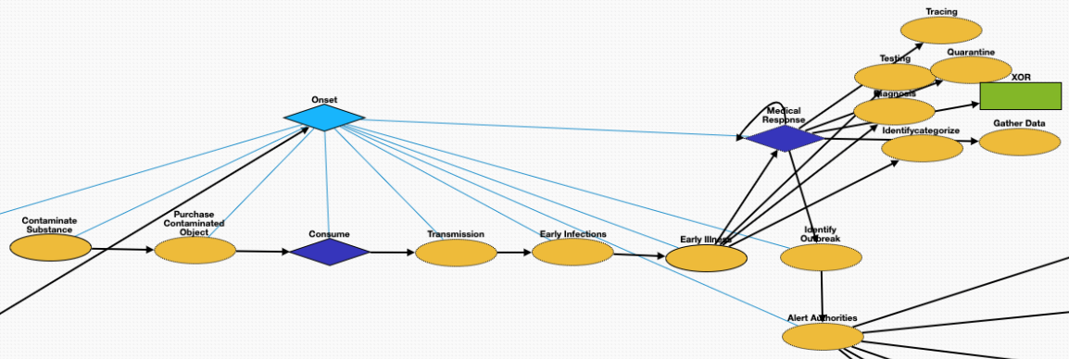
Onset
Contaminate Substance: Presence of an unwanted constituent, harmful substance or impurity in a material, physical body, or environment. Contaminated object could be food, liquid or air.
Purchase Contaminated Object: Optionally, the victim purchases the contaminated food or liquid.
Consume: Consumption of a substance by an organism.
Transmission: passing of a pathogen causing communicable disease from an infected host individual or group to other individual or group, regardless of whether the other individual was previously infected
Infections: Invasion of an organism's body tissues by the virus. People can be infected by the virus in the disease outbreak
Early Illness: Abnormal condition that negatively affects the structure or function of all or part of an organism due to the virus in the disease outbreak
Medical Response: [See next page]
Identify Outbreak: Detecting a possible outbreak. Usually accompanied by an announcement.
Alert Authorities: Alerting and reporting the detected outbreak to state and local public health authorities

Slide 6
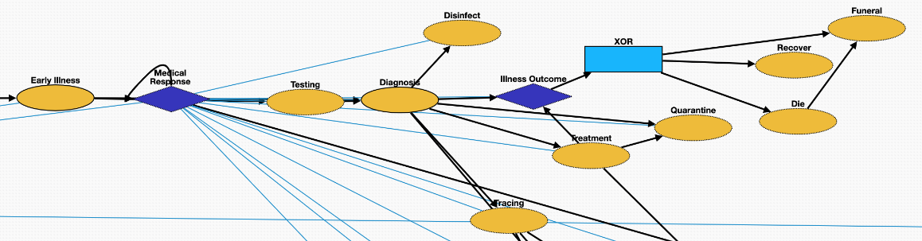
Medical Response
Testing: A viral test checks specimens from your nose or your mouth to find out if you are currently infected with the virus
Diagnosis: Medical diagnosis on infection of the virus in the disease outbreak
Disinfect: Cleaning surfaces and substances that are within contact of the pathogen
Treatment: Attempted remediation of a health problem due to infection of the virus in the disease outbreak
Tracing: Contact tracing identifies persons who may have come into contact with an infected person during the disease outbreak
Quarantine: Restriction on the movement of people, animals and goods which is intended to prevent the spread of the disease
Illness Outcome: an XOR gate connecting the following two outcomes
- Die → Funeral
- Recover

Slide 7
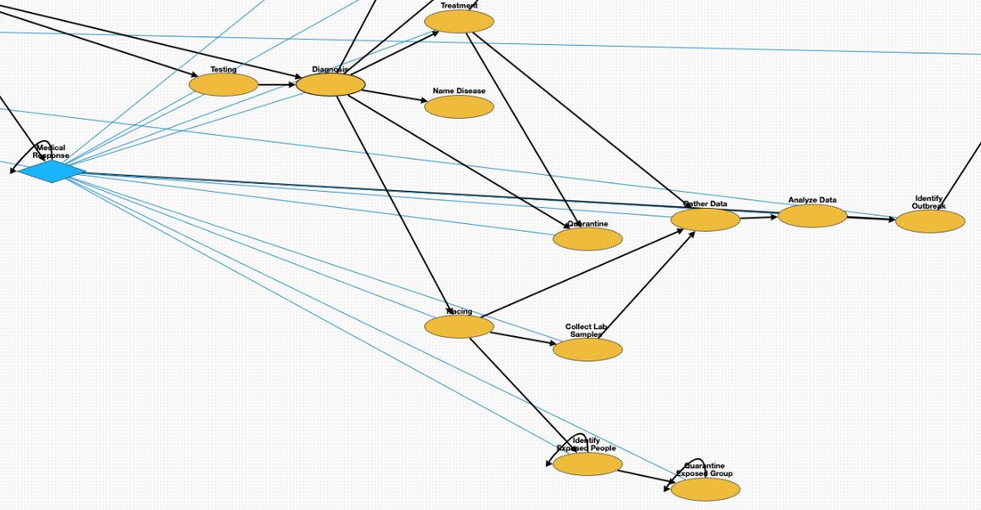
Medical Response cont.
After tracing, an extra group of exposed people could be identified and quarantined.
After tracing the pathogen, collecting lab samples (and performing lab tests), gathering and analyzing data, the disease is identified and announced.

Slide 8
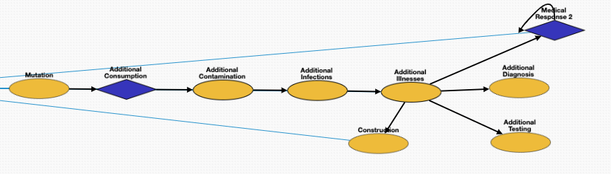
Outbreak
Mutations: The virus may undergo an alteration in the nucleotide sequence of the genome during the disease outbreak
Infections: Invasion of an organism's body tissues by disease-causing agents. People can be infected by the virus in the disease outbreak
Illness: Abnormal condition that negatively affects the structure or function of all or part of an organism due to infection of the virus in the disease outbreak
Construction: Field hospitals may be constructed to accommodate patients during the outbreak

Slide 9
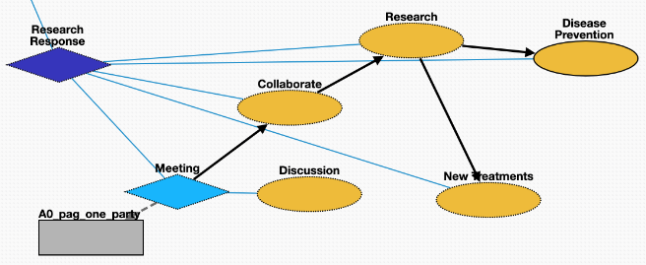
Research Response
Meeting: Academic conference or scientific conference for conducting research on fighting the virus
Discussion: conversation between two or more people on responding to the disease outbreak
Collaborate: Research collaboration on finding treatment for the virus
Research: Conducting research fighting the disease outbreak
New Treatments: Developing effective treatment or cure for the disease
Disease Prevention: acting to avoid the occurrence of certain diseases in an organism or a population

Slide 10
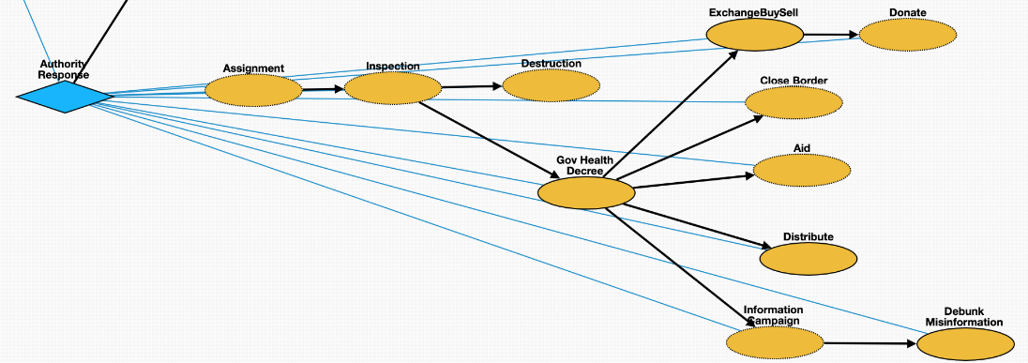
Authority Response
Assignment: Officials are assigned to monitor, prevent, contain, and mitigate the disease outbreak
Inspection: Officials inspect the source of the disease to devise countermeasures
Destruction: Government destroys the source of the disease, for example, Haiti demolished the fishing nuts where the Cholera epidemic started.
Gov Health Decree: Legislations were issued fighting the disease outbreak by government
Information Campaign: Use of media to inform public about the disease
Debunk Misinformation: Debunking misinformation of related to the disease outbreak
Close Border: Border were closed to slow the spread of the virus
Distribute: Distributing the vaccines of the virus
Financial Aid: Financial assistance with food, housing and bills
ExchangeBuySell: Buying, selling or exchanging goods related to the disease outbreak
Donate: Charitable activities related to the disease outbreak

Slide 11
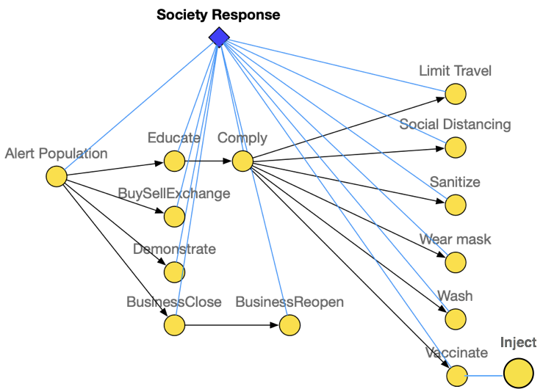
Society Response
Alert Population: Alerting population of the exposure of the virus
Educate: Sharing and educating related knowledge for fighting the disease outbreak
BuySellExchange: Buying, selling or exchanging goods related to the disease outbreak
Demonstrate: Protests over responses to the disease outbreak
BusinessClose: Business close due to the disease outbreak
BusinessReopen: Business reopen due to the disease outbreak
Comply: Complying to the government legislations
Limit Travel: Restrictions on traveling to slow down the spread of the virus
Social Distancing: Keep physical distance to prevent the spread of the disease
Sanitize: Disinfection to prevent infection of the virus
Wear Mask: Wearing masks to prevent the spread of virus
Wash: Washing hands to prevent infection
Vaccinate: Vaccine intended to provide acquired immunity against the virus
Inject: The act of administering a liquid, especially a drug, into a patient infected by the virus using a needle and a syringe

Slide 12
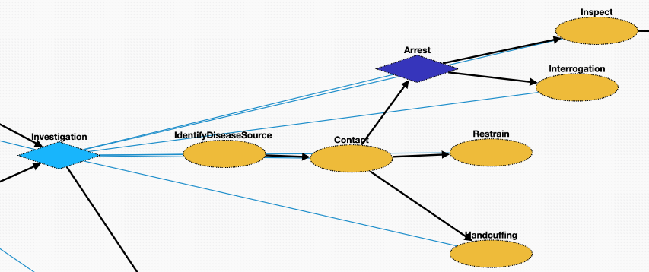
Investigation
IdentifyDiseaseSource: Investigation of the disease outbreak includes identify the source of the virus as well as the suspect of the creator
Contact: Make contact with the suspect
Arrest: Taking the suspect who created the virus or violated laws during the outbreak into custody
Inspect: Organized examination or formal evaluation on the suspect for creating the virus
Interrogation: Interviewing with the goal of eliciting useful information related to suspected crime during the disease outbreak
Handcuffing: Using handcuffs to secure a suspect who violated law during the disease outbreak
Restrain: Physical restraint on the suspect

Slide 13
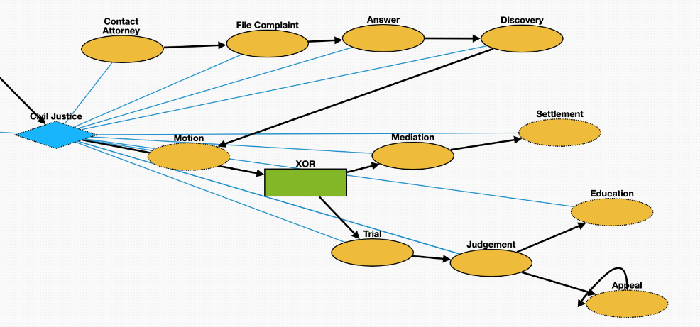
Civil Justice
File Complaint: Plaintiff files a complaint to initiate a lawsuit
Answer: In law, a solemn assertion in opposition to someone or something by the defendant
Discovery: Pre-trial procedure in common law countries for obtaining evidence
Motion: In US law, a procedural device to bring a limited, contested issue before a court for decision
Trial: Coming together of parties to a dispute, to present information in a tribunals on the case of creation of the virus
Judgement: The formal decision made by a court following a lawsuit
Education: learning in which knowledge and skills are transferred through teaching. The defendant is educated about regulations.
Appeal: Resort to a superior court to review the decision of an inferior court or administrative agency
Mediation: Dispute resolution with assistance of an impartial third party moderator through the use of communication and negotiation techniques
Settlement: The dispute is resolved through a payment of money.

