Slide 1
RESIN Disaster and Rescue Schema Quizlet 9
Veronica Qing Lyu

Slide 2
Manmade Disaster and Rescue

Slide 3
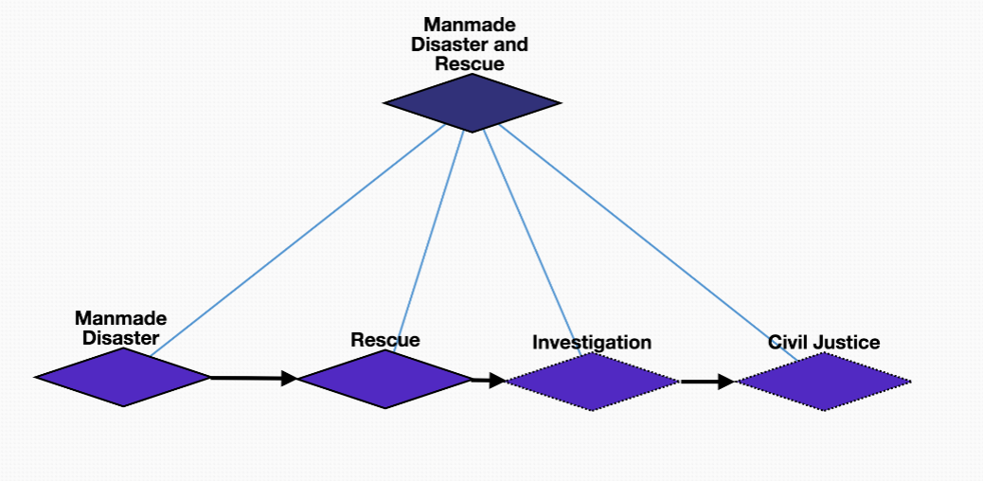
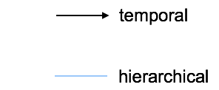
Overview

Slide 4
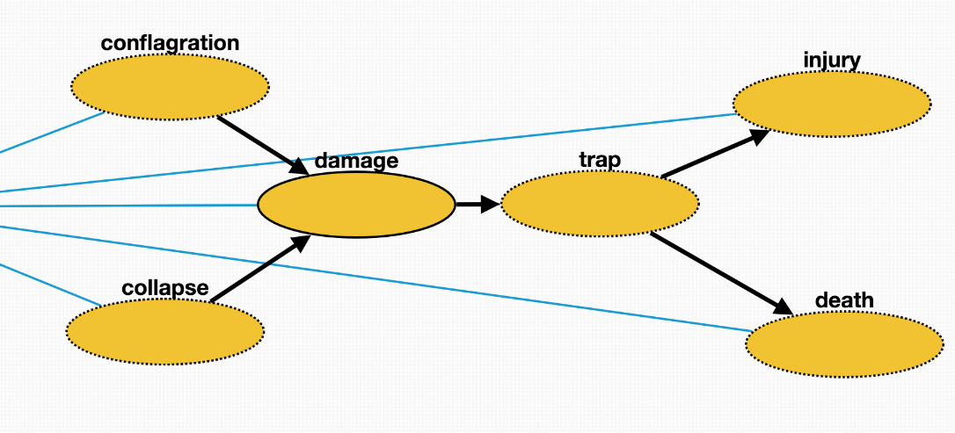
Manmade disaster
Collapse: Collapse of a building etc., in a disaster
Conflagration: An area or building is set on fire.
Trap: victims are trapped in the disaster site
Damage: Damage caused to buildings at the disaster site.
Injury: Victims are injured by the disaster.
Death: Victims die from the disaster.

Slide 5
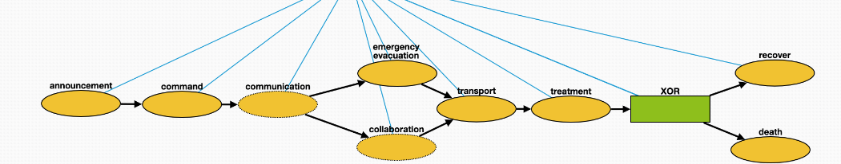
Rescue
Announcement: government announces the disaster to public
Command: government commands rescuers to carry out rescue
Communication: rescuers communicate with trapped victims
Emergency evacuation: rescuers evacuate trapped victims
Collaboration: different parties of rescuers collaborate
Transport: rescuers transport victims to medical sites
Treatment: medical treatment of the victims
Recover: victims recover from injuries
Death: Patients die post treatment.

Slide 6
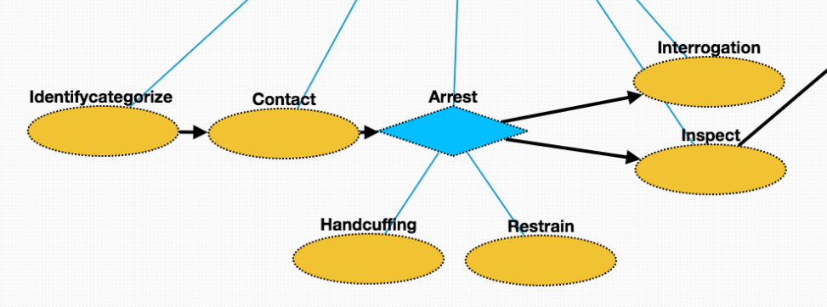
Investigation
Identifycategorize: Investigation of a manmade disaster includes identifying its initiators.
Contact: Make contact with the suspect
Arrest: Taking the suspect who caused the disaster into custody
Handcuffing: Using handcuffs to secure a suspect who initiated the disaster.
Restrain: Physical restraint on the suspect
Interrogation: Interviewing with the goal of eliciting useful information related to suspected crime
Inspect: Organized examination or formal evaluation on the initiator of the disaster.

Slide 7
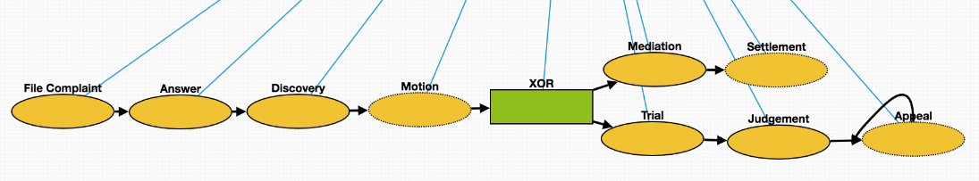
Civil Justice
File Complaint: Plaintiff files a complaint to initiate a lawsuit
Answer: In law, a solemn assertion in opposition to someone or something by the defendant
Discovery: Pre-trial procedure in common law countries for obtaining evidence
Motion: In US law, a procedural device to bring a limited, contested issue before a court for decision
Mediation: Dispute resolution with assistance of an impartial third party moderator throughthe use of communication and negotiation techniques
Settlement: The dispute is resolved through a payment of money.
Trial: Coming together of parties to a dispute, to present information in a tribunal
Judgement: The formal decision made by a court following a lawsuit
Appeal: Resort to a superior court to review the decision of an inferior court or administrative agency

Slide 8
Natural Disaster and Rescue

Slide 9
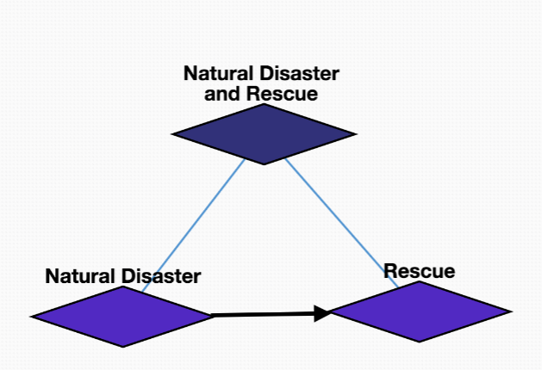
Overview

Slide 10
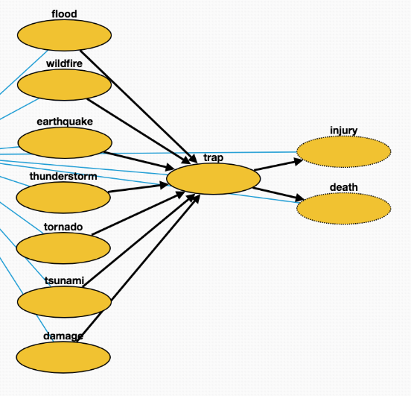
Natural disaster
Tornado: violently rotating column of air that is in contact with both the earth's surface and a cumulonimbus cloud in the air
Flood: overflow of water that submerges land
Wildfire: uncontrolled fire in an area of combustible vegetation that occurs in the countryside or a wilderness area
Earthquake: result of a sudden release of energy in the Earth's crust that creates seismic waves
Tsunami: series of water waves caused by the displacement of a large volume of a body of water
Thunderstorm: type of weather
Trap: victims are trapped in the disaster site
Damage: changes introduced into a system that adversely affect its current or future performance

Slide 11
Rescue
Announcement: government announces the disaster to public
Command: government commands rescuers to carry out rescue
Communication: rescuers communicate with trapped victims
Emergency evacuation: rescuers evacuate trapped victims
Collaboration: different parties of rescuers collaborate
Transport: rescuers transport victims to medical sites
Treatment: medical treatment of the victims
Recover: victims recover from injuries
Death: Patients die post treatment.

